Slide 1
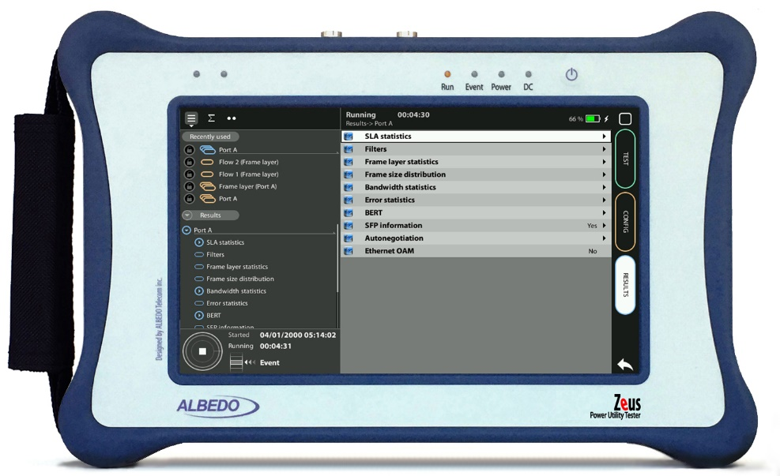
MPLS Traffic test
MPLS Traffic test with xGenius
Guide & Slides corresponding to software ver. 2.3.13

Slide 2
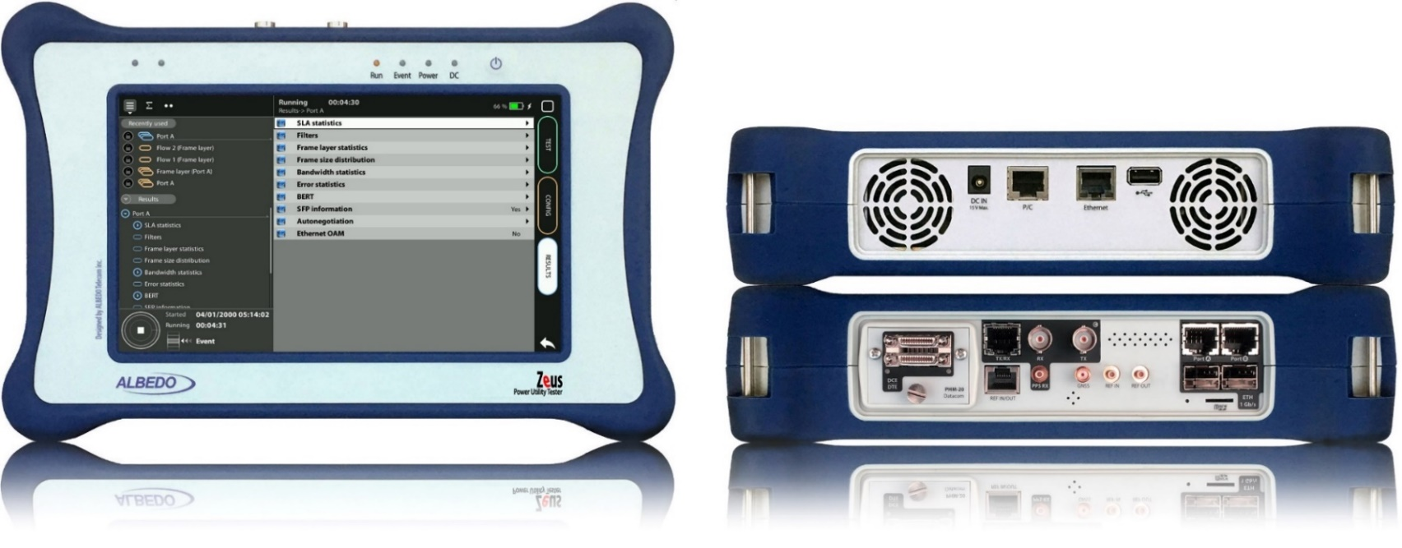
Zeus & xGenius
Zeus & xGenius provide deep insights to design, install, maintain, troubleshoot and engineer communications resources of Mobile Operators, Power Utilities, Finace, Labs and R+D centers. The unit is able to verify Ethernet/IP, SyncE, PTP, GbE, IRIG-B, 1PPS, T1/E1, G703, Serial Datacom, C37.94, GOOSE, SV, MMS, Round-trip & One-way Delay tests at all interfaces.
It also has a set of programmable filters to capture live data traffic at wire-speed

Slide 3
Interfaces & time References
PHM
RJ45-C
BNC-C
SFP+ A
SFP+ B
RJ45-A
RJ45-B
xGenius generates and analyses different kinds of 1544 kb/s and 2048 kb/s signals and also unframed 1544 / 2048 kb/s signals.
RJ45
SMB-C
SMA
SMB-1
SMB-2
SFP-A
Micro SD
SFP-B
 | GNSS | Eth/IP | PTP | NTP | ToD | IRIG-B | PPS | PP2S | SyncE | T1/E1 | MHz | Data
RJ45-A |  | in/out | in/out | in/out |  |  |  |  | in/out
RJ45-B |  | in/out |  |  |  |  |  |  | in/out
SFP-A |  | in/out | in/out | in/out |  |  |  |  | in/out
SFP-B |  | in/out |  |  |  |  |  |  | in/out
SFP+A |  | in/out | in/out | in/out |  |  |  |  | in/out
SFP+B |  | in/out |  |  |  |  |  |  | in/out
BNC-C |  |  |  |  |  |  |  |  |  | in/out | in/out
RJ45-C |  |  |  |  | in |  | in | in |  | in/out | in/out
SMB-C
SMA | in
SMB-1 |  |  |  |  |  | in | in | in
SMB-2 |  |  |  |  |  | out | out | out
RJ-45 |  |  |  |  | in/out | in/out | in/out | in/out |  | in/out | in/out
PHM |  |  |  |  |  |  |  |  |  |  |  | in/out

Slide 4
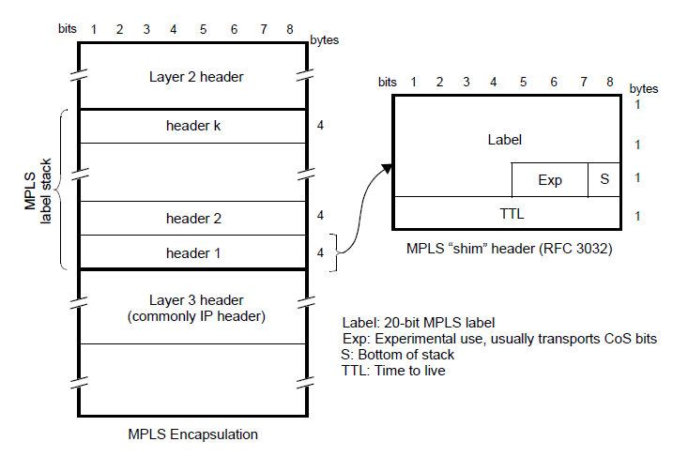
The MPLS label format
When Ethernet is used as the transport infrastructure, it is necessary to add a header between the IEEE 802.3 MAC frames and the IP header to carry the MPLS label. The label format is shared by MPLS flavors and profiles: IP/MPLS, VPLS, MPLS-TP…

Slide 5
The Traffic test
MPLS
1
Port A
ALBEDO
xGenius
Port B
The test described aims to teach how to set up the tester to generate and receive real traffic with specific frames, bit rates, and events. With a few changes it will be possible to evaluate other traffic parameters such as throughput, latency, frame loss rate, etc. The document also describes specific formats for tracing and reporting the results of this test.

Slide 6
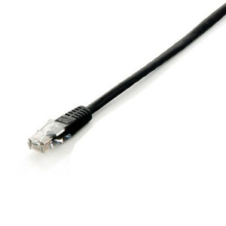
Connecting the BNC cables to Port C
1
1
xGenius Ports A and B have the connector for the RJ45 cables
xGenius also support optical media and higher bit rates but we are going to execute this test in 1000BASE-T
Connect the Cable to Port A
Connect the Cable to Port B

Slide 7
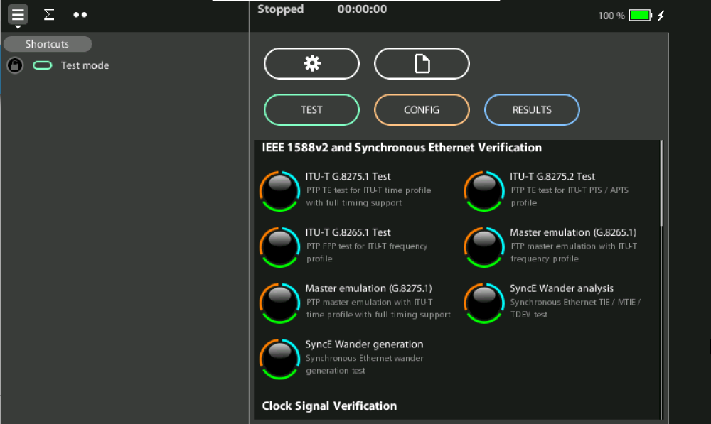
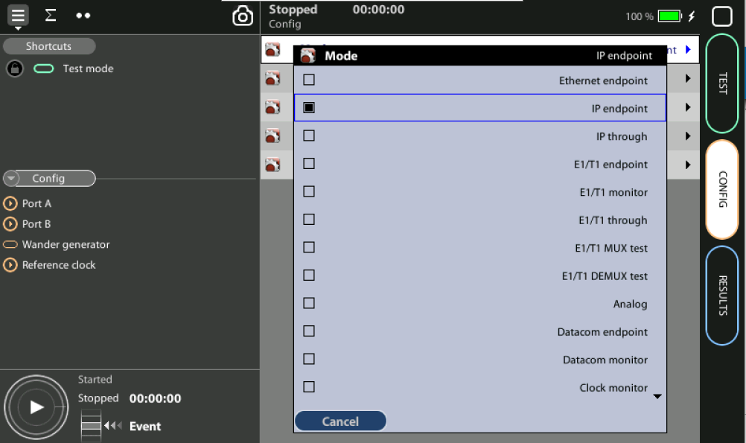
Select the global operation mode
1
2
Restore defaults: Home > [System] > Reset to factory settings := Yes
Set operation mode: Home > Test > Mode := IP endpoint

Slide 8
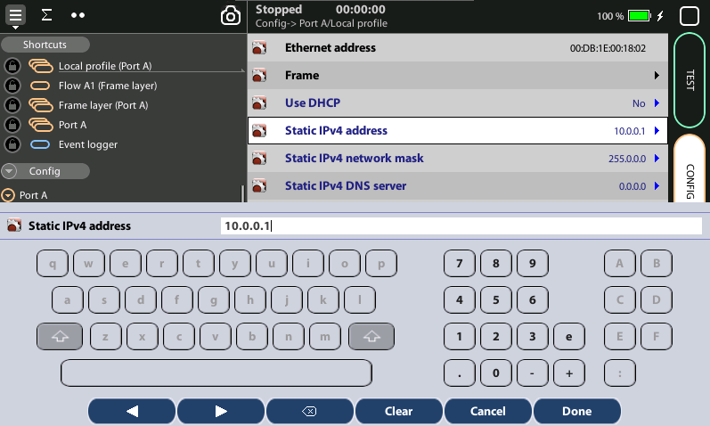
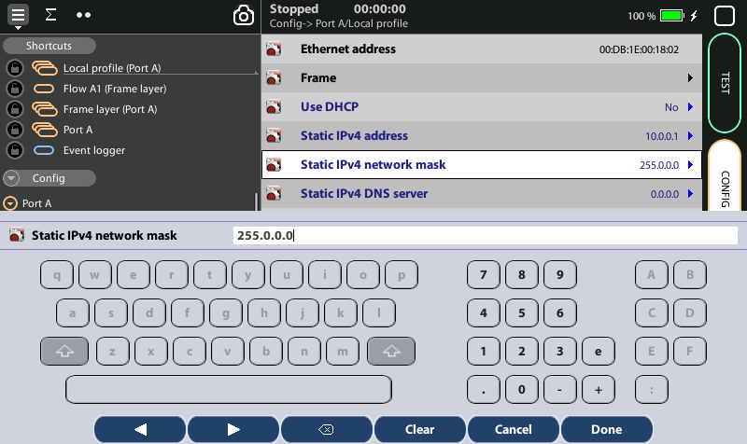
Configure the IP local profile
2
3
Configure in Tester Port A local profile:
Config > Port A > Local profile > Use DHCP := No
Config > Port A > Local profile > Static IPv4 address := 10.0.0.1
Config > Port A > Local profile > Static IPv4 network mask := 255.0.0.0
Configure also Tester Port B local profile:
Config > Port B > Local profile > Use DHCP := No
Config > Port B > Local profile > Static IPv4 address := 10.0.0.2
Config > Port B > Local profile > Static IPv4 network mask := 255.0.0.0

Slide 9
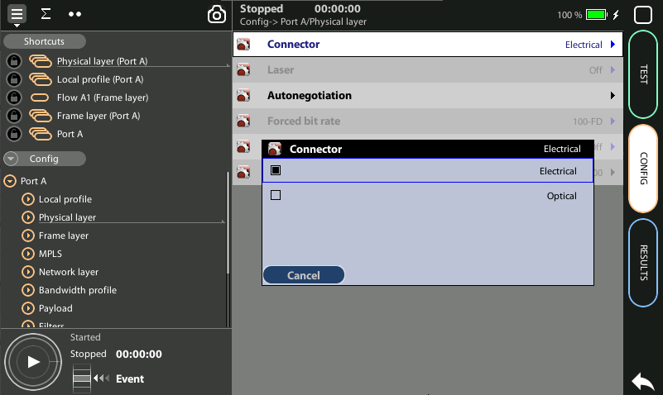
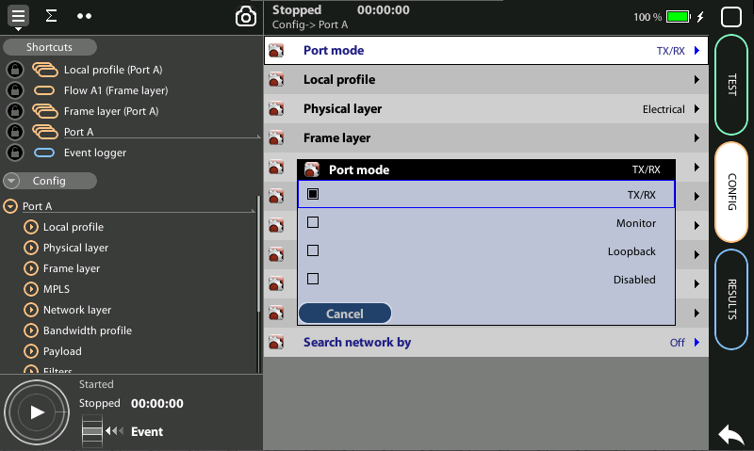
Configure the PHY layer
1
2
Configure in Tester the MAC layer:
Config > Port A > Physical Layer > Connector := Electrical
Config > Port A > Port Mode := Tx/Rx
Configure also Tester Port B in the same way than Port A:
Config > Port B > Physical Layer > Connector := Electrical
Config > Port B > Port Mode := Tx/Rx

Slide 10
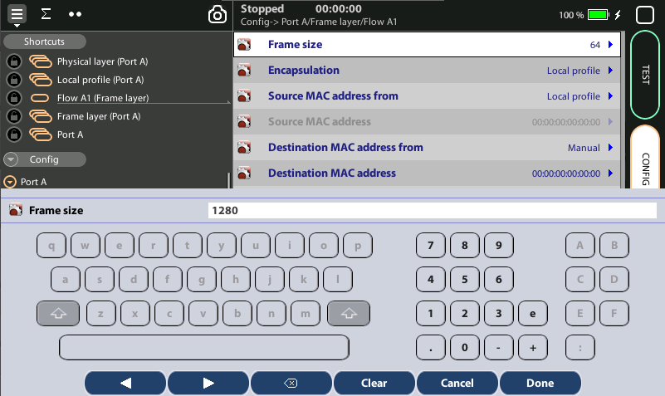
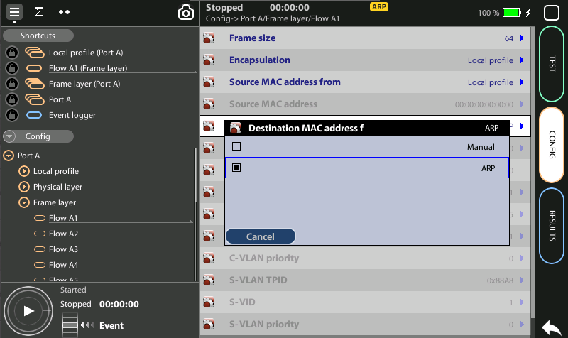
Configure the MAC layer
2
1
Configure in Tester the MAC layer:
Config > Port A > Frame Layer > Flow A1 > Frame size := 1280
Config > Port A > Frame Layer > Flow A1 > Destination MAC address from := ARP

Slide 11
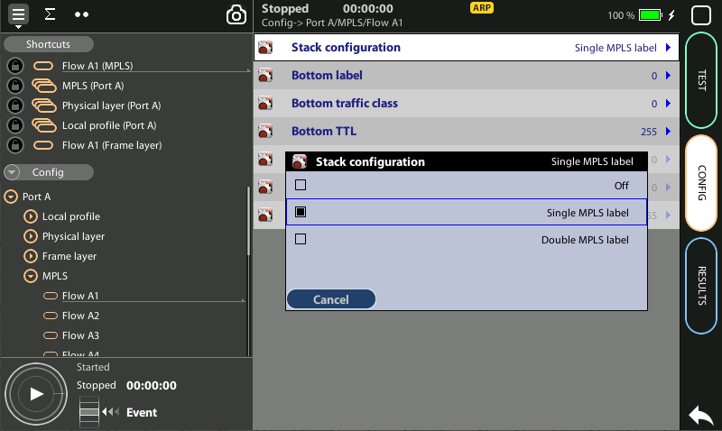
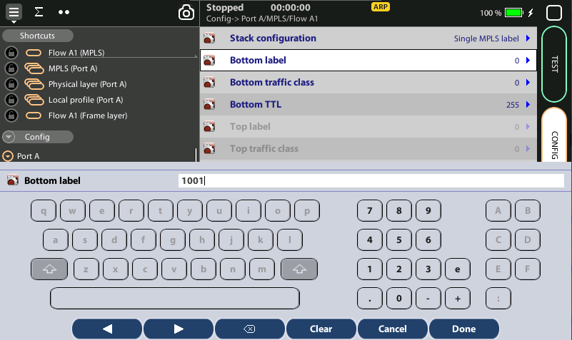
Configure the MPLS layer
1
2
Configure in Tester the MPLS stack:
Config > Port A > MPLS > Flow A1 := Single MPLS label
Config > Port A > MPLS > Flow A1 := 1001

Slide 12
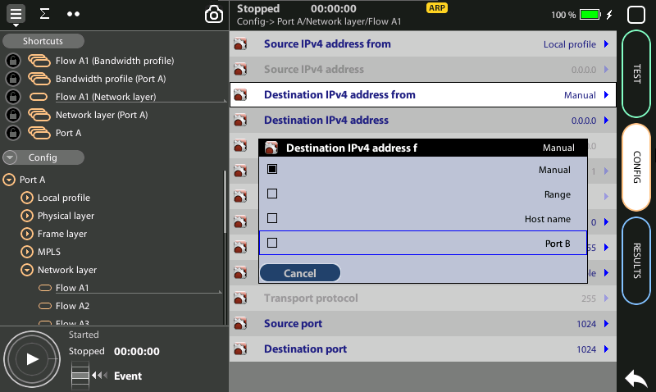
Configure the IP layer
1
3
Configure in Tester the destination IP address to be the Port B address:
Config > Port A > Network Layer > Destination address from := Port B

Slide 13
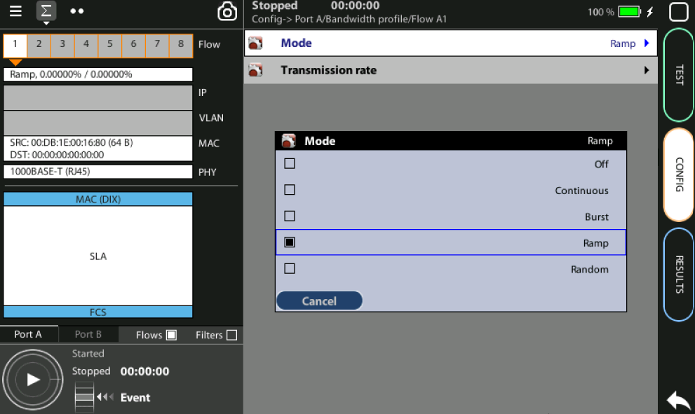
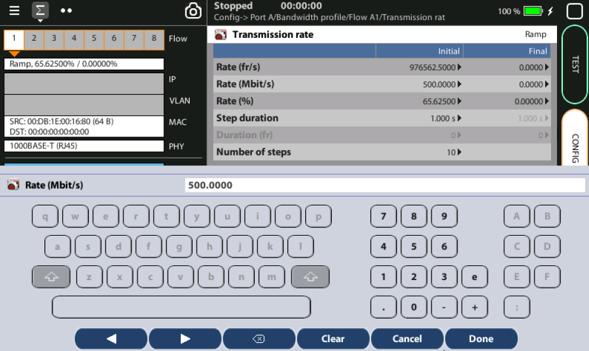
Configure Traffic Profile
1
2
The tester can generate up to 8 traffic flows simultaneously, set up the 1st one:
Config > Port A > Bandwidth profile > Flow A1 := Ramp
Configure the bandwidth parameters:
Config > Port A > Bandwidth profile > Flow A1 > Transmission rate := [Rate fr/s | Rate (Mb/s) | Rate (%) …]
Program the payload to a PRBS: Config > Port A > Flow A1 > Payload type := BERT Config > Port A > Flow A1 > BERT patterns := ITU PBS 2^11
Set the payload in Port B, flow B1 in the same way.

Slide 14
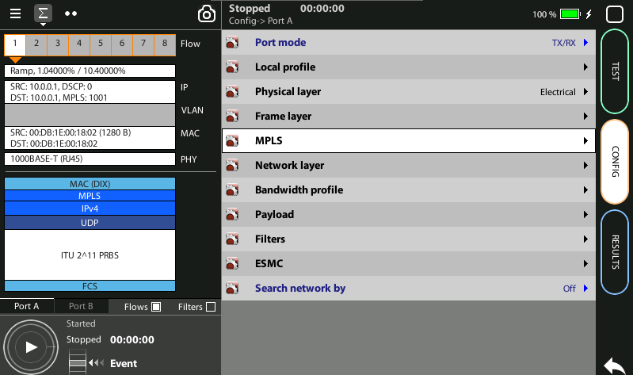
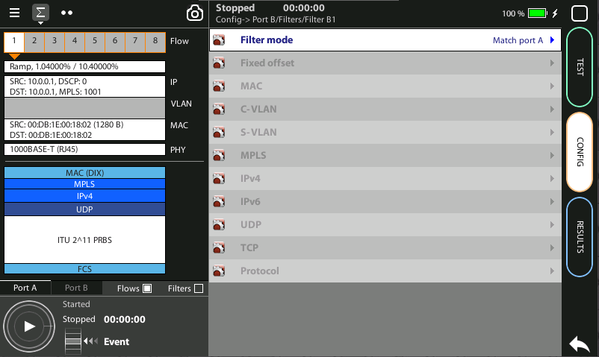
Press RUN
1
2
You can spot the frame and the test profile configured at Flow A1 including the type of traffic to be generated at Port A including the flow, the Physical layer, the Ethernet frame, MAC addresses, the PRBS generated, etc.
Make sure that Filter B1 is configured to match the traffic from Port A Config > Port B > Filters > Filter B1 > Filter mode := Match port A
Press RUN to activate the traffic generation

Slide 15
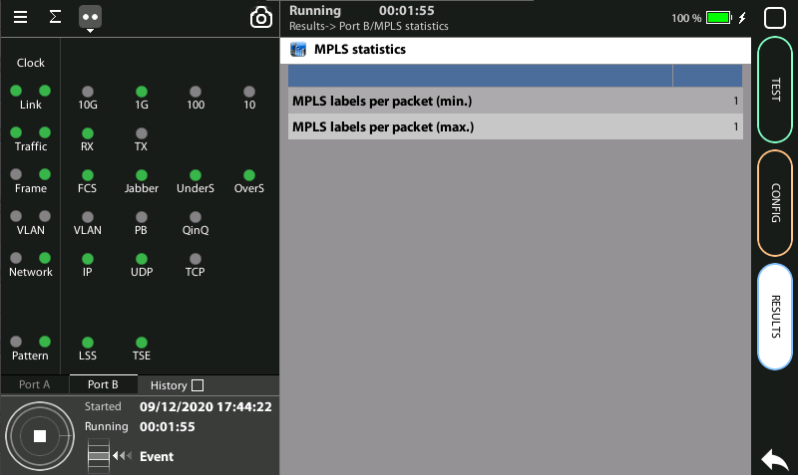
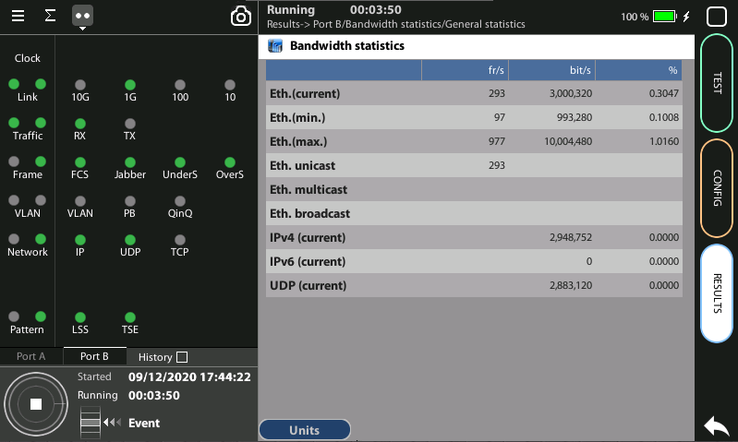
Press RUN
1
5
2
3
4
You can see now you are receiving MPLS labels from the following menu:
Results > Port B > MPLS statistics
Press LED symbol and select Port B
Immediately the RX LED will turn green indicating the reception of traffic
As you have selected a PRBS spot the LED indicating that the pattern is being received correctly
You can spot other results for instance some statistics regarding traffic: Results > Port B > Bandwidth statistics > General statistics

Slide 16
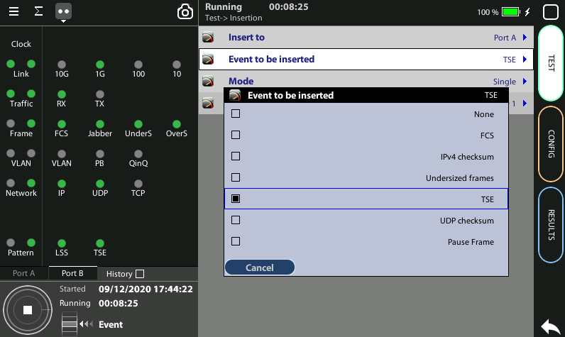
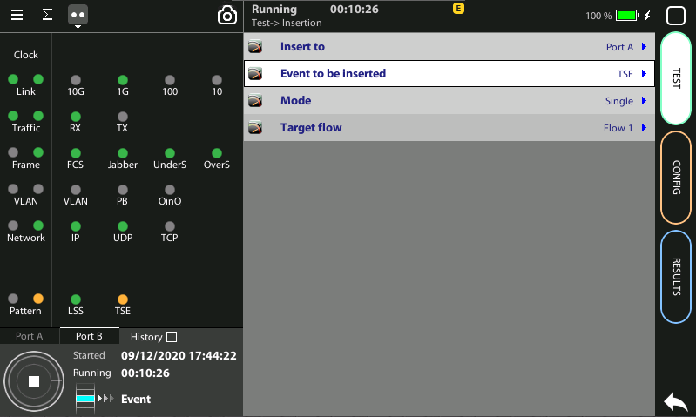
Insert events in Tester 1
5
2
4
This is a good practice to understand how it all works
Test > Insertion > Insert to := Port A
Test > Insertion > Event to insert := TSE
Test > Insertion > Mode := Single
Press Event to insert one TSE error
Spot how the error appears in the LED and the tester shows an E label

Slide 17
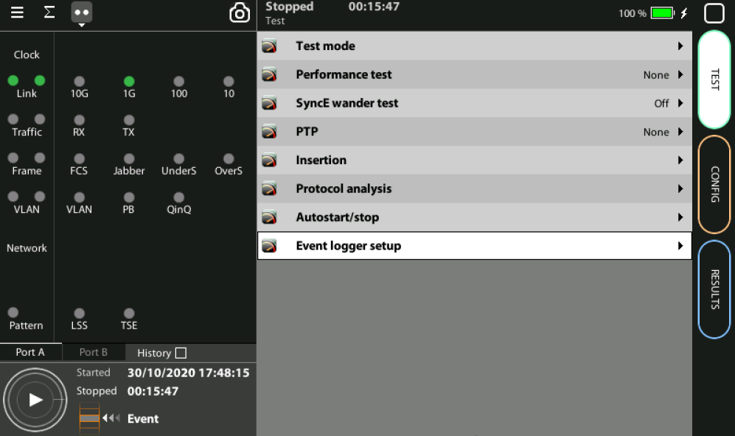
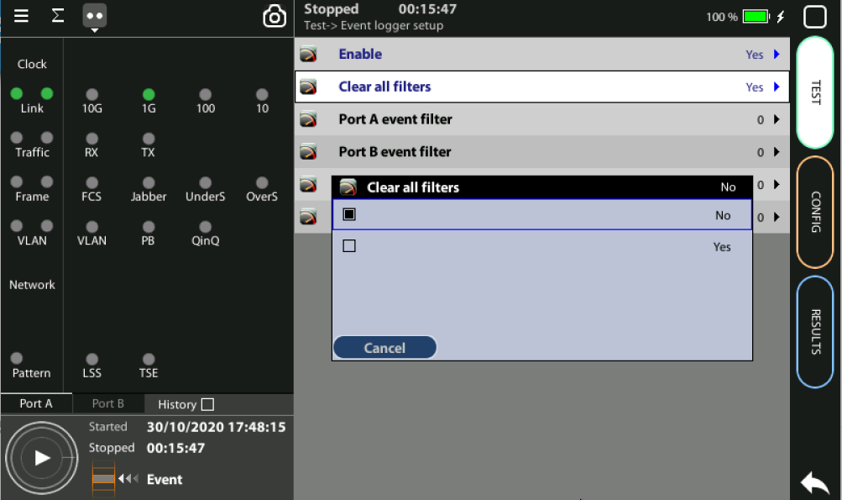
Event logger enable
1
Global counts, statistics and LEDs provide information about which events and how many of them have been registered but they do not say too much about how they are distributed in time. These information is supplied at the Event Logger a graphical representation tool that permits to trace the evolution of key parameters. The first thing to to is to enable it:
Home > Test > Event logger sep > Enable := Yes
Clear the currently selected filtertus: Clear all filters := Yes

Slide 18
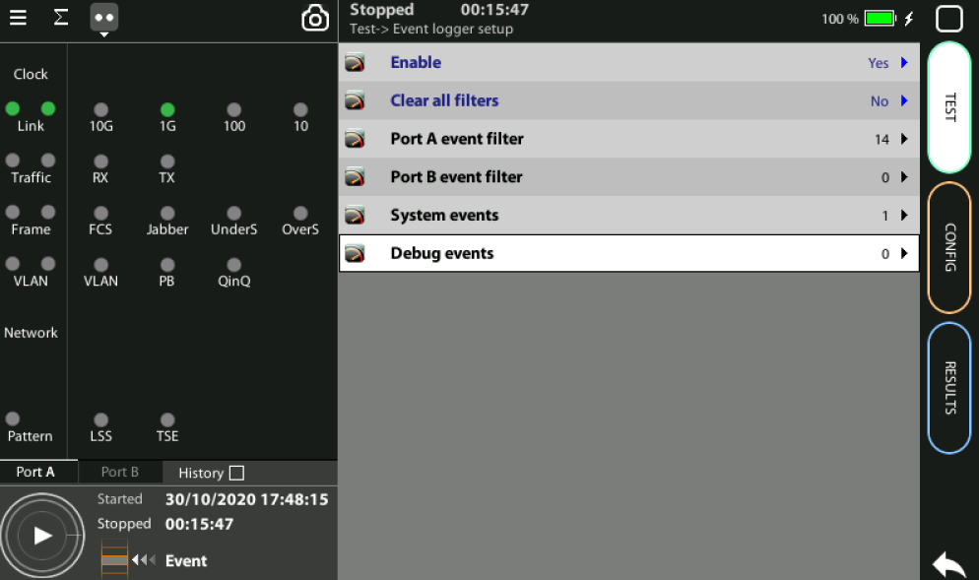
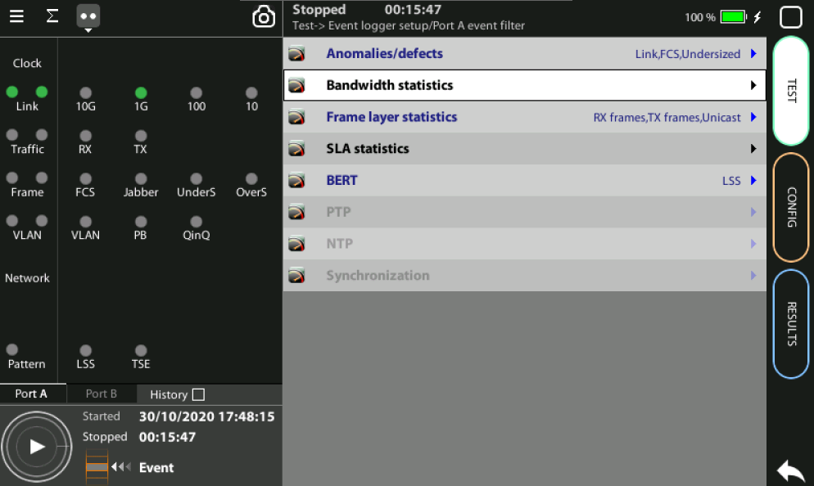
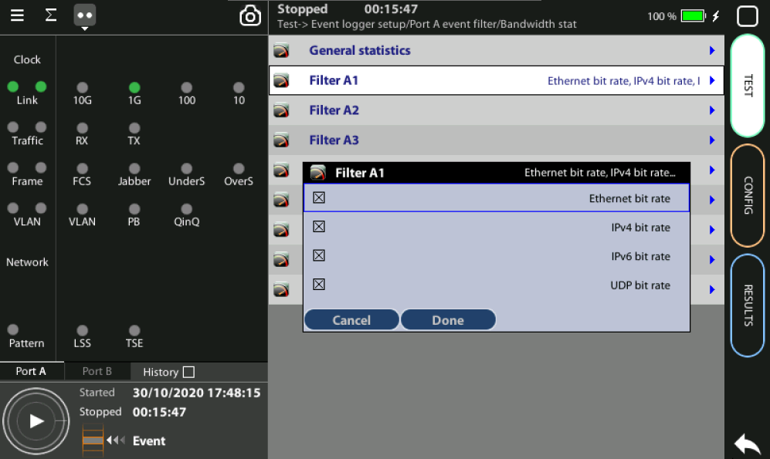
Select the Events to Log
2
2
1
1
3
3
Now you need to select which events you want to trace are categorized in classes:
Test > Event Logger setup > [ Port A | Port B | System event | Debug events]
You will find out several groups of events and statistics: Port A event filter > Port A event filter := [Anom/defts | Bwd | Frame | SLA | BERT]
For our particular test select a bundle or events in Port A : Port A event filter > Bandwidth stats > Filter A1 := [Ethernet | IPv4 | IPv6 | UDP]

Slide 19
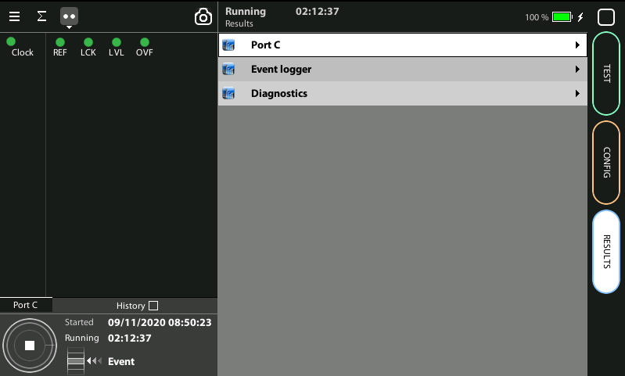
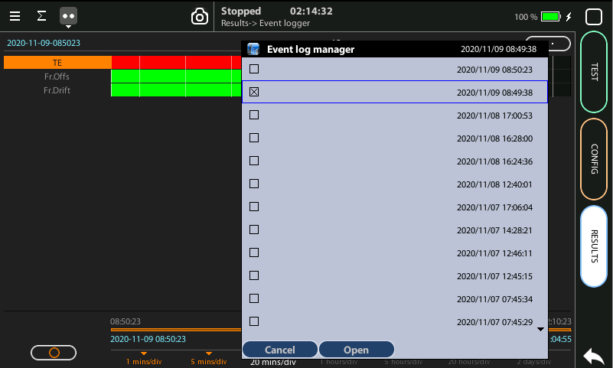
Display the logs
2
1
3
3
With the Event Logger you can select one or various events and trace them so that all changes along with the time and date these changes are registered are recorded with a 1 second resolution. The event logger provides representations and zoom levels to enable event analysis at different time scales:
Go to Results > Event logger
To select a saved trace double click at (…) to display the folder of traces
Select and Open one of the files

Slide 20
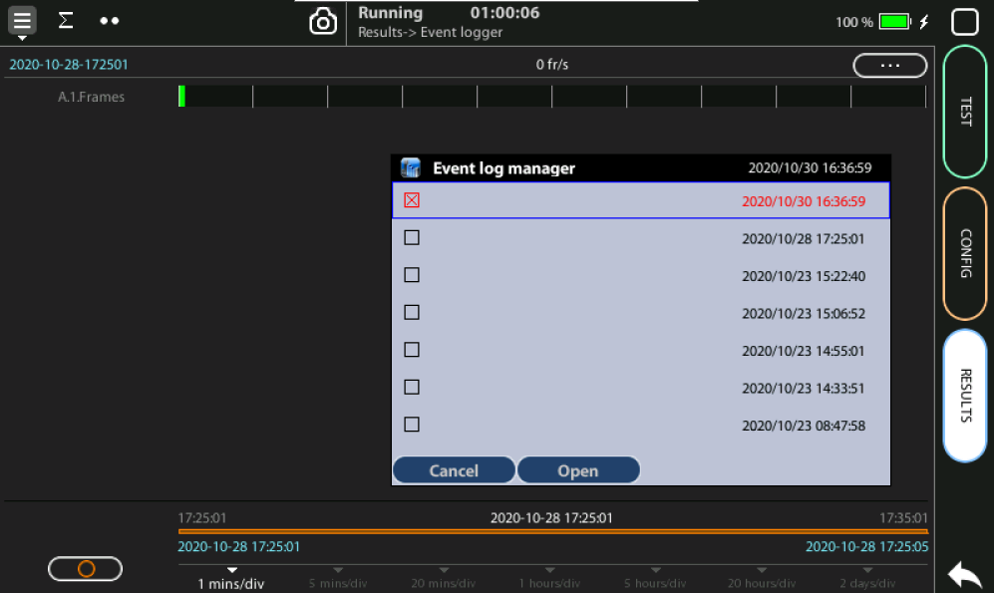
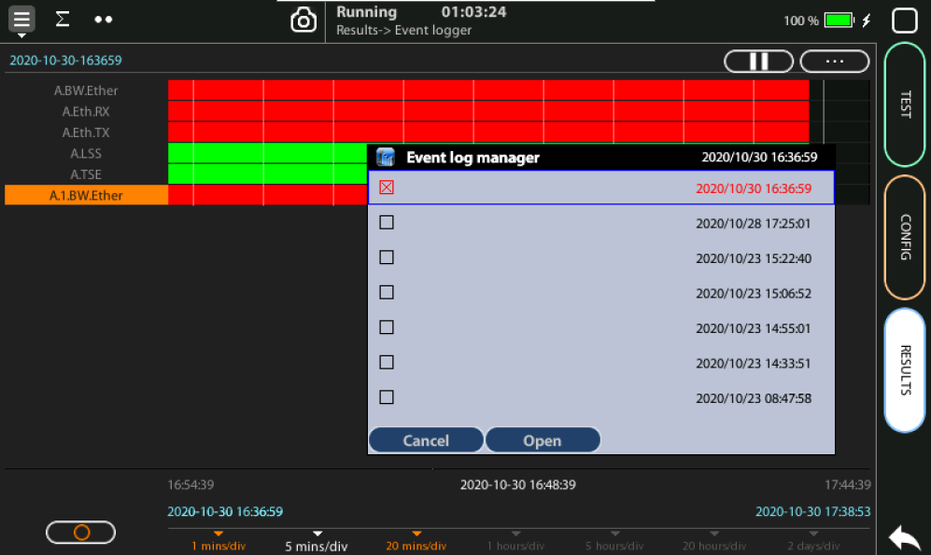
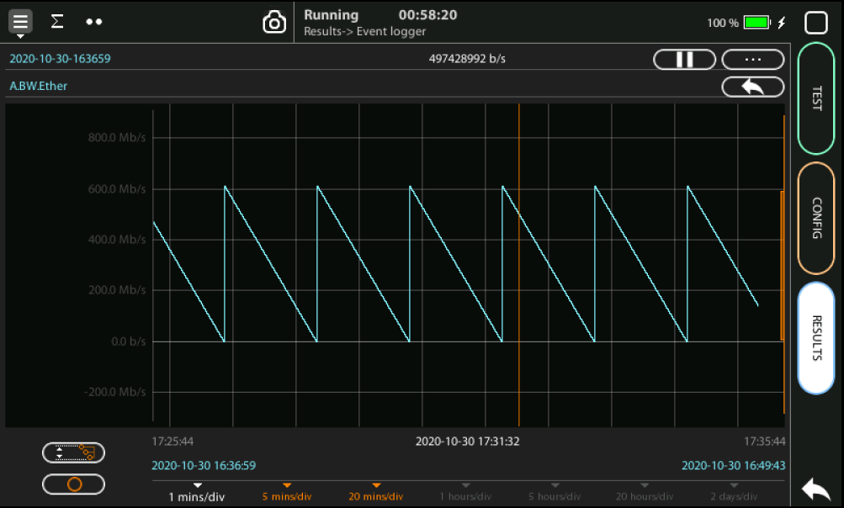
Display chronogram & histogram
4
3
1
4
To display the logger open the actual trace always in red
Select the event you want to display in the chronograme
You can see the value evolution
To know the exact value at one specific moment press on the screen

Slide 21
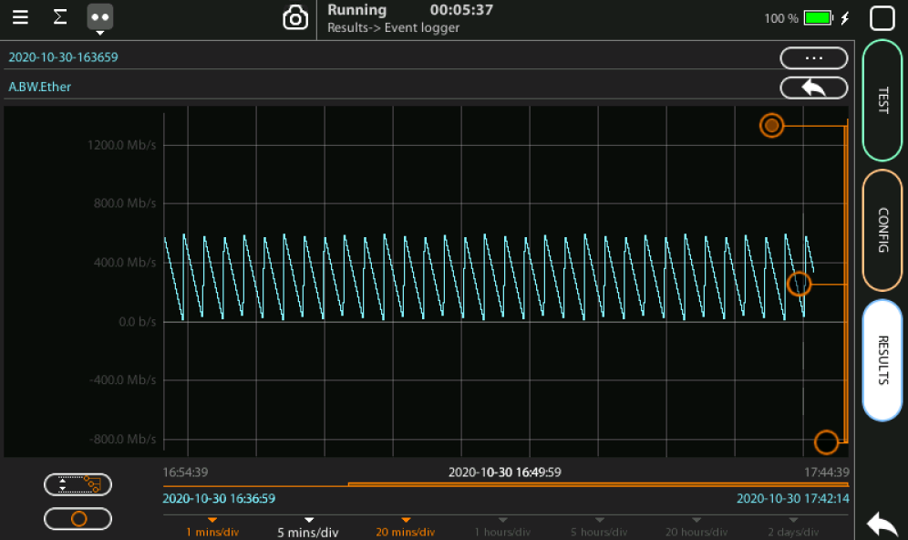
Scale the results on screen
2
3
1
You can change the scale to see in more details the results
Using the auxiliary bars change the vertical scale
Reset to the original scale

Slide 22
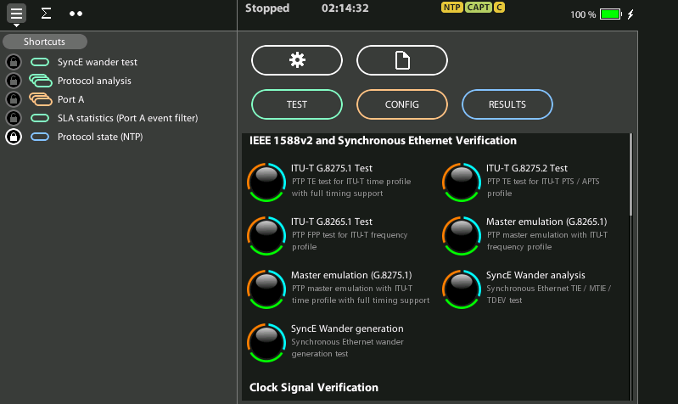
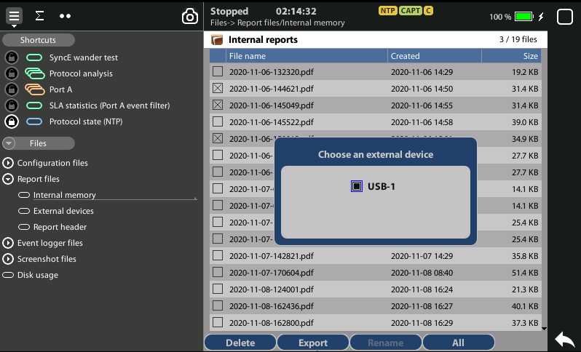
Exporting Logs
1
1
3
2
To export log files in CSV format:
Go Home > [File icon] > Configuration files | Report files > Internal memory to list the files currently stored in the unit
Select the files you want to export: File name > Export
Choose an external device: micro SD | USB
If no external device a popup will appear: ‘No devices present’

Slide 23
That’s all
www.albedotelecom.com

