Slide 1
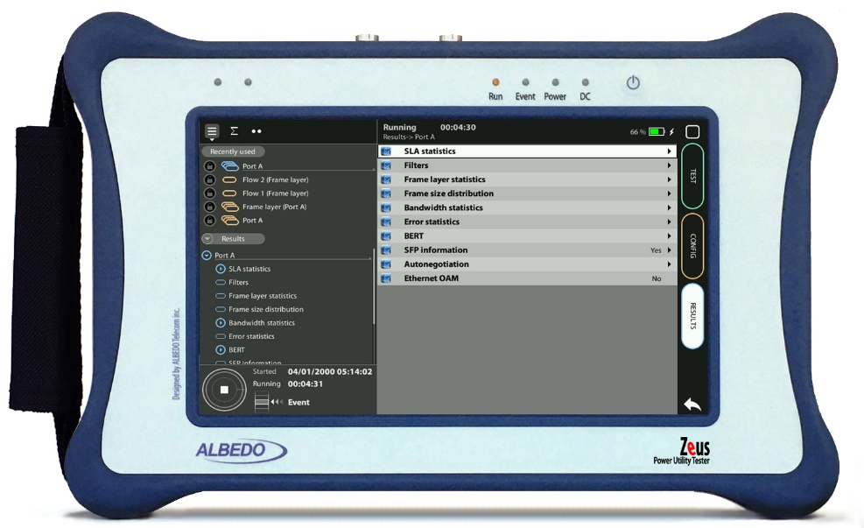
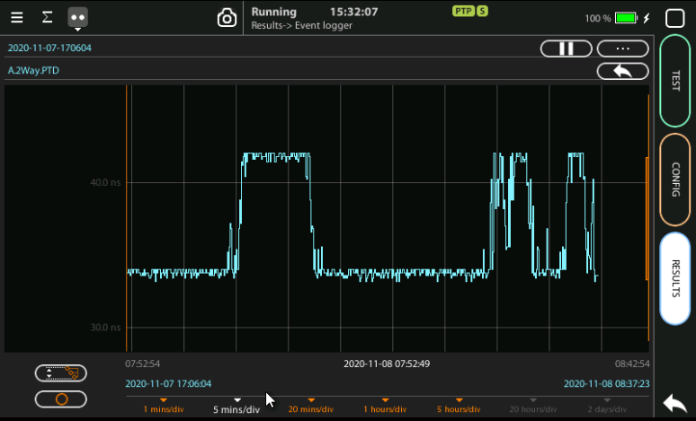

Event Logger Activation
How to with Zeus or xGenius
Guide & Slides corresponding to software ver. 2.3.11

Slide 2
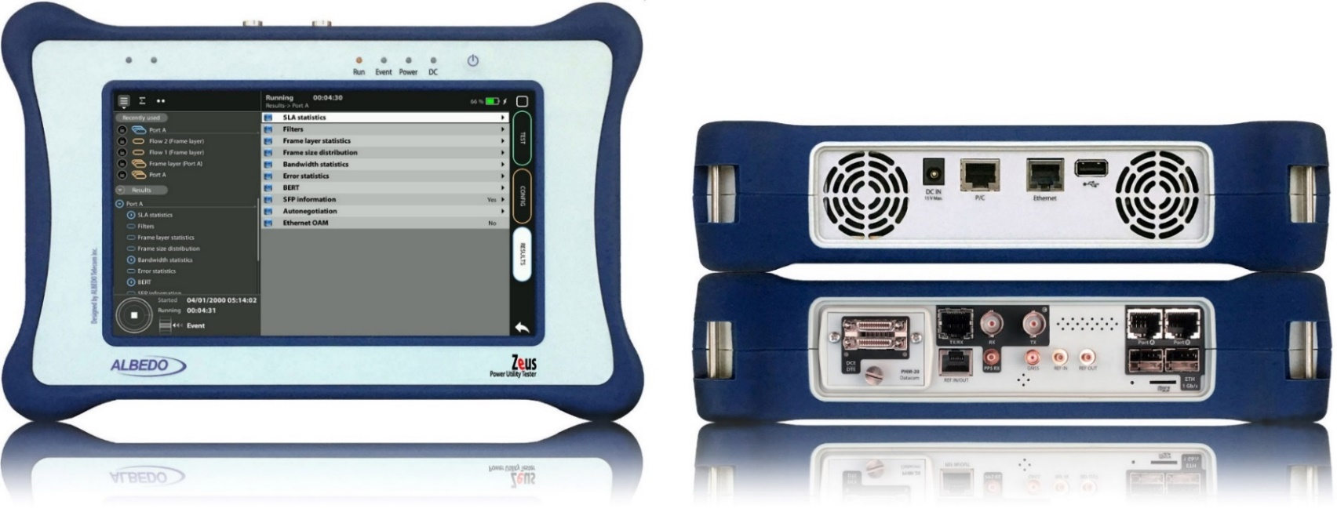
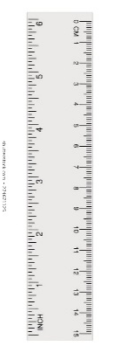
Zeus & xGenius
Zeus & xGenius provides deep insights to design, install, maintain, troubleshoot and engineer communications infrastructures of the Smart Grid and more particularly of the Power Substations. The unit is able to test Ethernet/IP, PTP, GbE, IRIG-B, T1/E1, G703, C37.94, GOOSE, SV and MMS protocols. One-way-delay tests, assisted by GPS, is possible at all interfaces.
It also has a set of programmable filters to capture live data traffic at wire-speed

Slide 3
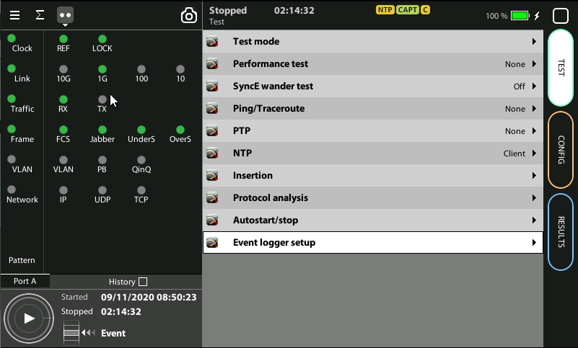
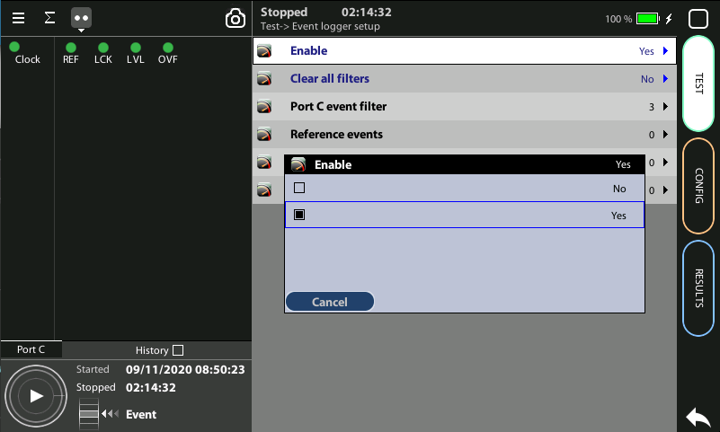

Event logger enable
1
1
Global counts, statistics and LEDs provide information about which events and how many of them have been registered but they do not say too much about how they are distributed in time. These information is supplied at the Event Logger a graphical representation tool that permits to trace the evolution of key parameters.
The first thing to to is to enable it:
Go to Home > Test > Event logger setup
Set Enable := Yes

Slide 4
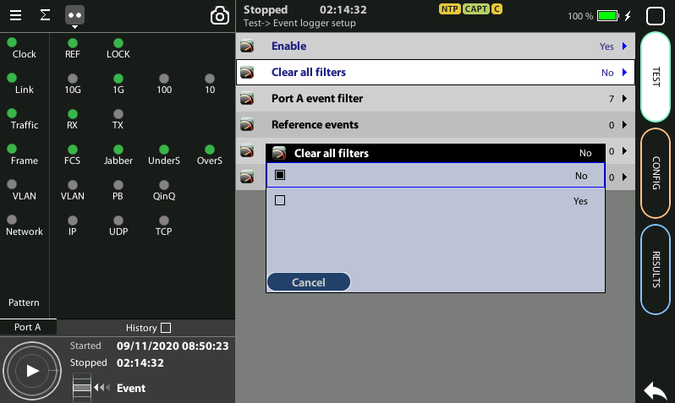
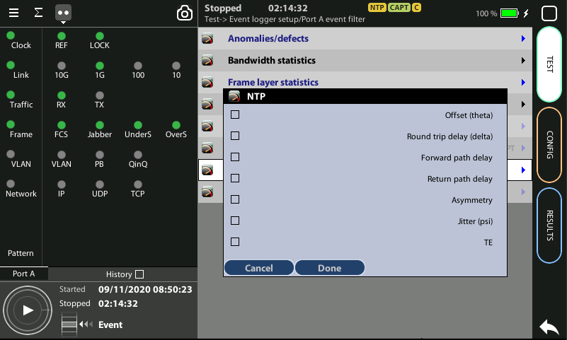
Configuring the Event Logger
2
1
3
4
Traceable Events are categorized in different classes. Moreover, each test port has its own traceable events. These events may be different for each test port.
Clear the currently selected filters: Clear all filters := Yes
Select the Port A or Port B
Choose the events to trace: Anomalies/defects | Bandwidth statistics | Frame layer statistics | SLA statistics | BERT | PTP | NTP | Synchronization
Press Run to begin the generation of a trace file

Slide 5
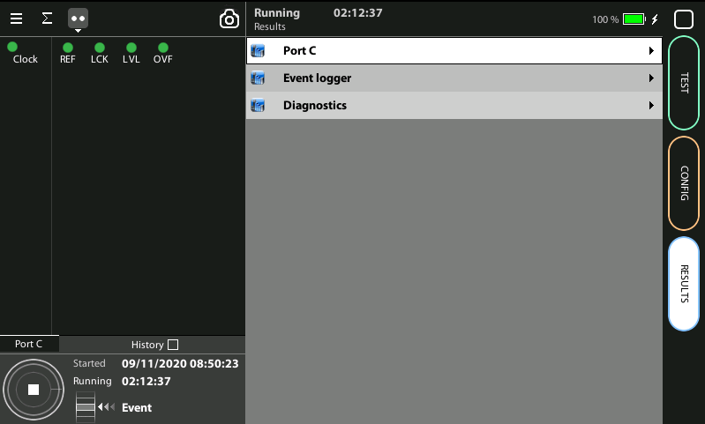
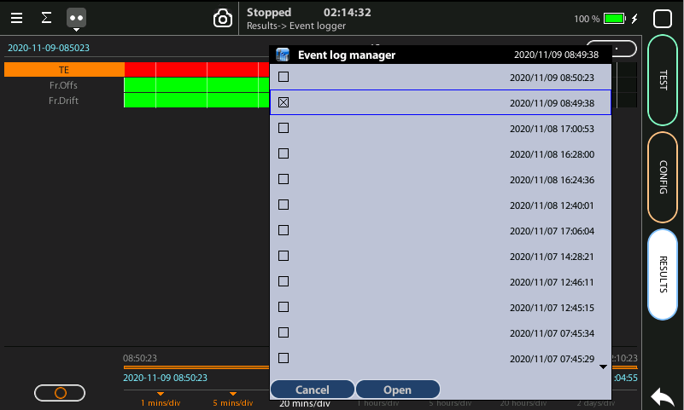
Display the logs
2
1
3
3
With the Event Logger you can select one or various events and trace them so that all changes along with the time and date these changes are registered are recorded with a 1 second resolution. The event logger provides representations and zoom levels to enable event analysis at different time scales:
Go to Results > Event logger
To select a saved trace double click at (…) to display the folder of traces
Select and Open one of the files

Slide 6

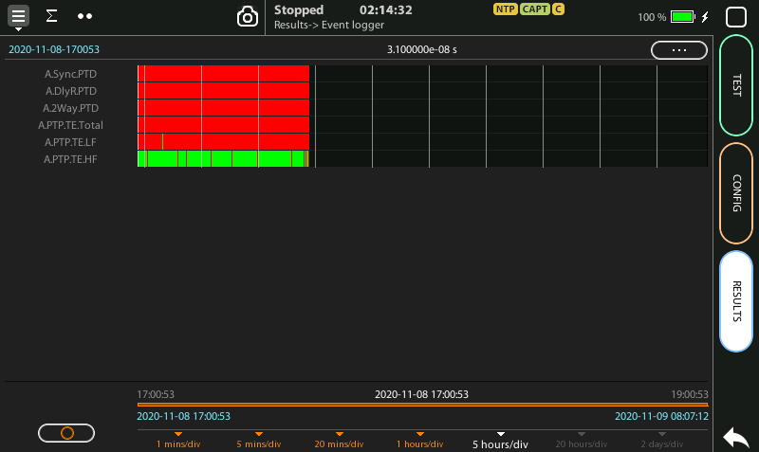
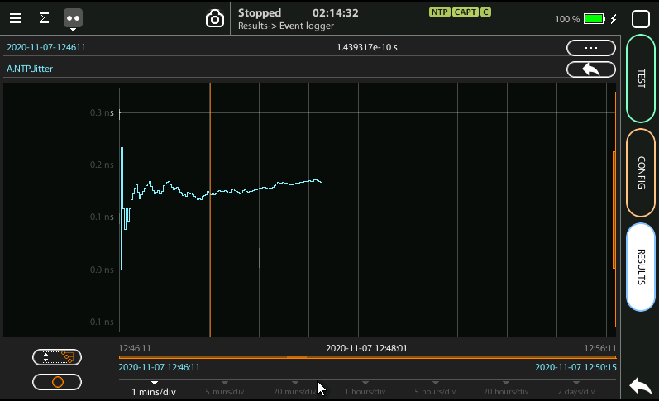
Event logger results
1
4
6
3
4
2
2
2
You can display the trace of the evolution of the previously selected parameters:
View and analyze the details of the histogram
Set the scale at your preferred zoom level
Selected one event to display a more detailed diagram
Click on the screen to know the exact value at one specific time

Slide 7
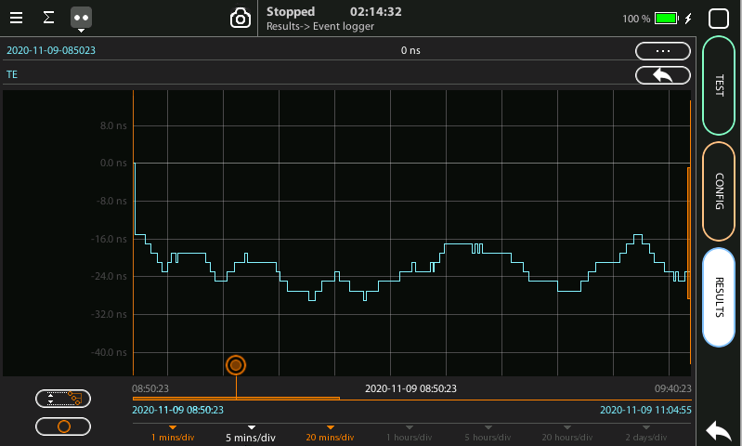
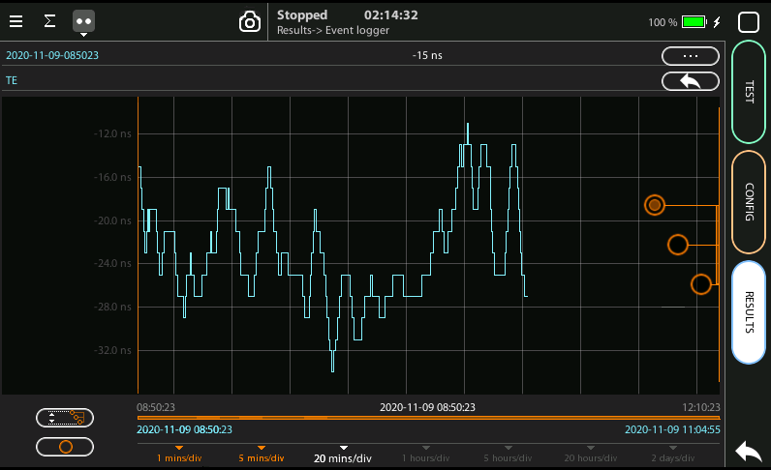
Scaling the trace
1
2
5
1
1
To change the scale horizontally click one time, for vertical two times
Click in the red buttom and draw to the left or to the right
To change the scale vertically click two times
To move the trace across the time click one of the three the red buttoms and draw the finger up and down
Click in the auto-scale symbol to return to the initial conditions

Slide 8
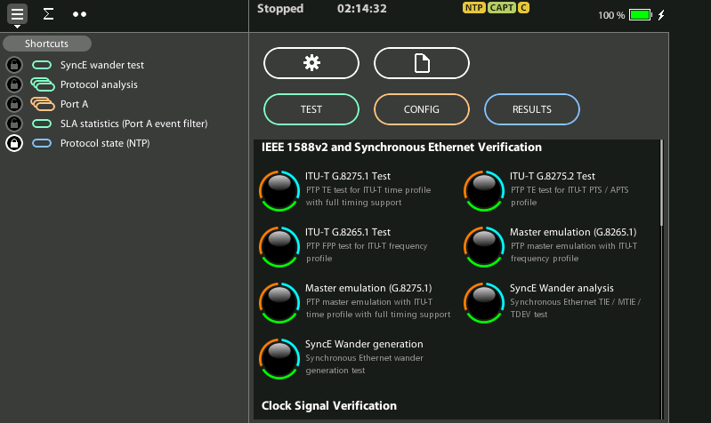
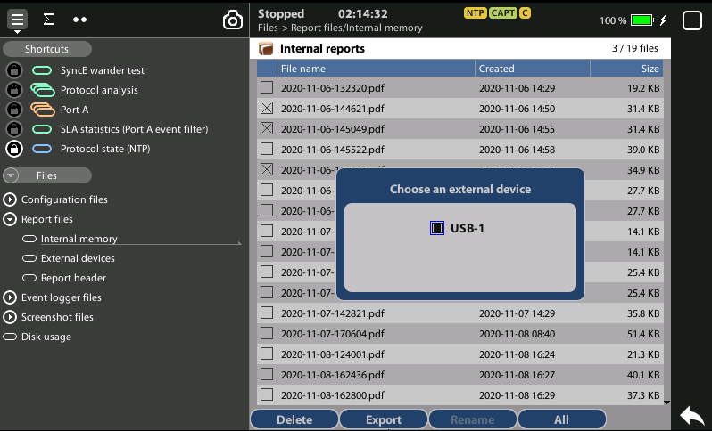
Exporting Logs
1
1
3
2
To export log files in CSV format:
Go Home > [File icon] > Configuration files | Report files > Internal memory
to list the files currently stored in the unit
Select the files you want to export: File name > Export
Choose an external device: micro SD | USB
If no external device a popup will appear: ‘No devices present’

Slide 9
Glossary
AAA: Authentication, Authorization, and Accounting
ACL: Access Control List
AP: Access Point
Busbar: Metallic strip or bar, typically housed inside switchgear, panel boards, and busway enclosures for local high current power distribution C37.94: TDM interface devoted for teleprotection
CB: Circuit Breaker designed to close or open electrical circuit under normal or abnormal conditions. It operates on relays command.
CBWFQ: Class-Based Weighted Fair Queuing
CG: Connected Grid
CID: Individual configuration of each IED CIP: Critical Infrastructure Protection CLI: Command-Line Interface
CorpSS: Corporate Substation
CT: Current Transformer, used for measurement of current, if too high to apply directly to measuring instruments, a CT produces a proportional current which can be measured and recorded, CT are used in metering and protective relays
DAN: Doubly Attached Nodes implementing HSR or PRP
DAU: Data Acquisition Unit
Disconnector: isolates physically and visually the lines
DMZ: Demilitarized Zone
DCB: Directional Comparison Blocking
DCS: distributed control systems
DSC: Differentiated Services Code Point
ESP: Electronic Security Perimeter
Feeder: Transmits power to the distribution points
GM: Grandmaster
GNSS: Global Navigation Satellite System
GOOSE: Generic Object-Oriented Substation Events is a control model defined as per IEC 61850 which provides a fast and reliable mechanism of transferring event data over entire electrical substation networks. When implemented, this model ensures the same event message is received by multiple physical devices using multicast or broadcast services
HMI: Human Machine Interface
PTP: Precision Time Protocol
RedBox: Redundancy Box
Relay: is automatic device which senses an abnormal condition of electrical circuit and closes its contacts and complete the circuit breaker trip.
REP: Resilient Ethernet Protocol
RCT: Redundancy Control Trailer
RTU: Remote Terminal Unit
SA: Substation Automation
SAN: Singly-Attached Node
Secondary Lines: lower voltage side at the substation
SCADA: Supervisory Control And Data Acquisition, transmits and receives data from events of controls, measuring, safety and monitoring. Power system elements can be controlled remotely over. Remote switching, telemetering of grids showing voltage, current, power, direction, consumption in kWh, synchronization.
SCD: Substation Configuration Description SCL: Substation Configuration Language SNTP: Simple Network Time Protocol
Station Bus: Connects the entire substation and helps provide connectivity between central management and individual bays
STP: Spanning Tree Protocol
SV: Sampled Values, is a method to read instantaneous values such as currents, voltages, impedances, etc. from CTs, VTs or digital I/O and then transmitted to make them are available for those IED subscribed.
Switchgear: combination of switches, fuses or CB to control, protect and isolate electrical equipment
SyncE: Synchronous Ethernet
TLV: Type, Length, Value
VT: Voltage Transformer (see CT)Potential Transformer, gives the reference voltage to the Relay for Over-voltage or Under-voltage Protection
UCA IuG: Utility Communications Architecture International Users Group
VDAN: Virtual D
HQoS: Hierarchical Quality of Service
HSR: High-Availability Seamless Redundancy
IA: Industrial Automation
ICS: Industrial control systems
ICU: Intelligent Control Unit
IEC: International Electrotechnical Commission
IEC 61850: Standard defining communication protocols for intelligent electronic devices at electrical substations
IED: Intelligent End Device, microprocessor-based controllers of power system equipment, such as circuit breakers, transformers and capacitor banks to enable advanced power automation.
IRIG: Inter-Range Instrumentation Group
ISE: Identity Services Engine
L3VPN: Layer 3 Virtual Private Network
LA: Lightning Arrester protects the power grid from electric storms
MQC: Modular QoS Command-Line Interface
MMS: Manufacturing Message Specification, messaging system for exchanging real-time data and supervisory control information. Allows client such as SCADA, an OPC server or a gateway to access all IED objects MPLS: Multi-protocol Label Switching
MU: Merging Unit connected to the process bus converts analog data(ie. volts, currect...) into digital information
NERC: North American Electric Reliability Corporation
NIST: National Institute of Standards and Technology
NMS: Network Management System
OAM: Operations and Maintenance
PCP: Priority Code Point
PIOC: Instantaneous overcorrent Protection
PLC: Programmable Logic Controller
PMU: Phasor Measurement Unit
POTT: Permissive Overreaching Transfer Trip
PP: Primary Power
Process Bus: Connects primary units and control equipment to the IEDs
PRP: Parallel Redundancy Protocol
PRTC: Primary Reference Clock
PT: see VT
T-GM: Grand Master PTP
T-BC: Boundary Clock
T-TSC: Slave Clock

Slide 10



That’s all
www.albedotelecom.com

