Slide 1
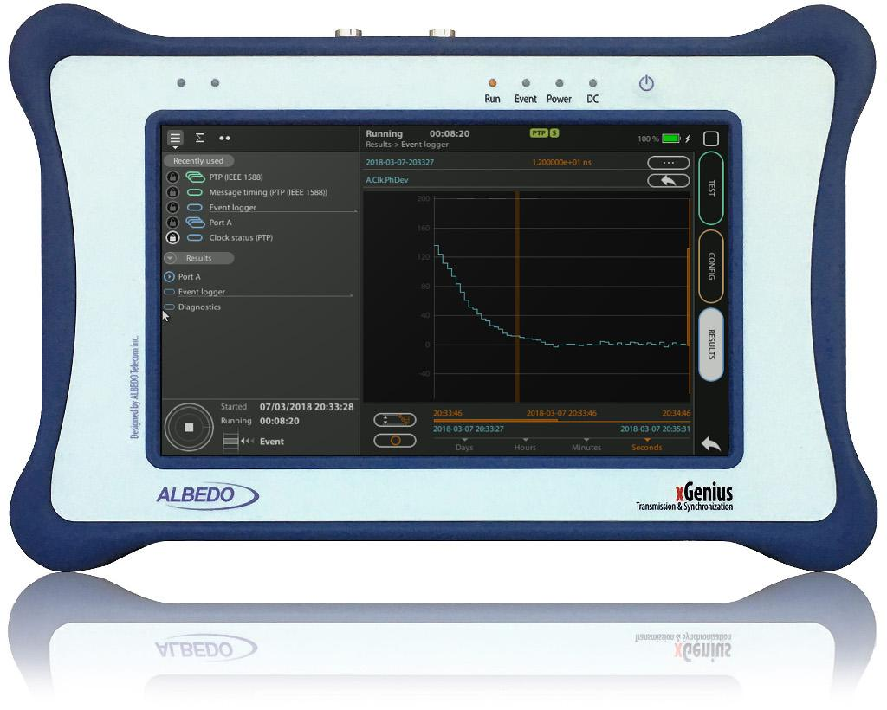
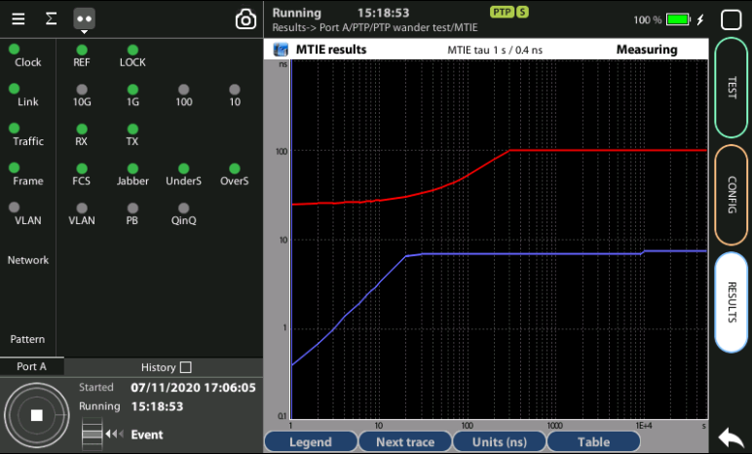

PTP clock Testing
PTP Slave analysis with xGenius
Guide & Slides corresponding to software ver. 2.3.11

Slide 2
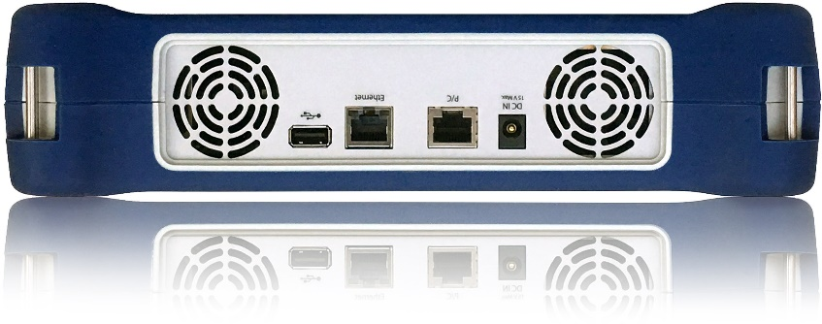

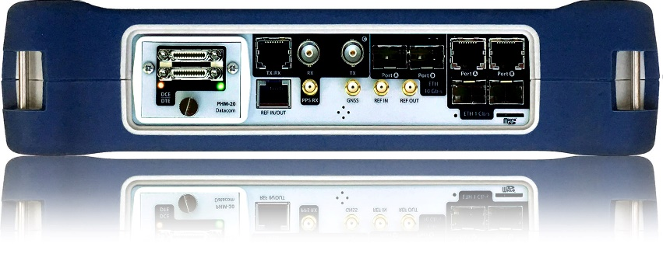
xGenius
xGenius provides deep insights to design, install, maintain, troubleshoot and engineer communications resources of Mobile Operators, Power Utilities, Finace, Labs and R+D centers. The unit is able to verify Ethernet/IP, SyncE, PTP, GbE, IRIG-B, 1PPS, T1/E1, G703, Serial Datacom, C37.94, GOOSE, SV, MMS, Round-trip & One-way Delay tests at all interfaces. It also has a set of programmable filters to capture live data traffic at wire-speed

Slide 3
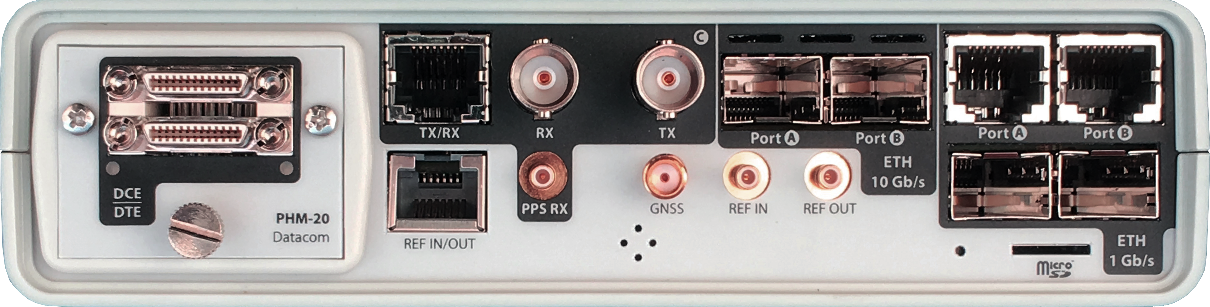

Interfaces & time References
PHM
RJ45-C
BNC-C
SFP+ A
SFP+ B
RJ45-A
RJ45-B
The unit is equipped with GNSS receiver with SMA female connector for connecting an antenna typically supplied with a 5 m of coaxial cable plus a 10 m extension cable.
RJ45
SMB-C
SMA
SMB-1
SMB-2
SFP-A
Micro SD
 | GNSS | PTP | NTP | ToD | IRIG-B | PPS | PP2S | SyncE | T1/E1 | MHz | Data
RJ45-A |  | in/out | in/out |  |  |  |  | in/out
RJ45-B |  |  |  |  |  |  |  | in/out
SFP-A |  | in/out | in/out |  |  |  |  | in/out
SFP-B |  |  |  |  |  |  |  | in/out
SFP+A |  | in/out | in/out |  |  |  |  | in/out
SFP+B |  |  |  |  |  |  |  | in/out
BNC-C |  |  |  |  |  |  |  |  | in/out | in/out
RJ45-C |  |  |  | in |  | in | in |  | in/out | in/out
SMB-C
SMA | in
SMB-1 |  |  |  |  | in | in | in
SMB-2 |  |  |  |  | out | out | out
RJ-45 |  |  |  | in/out | in/out | in/out | in/out |  | in/out | in/out
PHM |  |  |  |  |  |  |  |  |  |  | in/out

Slide 4





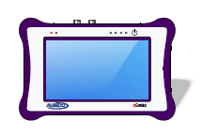
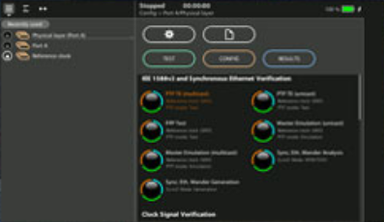

PTP in xGenius
Network Time Reference
PRTC
(Primary Reference Clock)
This presentation describes how to verify the PTP performance in a site synchronized by ITU-T G.8275.1 phase and time profile.
xGenius supports PTP (IEEE 1588 v2) including master and slave emulation and time and frequency features.
For external time reference you can use GNSS, ToD or IRIG-B (avoid 1.5/2.0 MHz, 2048 kHz, 1 PPS and SyncE, because are frequency-only references and this test require also phase)
T-GM
(Grand Master PTP)
T-BC
(Boundary Clock)
GNSS
Ethernet / IP
T-BC
(Boundary Clock)
¹......^{p}....^{p}....^{s}. ^{/ TOD} 17:23UTC
ALBEDO
Ethernet
T-TSC
(Slave Clock)
xGenius
Testing Points

Slide 5

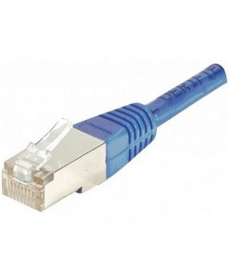
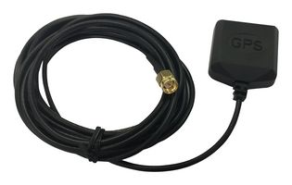
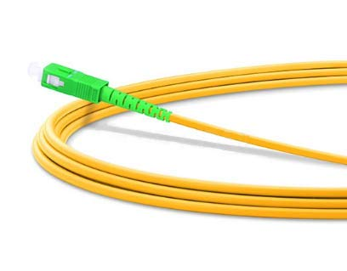
Connecting the antenna & the network
xGenius is equipped with a built-in GNSS receiver. It has a SMA female connector suitable for connecting an antenna. A compact antenna with 5 m of coaxial cable plus a 10 m extension cable. Using a different antenna is possible whenever is compliant with xGenius specifications.
Connect the PTP network to Port A of the xGenius by means of one cable or one optical fiber.
Connect the antenna to the unit oriented to open sky. Some tests may loss accuracy if the number of satellites in sight is limited.

Slide 6

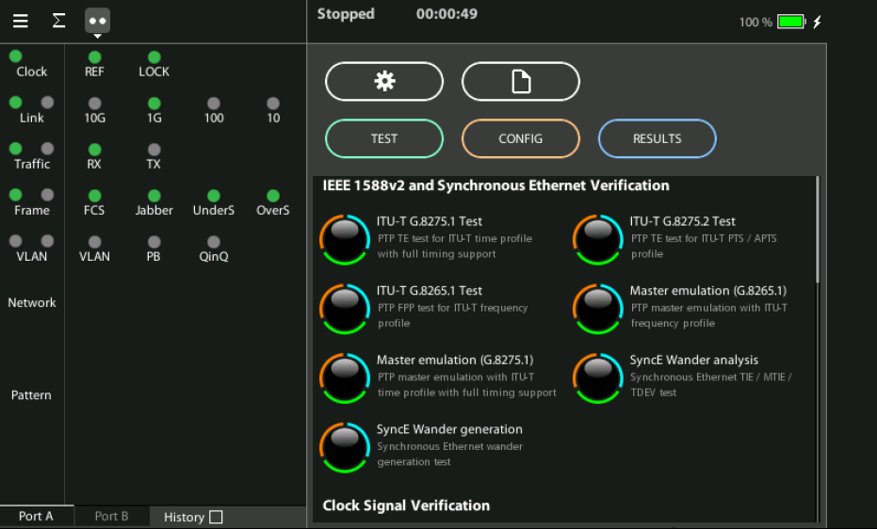
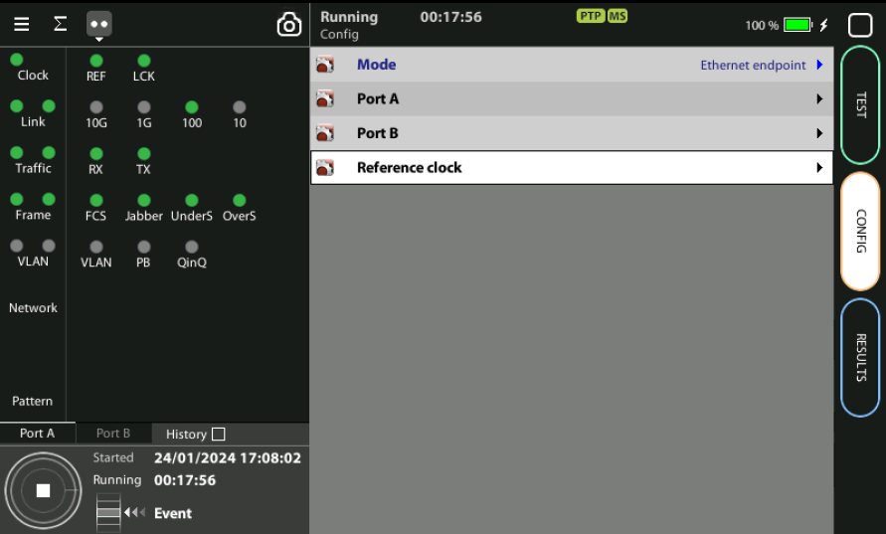
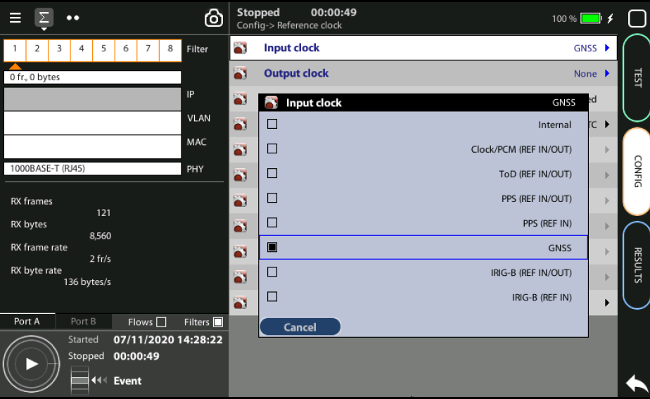
Steps to connect the built-in GNSS
3
2
1
1
Home > Config > Reference clock > Input clock := GNSS (*)
Press LEDS to check the status
Wait for the REF and LOCK LEDs to become green
(*) Go to Home panel, go to Config, the port setup will be displayed then Go to Reference clock and configure Input clock to GNSS.

Slide 7
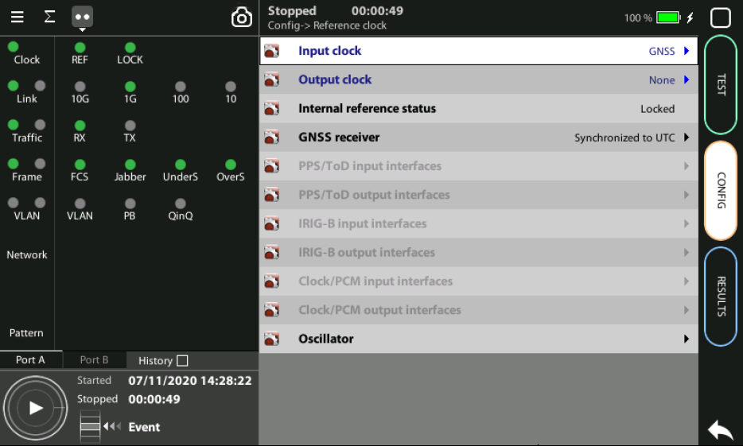
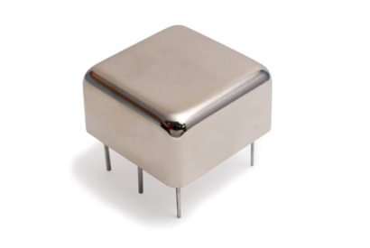
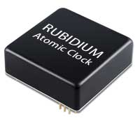
OCXO or Rubidium
1
  The unit will be ready for testing LOCK LED is green
  Mind that time is different depending which oscillator xGenius is equipped
Note: Current locking status (Locking, Fine locking, Locked, Holdover, etc.) can be checked in the Reference clock menu.
Metric | OCXO | Rubidium
Locking time | < 5 minutes | < 4 hours

Slide 8
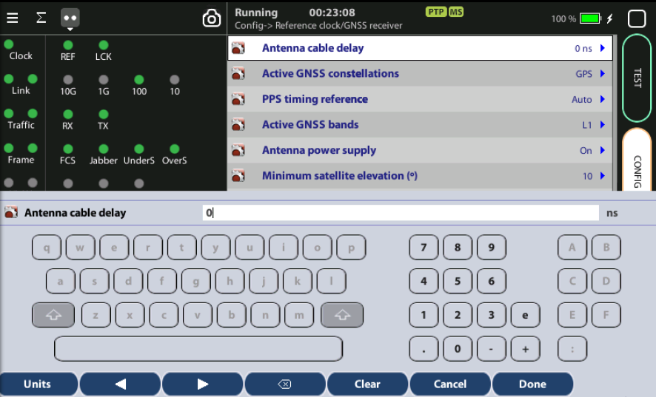
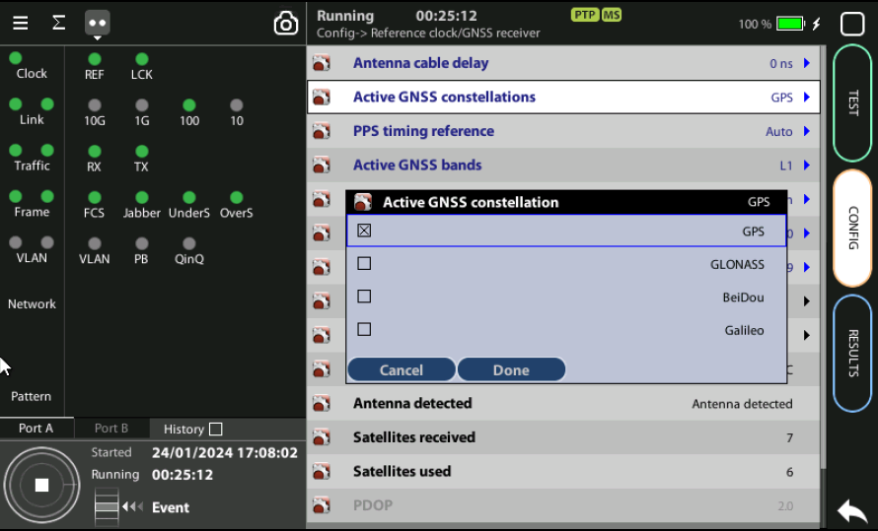
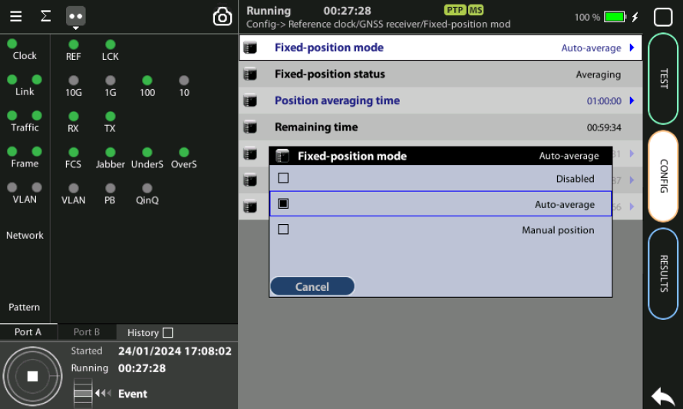
Configuring the GNSS Properties
1
2
2
1
3
Configure the GNSS to increase the accuracy:
Config > Reference clock > GNSS receiver > Antenna cable delay to configure a compensation at the correction field
In the same screen Enable/Disable any constellation (GPS, GLONASS, GALILEO, BEIDO) through the Active GNSS setting := GPS…
Go to Fixed‐position mode := Auto-average
NOTE: In this mode the equipment uses given spacial GNSS coordinates (longitude, latitude, altitude)

Slide 9
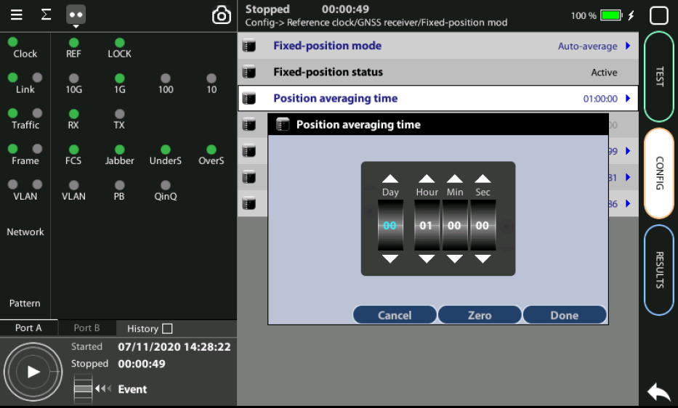
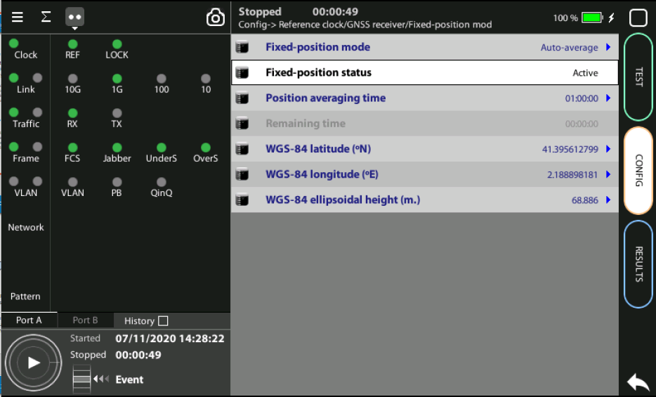
Position Averaging time
GPS signal has noise, errors… then averaging is the procedure to improve the accuracy.
Adjust the Position averaging time and by configuring Auto‐average in the that now displays Averaging
Notes: (a) At least 1h of averaging is required for reasonable accuracy, (b) The procedure should be run only once as long as the location does not change. If any change is detected (longitude, latitude, altitude) an error will be displayed.
Wait to the Fixed position status to become Active when the unit will be ready for testing.
Note: Theoretically, testing could start before the end of the position averaging process. The improved time estimation due to this function would be automatically applied starting from the end of the auto‐averaging process.
1
2

Slide 10


Hands-on to PTP test
Referencia
GPS
PTP
Ethernet / IP
Master Clock
Analizador
Frecuencia: TE
Fase: MTIE/TEV
xGenius can be configured as a genuine PTP slave clock, no differences at all excepting that xGenius can also qualify the stability of a PTP timing source.
In the pseudo‐slave emulation mode xGenius behaves as a PTP slave but keeping an independent synchronization source that enables the unit to calculate parameters such as MTIE, TDEV, TE by comparing both timing signals.

Slide 11
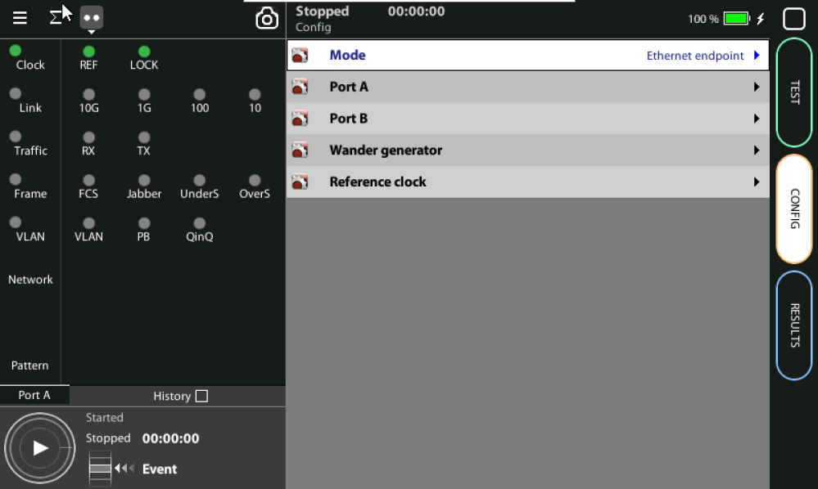
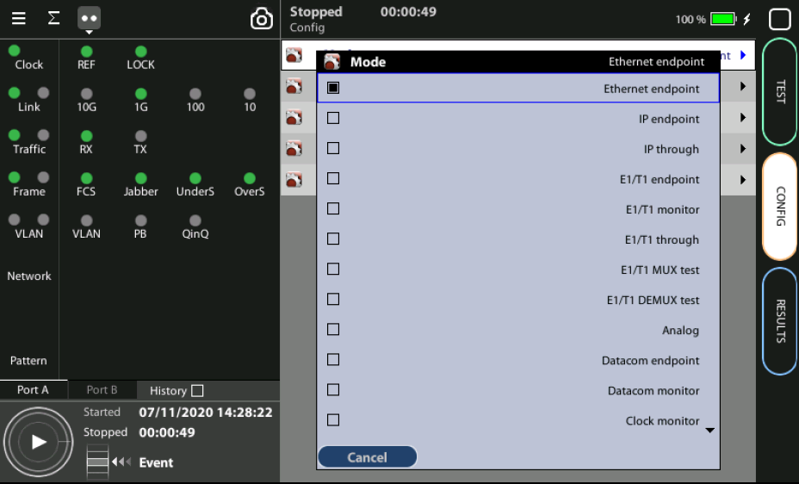
Connecting xGenius
1
2
In order to connect the xGenius use the RJ‐45 to link the network and configure it as a proper Telecom Slave clock (T‐TSC):
From the Home > Config > Mode to get the selection
Choose Mode := Ethernet endpoint

Slide 12
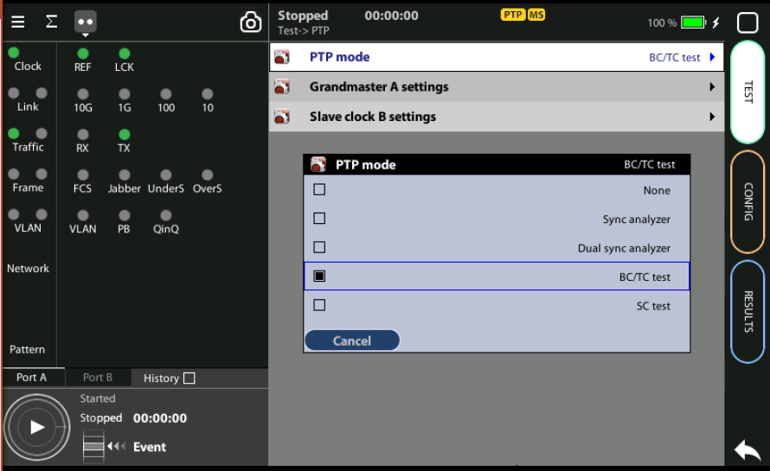
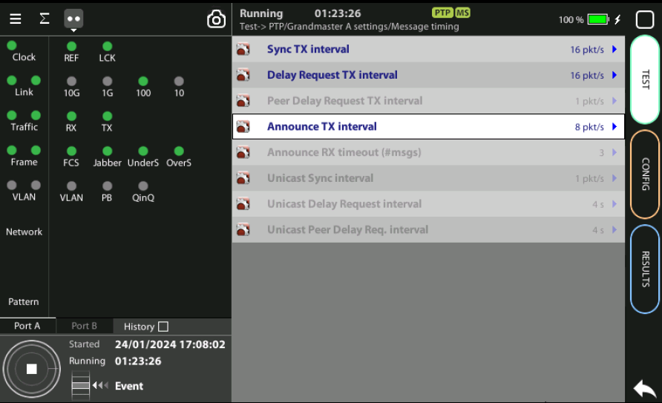
Configuring PTP in test Port A
2
2
1
3
3
3
3
1
Assume a simple configuration (1000BASE‐T, no VLANs)
From the Home > Test > PTP > PTP mode := BC/TC test
Configure the timing of PTP at Message timing menú
PTP indication changes yellow to green and MS is displayed
The following sequence is required to generate the PTP stimulus signal in Port A:
Test > PTP > Grandmaster A > Message timing > Sync TX interval := 16 pkt/s,
Test > Delay Request TX interval := 16 pkt/s,
Test > Announce TX interval := 8 pkt/s

Slide 13
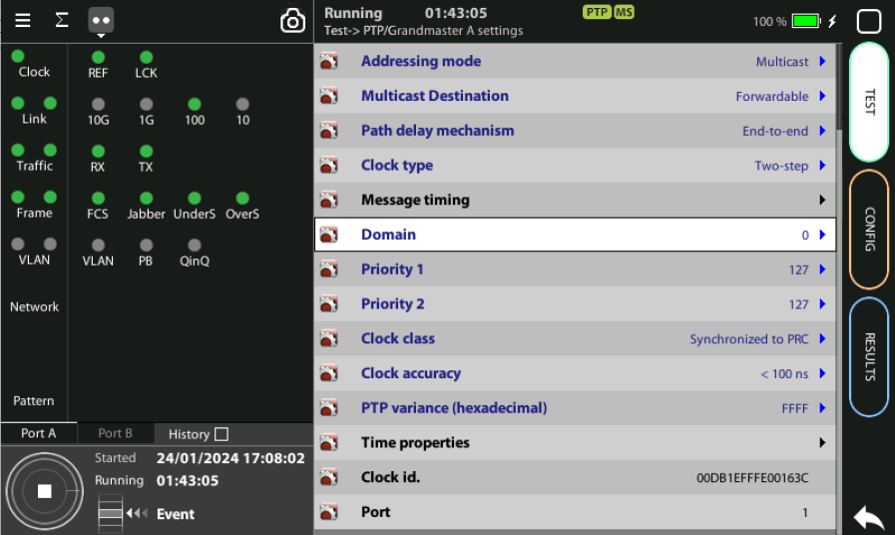
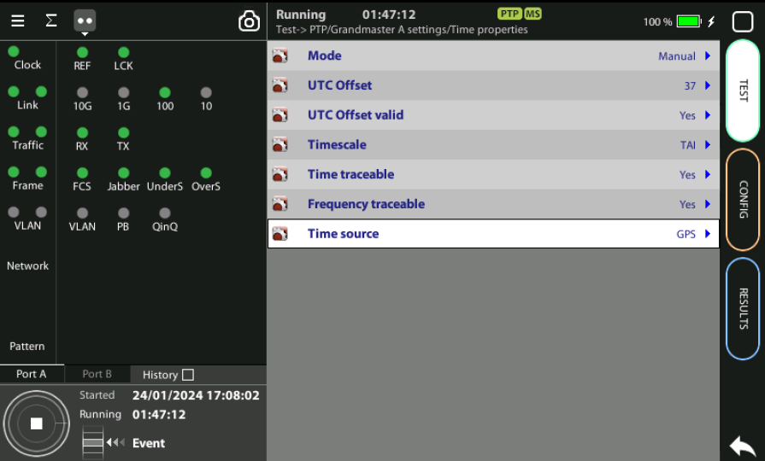
Domain, of your Network
3
3
1
1
3
2
Configure the Domain, Priority 1 & 2 to match your network
Configure Clock class to Synchronized to PRC
Configure Clock accuracy := 100 ns.
Go to Time properties
Mode := Manual
Offset valid := Yes
Timescale := TAI
Time traceable := Yes
Frequency traceable := Yes
Time source := GPS.

Slide 14
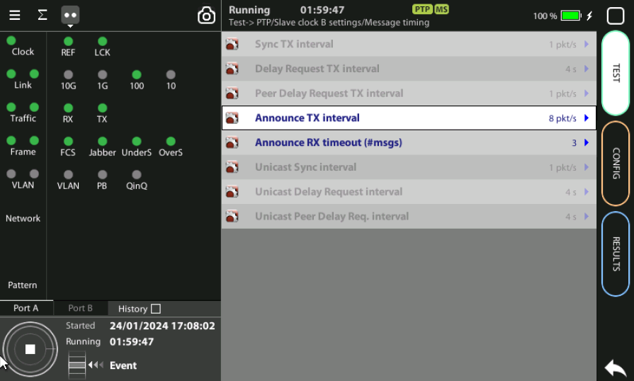
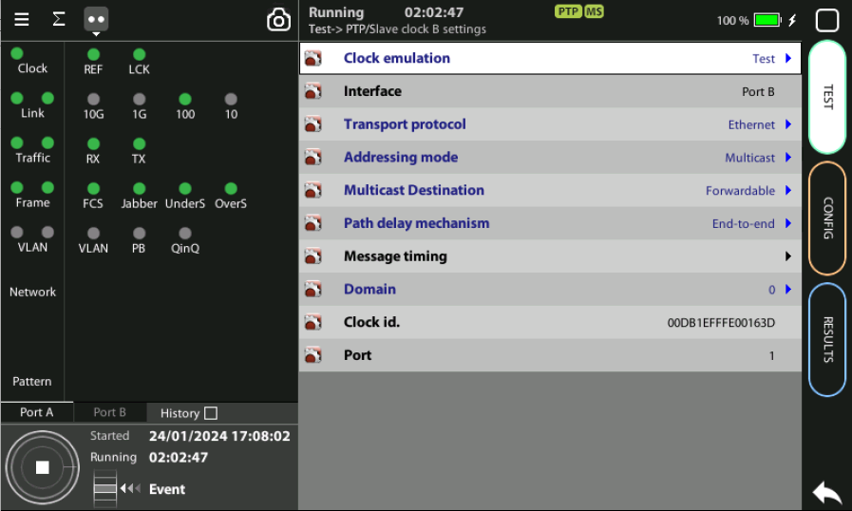
Configuring PTP Pseudo-slave & Priorities
3
1
1
2
Enable the PTP performance test in port B which has the telecom profile like in Port A
From the Home > Test > PTP > Slave clock B settings > Message timing
Announce TX interval := 8 pkt/s
Domain to the right value for your network
If correct, PTP indications will change from yellow to green

Slide 15
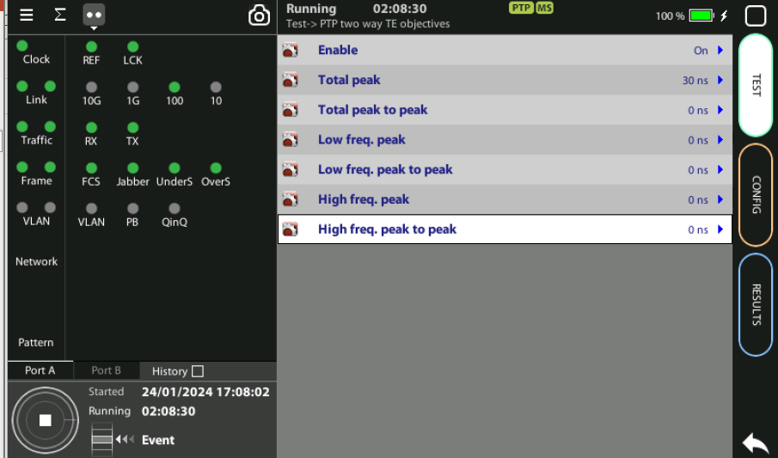
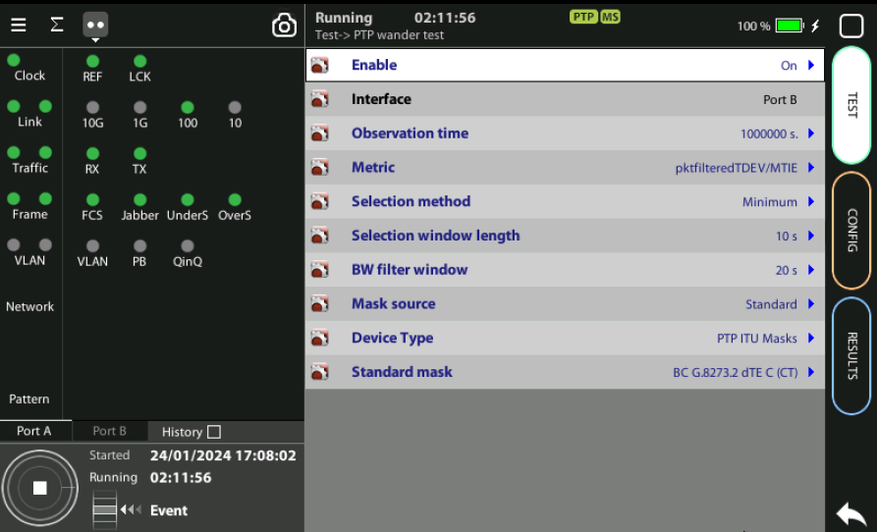
Configuring the Wander Test
2
1
1
1
To enable MTIE & TDEV test configure thresholds for the G.8273.2
Test > PTP two way TE objectives := 30 ns
Test > PTP wander test :
MTIE / TDEV := On
Mask source := Standard
Configure Device Type := PTP ITU Masks
Set Standard := BC G.8273.2 dTE (CT)

Slide 16
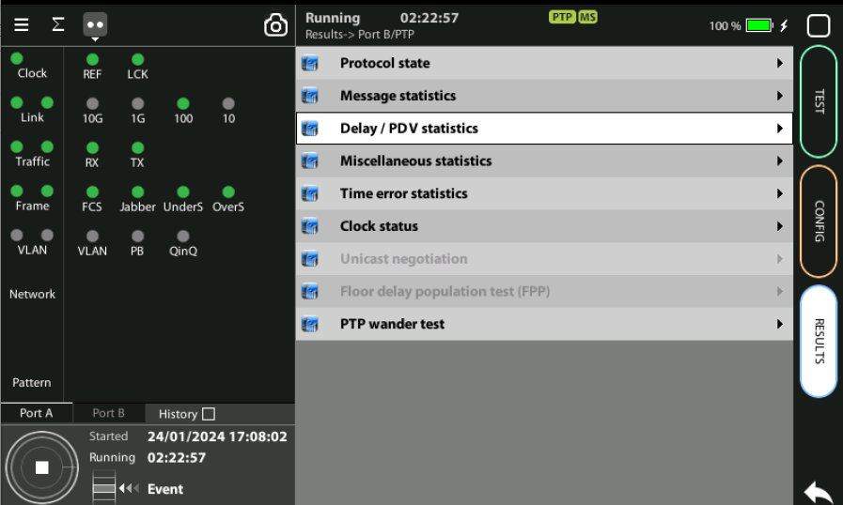
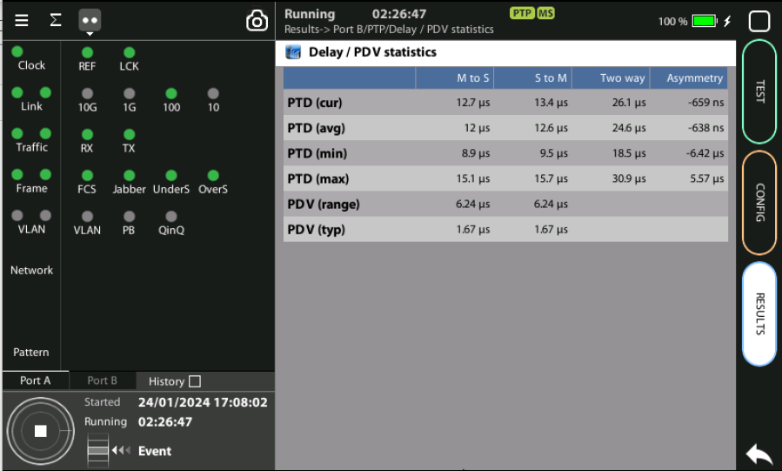
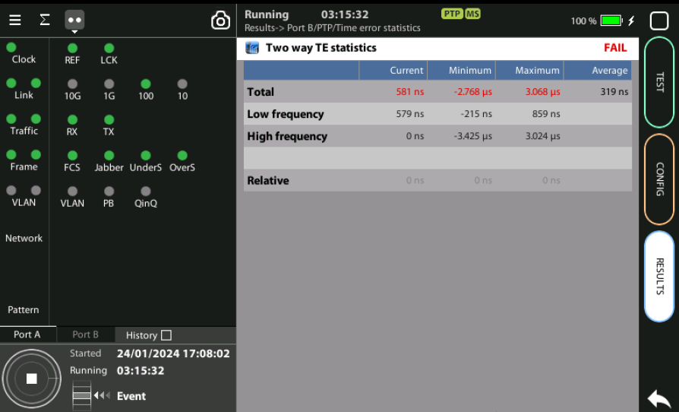
Running the Test
3
3
2
2
2
2
1
Press RUN and TE and MTIE / TDEV will be computed in real-time
You can check the TE results following these steps:
To see statistic: Results > Port B > PTP
Results > Port B > PTP > Delay / PDV
Results > Port B > PTP > Time error statistics to get the 2‐way TE results
Look at Maximum and Minimum of Total, Low frequency & High frequency TE and check if are under the limits defined in ITU‐T G.8271.1

Slide 17
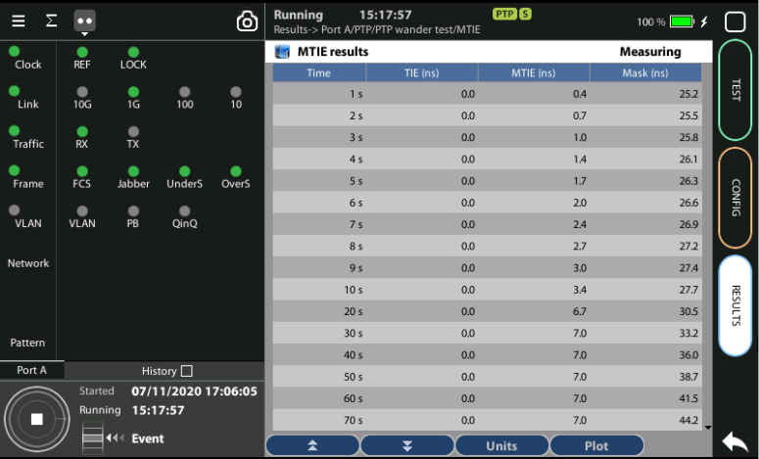
MTIE results
2
3
The MTIE / TDEV test is executed at the same time that the TE test:
Results > Port B > PTP > PTP wander test > MTIE to display PTP results
Check [Time, TIE, MTIE, Mask] results in table format
Press Plot to display the same results in graphical mode
Notes:
(1) TIE, MTIE, TDEV values must be understood as pktfilteredTIE, pktfilteredMTIE, and pktfilteredTDEV (2) The amount of time to wait before the first results are displayed depends of the filter settings
(3) To stop the tests press RUN a second time at any moment.

Slide 18

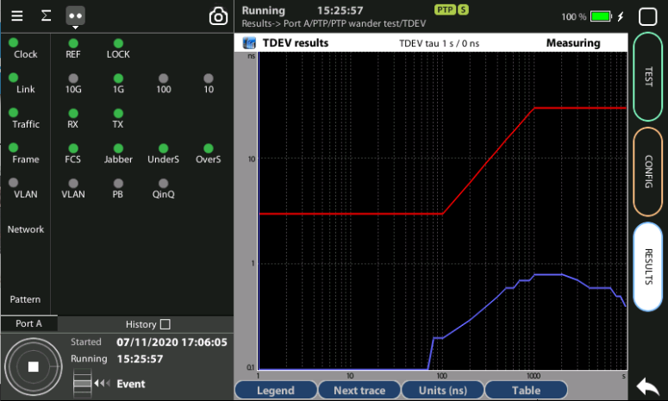
TDEV results
2
3
With the event logger you can trace event so that changes acrros the time will be registered with 1 sec. resolution. The logger has zoom levels to analyze the results at different time scales.
Go to Results > Port B > PTP > PTP wander test > TDEV to display the results
Check [Time, TDEV, Mask] results in table format
Press Plot to display the same results in graphical mode
Notes:
(1) TIE, MTIE, TDEV values must be understood as pktfilteredTIE, pktfilteredMTIE, and pktfilteredTDEV (2) The amount of time to wait before the first results are displayed depends of the filter settings
(3) To stop the tests press RUN a second time at any moment.

Slide 19
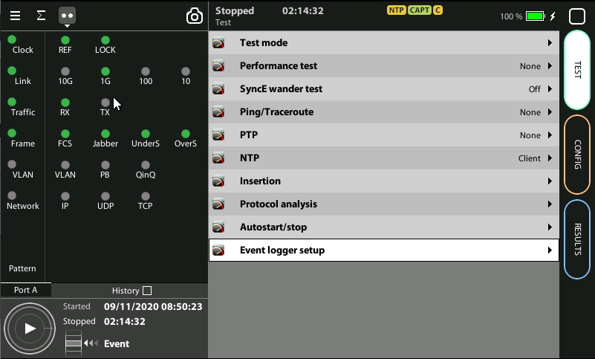
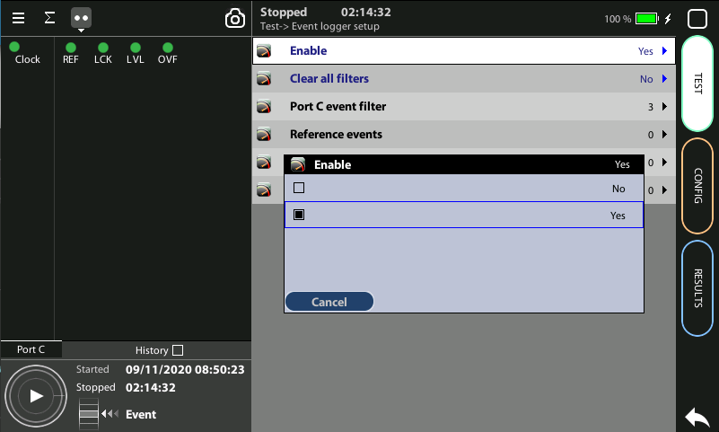
Event logger enable
1
1
Global counts, statistics and LEDs provide information about which events and how many of them have been registered but they do not say too much about how they are distributed in time. These information is supplied at the Event Logger a graphical representation tool that permits to trace the evolution of key parameters.
The first thing to to is to enable it:
Go to Home > Test > Event logger setup
Set Enable := Yes

Slide 20
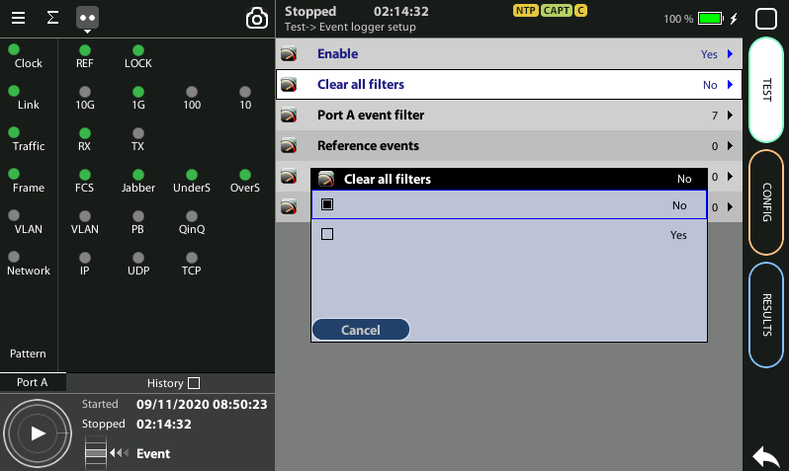
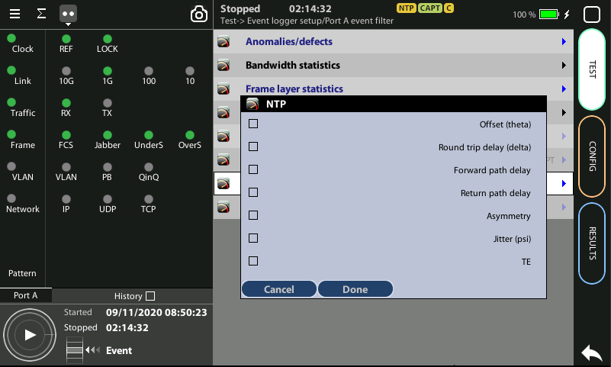
Configuring the Event Logger
2
1
3
4
Traceable Events are categorized in different classes. Moreover, each test port has its own traceable events. These events may be different for each test port.
Clear the currently selected filters: Clear all filters := Yes
Select the Port A or Port B
Choose the events to trace: Anomalies/defects | Bandwidth statistics | Frame layer statistics | SLA statistics | BERT | PTP | NTP | Synchronization
Press Run to begin the generation of a trace file

Slide 21
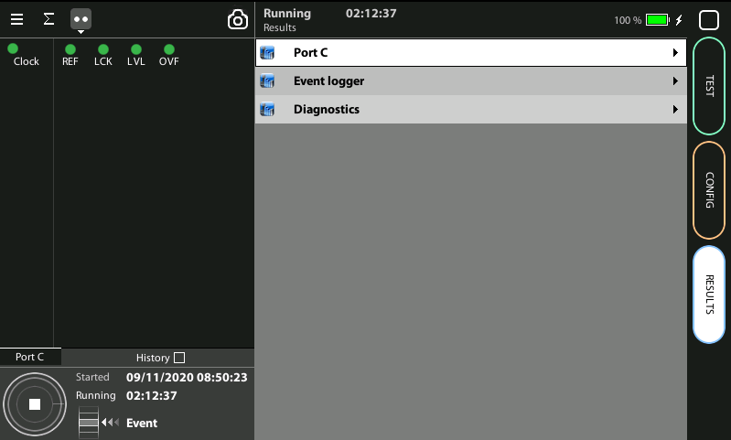
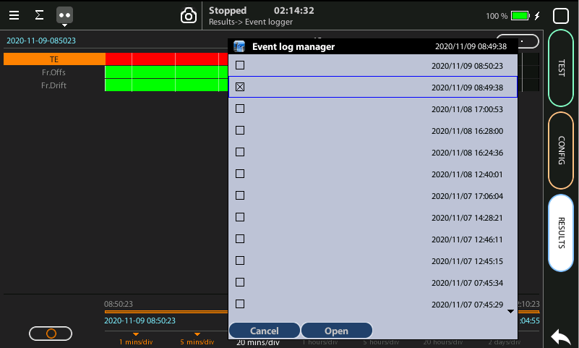
Display the logs
2
1
3
3
With the Event Logger you can select one or various events and trace them so that all changes along with the time and date these changes are registered are recorded with a 1 second resolution. The event logger provides representations and zoom levels to enable event analysis at different time scales:
Go to Results > Event logger
To select a saved trace double click at (…) to display the folder of traces
Select and Open one of the files

Slide 22
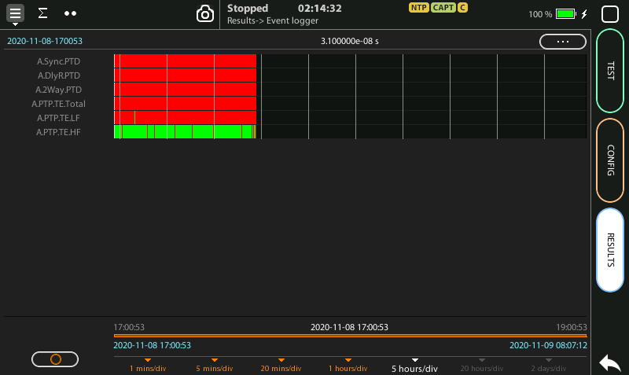
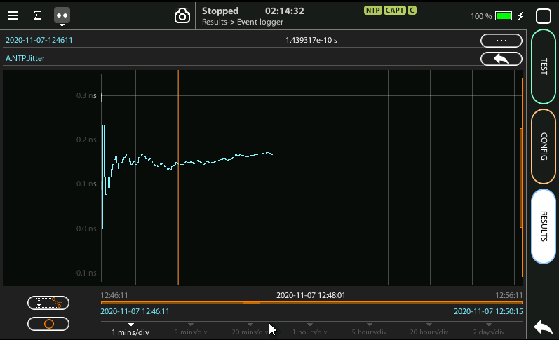
Event logger results
1
4
6
3
4
2
2
2
You can display the trace of the evolution of the previously selected parameters:
View and analyze the details of the histogram
Set the scale at your preferred zoom level
Selected one event to display a more detailed diagram
Click on the screen to know the exact value at one specific time

Slide 23
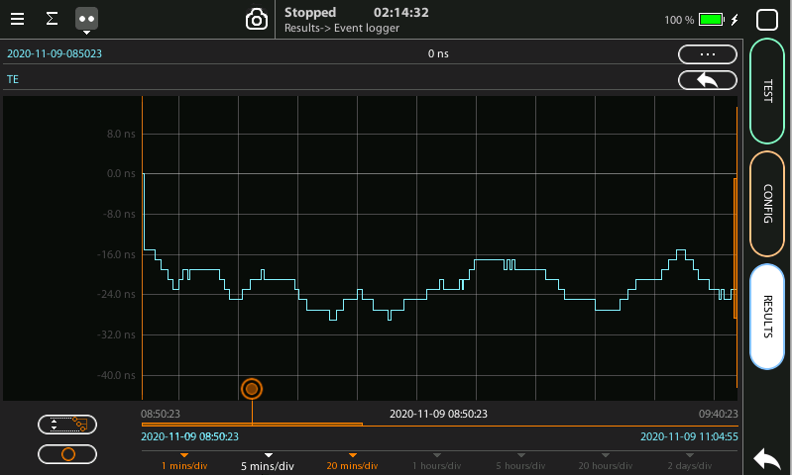
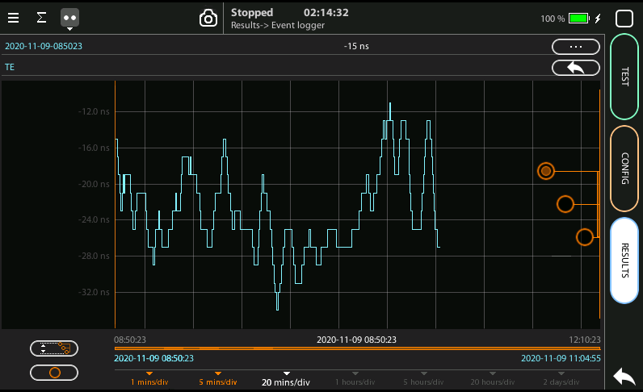
Scaling the trace
1
2
5
1
1
To change the scale horizontally click one time, for vertical two times
Click in the red buttom and draw to the left or to the right
To change the scale vertically click two times
To move the trace across the time click one of the three the red buttoms and draw the finger up and down
Click in the auto-scale symbol to return to the initial conditions

Slide 24
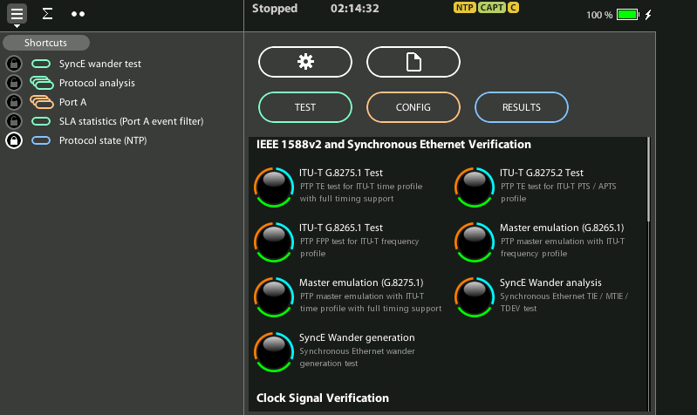
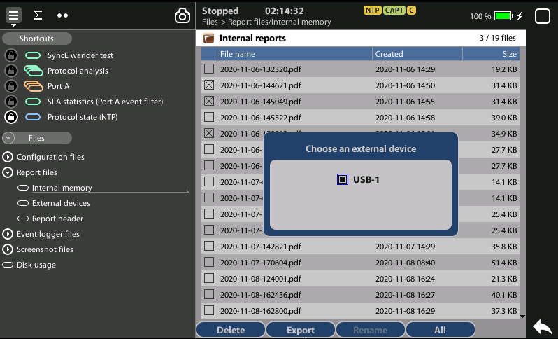
Exporting Logs
1
1
3
2
To export log files in CSV format:
Go Home > [File icon] > Configuration files | Report files > Internal memory
to list the files currently stored in the unit
Select the files you want to export: File name > Export
Choose an external device: micro SD | USB
If no external device a popup will appear: ‘No devices present’

Slide 25
Glossary
AAA: Authentication, Authorization, and Accounting
ACL: Access Control List
AP: Access Point
Busbar: Metallic strip or bar, typically housed inside switchgear, panel boards, and busway enclosures for local high current power distribution C37.94: TDM interface devoted for teleprotection
CB: Circuit Breaker designed to close or open electrical circuit under normal or abnormal conditions. It operates on relays command.
CBWFQ: Class-Based Weighted Fair Queuing
CG: Connected Grid
CID: Individual configuration of each IED CIP: Critical Infrastructure Protection CLI: Command-Line Interface
CorpSS: Corporate Substation
CT: Current Transformer, used for measurement of current, if too high to apply directly to measuring instruments, a CT produces a proportional current which can be measured and recorded, CT are used in metering and protective relays
DAN: Doubly Attached Nodes implementing HSR or PRP
DAU: Data Acquisition Unit
Disconnector: isolates physically and visually the lines
DMZ: Demilitarized Zone
DCB: Directional Comparison Blocking
DCS: distributed control systems
DSC: Differentiated Services Code Point
ESP: Electronic Security Perimeter
Feeder: Transmits power to the distribution points
GM: Grandmaster
GNSS: Global Navigation Satellite System
GOOSE: Generic Object-Oriented Substation Events is a control model defined as per IEC 61850 which provides a fast and reliable mechanism of transferring event data over entire electrical substation networks. When implemented, this model ensures the same event message is received by multiple physical devices using multicast or broadcast services
HMI: Human Machine Interface
PTP: Precision Time Protocol
RedBox: Redundancy Box
Relay: is automatic device which senses an abnormal condition of electrical circuit and closes its contacts and complete the circuit breaker trip.
REP: Resilient Ethernet Protocol
RCT: Redundancy Control Trailer
RTU: Remote Terminal Unit
SA: Substation Automation
SAN: Singly-Attached Node
Secondary Lines: lower voltage side at the substation
SCADA: Supervisory Control And Data Acquisition, transmits and receives data from events of controls, measuring, safety and monitoring. Power system elements can be controlled remotely over. Remote switching, telemetering of grids showing voltage, current, power, direction, consumption in kWh, synchronization.
SCD: Substation Configuration Description SCL: Substation Configuration Language SNTP: Simple Network Time Protocol
Station Bus: Connects the entire substation and helps provide connectivity between central management and individual bays
STP: Spanning Tree Protocol
SV: Sampled Values, is a method to read instantaneous values such as currents, voltages, impedances, etc. from CTs, VTs or digital I/O and then transmitted to make them are available for those IED subscribed.
Switchgear: combination of switches, fuses or CB to control, protect and isolate electrical equipment
SyncE: Synchronous Ethernet
TLV: Type, Length, Value
VT: Voltage Transformer (see CT)Potential Transformer, gives the reference voltage to the Relay for Over-voltage or Under-voltage Protection
UCA IuG: Utility Communications Architecture International Users Group
VDAN: Virtual D
HQoS: Hierarchical Quality of Service
HSR: High-Availability Seamless Redundancy
IA: Industrial Automation
ICS: Industrial control systems
ICU: Intelligent Control Unit
IEC: International Electrotechnical Commission
IEC 61850: Standard defining communication protocols for intelligent electronic devices at electrical substations
IED: Intelligent End Device, microprocessor-based controllers of power system equipment, such as circuit breakers, transformers and capacitor banks to enable advanced power automation.
IRIG: Inter-Range Instrumentation Group
ISE: Identity Services Engine
L3VPN: Layer 3 Virtual Private Network
LA: Lightning Arrester protects the power grid from electric storms
MQC: Modular QoS Command-Line Interface
MMS: Manufacturing Message Specification, messaging system for exchanging real-time data and supervisory control information. Allows client such as SCADA, an OPC server or a gateway to access all IED objects MPLS: Multi-protocol Label Switching
MU: Merging Unit connected to the process bus converts analog data(ie. volts, currect...) into digital information
NERC: North American Electric Reliability Corporation
NIST: National Institute of Standards and Technology
NMS: Network Management System
OAM: Operations and Maintenance
PCP: Priority Code Point
PIOC: Instantaneous overcorrent Protection
PLC: Programmable Logic Controller
PMU: Phasor Measurement Unit
POTT: Permissive Overreaching Transfer Trip
PP: Primary Power
Process Bus: Connects primary units and control equipment to the IEDs
PRP: Parallel Redundancy Protocol
PRTC: Primary Reference Clock
PT: see VT
T-GM: Grand Master PTP
T-BC: Boundary Clock
T-TSC: Slave Clock

Slide 26



That’s all
www.albedotelecom.com

Slide 27
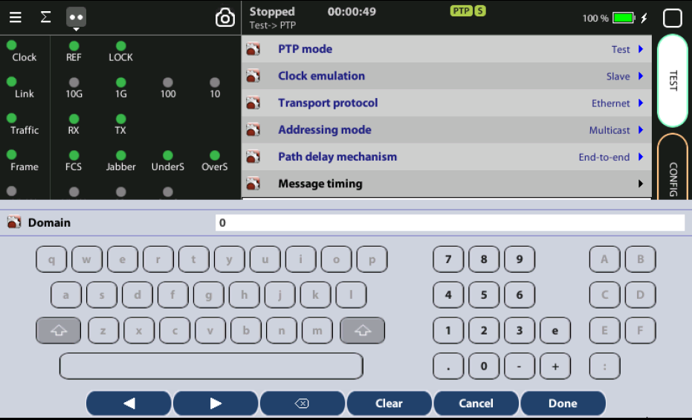
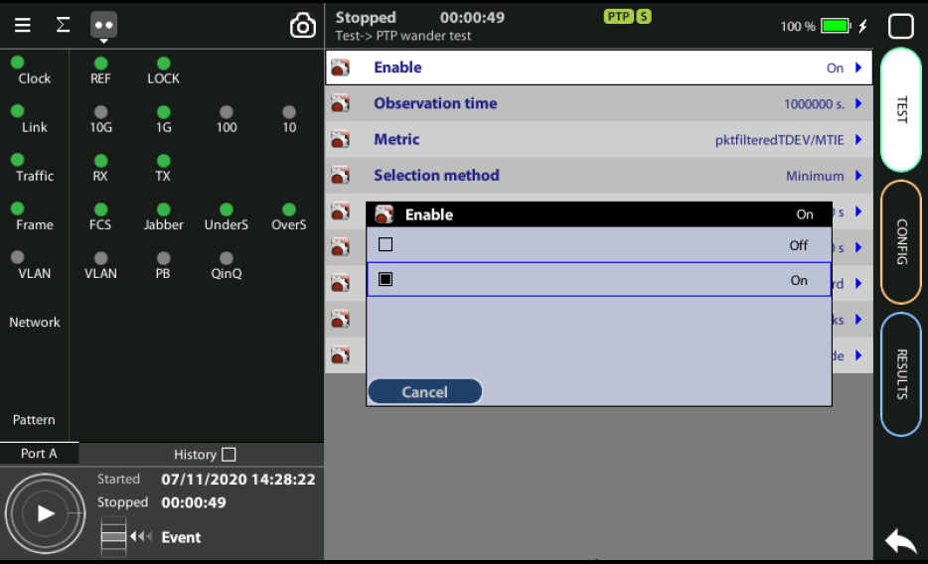
Configuring the TE, MTIE, TDEV test
3
1
To configure TE, MTIE, TDEV you need to enable them:
Configure the Domain to the right value for your network
Home > Test > PTP wander test
Enable the MTIE / TDEV test by setting the Enable := On

Slide 28


GPS (time ref)
Generador
Señal E1
GPS (time ref)
Analizador
Frecuencia: TE
Fase: MTIE/TEV

