Slide 1
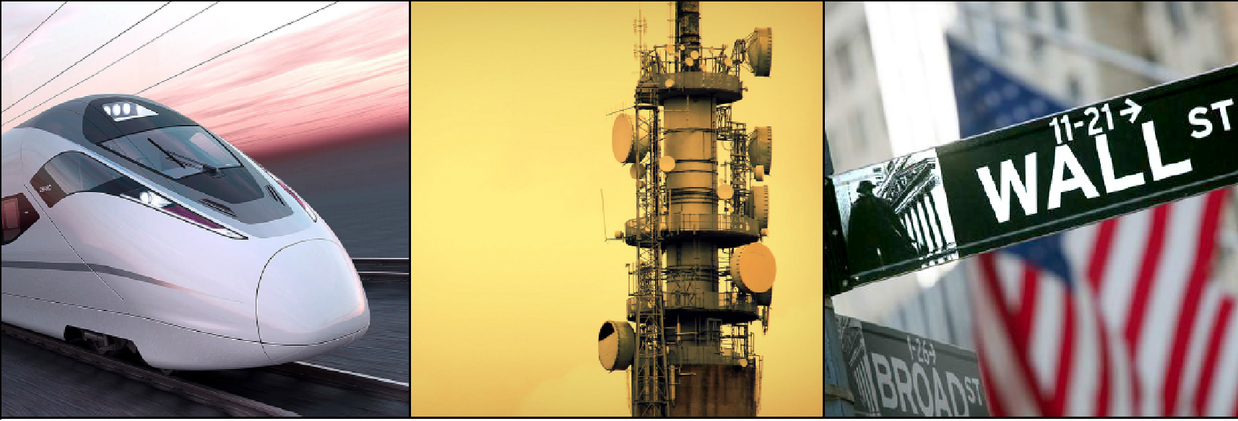
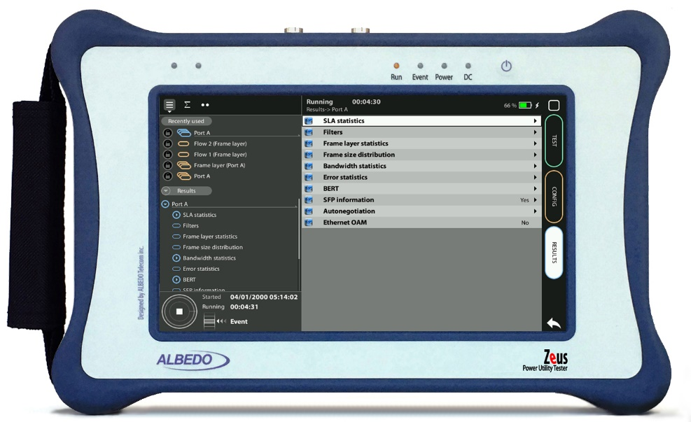
GOOSE Capture&Analysis
IEC 61850 GOOSE analysis with Zeus
Guide & Slides corresponding to software ver. 2.10.5

Slide 2
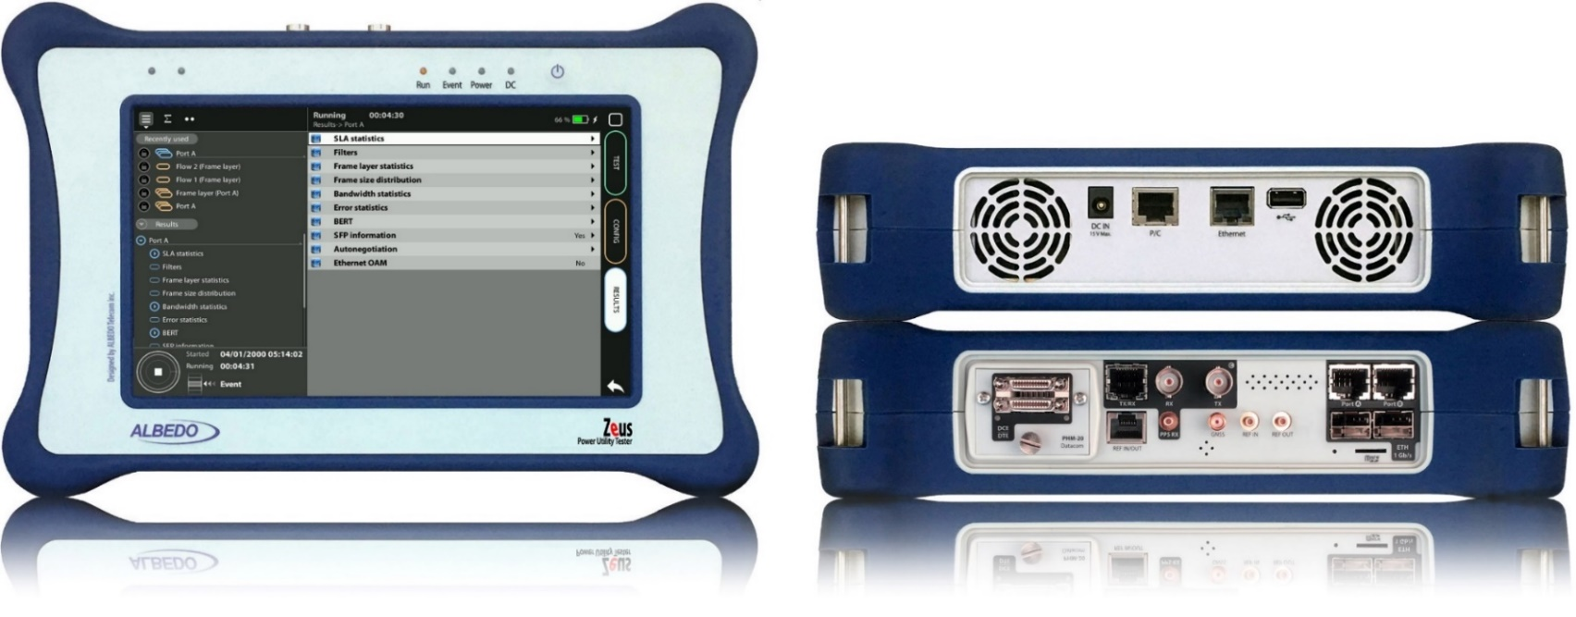
Zeus & xGenius
Zeus & xGenius provide deep insights to design, install, maintain, troubleshoot and engineer communications resources of Mobile Operators, Power Utilities, Finace, Labs and R+D centers. The unit is able to verify Ethernet/IP, SyncE, PTP, GbE, IRIG-B, 1PPS, T1/E1, G703, Serial Datacom, C37.94, GOOSE, SV, MMS, Round-trip & One-way Delay tests at all interfaces.
It also has a set of programmable filters to capture live data traffic at wire-speed

Slide 3
Interfaces & time References
PHM
RJ45-C
BNC-C
RJ45-A
RJ45-B
Zeus & xGenius enable Ethernet traffic capture at wirespeed by adding precise time stamps obtained from a time reference (GNSS, ToD, IRIG-B) when available.
RJ45
SMB-C
SMA
SMB-1
SMB-2
SFP-A
Micro SD
SFP-B
 | GNSS | GOOSE | PTP | NTP | ToD | IRIG-B | PPS | PP2S | SyncE | T1/E1 | MHz | C.3794
RJ45-A |  | in/out | in/out | in/out |  |  |  |  | in/out
RJ45-B |  |  |  |  |  |  |  |  | in/out
SFP-A |  | in/out | in/out | in/out |  |  |  |  | in/out
SFP-B |  |  |  |  |  |  |  |  | in/out
BNC-C |  |  |  |  |  |  |  |  |  | in/out | in/out
RJ45-C |  |  |  |  | in |  | in | in |  | in/out | in/out
SMB-C
SMA | in
SMB-1 |  |  |  |  |  | in | in | in
SMB-2 |  |  |  |  |  | out | out | out
RJ-45 |  |  |  |  | in/out | in/out | in/out | in/out |  | in/out | in/out
PHM |  |  |  |  |  |  |  |  |  |  |  | in/out

Slide 4
The GOOSE protocol
SCADA
GOOSE is a IEC-61850 messaging system used by IEDs and mission-critical applications to tell about substation events, such as commands, alarms, indications and measurements. Since the GOOSE messages replace hard-wired signals used for protection and control applications IEC 61850 introduces mechanisms that ensure the delivery of the required information.
Capturing GOOSE with Zeus is an extension of the multi-stream analysis performed by these units: Captured frames will be the outcome of matching the incoming traffic with the Port A filtering blocks.
.
ALBEDO
xGenius
G O O S E
Station
G O O S E
G O O S E
Bay
IED
Protection
IED
Control
SV
Process
PTP
G O O S E
SV
MU
ALBEDO
xGenius

Slide 5
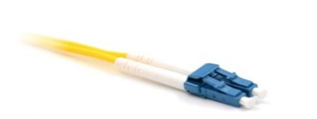
Connecting the fiber
1
2
Zeus / xGenius support the optical interfaces that you can connect to the Station or Process bus of the substation:
Introduce a compatible SFP into Port A*
Connect the optical cables to the SFP in Port A
(*) Port B is not intended for traffic capture.

Slide 6
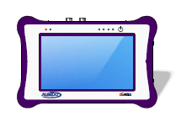
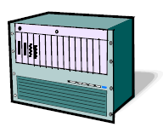
Hands-on to GOOSE protocol analyisis
Process / Station Bus
IED
G O O S E
G O O S E
G O O S E
G O O S E
A
B
Eth / IP endpoint
mode
Switch
IP though mode
CBR
The capture works in the following modes:
Ethernet endpoint,
IP endpoint
IP through modes

Slide 7
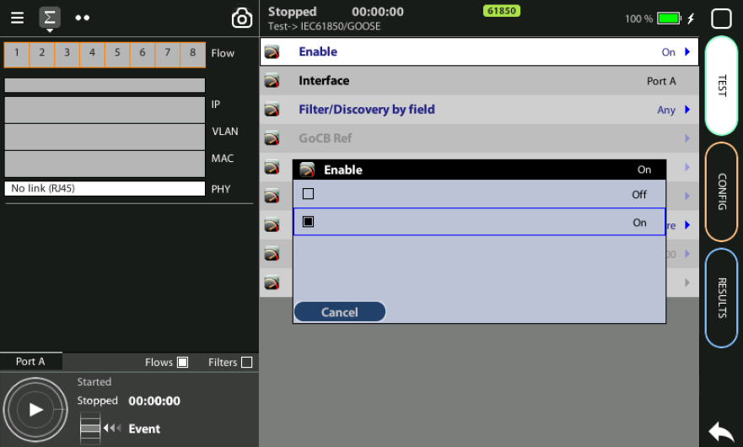
Home > Test > IEC 61850 > GOOSE > Enable := ON

Slide 8
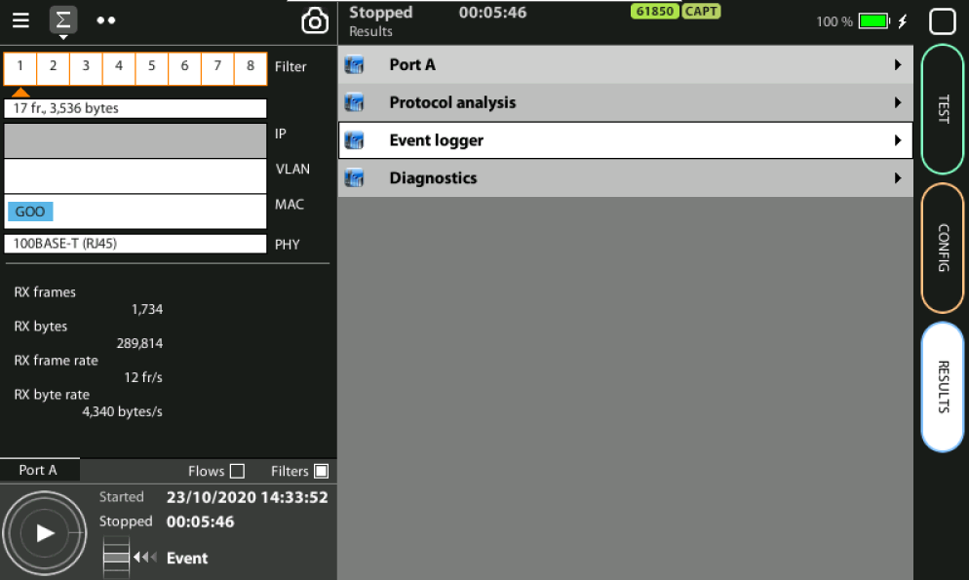
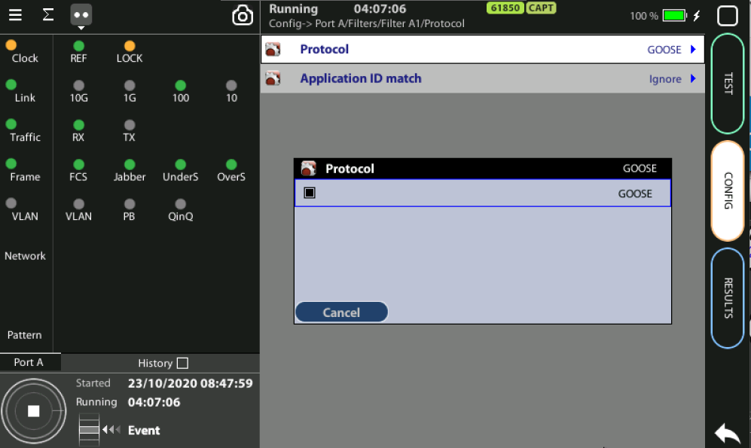
Enable filter for GOOSE protocol
3
2
2
1
To capture and process GOOSE frames a filter must be configured:
Home > Config > Port A > Filters > Filter mode := Custom
Home > Config > Port A > Filters > Filter A1 > Protocol := GOOSE
You can see all the filter by pressing in Summary tap
See GOOSE filter in the 1st position
You can select and display the rest of the filters

Slide 9
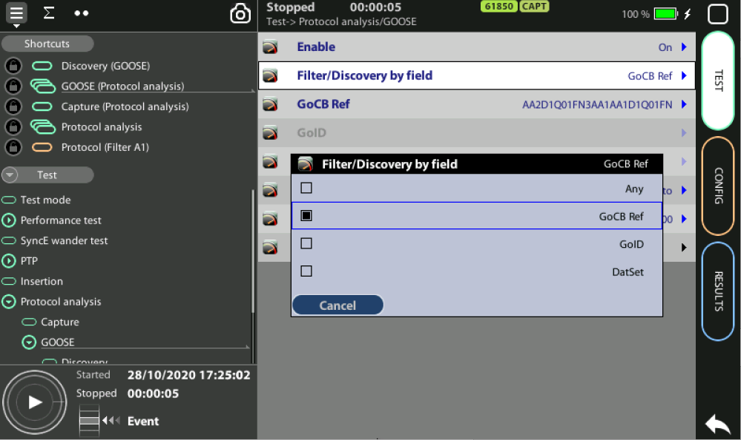
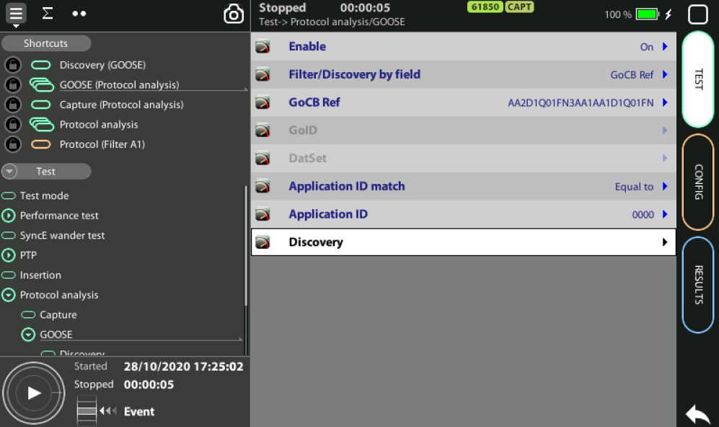
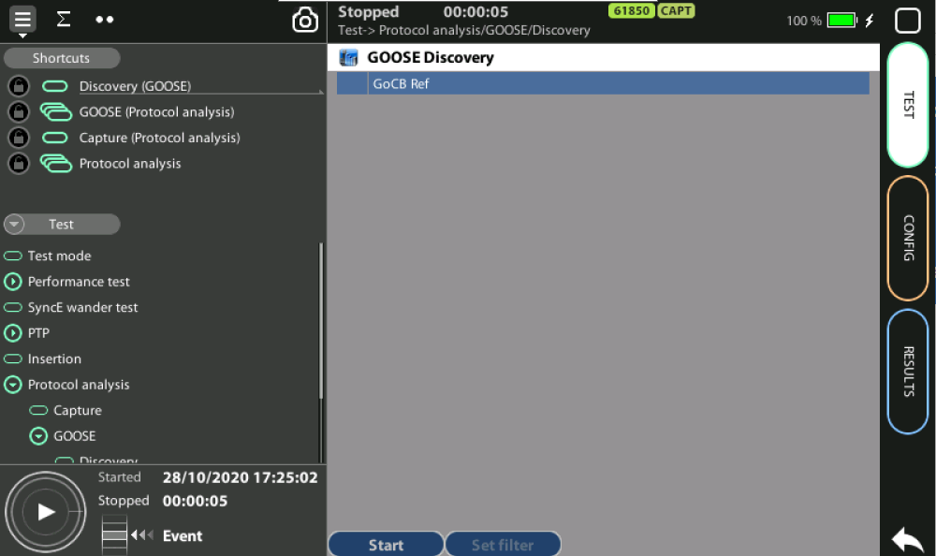
Scan the network
1
1
1
2
2
3
This option could be useful in some testing scenarios it may be difficult to know in advance the value of the GOOSE field to be used for analysis to retrieve information about active flows identified by their data of interest.
Test > Protocol analysis > GOOSE > Filter/Discovery := GoCB | GoId | DataSet
Test > Protocol analysis > GOOSE > Discovery > Start

Slide 10
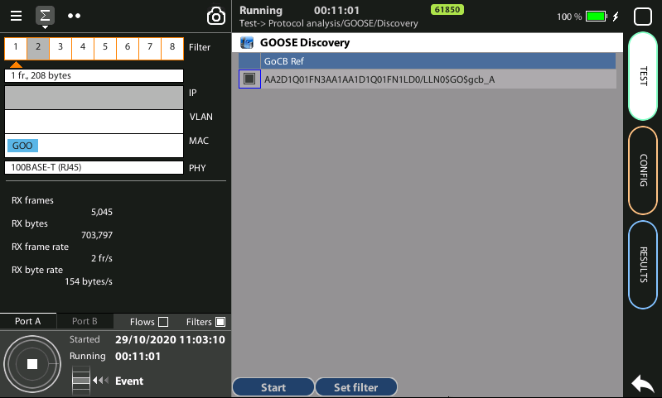
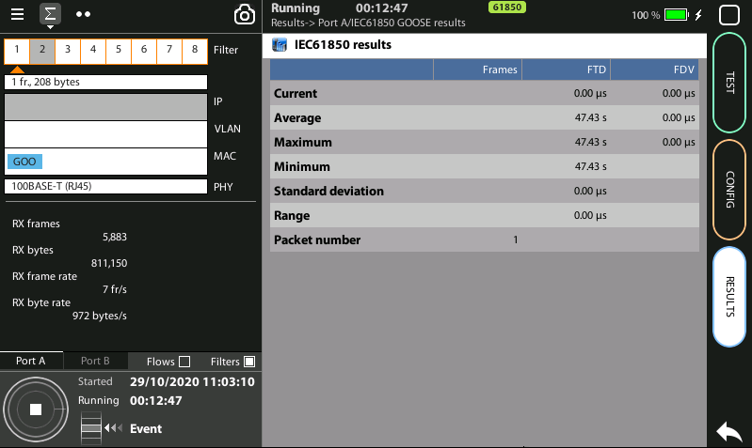
Discovery process
1
5
3
4
2
3
The table will be populated with flows compliant with the selected field
Press Stop
Select any item in the list you wish to use in the protocol analysis
You can now run the test and monitor the live captures
Home > Results > Port A > IEC 61850 GOOSE results

Slide 11
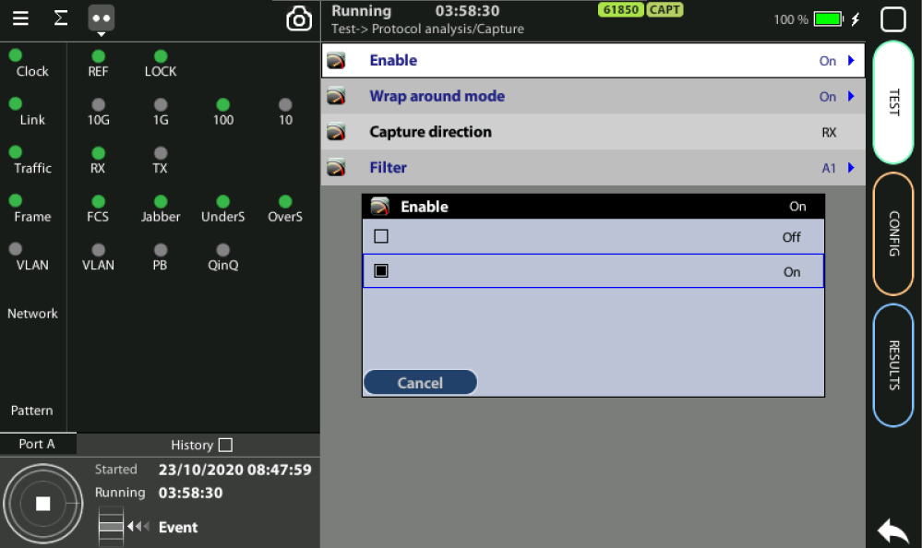
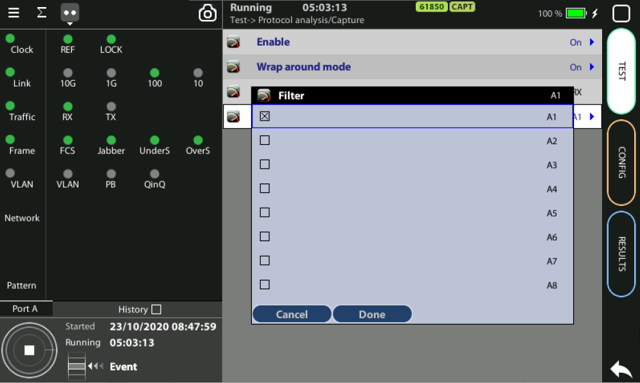
Enable the Traffic capture
2
3
1
4
Go to Home > Test > Protocol Analysis > Capture > Enable := On
If you want overwrite old traffic then set Wrap around mode := On
Select the filter: Home > Test > Protocol Analysis > Filter := A1
Press RUN

Slide 12
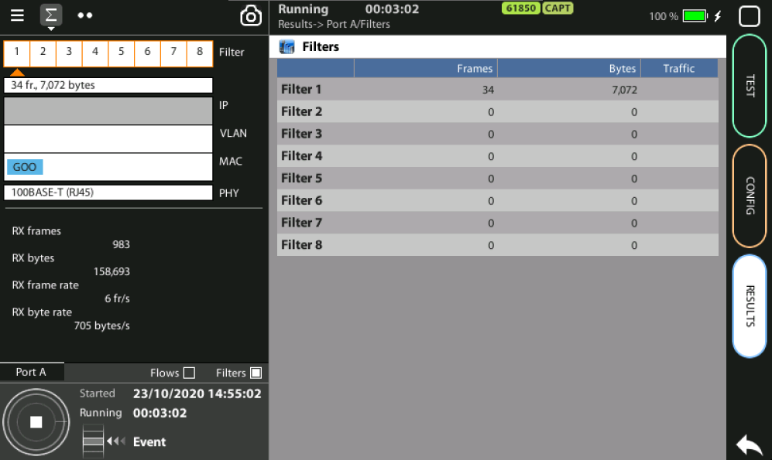
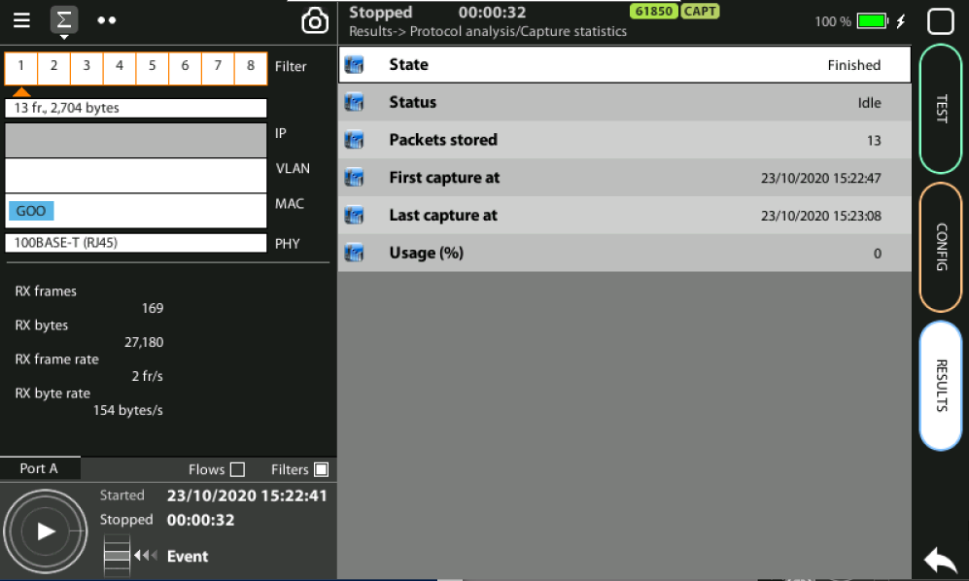
Capture control
1
1
Go to Home > Results > Port A > Filter statistics to see the captured frames
You can obtain a complete set of information about your capture: Home > Results > Protocol analysis > Capture statistics
The tester will display fresh details regarding the test and the available space to capture more packets. Mind that the storage capacity is limited to 128MB.

Slide 13
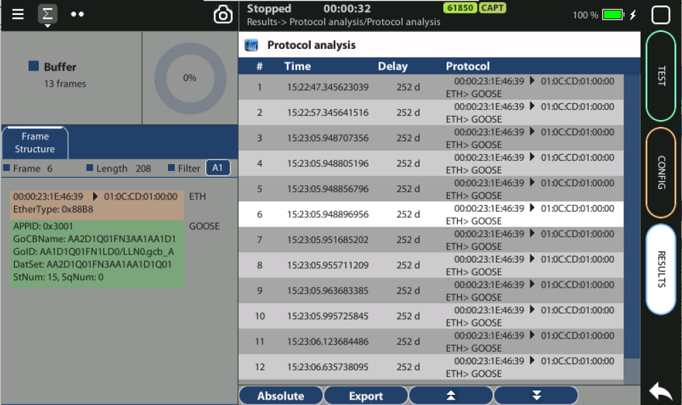
Protocol Analysis
Occupation
Timestamps
1
Count
Sequence
Delay analysis
Contents
Contents
2
The protocol analyzer permits to find out the frame structure, content and the time sequences of the GOOSE traffic captured thanks to time-stamped marks.
Home > Results > Protocol analysis > Protocol analysis
Select one packet to analyze the contents

Slide 14
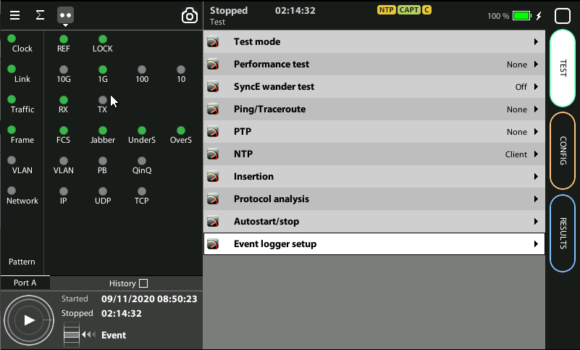
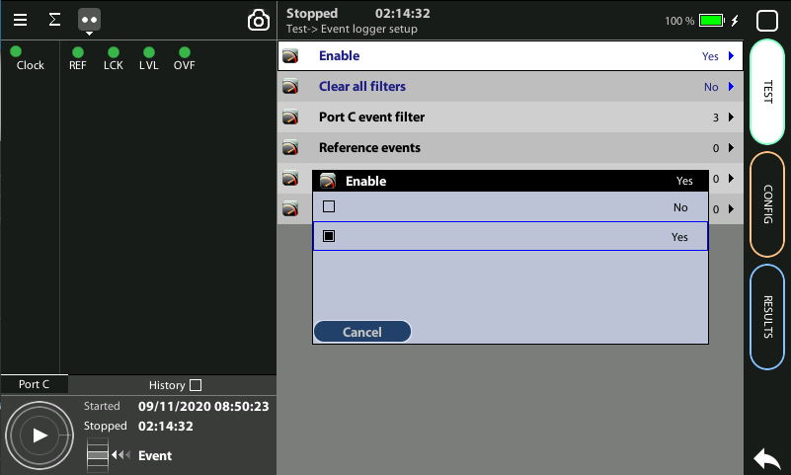
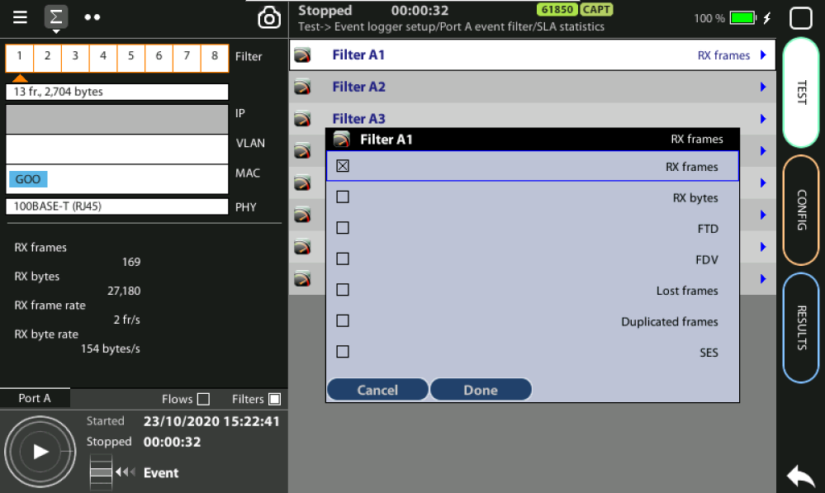
Event logger enable
1
1
Global counts, statistics and LEDs provide information about which events and how many of them have been registered but they do not say too much about how they are distributed in time. These information is supplied at the Event Logger a graphical representation tool that permits to trace the evolution of key parameters.
The first thing to to is to enable it:
Go to Home > Test > Event logger setup
Set Enable := Yes

Slide 15
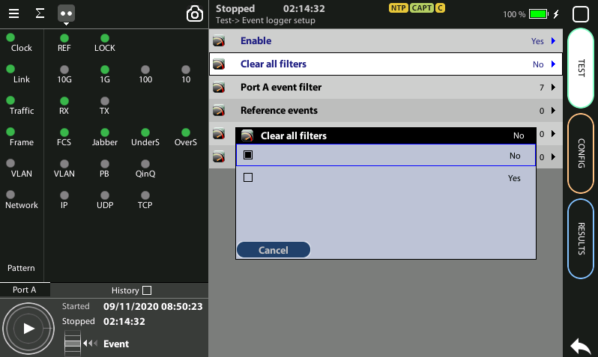
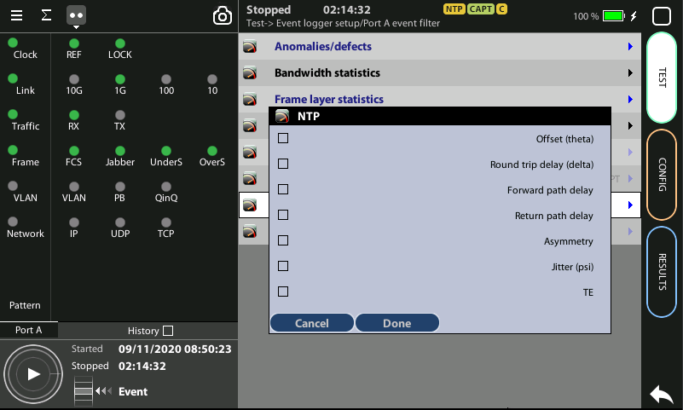
Configuring the Event Logger
2
1
3
4
Traceable Events are categorized in different classes. Moreover, each test port has its own traceable events. These events may be different for each test port.
Clear the currently selected filters: Clear all filters := Yes
Select the Port A or Port B
Choose the events to trace: Anomalies/defects | Bandwidth statistics | Frame layer statistics | SLA statistics | BERT | PTP | NTP | Synchronization
Press Run to begin the generation of a trace file

Slide 16
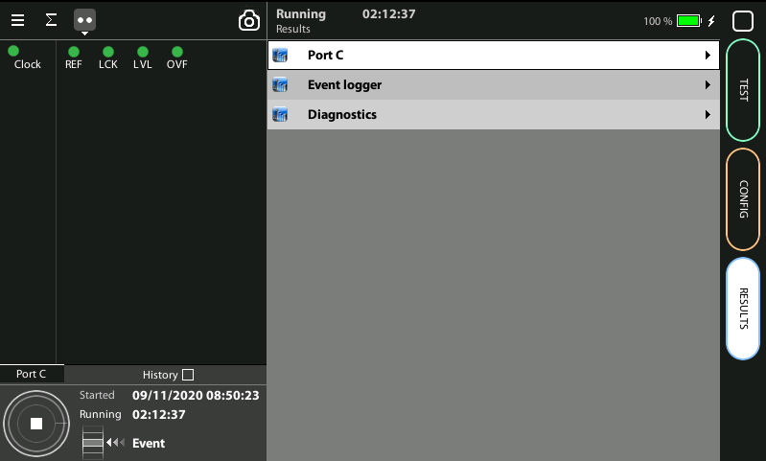
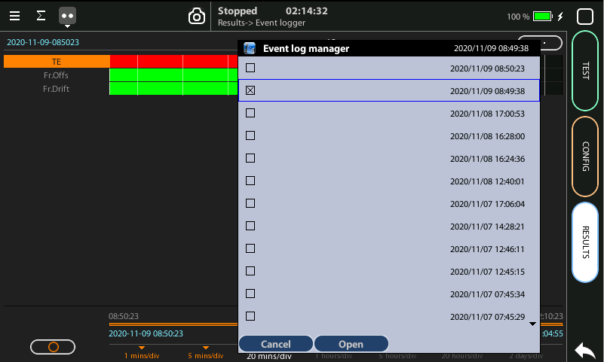
Display the logs
2
1
3
3
With the Event Logger you can select one or various events and trace them so that all changes along with the time and date these changes are registered are recorded with a 1 second resolution. The event logger provides representations and zoom levels to enable event analysis at different time scales:
Go to Results > Event logger
To select a saved trace double click at (…) to display the folder of traces
Select and Open one of the files

Slide 17
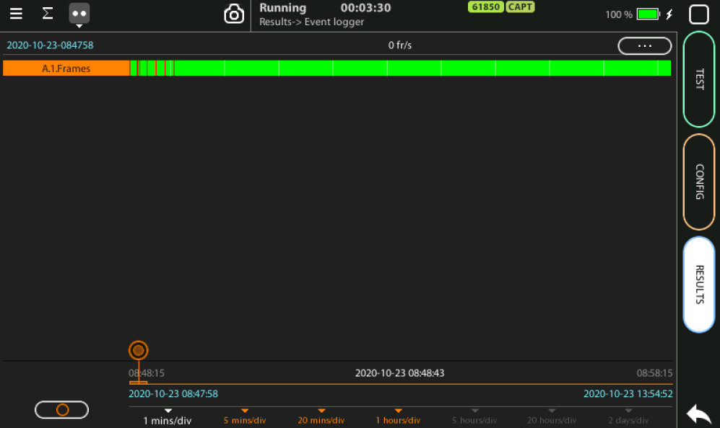
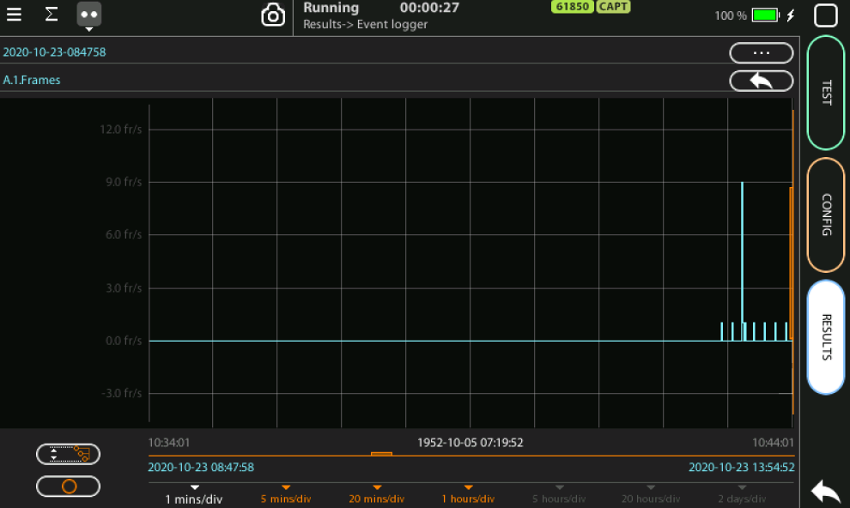
Event logger results
1
4
3
6
4
2
2
2
You can display the trace of the evolution of the previously selected parameters:
View and analyze the details of the histogram
Set the scale at your preferred zoom level
Selected the filter A1 to display a more detailed diagram about the captures
Click on the screen to know the exact value at one specific time

Slide 18
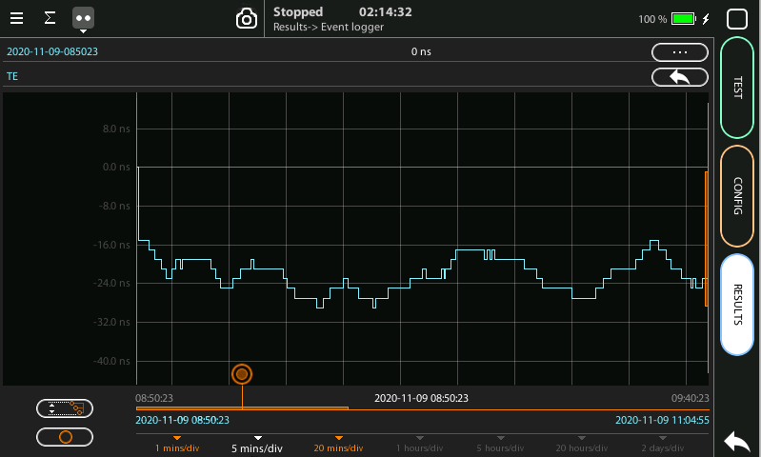
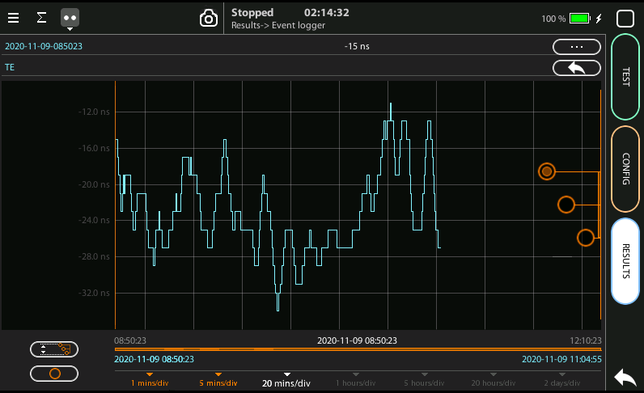
Scaling the trace
1
2
5
1
1
To change the scale horizontally click one time, for vertical two times
Click in the red button and draw to the left or to the right
To change the scale vertically click two times
To move the trace across the time click one of the three the red buttons and draw the finger up and down
Click in the auto-scale symbol to return to the initial conditions

Slide 19
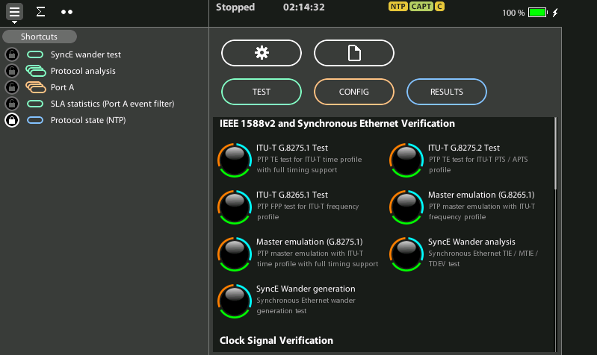
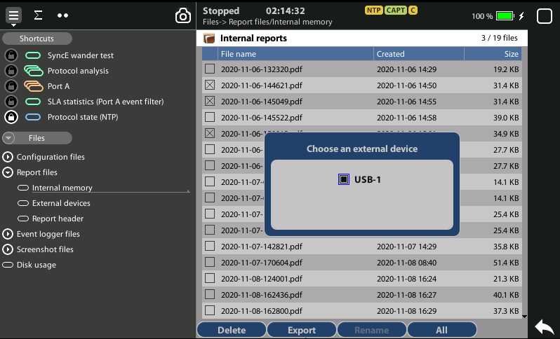
Exporting Logs
1
1
3
2
To export log files in CSV format:
Go Home > [File icon] > Configuration files | Report files > Internal memory to list the files currently stored in the unit
Select the files you want to export: File name > Export
Choose an external device: micro SD | USB
If no external device a popup will appear: ‘No devices present’

Slide 20
Glossary
AAA: Authentication, Authorization, and Accounting
ACL: Access Control List
AP: Access Point
Busbar: Metallic strip or bar, typically housed inside switchgear, panel boards, and busway enclosures for local high current power distribution C37.94: TDM interface devoted for teleprotection
CB: Circuit Breaker designed to close or open electrical circuit under normal or abnormal conditions. It operates on relays command.
CBWFQ: Class-Based Weighted Fair Queuing
CG: Connected Grid
CID: Individual configuration of each IED CIP: Critical Infrastructure Protection CLI: Command-Line Interface
CorpSS: Corporate Substation
CT: Current Transformer, used for measurement of current, if too high to apply directly to measuring instruments, a CT produces a proportional current which can be measured and recorded, CT are used in metering and protective relays
DAN: Doubly Attached Nodes implementing HSR or PRP
DAU: Data Acquisition Unit
Disconnector: isolates physically and visually the lines
DMZ: Demilitarized Zone
DCB: Directional Comparison Blocking
DCS: distributed control systems
DSC: Differentiated Services Code Point
ESP: Electronic Security Perimeter
Feeder: Transmits power to the distribution points
GM: Grandmaster
GNSS: Global Navigation Satellite System
GOOSE: Generic Object-Oriented Substation Events is a control model defined as per IEC 61850 which provides a fast and reliable mechanism of transferring event data over entire electrical substation networks. When implemented, this model ensures the same event message is received by multiple physical devices using multicast or broadcast services
HMI: Human Machine Interface
PTP: Precision Time Protocol
RedBox: Redundancy Box
Relay: is automatic device which senses an abnormal condition of electrical circuit and closes its contacts and complete the circuit breaker trip.
REP: Resilient Ethernet Protocol
RCT: Redundancy Control Trailer
RTU: Remote Terminal Unit
SA: Substation Automation
SAN: Singly-Attached Node
Secondary Lines: lower voltage side at the substation
SCADA: Supervisory Control And Data Acquisition, transmits and receives data from events of controls, measuring, safety and monitoring. Power system elements can be controlled remotely over. Remote switching, telemetering of grids showing voltage, current, power, direction, consumption in kWh, synchronization.
SCD: Substation Configuration Description SCL: Substation Configuration Language SNTP: Simple Network Time Protocol
Station Bus: Connects the entire substation and helps provide connectivity between central management and individual bays
STP: Spanning Tree Protocol
SV: Sampled Values, is a method to read instantaneous values such as currents, voltages, impedances, etc. from CTs, VTs or digital I/O and then transmitted to make them are available for those IED subscribed.
Switchgear: combination of switches, fuses or CB to control, protect and isolate electrical equipment
SyncE: Synchronous Ethernet
TLV: Type, Length, Value
VT: Voltage Transformer (see CT)Potential Transformer, gives the reference voltage to the Relay for Over-voltage or Under-voltage Protection
UCA IuG: Utility Communications Architecture International Users Group
VDAN: Virtual D
HQoS: Hierarchical Quality of Service
HSR: High-Availability Seamless Redundancy
IA: Industrial Automation
ICS: Industrial control systems
ICU: Intelligent Control Unit
IEC: International Electrotechnical Commission
IEC 61850: Standard defining communication protocols for intelligent electronic devices at electrical substations
IED: Intelligent End Device, microprocessor-based controllers of power system equipment, such as circuit breakers, transformers and capacitor banks to enable advanced power automation.
IRIG: Inter-Range Instrumentation Group
ISE: Identity Services Engine
L3VPN: Layer 3 Virtual Private Network
LA: Lightning Arrester protects the power grid from electric storms
MQC: Modular QoS Command-Line Interface
MMS: Manufacturing Message Specification, messaging system for exchanging real-time data and supervisory control information. Allows client such as SCADA, an OPC server or a gateway to access all IED objects MPLS: Multi-protocol Label Switching
MU: Merging Unit connected to the process bus converts analog data(ie. volts, currect...) into digital information
NERC: North American Electric Reliability Corporation
NIST: National Institute of Standards and Technology
NMS: Network Management System
OAM: Operations and Maintenance
PCP: Priority Code Point
PIOC: Instantaneous overcorrent Protection
PLC: Programmable Logic Controller
PMU: Phasor Measurement Unit
POTT: Permissive Overreaching Transfer Trip
PP: Primary Power
Process Bus: Connects primary units and control equipment to the IEDs
PRP: Parallel Redundancy Protocol
PRTC: Primary Reference Clock
PT: see VT
T-GM: Grand Master PTP
T-BC: Boundary Clock
T-TSC: Slave Clock

Slide 21
That’s all
www.albedotelecom.com

