Slide 1
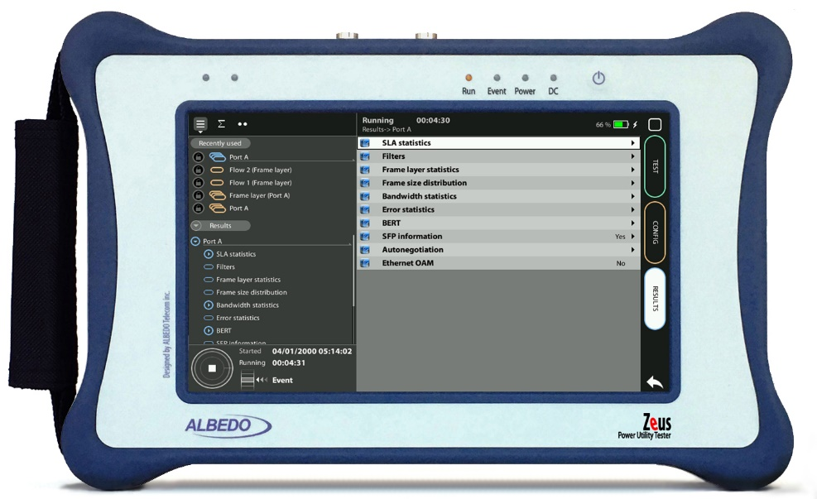
RFC 2544 test
RFC 2544 testing with xGenius
Guide & Slides corresponding to software ver. 2.10.5

Slide 2
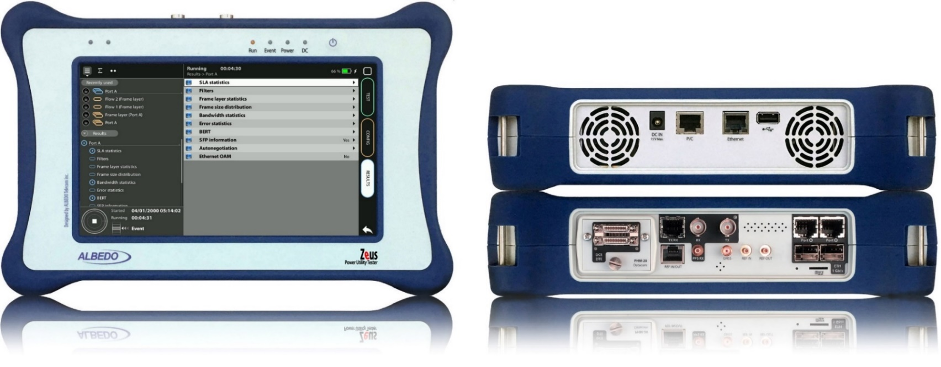
Zeus & xGenius
Zeus & xGenius provide deep insights to design, install, maintain, troubleshoot and engineer communications resources of Mobile Operators, Power Utilities, Finace, Labs and R+D centers. The unit is able to verify Ethernet/IP, SyncE, PTP, GbE, IRIG-B, 1PPS, T1/E1, G703, Serial Datacom, C37.94, GOOSE, SV, MMS, Round-trip & One-way Delay tests at all interfaces.
It also has a set of programmable filters to capture live data traffic at wire-speed

Slide 3
Interfaces & time References
PHM
RJ45-C
BNC-C
SFP+ A
SFP+ B
RJ45-A
RJ45-B
xGenius generates and analyses different kinds of 1544 kb/s and 2048 kb/s signals and also unframed 1544 / 2048 kb/s signals.
RJ45
SMB-C
SMA
SMB-1
SMB-2
SFP-A
Micro SD
SFP-B
 | GNSS | Eth/IP | PTP | NTP | ToD | IRIG-B | PPS | PP2S | SyncE | T1/E1 | MHz | Data
RJ45-A |  | in/out | in/out | in/out |  |  |  |  | in/out
RJ45-B |  | in/out |  |  |  |  |  |  | in/out
SFP-A |  | in/out | in/out | in/out |  |  |  |  | in/out
SFP-B |  | in/out |  |  |  |  |  |  | in/out
SFP+A |  | in/out | in/out | in/out |  |  |  |  | in/out
SFP+B |  | in/out |  |  |  |  |  |  | in/out
BNC-C |  |  |  |  |  |  |  |  |  | in/out | in/out
RJ45-C |  |  |  |  | in |  | in | in |  | in/out | in/out
SMB-C
SMA | in
SMB-1 |  |  |  |  |  | in | in | in
SMB-2 |  |  |  |  |  | out | out | out
RJ-45 |  |  |  |  | in/out | in/out | in/out | in/out |  | in/out | in/out
PHM |  |  |  |  |  |  |  |  |  |  |  | in/out

Slide 4
The RFC 2544
RFC 2544 describes a methodology for testing and evaluating the performance of devices such as routers, switches, and then networks. The RFC 2544 aim is to provide a standardized way to asses the performance in terms of:
Throughput: max. rate can forward traffic without errors
Latency: time for a packet to travel to the destination
Frame Loss: % of pasckets that are lost during the test
Back-to-Back: max. rate at which can receive/transmit frames without errors
These tests are designed to be repeatable and provide a common basis for comparing different devices and Ethernet networks.

Slide 5
RFC 2544 test
Using 2 testers
Test 1
Routed Network
Test 2
1
Port A
Port B
2
1000BASE-T
ALBEDO
xGenius
ALBEDO
xGenius
PHY Loop
Using 1 tester
Routed Network
1
Port A
ALBEDO
xGenius
The test described aims to teach how to set up the tester to generate and receive real traffic with specific frames, bit rates, and events. With a few changes it will be possible to evaluate other traffic parameters such as throughput, latency, frame loss rate, etc. The document also describes specific formats for tracing and reporting the results of this test.

Slide 6
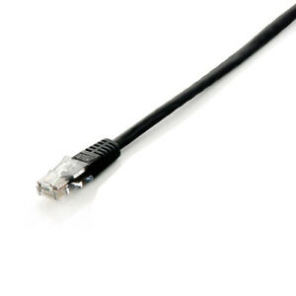
Connecting the BNC cables to Port C
1
1
xGenius Ports A and B have the connector for the RJ45 cables
xGenius also support optical media and higher bit rates but we are going to execute this test in 1000BASE-T
Connect the Cable to Port A in tester A
Connect the Cable to Port B in tester B

Slide 7
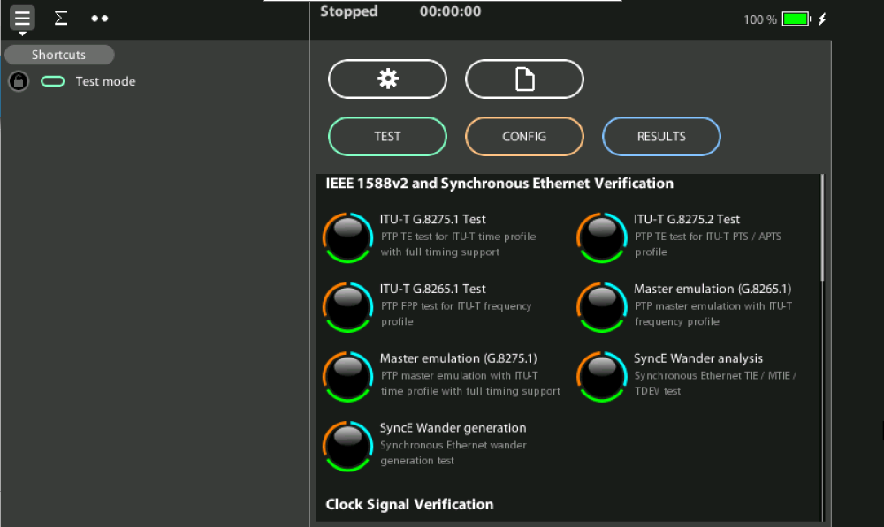
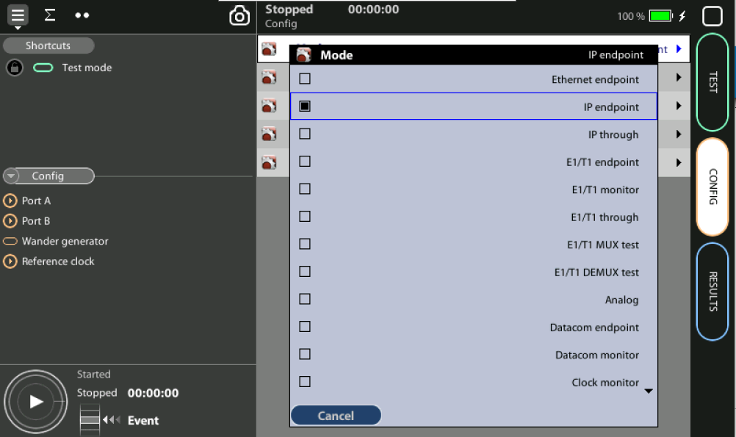
Configure the tester
1
2
Restore defaults: Home > [System] > Reset to factory settings := Yes
Set operation mode: Home > Test > Mode := Ethernet endpoint

Slide 8
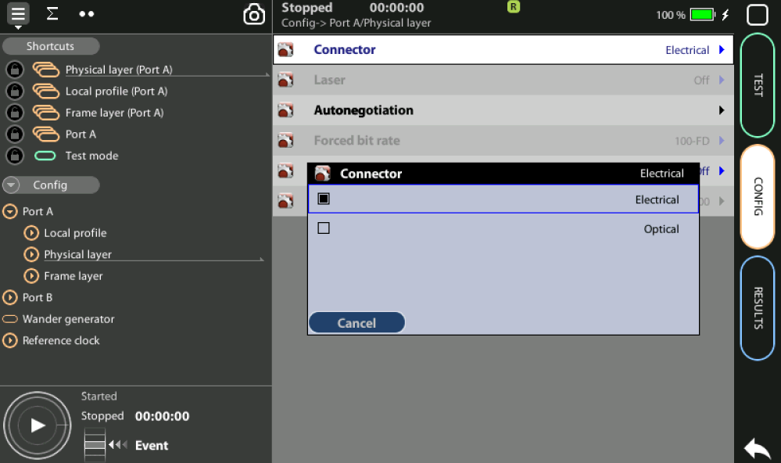
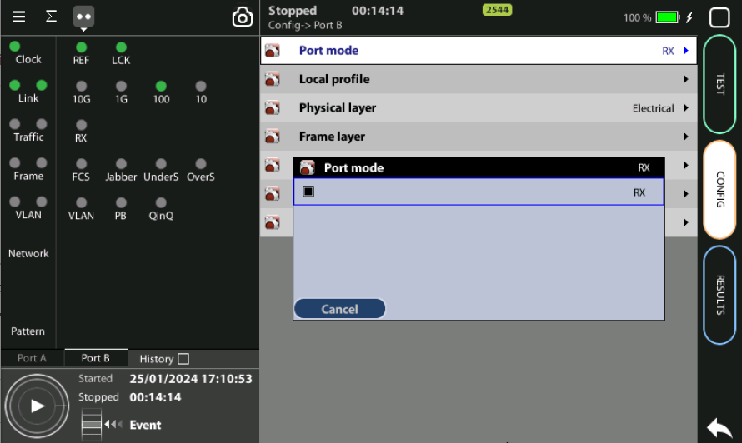
Configure the PHY layer Tester 1
1
3
Configure the Physical layer in Port A to generate traffic:
Config > Port A > Physical Layer > Connector := Electrical
Config > Port A > Port Mode := Tx/Rx
Results are in Port B in the case we use only one tester:
Config > Port B > Port Mode := Rx
(*) The RFC can also be executed with two testers

Slide 9
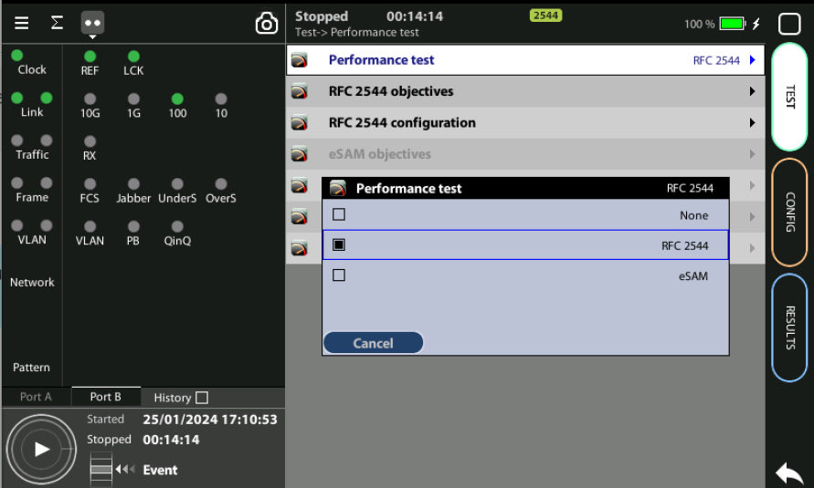
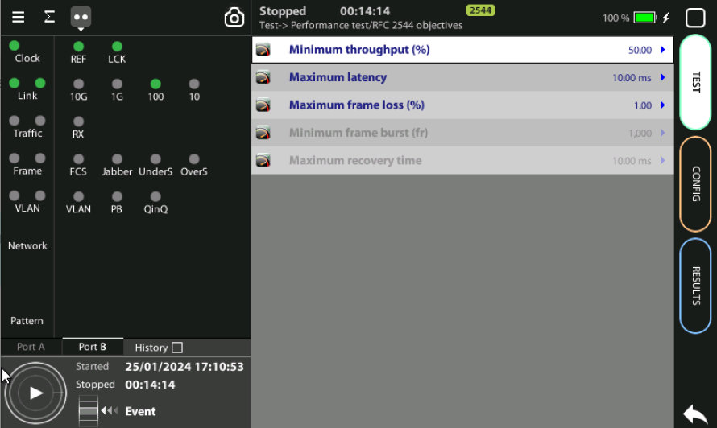
Configure the RFC
1
3
Select RFC 2544, define Objectives:
Test > Performance test := RFC 2544
Config > Port B > Port Mode := LoopBack
(*) If you want just to learn how to program you can use Port A and B of the same tester

Slide 10
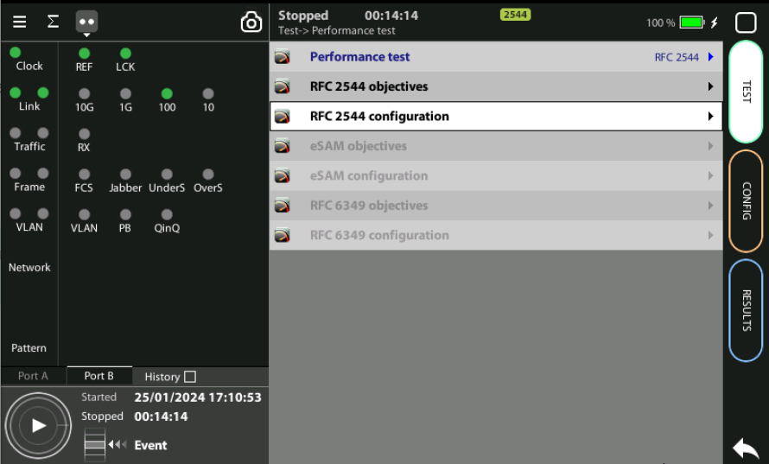
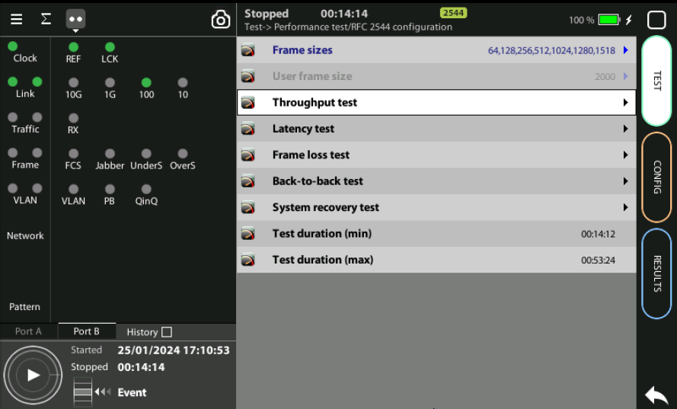
Configure the RFC 2544
1
1
1
6
2
For each separate test:
Test > Performance test > Throughput test := (setup values)
Test > Performance test > Latency test := (setup values)
Test > Performance test > Frame loss test := (setup values)
Test > Performance test > Back-to-back test := (setup values)
Test > Performance test > System recovery test := (setup values)
The unit will inform you about the duration of the RFC test

Slide 11
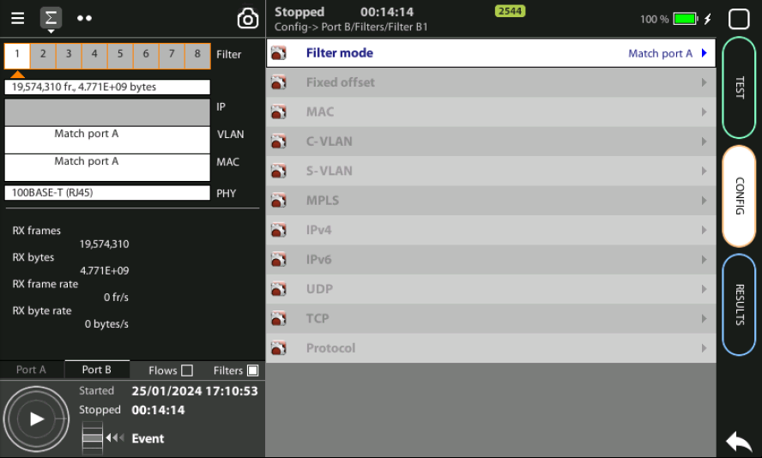
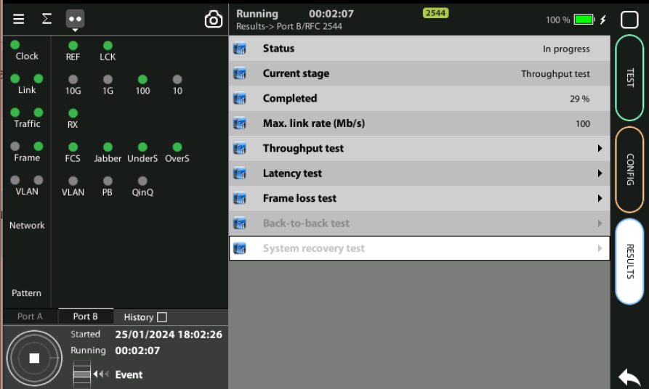
Press RUN
1
3
2
You can spot the frame and the test profile configured at Port B and the type of traffic to be generated at Port A including the flow, the Physical layer, the Ethernet frame, MAC addresses, the PRBS generated, etc.
Press RUN to activate the traffic generation
You can see the activity how the test is progressing Results > Port B > RFC2544

Slide 12
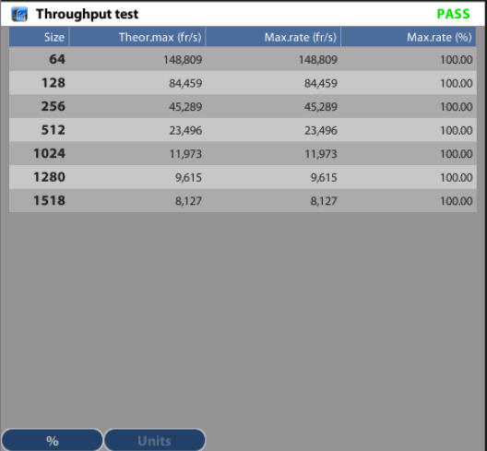
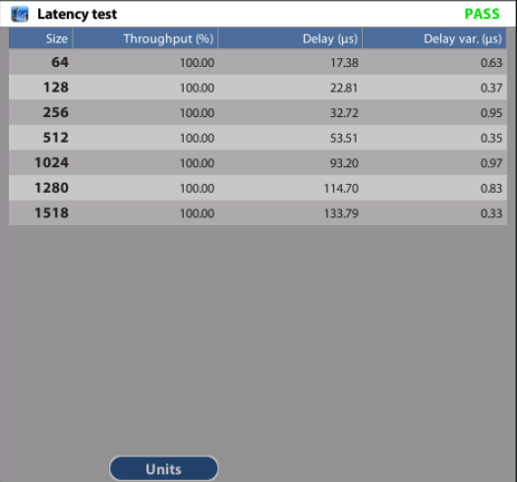
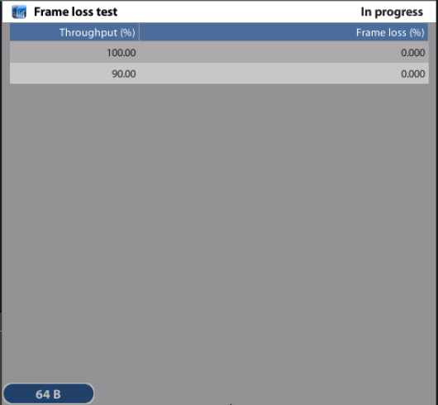
See Results
1
2
3
1
1
You can see the results separately for each test:
Results > Port B > RFC2544 > Throughput
Results > Port B > RFC2544 > Latency
Results > Port B > RFC2544 > Frame loss
Results > Port B > RFC2544 > Back-to-back
Results > Port B > RFC2544 > System recovery

Slide 13
That’s all
www.albedotelecom.com

