Slide 1
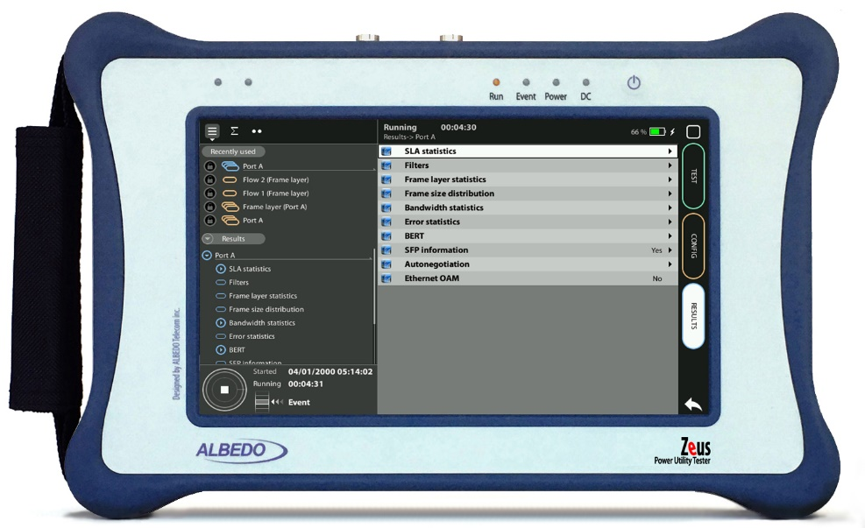
Loop Mode
Using the Traffic Reflector Guide & Slides corresponding to software ver. 2.10.5

Slide 2
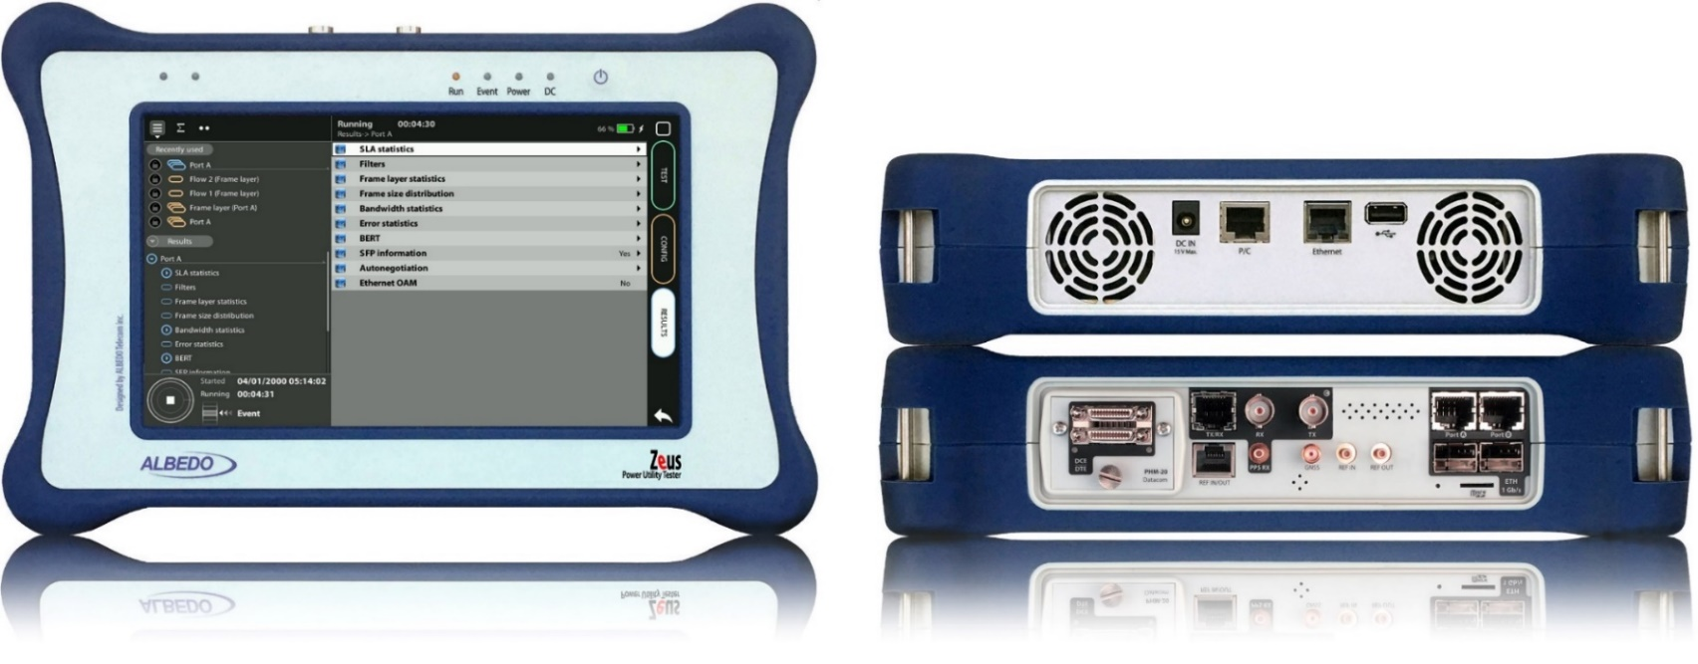
Zeus & xGenius
Zeus & xGenius provide deep insights to design, install, maintain, troubleshoot and engineer communications resources of Mobile Operators, Power Utilities, Finace, Labs and R+D centers. The unit is able to verify Ethernet/IP, SyncE, PTP, GbE, IRIG-B, 1PPS, T1/E1, G703, Serial Datacom, C37.94, GOOSE, SV, MMS, Round-trip & One-way Delay tests at all interfaces.
It also has a set of programmable filters to capture live data traffic at wire-speed

Slide 3
Loop mode
The Loop mode is a traffic reflector equipped with two independent ports that can be set up and operate independently and simultaneously. Any remote tester loopback functions can relay on this advanced device when installing, maintaining or commissioning telecom services.

Slide 4
Interfaces
BNC-C
SFP+ A
RJ45-A
PHM
RJ45-C
SFP+ B
RJ45-B
The Loop mode is a traffic reflector equipped with two independent ports that can be set up and operate independently and simultaneously. Any remote tester loopback functions can relay on this advanced device when installing, maintaining or commissioning telecom services.
RJ45
SMB-C
SMA
SMB-1
SMB-2
SFP-A
SFP-B
Micro SD
 | GNSS | Eth/IP | PTP | NTP | ToD | IRIG-B | PPS | PP2S | SyncE | T1/E1 | MHz | Data
RJ45-A |  | in/out | in/out | in/out |  |  |  |  | in/out
RJ45-B |  | in/out |  |  |  |  |  |  | in/out
SFP-A |  | in/out | in/out | in/out |  |  |  |  | in/out
SFP-B |  | in/out |  |  |  |  |  |  | in/out
SFP+A |  | in/out | in/out | in/out |  |  |  |  | in/out
SFP+B |  | in/out |  |  |  |  |  |  | in/out
BNC-C |  |  |  |  |  |  |  |  |  | in/out | in/out
RJ45-C |  |  |  |  | in |  | in | in |  | in/out | in/out
SMB-C
SMA | in
SMB-1 |  |  |  |  |  | in | in | in
SMB-2 |  |  |  |  |  | out | out | out
RJ-45 |  |  |  |  | in/out | in/out | in/out | in/out |  | in/out | in/out
PHM |  |  |  |  |  |  |  |  |  |  |  | in/out

Slide 5
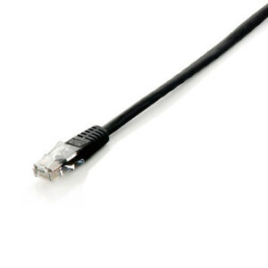
Connecting the Electrical or Optical cables
2
1
1
3
xGenius Ports A and B have the connector for the RJ45 cables and SFP for optical media. Connect the selected interface:
For electrical the Cable directly
For Optical introduce a compatible SFP into Port A*
Connect the optical cables to the SFP in Port A

Slide 6
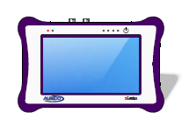
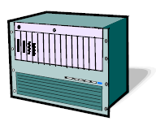
Loop-back operation
A
Eth / IP
B
Generation Analysis
Loopback
You can configure the test unit ports in loopback mode so that the traffic they receive is forwarded toward their originator. This is very useful in many test and measurement applications where the traffic generator receives the transmitted frames back and runs some kind of analysis over this traffic requiring correlation between received and transmitted frames.

Slide 7
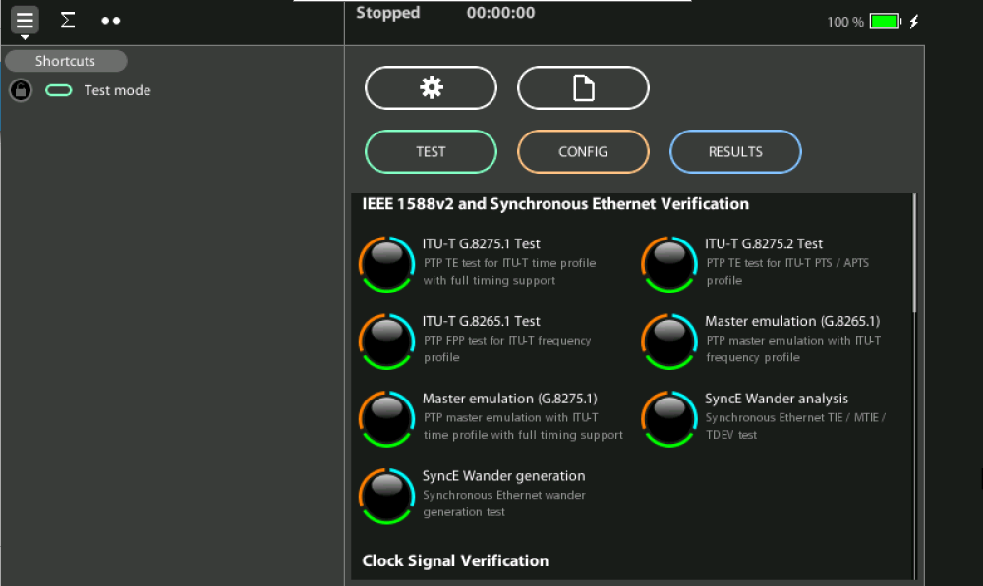
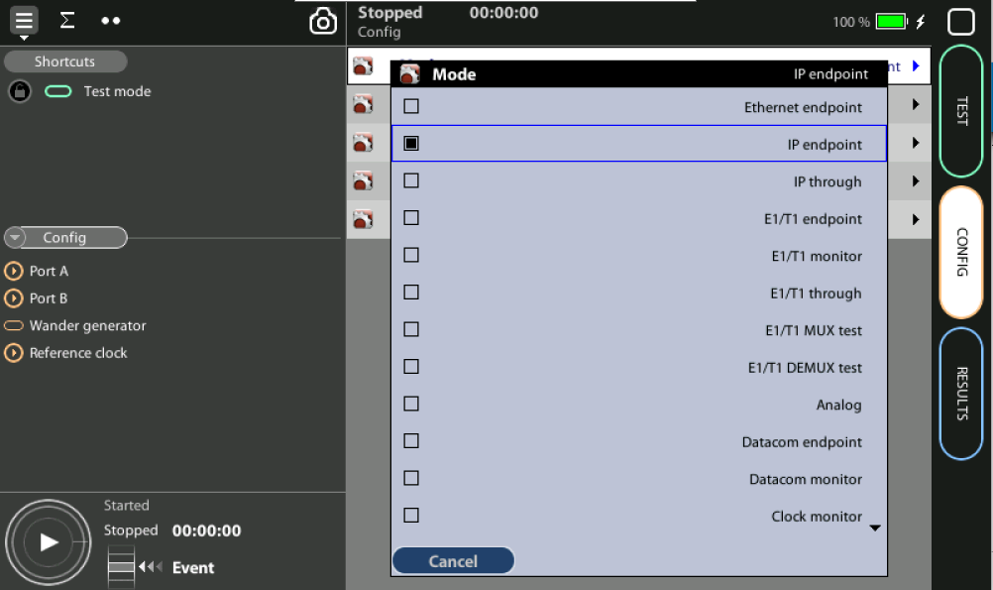
Configuring operation mode
1
1
Set operation mode: Home > Config > Mode := [Ethernet endpoint | IP endpoint | Ethernet cable test | L1 endpoint](*)(**)
(*) Some other operation modes may be available depending on the hardware /
software options available in your test unit.
(**) For layer 3 (IP) and 4 (UDP) loopback modes, choose IP endpoint mode

Slide 8
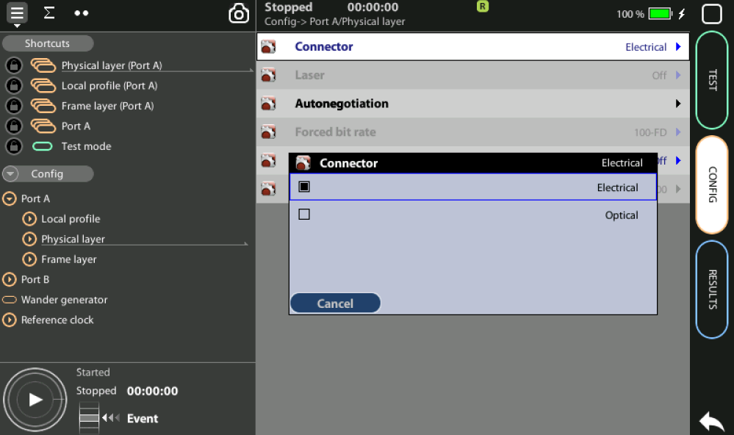
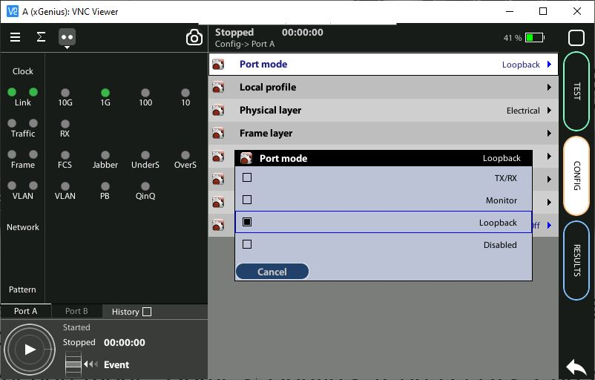
Enabling the loopback mode
1
2
Select port connector: Config > Port A | B > Physical Layer > Connector := [Electrical |Optical]
Select port mode: Home > Config > [Port A | B] > Port mode := [Loopback]

Slide 9
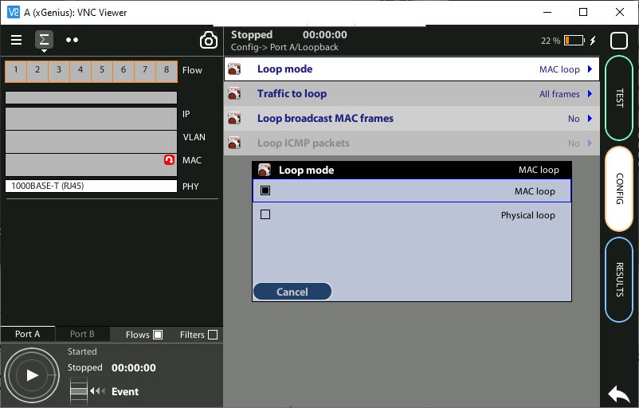
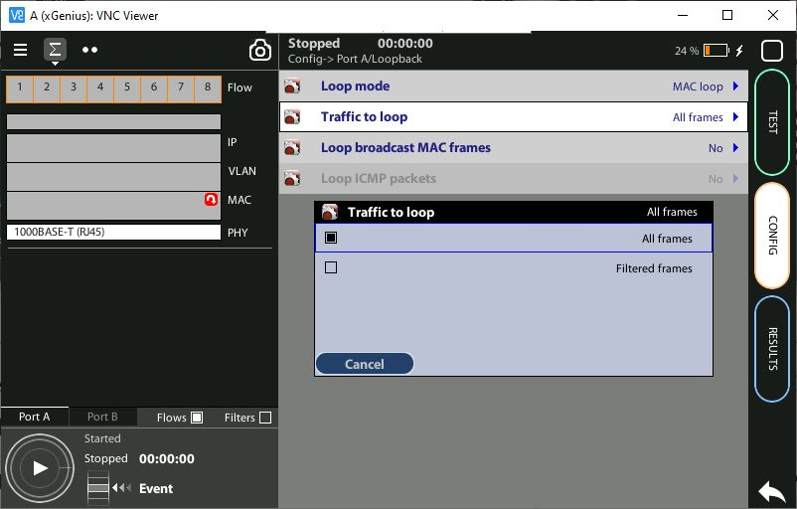
Configuring loopback settings
1
2
Select loopback mode: Config > Port A | B > Loopback> Loopback mode := [MAC loop | Physical loop]*
Choose looped traffic: Config > Port A | B > Loopback> Traffic to loop := [All frames | Filtered frames]**
(*) MAC loop mode not available when the operation mode is set to L1 endpoint
(**) Looped traffic selection is not available on the L1 endpoint operation mode

Slide 10
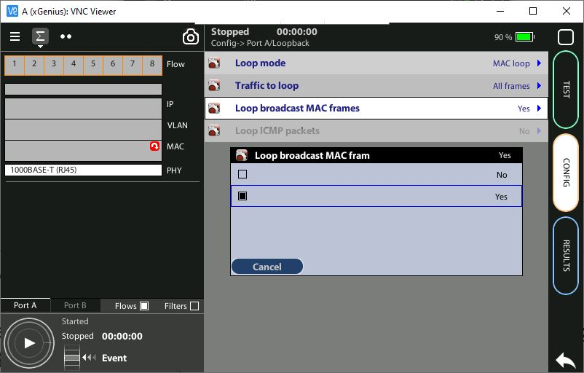
Looping broadcast MAC frames
1
To avoid Ethernet broadcast frames to proliferate and potentially flood the network, looping broadcast MAC frames is by default disabled.
To enable looping broadcast MAC frames: Config > Port A | B > Loopback> Loop broadcast MAC frames:= [Yes]*
(*) Not available when the operation mode is set to L1 endpoint

Slide 11
Looping ICMP packets
1
While a port is operating in loopback mode it still replies to network protocols like ARP or ICMP echo request (ping) but does not loop them back to avoid ICMP packet proliferation network.
To enable looping ICMP packets: Config > Port A | B > Loopback> Looping ICMP packets:= [Yes]*
(*) Only available in layer 3 (IP) and 4 (UDP) loopback mode (IP endpoint operation mode)

Slide 12
That’s all
www.albedotelecom.com

