Slide 1
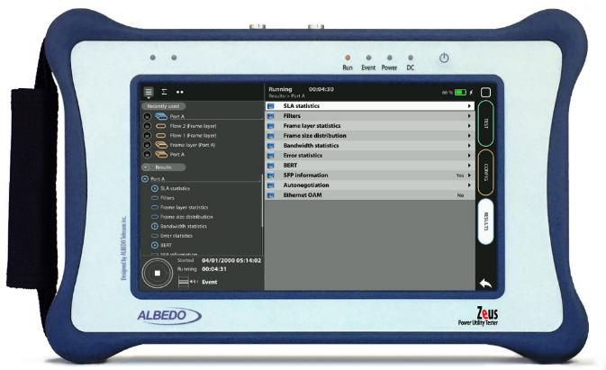
IP Traffic & Delay test
Delay and Traffic test with Zeus/xGenius
Guide & Slides corresponding to software ver. 2.10.5

Slide 2
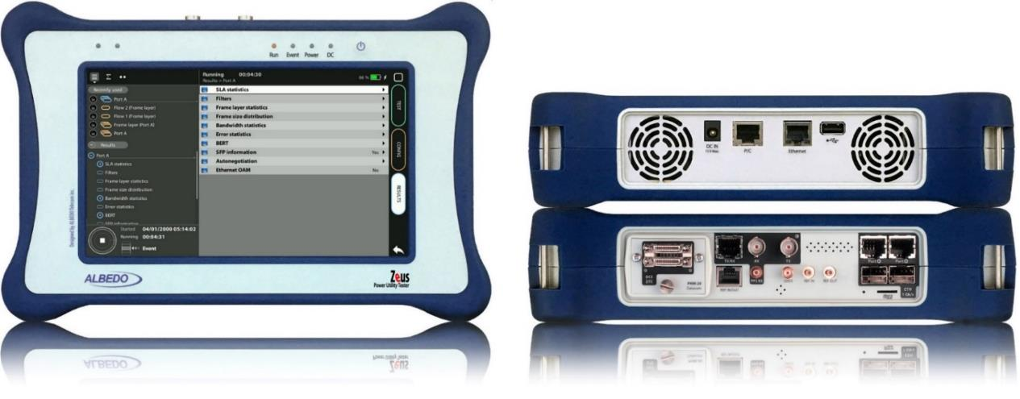
Zeus & xGenius
Zeus & xGenius provide deep insights to design, install, maintain, troubleshoot and engineer communications resources of Mobile Operators, Power Utilities, Finace, Labs and R+D centers. The unit is able to verify Ethernet/IP, SyncE, PTP, GbE, IRIG-B, 1PPS, T1/E1, G703, Serial Datacom, C37.94, GOOSE, SV, MMS, Round-trip & One-way Delay tests at all interfaces.
It also has a set of programmable filters to capture live data traffic at wire-speed

Slide 3
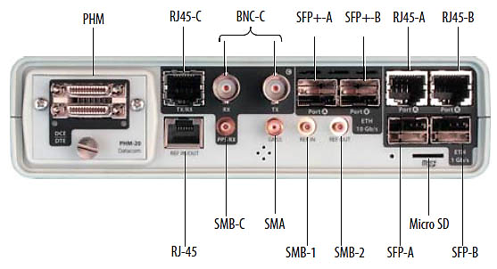
Interfaces & time References
xGenius generates and analyses different kinds of 1544 kb/s and 2048 kb/s signals and also unframed 1544 / 2048 kb/s signals.
 | GNSS | Eth/IP | PTP | NTP | ToD | IRIG-B | PPS | PP2S | SyncE | T1/E1 | MHz | Data
RJ45-A |  | in/out | in/out | in/out |  |  |  |  | in/out
RJ45-B |  | in/out |  |  |  |  |  |  | in/out
SFP-A |  | in/out | in/out | in/out |  |  |  |  | in/out
SFP-B |  | in/out |  |  |  |  |  |  | in/out
SFP+A |  | in/out | in/out | in/out |  |  |  |  | in/out
SFP+B |  | in/out |  |  |  |  |  |  | in/out
BNC-C |  |  |  |  |  |  |  |  |  | in/out | in/out
RJ45-C |  |  |  |  | in |  | in | in |  | in/out | in/out
SMB-C
SMA | in
SMB-1 |  |  |  |  |  | in | in | in
SMB-2 |  |  |  |  |  | out | out | out
RJ-45 |  |  |  |  | in/out | in/out | in/out | in/out |  | in/out | in/out
PHM |  |  |  |  |  |  |  |  |  |  |  | in/out

Slide 4
Test set-up
Using 2 testers
GNSS
GNSS
Routed Network
A
Port A
Port A
B
1000BASE-T
1000BASE-T
ALBEDO
xGenius
ALBEDO
xGenius
The objective is to set up the testers to generate and receive IP based traffic with specific frames, bit rates, and events. Using GNSS as an external reference for One Way Delay testing in both ends.

Slide 5
Configuration steps
Connecting to GNSS interface
Configuring GNSS properties
Positioning Averaging time
Activating Holdover mode (in case of lacking GPS coverage)
Connecting the tester
Configuring the tester
Configuring traffic profile
Enabling Event logger
Generating report file
Running the test
Viewing results
Displaying the Event logger
Exporting Logs
Exporting Reports

Slide 6
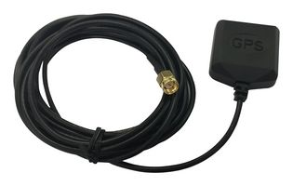
Connecting the GPS
1
Zeus / xGenius are equipped with a built-in GNSS receiver. Proceed to connect all the elements:
Connect the cable to the SMA and orient the antenna oriented to open sky
Repeat the same operation in Tester B

Slide 7
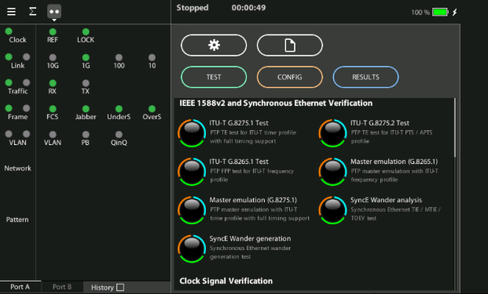
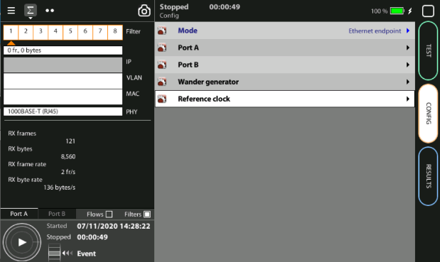
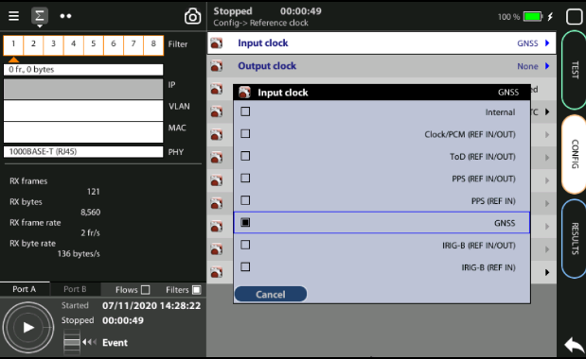
Configuring GNSS properties
3
2
1
1
Home > Config > Reference clock > Input clock := GNSS (*)
Press LEDS to check the status
Wait for the REF and LOCK LEDs to become green
(*) Go to Home panel, go to Config, the port setup will be displayed then Go to Reference clock and configure Input clock to GNSS.

Slide 8
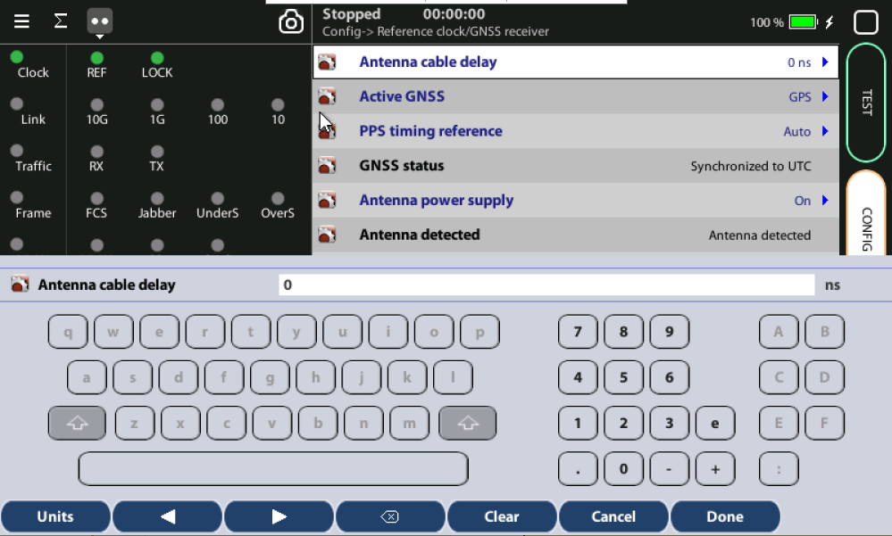
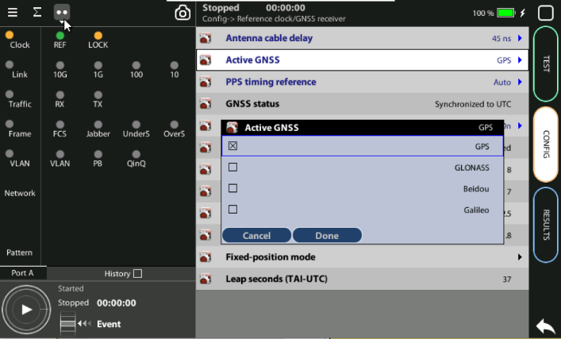
Configuring GNSS properties
2
1
Configure the GNSS to increase the accuracy:
Config > Reference clock > GNSS receiver > Antenna cable delay to configure a compensation at the correction field
In the same screen Enable/Disable any constellation (GPS, GLONASS, GALILEO, BEIDO) through the Active GNSS setting := GPS…

Slide 9
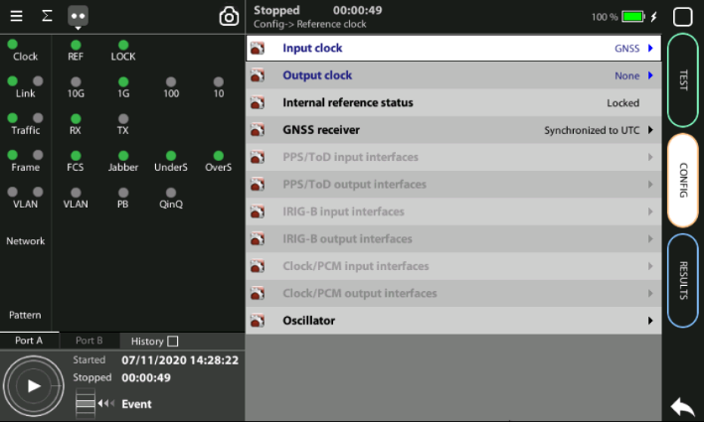
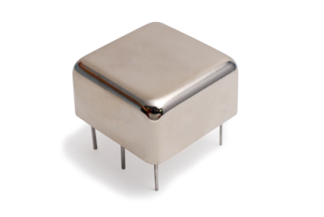
OCXO or Rubidium
1
The unit will be ready for testing LOCK LED is green
Mind that time is different depending which oscillator xGenius is equipped
Current locking status (Locking, Fine locking, Locked, Holdover, etc.) can be checked in the Reference clock menu.
Metric | OCXO | Rubidium
Locking time | < 5 minutes | < 4 hours

Slide 10
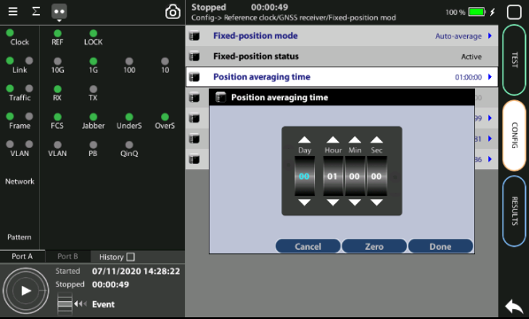
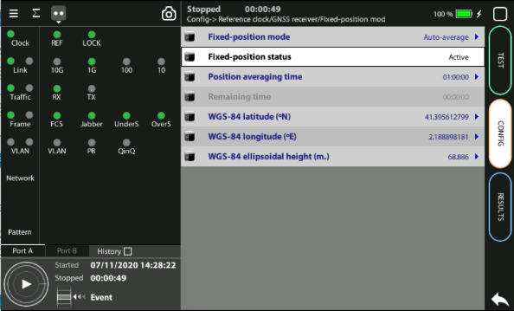
Positioning Averaging time
GPS has a statistical distribution and averaging for a time filters errors to improve accuracy.
Adjust the Position averaging time and by configuring Auto‐average in the that now displays Averaging
Wait to the Fixed position status to become Active. The unit is now ready for testing.
Note: Theoretically, testing could start before the end of the position averaging process. The improved time estimation due to this function would be automatically applied starting from the end of the auto‐averaging process.
1
Notes: (a) At least 1h of averaging is required for reasonable accuracy. (b) The procedure should be run only once as long as the location does not change. If any change is detected (longitude, latitude, altitude) an error will be displayed.
2

Slide 11
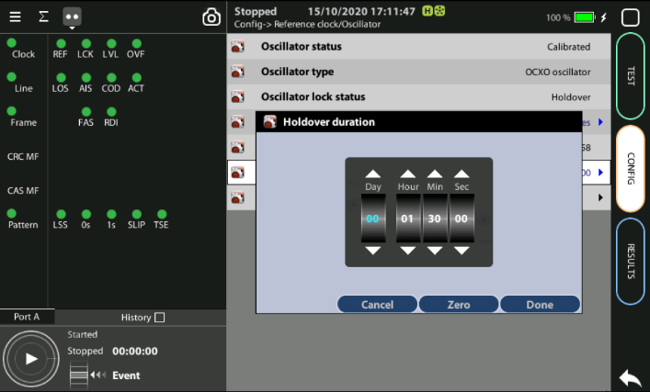
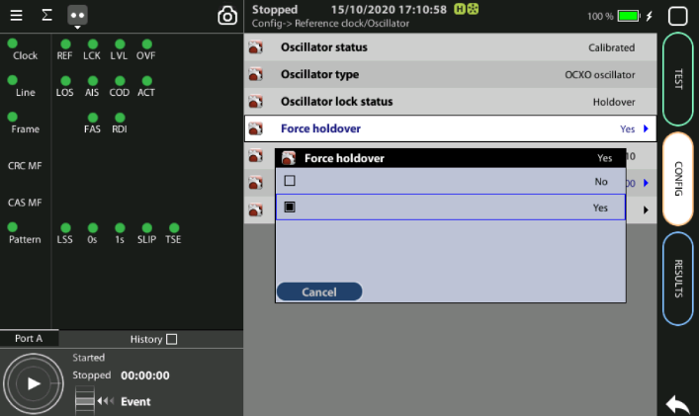
Activating Holdover mode
1
3
2
When GPS is not available (i.e. a room without windows) you can first synchronize the unit in a place with GPS and then go to execute the test in holdover mode.
Accuracy will depend on: (a) the quality of the internal oscillator (Quartz, OCXO, Rubidium); and (b) the holdover period.
Synchronize to GPS and and verify that LED Clock, REF and LOCK are green
Config > Reference clock > Holdover duration := set the time you need for testing
Config > Reference clock > Force holdover := Yes (can be forced only if LCK is green)

Slide 12
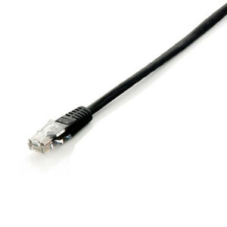
Connecting the tester
1
1
xGenius Ports A and B have the connector for the RJ45 cables
xGenius also support optical media and higher bit rates but we are going to execute this test in 1000BASE-T
Connect the Cable to Port A in both testers A and B

Slide 13
Configuring the tester
video
Configurations apply the same way for both testers:
Set operation mode: Home > Config > Mode := IP endpoint
Select Port A > Port Mode := Tx/Rx
From Local profile> configure IP properties manually or using DHCP
From Physical Layer > Connector := Electrical

Slide 14
Configuring Traffic Profile
video
The tester can generate up to 8 traffic flows simultaneously, set up the 1st one:
Config > Port A > Network layer > Flow A1 > Dest IPV4 addr from := Manual
From Destination IPV4 address := insert Tester B address
Go to Config > Port A > Bandwidth profile > Flow A1 := Continuous

Slide 15
Configuring Traffic Profile
video
Configure the bandwidth parameters: Config > Port A > Bandwidth profile > Flow A1 > Transmission rate > [Rate fr/s | Rate (Mb/s) | Rate (%) …]
Choose a payload for instance as SLA: Config > Port A > Payload type := SLA
Repeat the same for Tester B

Slide 16
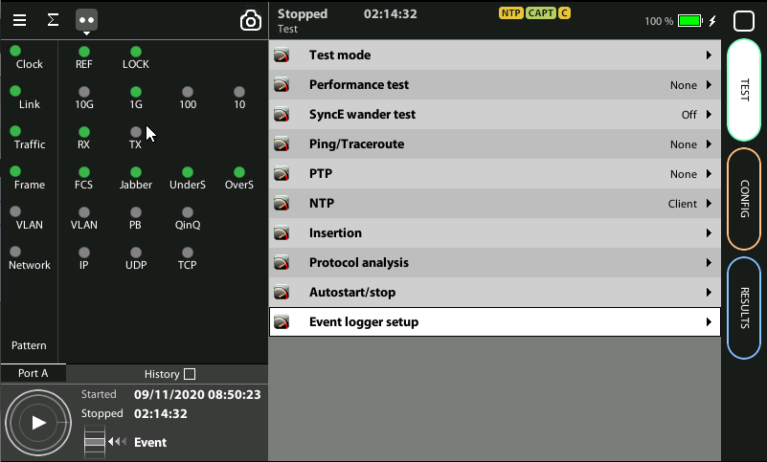
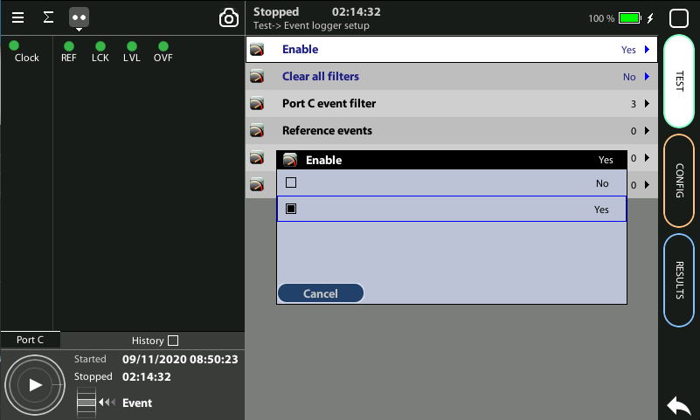
Enabling Event logger
1
1
Global counts, statistics and LEDs provide information about which events and how many of them have been registered but they do not say too much about how they are distributed in time. These information is supplied at the Event Logger a graphical representation tool that permits to trace the evolution of key parameters.
The first thing to to is to enable it:
Go to Home > Test > Event logger setup
Set Enable := Yes

Slide 17
Configuring the Event Logger
video
Traceable Events are categorized in different classes. Moreover, each test port has its own traceable events. These events may be different for each test port.
From Event logger setup > Clear all filters := Yes
Select the events: Port A event filter > SLA statistics > Filter A := FTD / FDV …
Choose any other events to trace
Repeat the same for Tester B

Slide 18
Generating report file
video
To generate report for the test result, follow these steps:
From the Home > Files := Report files
Click on Generate report := Yes

Slide 19
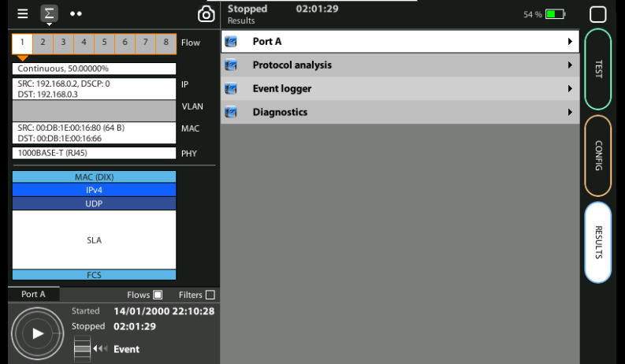
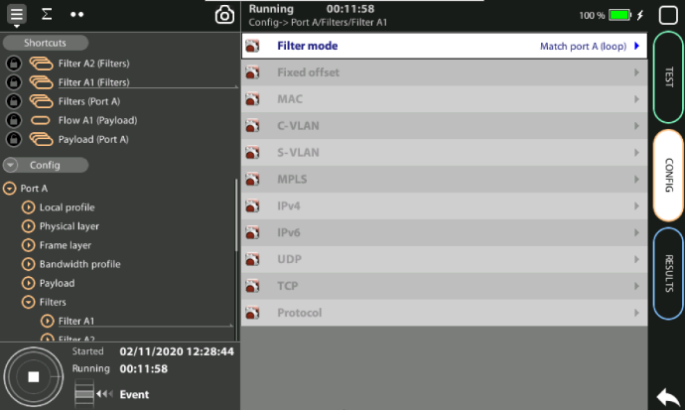
Running the test
1
2
The test is now ready to start
You can spot the frame and the test profile configured at Filter A1 including the type of traffic to be generated at Port A including the flow, the Physical layer, the Ethernet frame, MAC addresses, the SLA generated, etc.
Press RUN in both testers to activate the traffic generation

Slide 20
Viewing results
video
You can see now Traffic TX/RX LED indication becomes green, to see results:
Click on Results > Port A := SLA statistics
Click on Delay statistics > Delay (FTD) and variation (FDV) results are shown
You can spot other results for instance some statistics regarding traffic: Results > Port A > Bandwidth statistics := General statistics
Go back to Results menu to view more result information

Slide 21
Displaying the Event logger
video
With the Event Logger you can select one or various events and trace them so that all changes along with the time and date these changes are registered are recorded with a 1 second resolution. The event logger provides representations and zoom levels to enable event analysis at different time scales:
Go to Results > Event logger
Select the currently running test log from (…) highlighted by red color
Click on the event to be traced

Slide 22
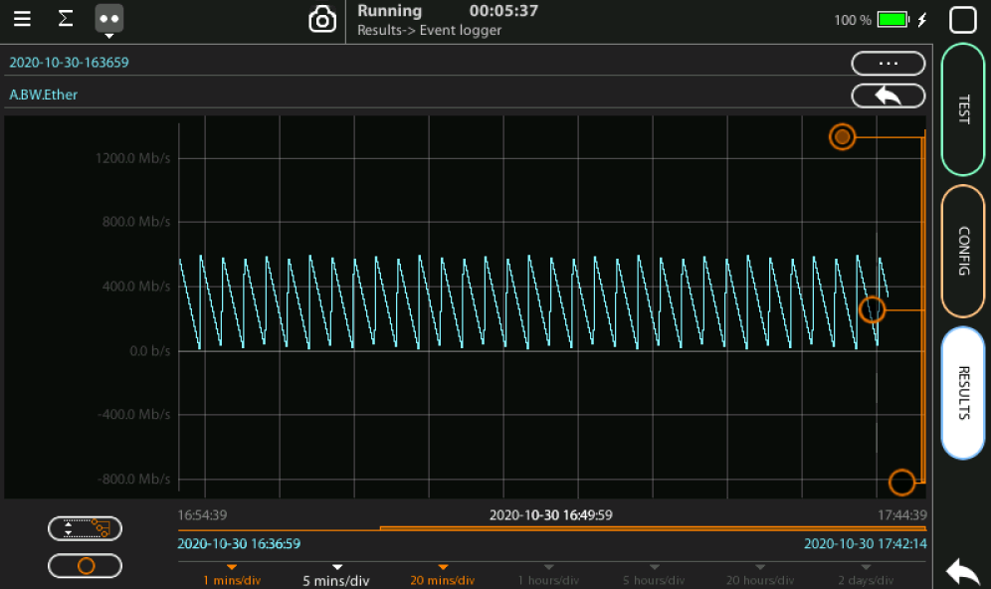
Scale the results on screen
2
3
1
You can change the scale to see in more details the results
Using the auxiliary bars change the vertical scale
Reset to the original scale

Slide 23
Exporting Logs
video
To export log files in CSV format:
Go Files > Event logger files > Internal memory to list files stored in the unit
Select the files you want to export: File name > Export
Choose an external device: micro SD | USB
If no external device a popup will appear: ‘No devices present’

Slide 24
Exporting Reports
video
To export reports in PDF format:
From Files > Report files > Internal memory to list files stored in the unit
Select the files you want to export: File name > Export
Choose an external device: micro SD | USB
If no external device a popup will appear: ‘No devices present’

Slide 25
That’s all
www.albedotelecom.com

