Slide 1
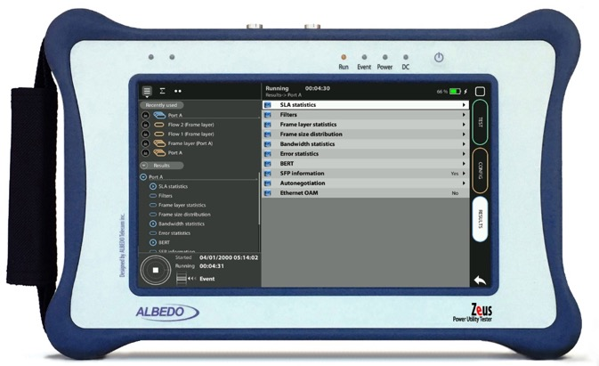

Datacom Endpoint
with xGenius/Zeus
Guide & Slides corresponding to software ver. 2.6.1/1.4.1

Slide 2
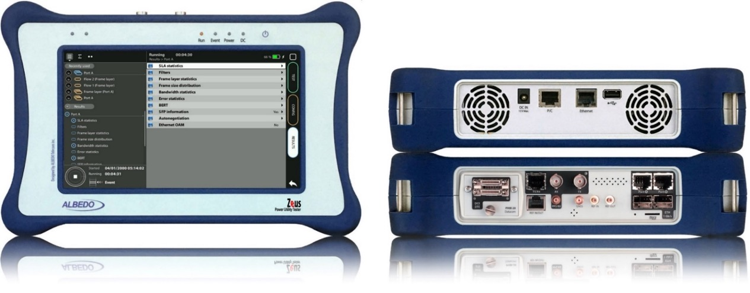
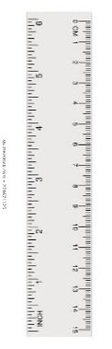
Zeus & xGenius
Zeus & xGenius provide deep insights to design, install, maintain, troubleshoot and engineer communications resources of Mobile Operators, Power Utilities, Finance, Labs and R+D centres. The unit is able to verify Ethernet/IP, SyncE, PTP, GbE, IRIG-B, 1PPS, T1/E1, G703, Serial Datacom, C37.94, GOOSE, SV, MMS, Round-trip & One-way Delay tests at all interfaces.
It also has a set of programmable filters to capture live data traffic at wire-speed

Slide 3
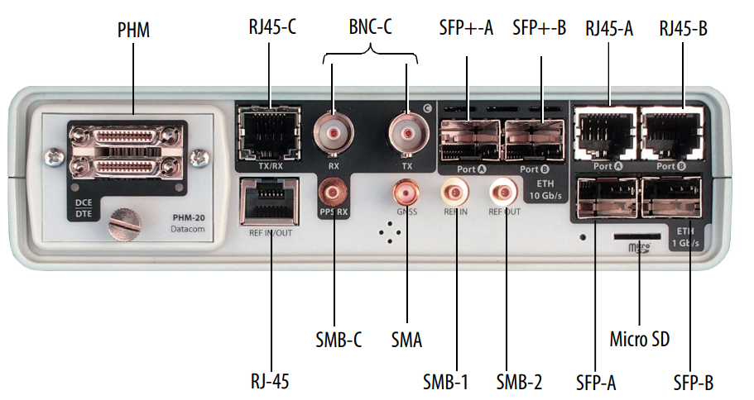
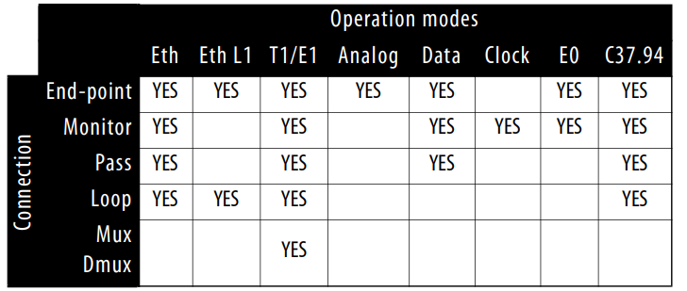
Datacom: Interfaces & time References
  Operation Modes
  Endpoint: Emulation of a data communications DTE or DCE.
  Monitor: Transparent, passive monitoring of a DTE to DCE connection

Slide 4
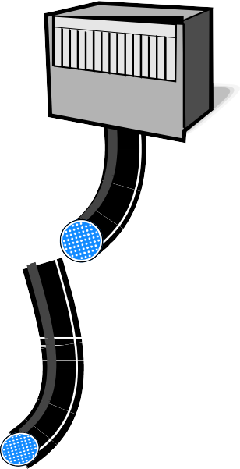



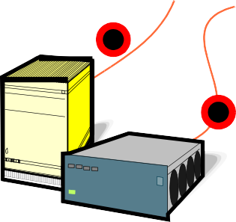


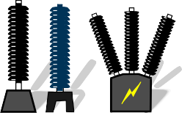

Test Serial intefaces in Legacy Substations
MMI, Control Board
Station
What to Test
V.24 / V.28 asynchronous from 50 b/s to 128 kb/s
V.24 / V.28 synchronous from 50 b/s to 128 kb/s
X.21 / V.11 asynchronous from 50 b/s to 128 kb/s
X.21 / V.11 synchronous from 50 b/s to 10 MHz
V.35 from 50 b/s to 10 MHz
V.36 (RS-449) from 50 b/s to 10 MHz
EIA-530 from 50 b/s to 10 MHz
EIA-530A 50 b/s to 10 MHz. RS-232, RS-422, V.35, V.36
Objectives
Installation & maintenance of:
  Serial communications
  Timing quality
  Voice circuits
Copper
Control
Bay
Timing
Hardwired Protection Relay
IRIG-B
Process
Copper
Testing
Points
VT CT
Metering
Switch Gear

Slide 5
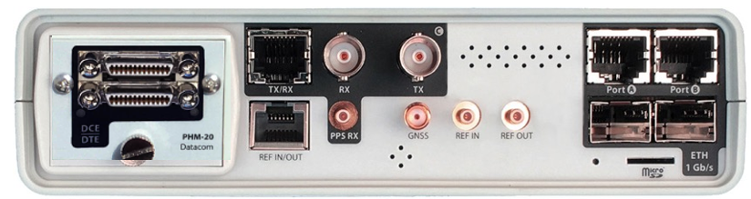

Connecting to the Serial interfaces
1
Serial Data Communication cables and interfaces
The PHM-20 provides access to the datacom modes in xGenius / Zeus. Specifically, it enables users to configure the Datacom endpoint and Datacom monitor operation modes.
Supported data communication interfaces are X21 / V11 / RS-422, V.24 / RS-232, V35, V.36 / RS-449, EIA-530 / RS-530 and EIA-530A / RS-530A. Interconnection between an xGenius / Zeus equipped with the PHM-20 module and the DUT requires one of the datacom cables designed for each different interface. Datacom cables are also different it the unit is going to run a test in DCE emulation mode (female port) or DTE emulation (male port).

Slide 6
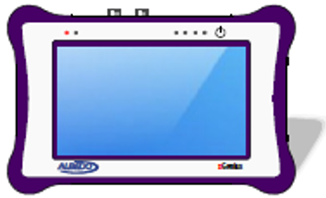

Hands-on End-Point test
DCE
Datacom
DTE
DTE
Datacom
DCE
xGenius / Zeus has two data communications operation modes.
  Datacom endpoint is used for DTE and DCE emulation. Some capabilities of the Datacom endpoint mode are BER / Performance tests over datacom interfaces and logic analysis of datacom signals.
  Datacom monitor mode enables analysis of datacom signals between the DTE and DCE without disturbing them.

Slide 7
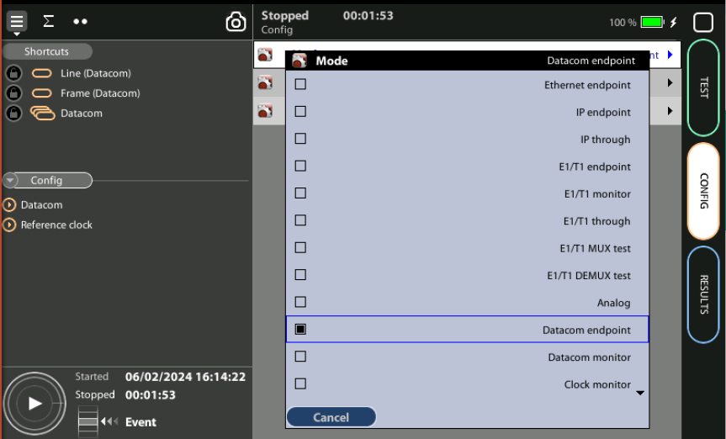
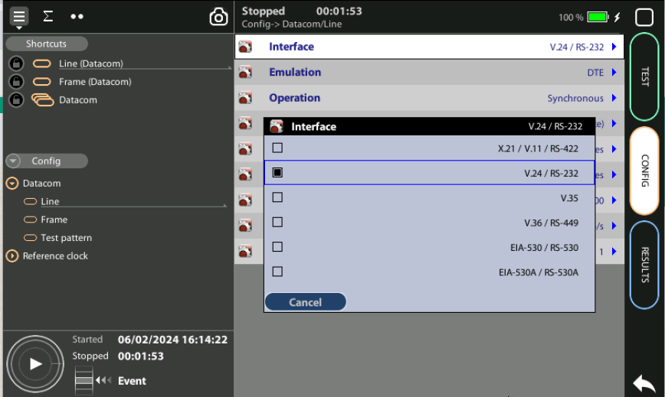
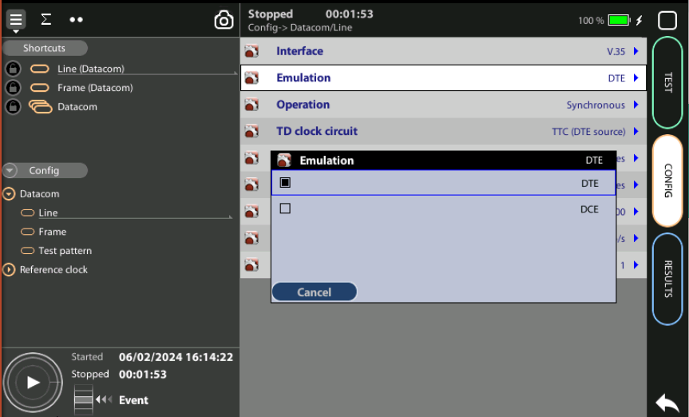
Select + Configure Datacom
1
1
2
1
3
1
Configure a datacom interface, the interface, DTE / DCE, Operation, etc. :
Go to Home > Config > Mode := Datacom endpoint
Config > Datacom > Line := V.24 / RS 232
Config > Datacom > Line > Emulation := DTE
Config > Datacom > Line > Operation := Synchronous
Config > Datacom > Line > TD Clock circuit := DTE
Config > Datacom > Line > Emulation := DTE

Slide 8

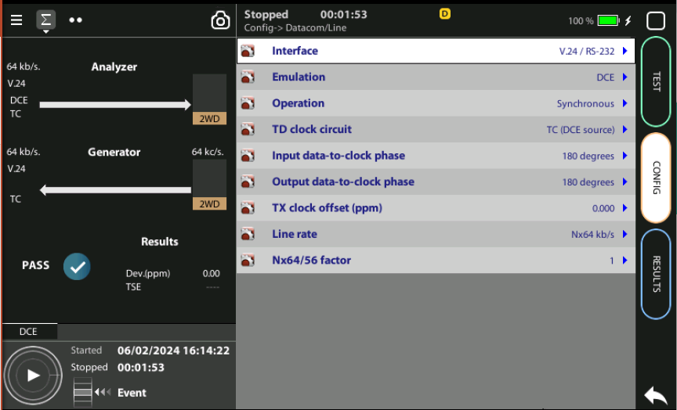
Configure ALL parameters
2
1
2
1
1
1
1
1
1
1
Configure all Datacom parameters :
Emulation, Operation, TD clock circuit, Input data-to-clock phase, etc.
Verify the configuration

Slide 9
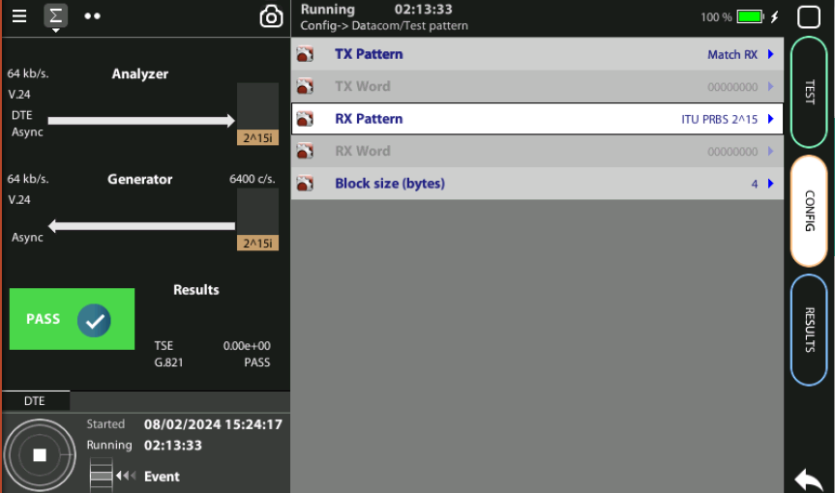
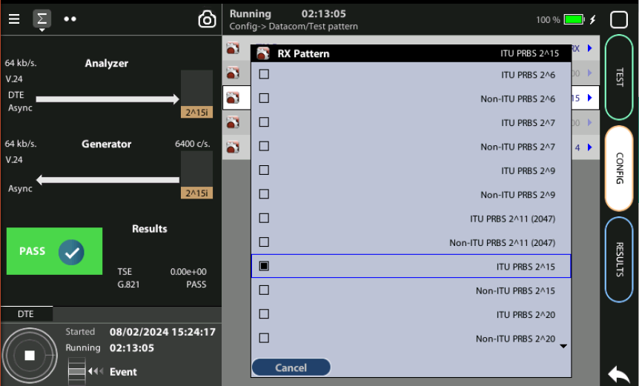
Test Pattern
1
2
2
Some datacom tests like the datacom BER and the datacom ITU-T G.821 require a test pattern. Select the one you need
Config > Datacom > Test pattern > Tx := Match Rx
Config > Datacom > Test pattern > Rx := ITU PRBS…

Slide 10
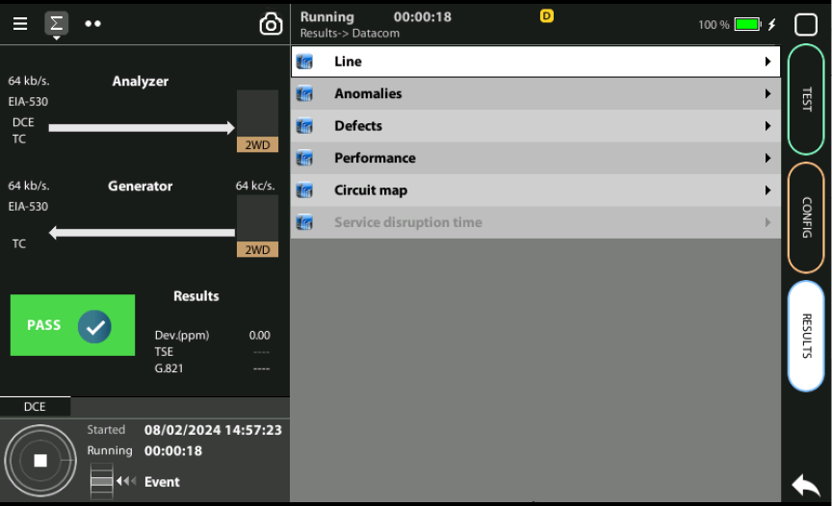
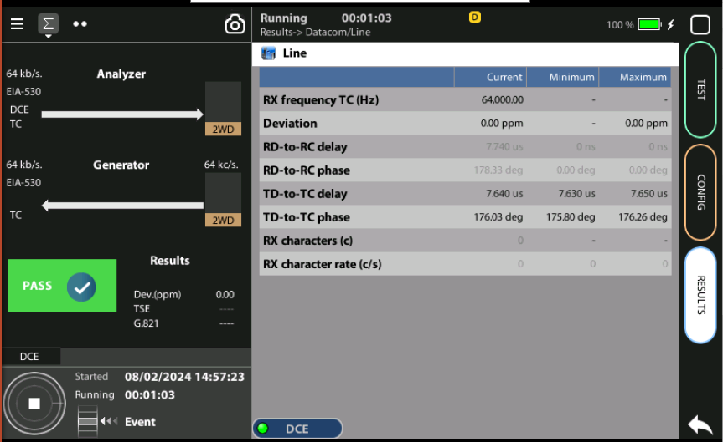
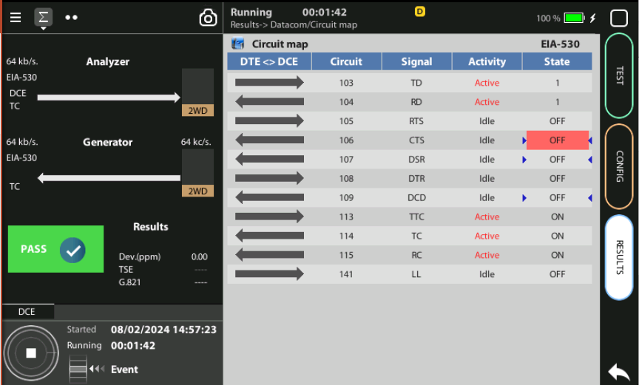
Display de Results
1
2
3
1
1
Press RUN and see the result after the test execution
Results > Datacom > Line
Results > Datacom > Circuitmap

Slide 11
Glossary
AAA: Authentication, Authorization, and Accounting
ACL: Access Control List
ACT: Activity alarm when no data is detected in transmission
AP: Access Point
Busbar: Metallic strip or bar, typically housed inside switchgear, panel boards, and busway enclosures for local high current power distribution C37.94: TDM interface devoted for teleprotection
CB: Circuit Breaker designed to close or open electrical circuit under normal or abnormal conditions. It operates on relays command.
CBWFQ: Class-Based Weighted Fair Queuing
CG: Connected Grid
CID: Individual configuration of each IED CIP: Critical Infrastructure Protection CLI: Command-Line Interface
CorpSS: Corporate Substation
CT: Current Transformer, used for measurement of current, if too high to apply directly to measuring instruments, a CT produces a proportional current which can be measured and recorded, CT are used in metering and protective relays
DAN: Doubly Attached Nodes implementing HSR or PRP
DAU: Data Acquisition Unit
Disconnector: isolates physically and visually the lines
DMZ: Demilitarized Zone
DCB: Directional Comparison Blocking
DCS: distributed control systems
DSC: Differentiated Services Code Point
ESP: Electronic Security Perimeter
Feeder: Transmits power to the distribution points
GM: Grandmaster
GNSS: Global Navigation Satellite System
GOOSE: Generic Object-Oriented Substation Events is a control model defined as per IEC 61850 which provides a fast and reliable mechanism of transferring event data over entire electrical substation networks. When implemented, this model ensures the same event message is received by multiple physical devices using multicast or broadcast services
HMI: Human Machine Interface
PTP: Precision Time Protocol
RedBox: Redundancy Box
Relay: is automatic device which senses an abnormal condition of electrical circuit and closes its contacts and complete the circuit breaker trip.
REP: Resilient Ethernet Protocol
RCT: Redundancy Control Trailer
RTU: Remote Terminal Unit
SA: Substation Automation
SAN: Singly-Attached Node
Secondary Lines: lower voltage side at the substation
SCADA: Supervisory Control And Data Acquisition, transmits and receives data from events of controls, measuring, safety and monitoring. Power system elements can be controlled remotely over. Remote switching, telemetering of grids showing voltage, current, power, direction, consumption in kWh, synchronization.
SCD: Substation Configuration Description SCL: Substation Configuration Language SNTP: Simple Network Time Protocol
Station Bus: Connects the entire substation and helps provide connectivity between central management and individual bays
STP: Spanning Tree Protocol
SV: Sampled Values, is a method to read instantaneous values such as currents, voltages, impedances, etc. from CTs, VTs or digital I/O and then transmitted to make them are available for those IED subscribed.
Switchgear: combination of switches, fuses or CB to control, protect and isolate electrical equipment
SyncE: Synchronous Ethernet
TLV: Type, Length, Value
VT: Voltage Transformer (see CT)Potential Transformer, gives the reference voltage to the Relay for Over-voltage or Under-voltage Protection
UCA IuG: Utility Communications Architecture International Users Group
VDAN: Virtual D
HQoS: Hierarchical Quality of Service
HSR: High-Availability Seamless Redundancy
IA: Industrial Automation
ICS: Industrial control systems
ICU: Intelligent Control Unit
IEC: International Electrotechnical Commission
IEC 61850: Standard defining communication protocols for intelligent electronic devices at electrical substations
IED: Intelligent End Device, microprocessor-based controllers of power system equipment, such as circuit breakers, transformers and capacitor banks to enable advanced power automation.
IRIG: Inter-Range Instrumentation Group
ISE: Identity Services Engine
L3VPN: Layer 3 Virtual Private Network
LA: Lightning Arrester protects the power grid from electric storms
MQC: Modular QoS Command-Line Interface
MMS: Manufacturing Message Specification, messaging system for exchanging real-time data and supervisory control information. Allows client such as SCADA, an OPC server or a gateway to access all IED objects MPLS: Multi-protocol Label Switching
MU: Merging Unit connected to the process bus converts analog data(ie. volts, currect...) into digital information
NERC: North American Electric Reliability Corporation
NIST: National Institute of Standards and Technology
NMS: Network Management System
OAM: Operations and Maintenance
PCP: Priority Code Point
PIOC: Instantaneous overcorrent Protection
PLC: Programmable Logic Controller
PMU: Phasor Measurement Unit
POTT: Permissive Overreaching Transfer Trip
PP: Primary Power
Process Bus: Connects primary units and control equipment to the IEDs
PRP: Parallel Redundancy Protocol
PRTC: Primary Reference Clock
PT: see VT
T-GM: Grand Master PTP
T-BC: Boundary Clock
T-TSC: Slave Clock

Slide 12



That’s all
www.albedotelecom.com

