Slide 1
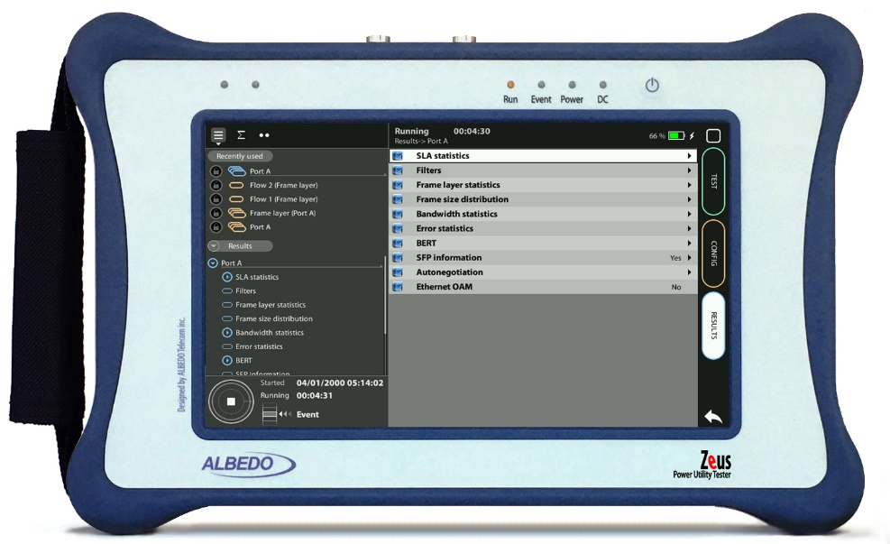

Contradirectional Testing
One-Way Delay over G.703 Contradirectional with xGEnius/Zeus
Guide & Slides corresponding to software ver. 2.10.5

Slide 2
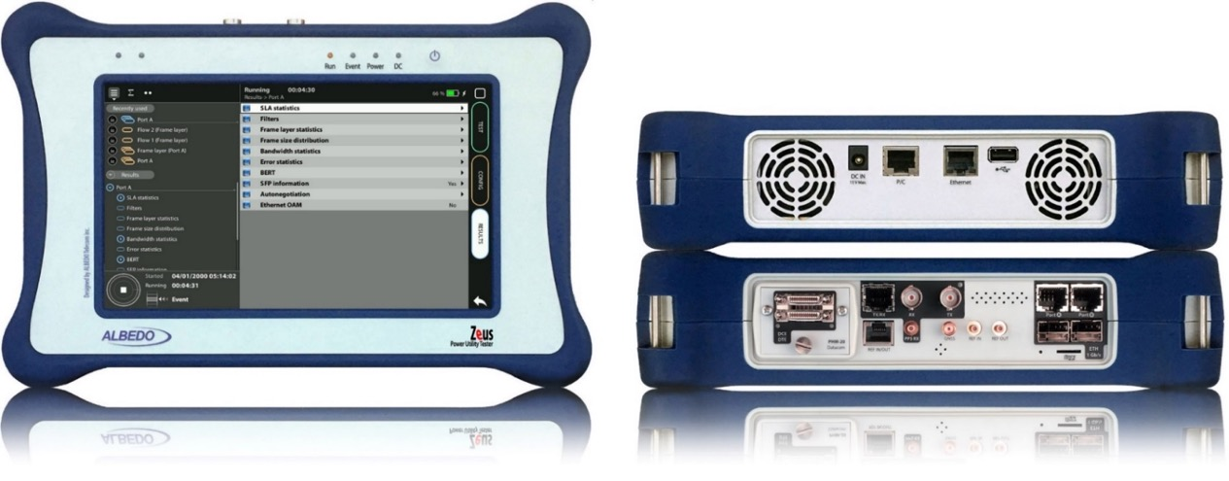
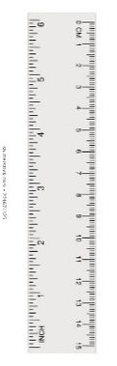
Zeus & xGenius
Zeus & xGenius provide deep insights to design, install, maintain, troubleshoot and engineer communications resources of Mobile Operators, Power Utilities, Finance, Labs and R+D centres. The unit is able to verify Ethernet/IP, SyncE, PTP, GbE, IRIG-B, 1PPS, T1/E1, G703, Serial Datacom, C37.94, GOOSE, SV, MMS, Round-trip & One-way Delay tests at all interfaces.
It also has a set of programmable filters to capture live data traffic at wire-speed

Slide 3
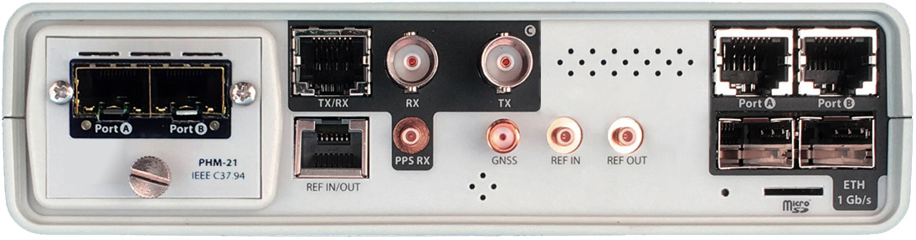
Interfaces & time References
PHM
RJ45-C
BNC-C
SFP+ A
SFP+ B
RJ45-A
RJ45-B
The unit is equipped with GNSS receiver with SMA female connector for connecting an antenna typically supplied with a 5 m of coaxial cable plus a 10 m extension cable.
RJ45
SMB-C
SMA
SMB-1
SMB-2
SFP-A
Micro SD
SFP-B
 | GNSS | PTP | NTP | ToD | IRIG-B | PPS | PP2S | SyncE | T1/E1 | MHz | C.3794
RJ45-A |  | in/out | in/out |  |  |  |  | in/out
RJ45-B |  |  |  |  |  |  |  | in/out
SFP-A |  | in/out | in/out |  |  |  |  | in/out
SFP-B |  |  |  |  |  |  |  | in/out
SFP+A |  | in/out | in/out |  |  |  |  | in/out
SFP+B |  |  |  |  |  |  |  | in/out
BNC-C |  |  |  |  |  |  |  |  | in/out | in/out
RJ45-C |  |  |  | in |  | in | in |  | in/out | in/out
SMB-C
SMA | in
SMB-1 |  |  |  |  | in | in | in
SMB-2 |  |  |  |  | out | out | out
RJ-45 |  |  |  | in/out | in/out | in/out | in/out |  | in/out | in/out
PHM |  |  |  |  |  |  |  |  |  |  | in/out

Slide 4


Typical Interconnection
G.703 / Codirectional: Endpoints, A and B are identical
TX Data + TX Clk
A
B
TX Data + TX Clk
G.703 / Contradirectional, direct connection: Two kinds of endpoint, C (controlling) and S (subordinated)
TX Data
C
TX Clk
S
RX Clk
TX Data
G.703 / Contradirectional, network connection: Again, identical S (subordinated) endpoints, the network provides the clocks
TX Data
RX Data
S
TX Clk
TX Clk
S
RX Clk
Network
RX Clk
RX Data
TX Data

Slide 5
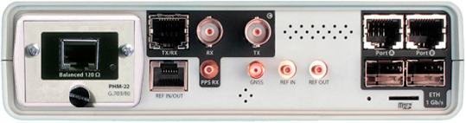
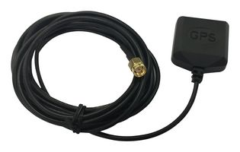
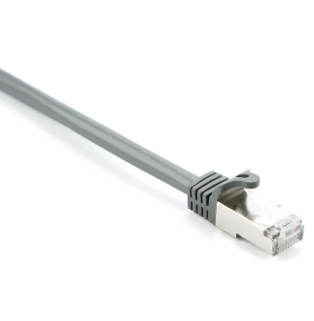

Connecting the GPS & C37.94
1
2
2
Zeus and xGenius are equipped with a G.703/E0 port (PHM22) and a built-in GNSS receiver. Proceed to connect all elements:
Plug the PHM22 module into the slot
Introduce the RJ48 connector to the test port
Connect the cable to the SMA and orient the antenna to open sky.

Slide 6

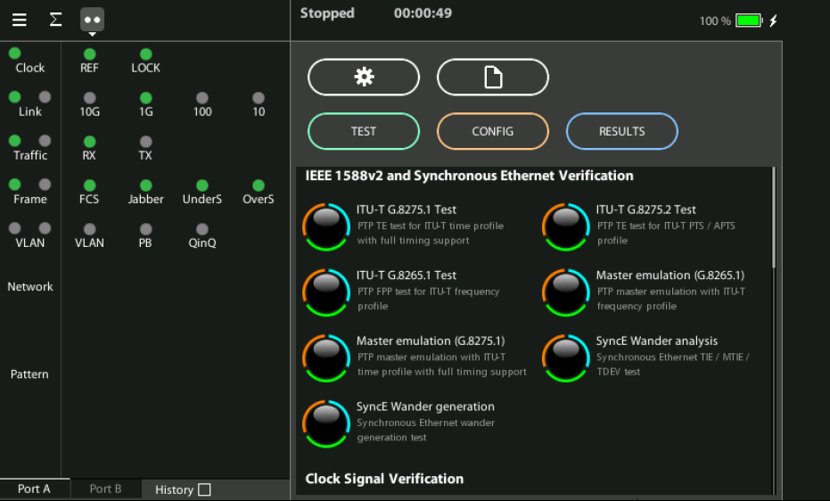
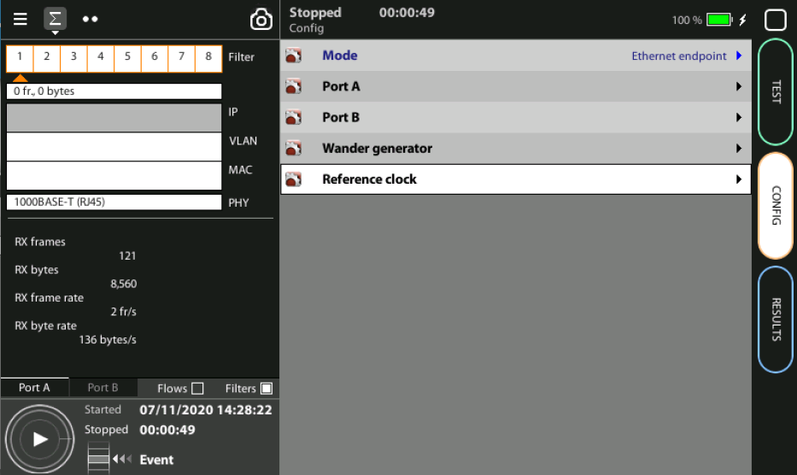
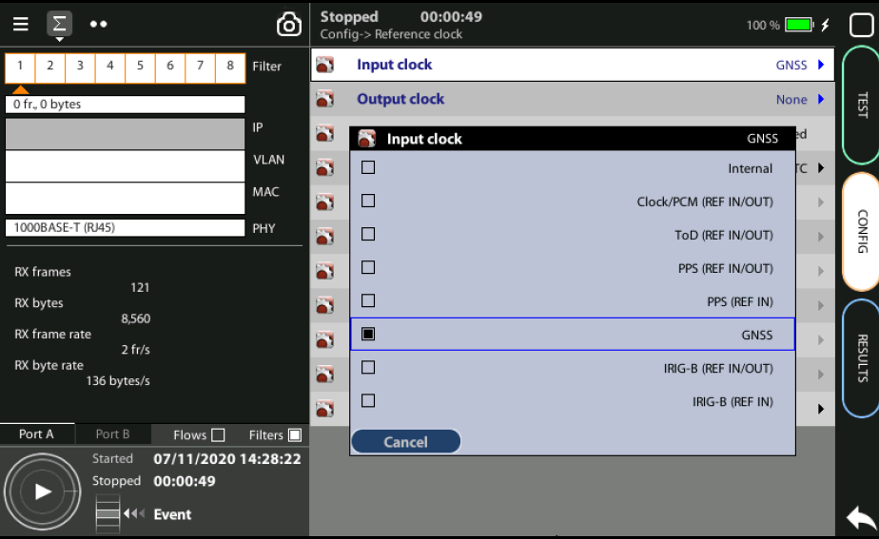
Steps to connect the built-in GNSS
3
2
1
1
Home > Config > Reference clock > Input clock := GNSS (*)
Press LEDS to check the status
Wait for the REF and LOCK LEDs to become green
(*) Go to Home panel, go to Config, the port setup will be displayed then Go to Reference clock and configure Input clock to GNSS.

Slide 7
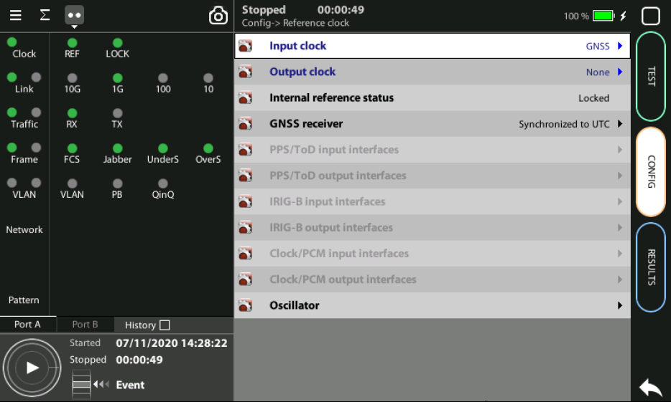
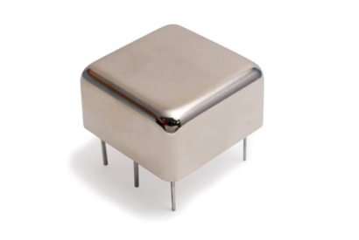
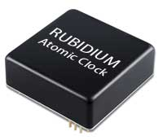
OCXO or Rubidium
1
  The unit will be ready for testing LOCK LED is green
  Mind that time is different depending which oscillator xGenius is equipped
Current locking status (Locking, Fine locking, Locked, Holdover, etc.) can be checked in the Reference clock menu.
Metric | OCXO | Rubidium
Locking time | < 5 minutes | < 4 hours

Slide 8
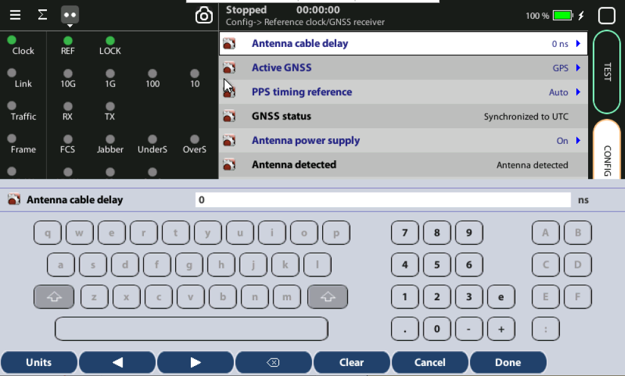
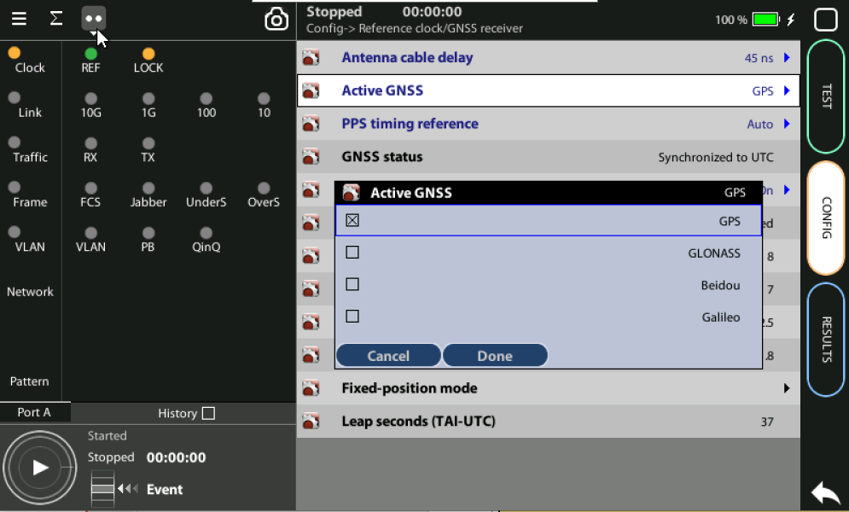
Configuring the GNSS Properties
2
1
3
Configure the GNSS to increase the accuracy:
Config > Reference clock > GNSS receiver > Antenna cable delay to configure a compensation at the correction field
In the same screen Enable/Disable any constellation (GPS, GLONASS, GALILEO, BEIDO) through the Active GNSS setting := GPS…
Go to Fixed‐position mode := Auto-average

Slide 9
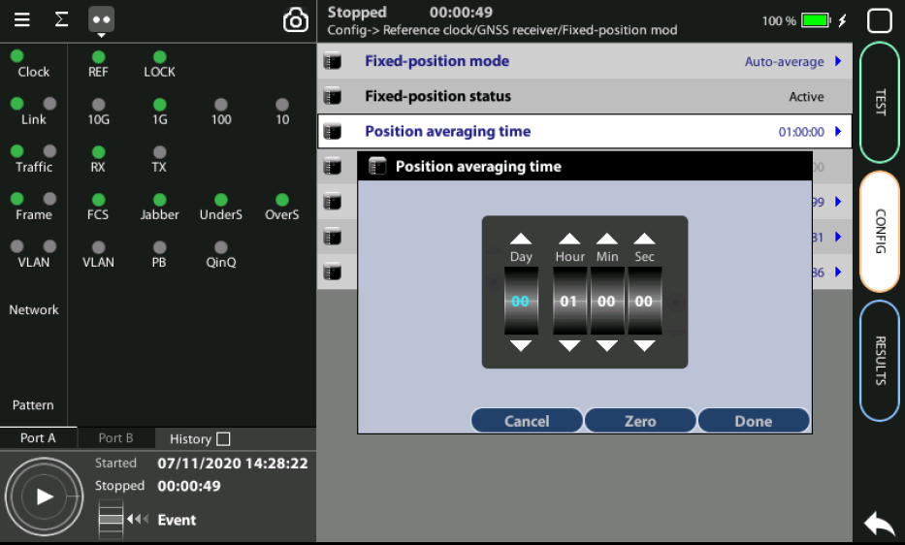
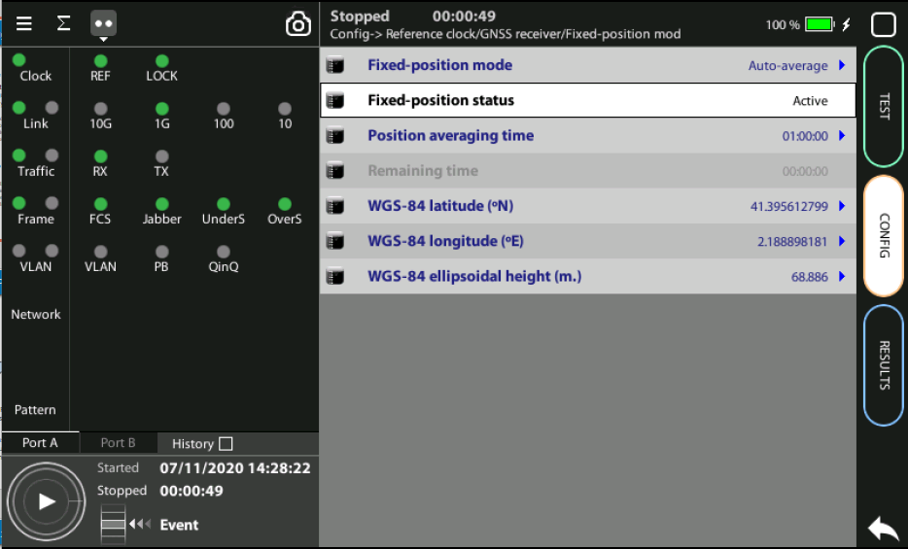
Position Averaging time
GPS has a statistical distribution and averaging for a time filters errors to improve accuracy.
Adjust the Position averaging time and by configuring Auto‐average in the that now displays Averaging
Wait to the Fixed position status to become Active. The unit is now ready for testing.
Note: Theoretically, testing could start before the end of the position averaging process. The improved time estimation due to this function would be automatically applied starting from the end of the auto‐averaging process.
1
Notes: (a) At least 1h of averaging is required for reasonable accuracy. (b) The procedure should be run only once as long as the location does not change. If any change is detected (longitude, latitude, altitude) an error will be displayed.
2

Slide 10
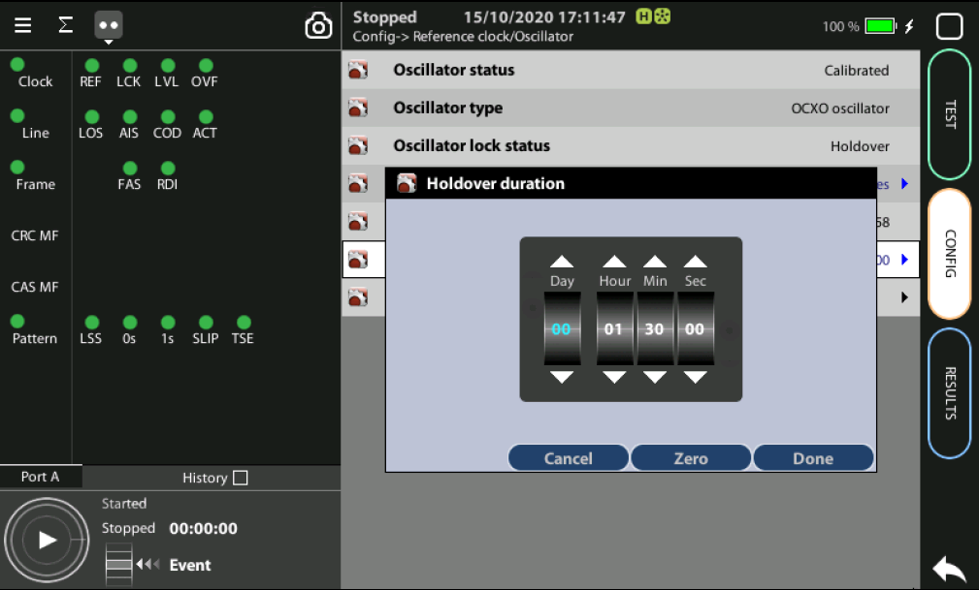
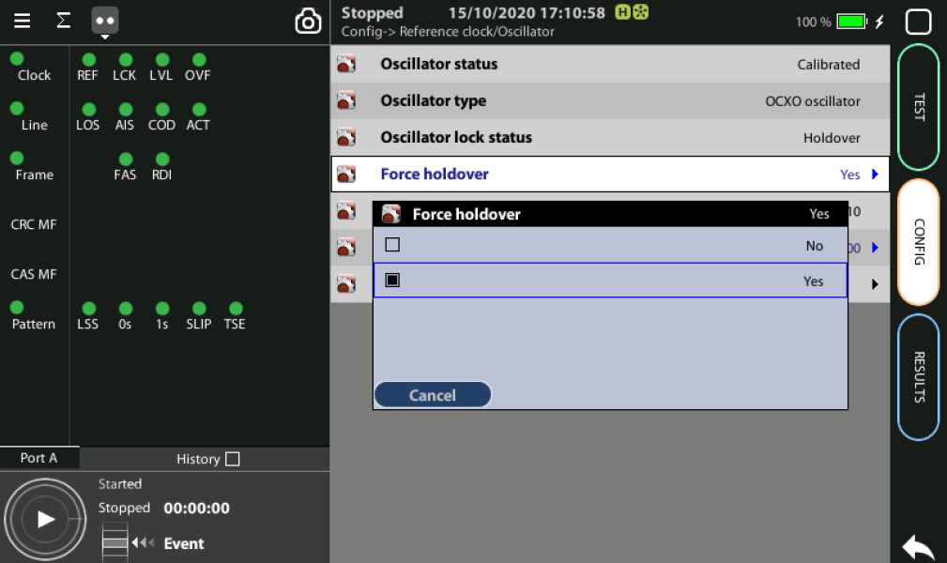
Holdover mode
1
3
2
When GNSS is not available (i.e. a room without windows) you can first synchronize the unit in a place with GNSS and then go to execute the test in holdover mode.
Accuracy will depend on: (a) the quality of the internal oscillator (Quartz, OCXO, Rubidium); and (b) the holdover period.
Synchronize to GPS and and verify that LED Clock, REF and LOCK are green
Config > Reference clock > Holdover duration := set the time you need for testing
Config > Reference clock > Force holdover := Yes

Slide 11



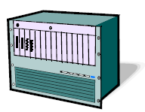
Hands-on to Contradirectional test
GNSS
GNSS
64 kb/s
contradir
64 kb/s
contradir
S
S
Generation
Analysis
MUX / Router
MUX / Router
Generation
Analysis
The testing scenario is a contradirectional network connection. Endpoints are identical (subordinated endpoints). The units measure One-way Delay but other tests are possible:
  Measuring Frequency and Frequency Offset
  Running BER and Performance Tests
  Event Generation and Analysis
  Round trip delay measurement

Slide 12
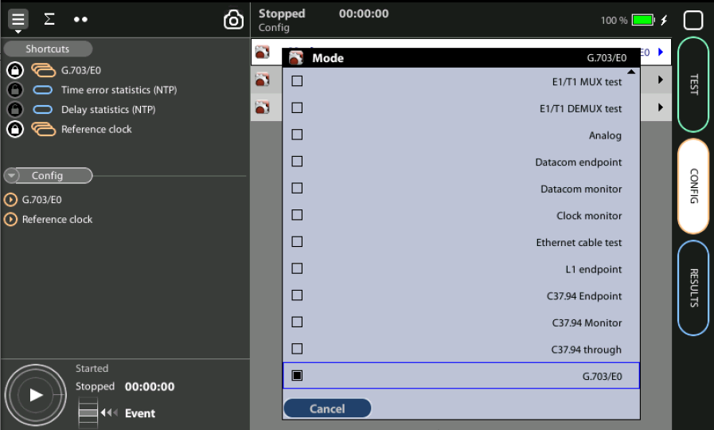
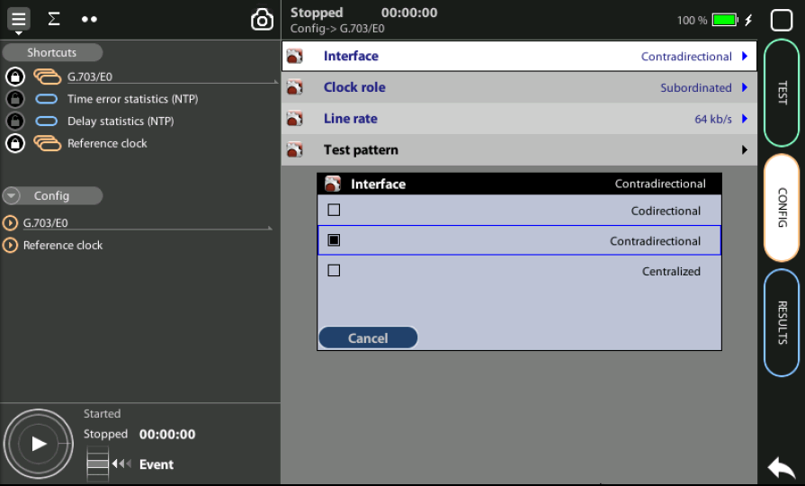
Enable the Contradirectional analysis
1
2
2
1
Configure Home > Config > Mode := G.703/E0 in both endpoints
Configure Home > Config > G.703/E0 := Contradirectional in both endpoints

Slide 13
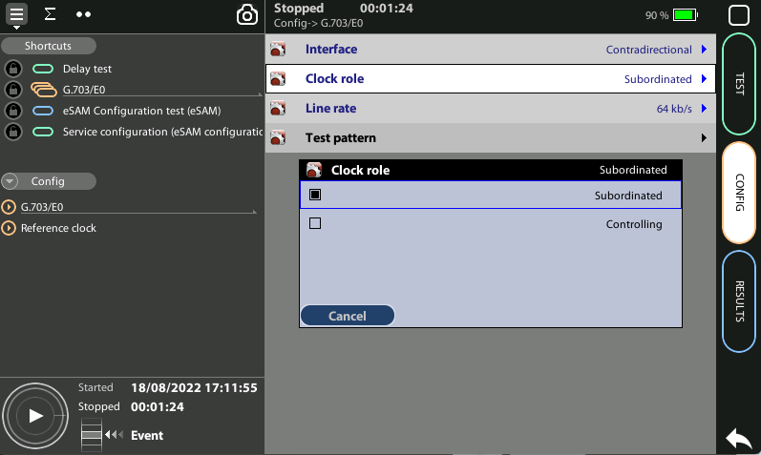
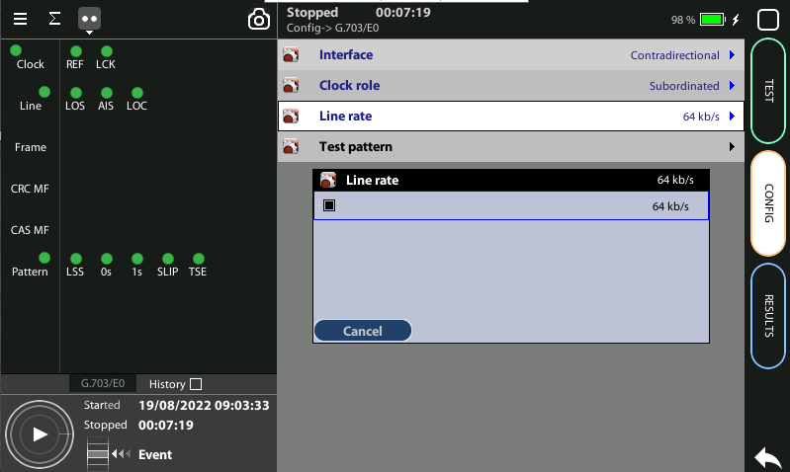
Configure the Interface
3
1
2
Set Home > Config > G.703/E0 > Clock role := Subordinated in both units
Set Home > Config > G.703/E0 > Line rate := 64 kb/s in both endpoints
In both units, display the LEDs panel and make sure that all LEDs are green

Slide 14
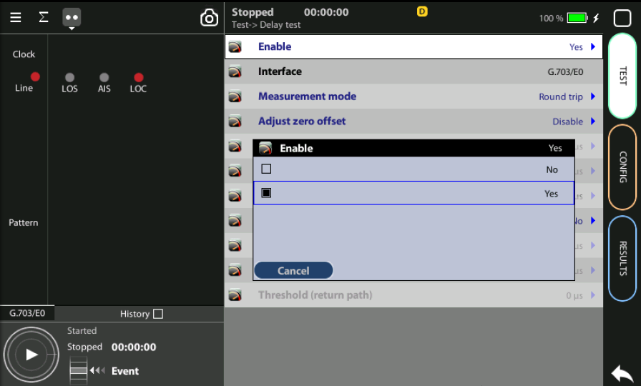
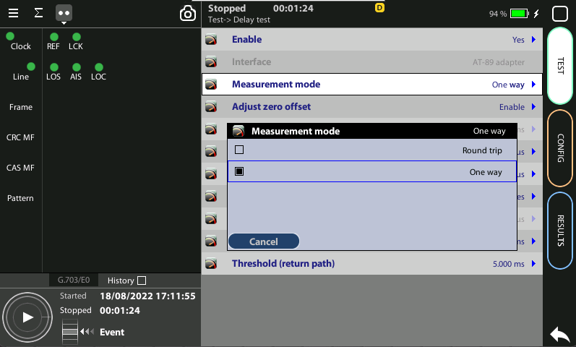
Enable the OWD test
1
1
2
Configure Test > Delay test > Enable := Yes in both units
Set Test > Delay test > Measurement mode := One way in both testers

Slide 15
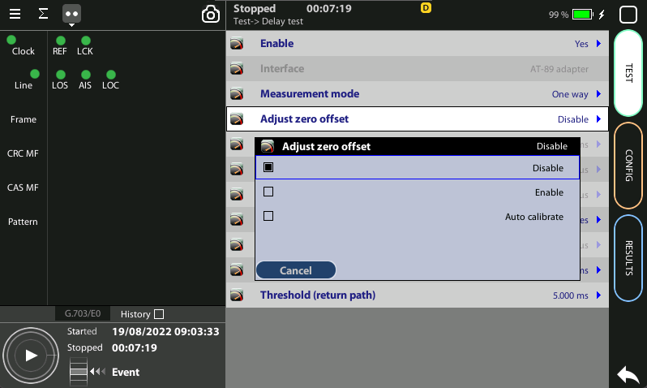
Set the Zero Delay Offset for your Test
Directly connected
S
C
3
Disconnect the units from the network and connect the units back-to-back (*)
In one of the units, set Home > Config > G.703/E0 > Clock role := Controlling
Enable Test > Delay test > Adjust zero offset := Auto calibrate in both units
Configure both units in Subordinated mode again
Home > Config > G.703/E0 > Clock role := Subordinated
Reconnect the units to the network
(*) The zero offset setting can be done without having to connect the units together with the help of a physical loopback and setting the unit in “Controlling” mode.

Slide 16
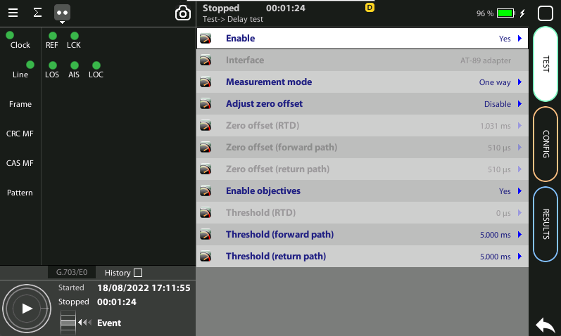
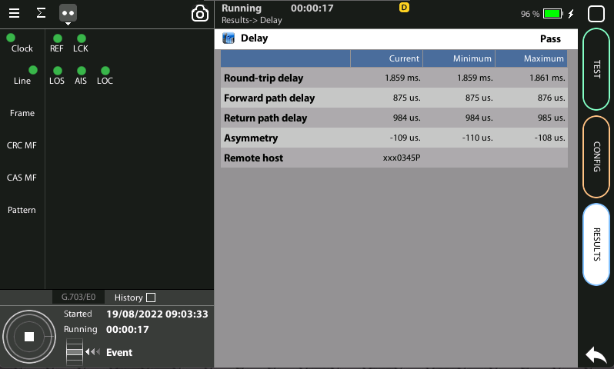
Running the OWD test
2
1
The test is now ready to start then Press RUN
Go to Home > Results > Delay test to check delay results

Slide 17
Glossary
AAA: Authentication, Authorization, and Accounting
ACL: Access Control List
AP: Access Point
Busbar: Metallic strip or bar, typically housed inside switchgear, panel boards, and busway enclosures for local high current power distribution C37.94: TDM interface devoted for teleprotection
CB: Circuit Breaker designed to close or open electrical circuit under normal or abnormal conditions. It operates on relays command.
CBWFQ: Class-Based Weighted Fair Queuing
CG: Connected Grid
CID: Individual configuration of each IED CIP: Critical Infrastructure Protection CLI: Command-Line Interface
CorpSS: Corporate Substation
CT: Current Transformer, used for measurement of current, if too high to apply directly to measuring instruments, a CT produces a proportional current which can be measured and recorded, CT are used in metering and protective relays
DAN: Doubly Attached Nodes implementing HSR or PRP
DAU: Data Acquisition Unit
Disconnector: isolates physically and visually the lines
DMZ: Demilitarized Zone
DCB: Directional Comparison Blocking
DCS: distributed control systems
DSC: Differentiated Services Code Point
ESP: Electronic Security Perimeter
Feeder: Transmits power to the distribution points
GM: Grandmaster
GNSS: Global Navigation Satellite System
GOOSE: Generic Object-Oriented Substation Events is a control model defined as per IEC 61850 which provides a fast and reliable mechanism of transferring event data over entire electrical substation networks. When implemented, this model ensures the same event message is received by multiple physical devices using multicast or broadcast services
HMI: Human Machine Interface
PTP: Precision Time Protocol
RedBox: Redundancy Box
Relay: is automatic device which senses an abnormal condition of electrical circuit and closes its contacts and complete the circuit breaker trip.
REP: Resilient Ethernet Protocol
RCT: Redundancy Control Trailer
RTU: Remote Terminal Unit
SA: Substation Automation
SAN: Singly-Attached Node
Secondary Lines: lower voltage side at the substation
SCADA: Supervisory Control And Data Acquisition, transmits and receives data from events of controls, measuring, safety and monitoring. Power system elements can be controlled remotely over. Remote switching, telemetering of grids showing voltage, current, power, direction, consumption in kWh, synchronization.
SCD: Substation Configuration Description SCL: Substation Configuration Language SNTP: Simple Network Time Protocol
Station Bus: Connects the entire substation and helps provide connectivity between central management and individual bays
STP: Spanning Tree Protocol
SV: Sampled Values, is a method to read instantaneous values such as currents, voltages, impedances, etc. from CTs, VTs or digital I/O and then transmitted to make them are available for those IED subscribed.
Switchgear: combination of switches, fuses or CB to control, protect and isolate electrical equipment
SyncE: Synchronous Ethernet
TLV: Type, Length, Value
VT: Voltage Transformer (see CT)Potential Transformer, gives the reference voltage to the Relay for Over-voltage or Under-voltage Protection
UCA IuG: Utility Communications Architecture International Users Group
VDAN: Virtual D
HQoS: Hierarchical Quality of Service
HSR: High-Availability Seamless Redundancy
IA: Industrial Automation
ICS: Industrial control systems
ICU: Intelligent Control Unit
IEC: International Electrotechnical Commission
IEC 61850: Standard defining communication protocols for intelligent electronic devices at electrical substations
IED: Intelligent End Device, microprocessor-based controllers of power system equipment, such as circuit breakers, transformers and capacitor banks to enable advanced power automation.
IRIG: Inter-Range Instrumentation Group
ISE: Identity Services Engine
L3VPN: Layer 3 Virtual Private Network
LA: Lightning Arrester protects the power grid from electric storms
MQC: Modular QoS Command-Line Interface
MMS: Manufacturing Message Specification, messaging system for exchanging real-time data and supervisory control information. Allows client such as SCADA, an OPC server or a gateway to access all IED objects MPLS: Multi-protocol Label Switching
MU: Merging Unit connected to the process bus converts analog data(ie. volts, currect...) into digital information
NERC: North American Electric Reliability Corporation
NIST: National Institute of Standards and Technology
NMS: Network Management System
OAM: Operations and Maintenance
PCP: Priority Code Point
PIOC: Instantaneous overcorrent Protection
PLC: Programmable Logic Controller
PMU: Phasor Measurement Unit
POTT: Permissive Overreaching Transfer Trip
PP: Primary Power
Process Bus: Connects primary units and control equipment to the IEDs
PRP: Parallel Redundancy Protocol
PRTC: Primary Reference Clock
PT: see VT
T-GM: Grand Master PTP
T-BC: Boundary Clock
T-TSC: Slave Clock

Slide 18



That’s all
www.albedotelecom.com

