Slide 1
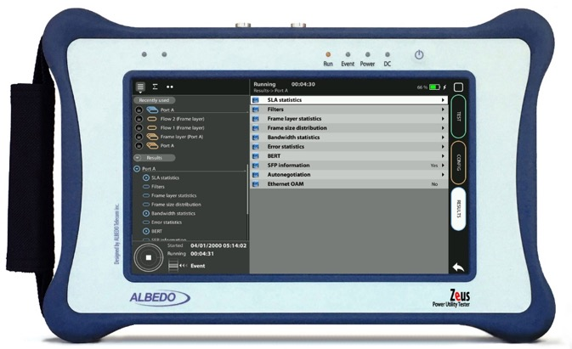

IRIG-B Monitoring
IRIG-B with xGenius/Zeus
Guide & Slides corresponding to software ver. 2.6.1/1.4.1

Slide 2
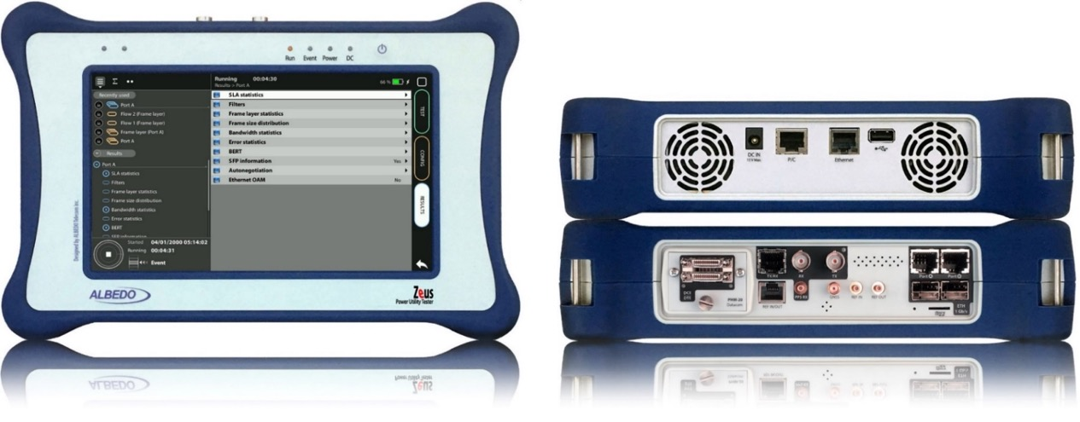
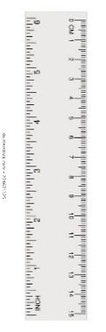
Zeus & xGenius
Zeus & xGenius provide deep insights to design, install, maintain, troubleshoot and engineer communications resources of Mobile Operators, Power Utilities, Finance, Labs and R+D centres. The unit is able to verify Ethernet/IP, SyncE, PTP, GbE, IRIG-B, 1PPS, T1/E1, G703, Serial Datacom, C37.94, GOOSE, SV, MMS, Round-trip & One-way Delay tests at all interfaces.
It also has a set of programmable filters to capture live data traffic at wire-speed

Slide 3
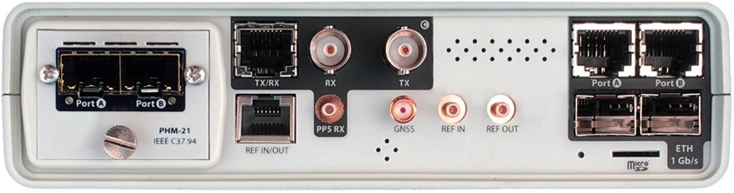

Interfaces & time References
PHM
RJ45-C
BNC-C
RJ45-A
RJ45-B
The unit is equipped with GNSS receiver with SMA female connector for connecting an antenna typically supplied with a 5 m of coaxial cable plus a 10 m extension cable.
RJ45
SMB-C
SMA
SMB-1
SMB-2
SFP-A
Micro SD
SFP-B
 | GNSS | PTP | NTP | ToD | IRIG-B | PPS | PP2S | SyncE | T1/E1 | MHz | C.3794
RJ45-A |  | in/out | in/out |  |  |  |  | in/out
RJ45-B |  |  |  |  |  |  |  | in/out
SFP-A |  | in/out | in/out |  |  |  |  | in/out
SFP-B |  |  |  |  |  |  |  | in/out
BNC-C |  |  |  |  |  |  |  |  | in/out | in/out
RJ45-C |  |  |  | in |  | in | in |  | in/out | in/out
SMB-C
SMA | in
SMB-1 |  |  |  |  | in | in | in
SMB-2 |  |  |  |  | out | out | out
RJ-45 |  |  |  | in/out | in/out | in/out | in/out |  | in/out | in/out
PHM |  |  |  |  |  |  |  |  |  |  | in/out

Slide 4
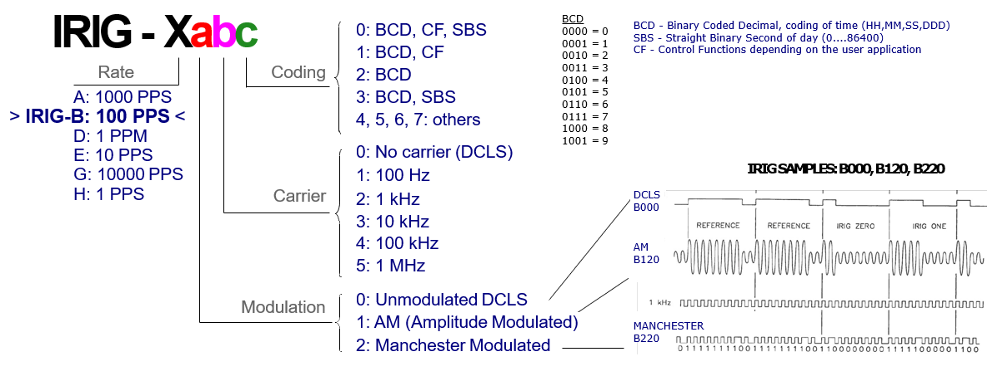
IRIG-B signals
IRIG-B time codes have time, date, time scale and any other information related with timing is embedded in a single electrical signal. The test unit is able to provide IRIG-B clock reference inputs/outputs both in balanced (RJ-45) and unbalanced (SMB) interfaces. IRIG-B sends a timing signal every second at 100 pulse/sec rate therefore the 100 is the number of bits of each frame. IRIG-B info includes Year, Day, Hour, Min, Sec.
DCLS IRIG-B offers several transmission alternatives including TTL-level signal over coaxial cable or shielded twisted-pair cable, Multi-point distribution using 24 Vdc for signal and control power, RS-485 differential signal over shielded twisted-pair cable, RS-232 signal over shielded cable (short distances only), Optical fiber.

Slide 5
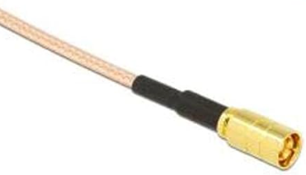

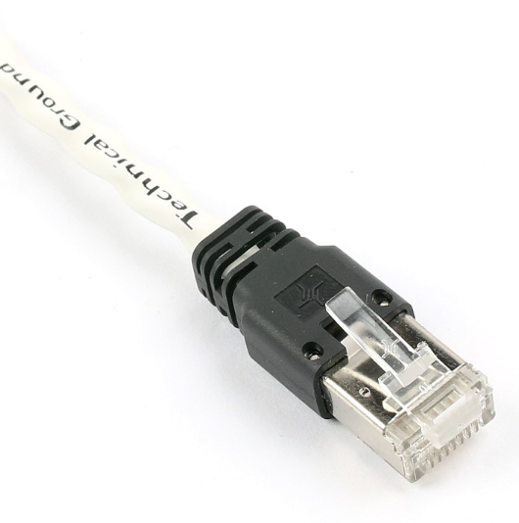
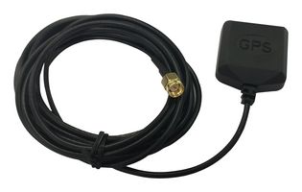
Connecting to the IRIG-B interfaces
3
1
2
2
1
Verification of IRIG-B signals with xGenius or Zeus requires configuration of both the clock reference and the test interface. Most results also require that a test is started with the RUN button. Zeus / xGenius are equipped with IRIG-B interfaces at the front pannel and also using the PHM-25 module.
Proceed to connect all the elements:
Insert compatible SMB unbalanced cable or
Insert compatible RJ48 balanced cable
Connect the GNSS antenna

Slide 6


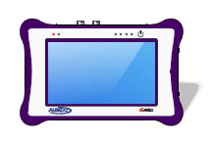

Hands-on IRIG-B test
GNSS
IRIG-B
Master Clock
Some common examples of industries that use IRIG-B include:
  Aerospace and defense: IRIG-B is often used in aerospace and defense applications to synchronize systems and equipment, such as radar and navigation systems, missile guidance systems, and satellite systems.
  Telecommunications: IRIG-B is commonly used in telecommunications systems to synchronize clocks and timing signals, which is essential for ensuring the accurate transmission and reception of data.
  Power and energy: IRIG-B is frequently used in electric power grids, to synchronize substations and other equipment, which is necessary for maintaining the stability and reliability of the power system.

Slide 7
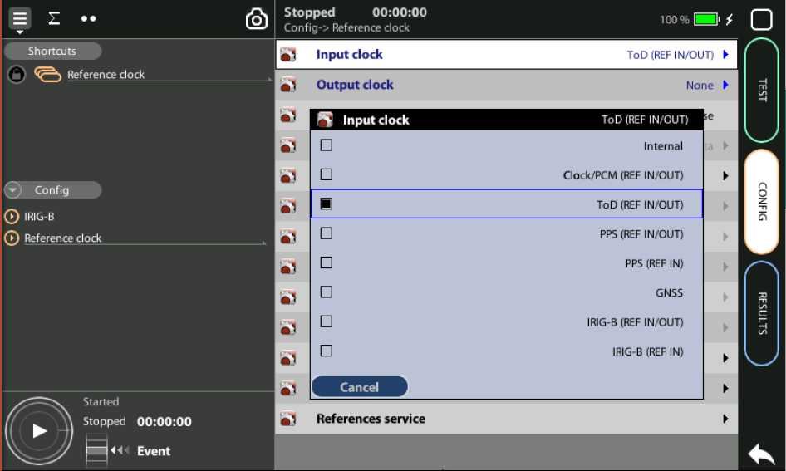

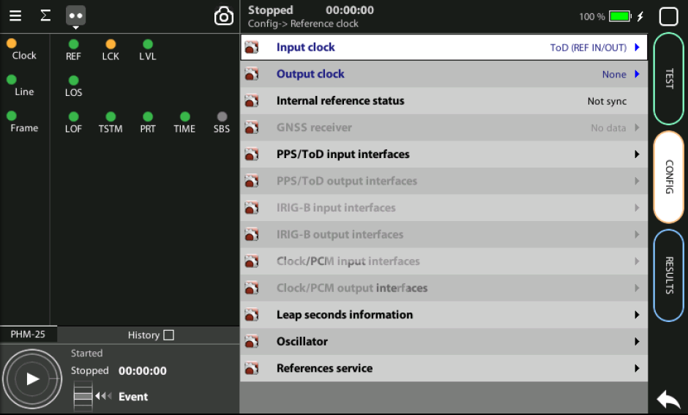
Get time reference
1
2
3
In addition to GNSS other alternatives are posible to obtain a time reference required to execute this test. We are going to use in this sample ToD
Proceed to connect all the elements:
Insert the RJ45 cable to provide the ToD signal
Go to Home > Config > Reference Clock := ToD
Observe how the unit gets the reference

Slide 8
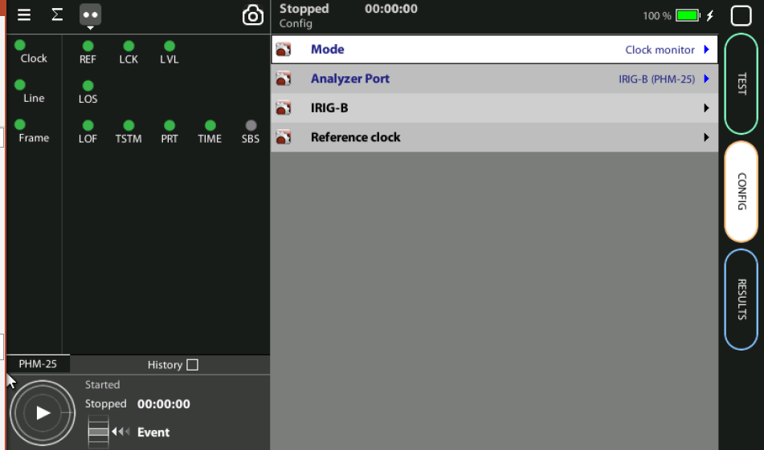
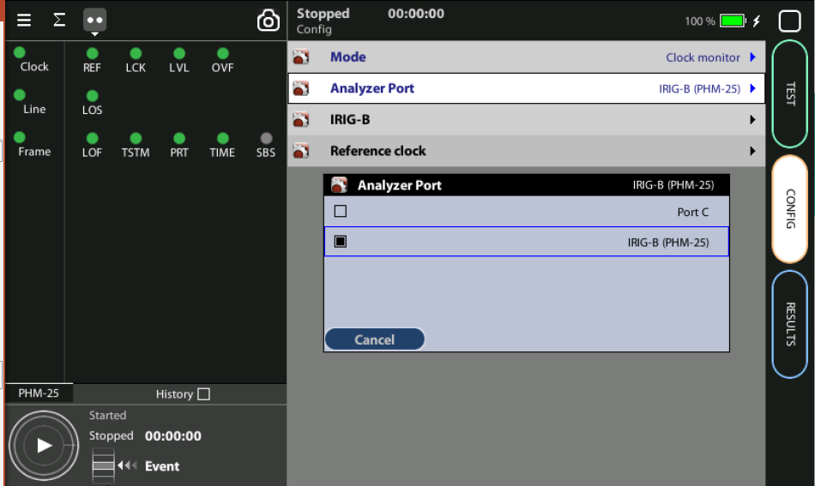
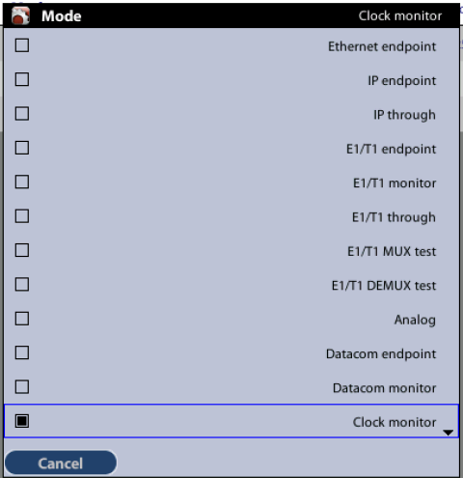
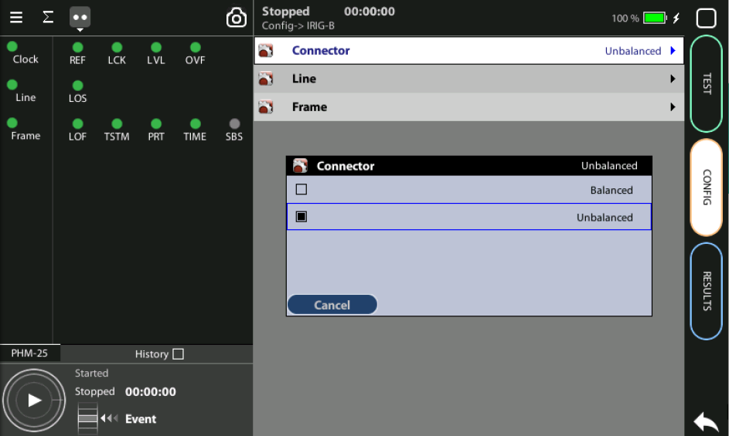
Get time reference
1
2
3
2
3
1
Once the reference is ready, configure the test port. Connect the SMB cable carrying an IRIG-B time code and configure the tester:
Go to Home > Config > Mode := Clock Monitor
Config > Analyzer Port := IRIB-B (PHM-25)
Config > IRIG-B := Unbalance

Slide 9
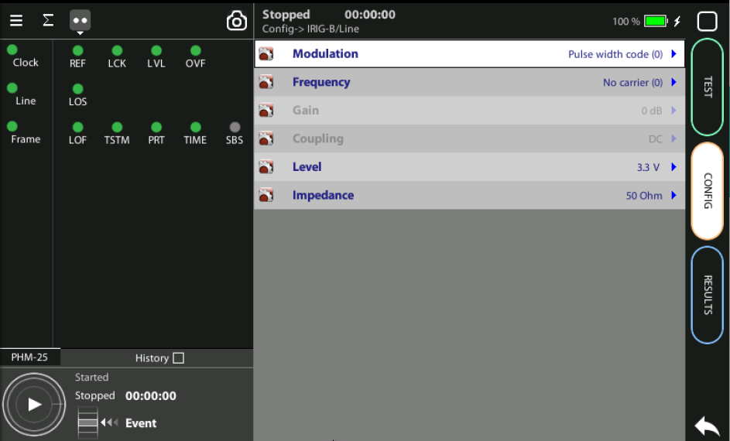
Enable the C37.94 through mode
1
1
1
Configure the type of IRIG-B to match with the signal to be analysed

Slide 10
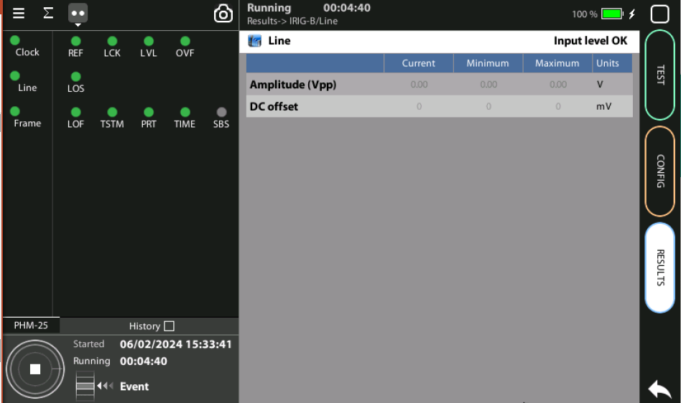
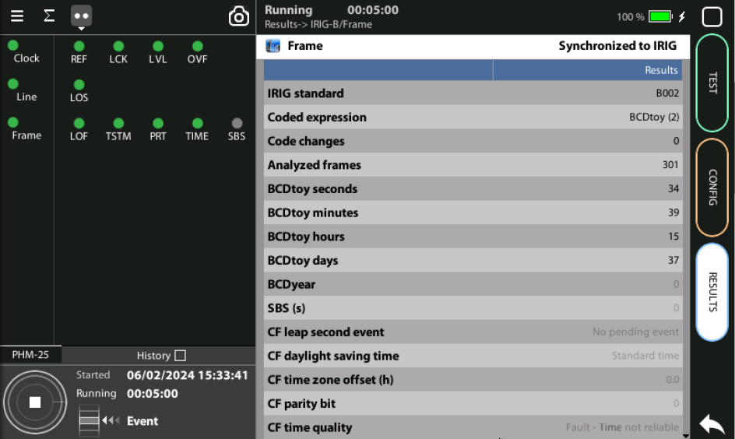
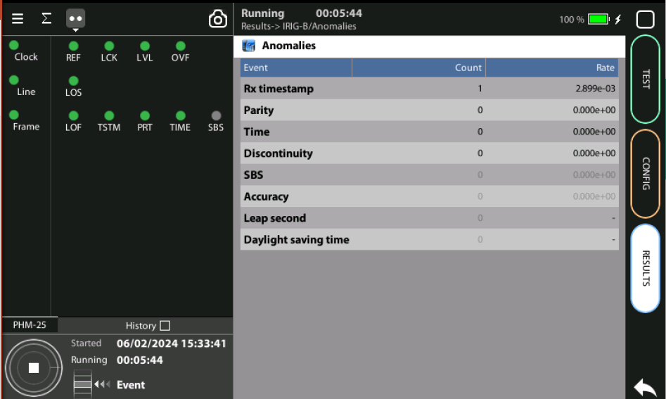
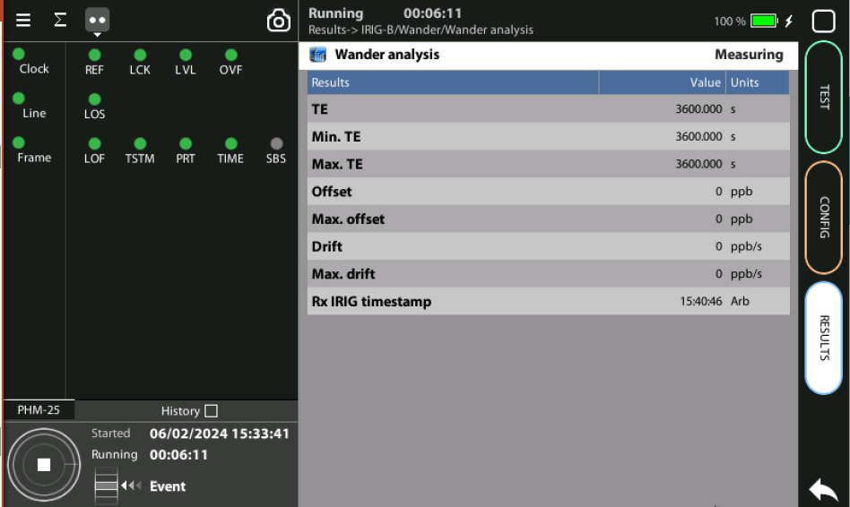
Display Results

Slide 11
Glossary
AAA: Authentication, Authorization, and Accounting
ACL: Access Control List
ACT: Activity alarm when no data is detected in transmission
AP: Access Point
Busbar: Metallic strip or bar, typically housed inside switchgear, panel boards, and busway enclosures for local high current power distribution C37.94: TDM interface devoted for teleprotection
CB: Circuit Breaker designed to close or open electrical circuit under normal or abnormal conditions. It operates on relays command.
CBWFQ: Class-Based Weighted Fair Queuing
CG: Connected Grid
CID: Individual configuration of each IED CIP: Critical Infrastructure Protection CLI: Command-Line Interface
CorpSS: Corporate Substation
CT: Current Transformer, used for measurement of current, if too high to apply directly to measuring instruments, a CT produces a proportional current which can be measured and recorded, CT are used in metering and protective relays
DAN: Doubly Attached Nodes implementing HSR or PRP
DAU: Data Acquisition Unit
Disconnector: isolates physically and visually the lines
DMZ: Demilitarized Zone
DCB: Directional Comparison Blocking
DCS: distributed control systems
DSC: Differentiated Services Code Point
ESP: Electronic Security Perimeter
Feeder: Transmits power to the distribution points
GM: Grandmaster
GNSS: Global Navigation Satellite System
GOOSE: Generic Object-Oriented Substation Events is a control model defined as per IEC 61850 which provides a fast and reliable mechanism of transferring event data over entire electrical substation networks. When implemented, this model ensures the same event message is received by multiple physical devices using multicast or broadcast services
HMI: Human Machine Interface
PTP: Precision Time Protocol
RedBox: Redundancy Box
Relay: is automatic device which senses an abnormal condition of electrical circuit and closes its contacts and complete the circuit breaker trip.
REP: Resilient Ethernet Protocol
RCT: Redundancy Control Trailer
RTU: Remote Terminal Unit
SA: Substation Automation
SAN: Singly-Attached Node
Secondary Lines: lower voltage side at the substation
SCADA: Supervisory Control And Data Acquisition, transmits and receives data from events of controls, measuring, safety and monitoring. Power system elements can be controlled remotely over. Remote switching, telemetering of grids showing voltage, current, power, direction, consumption in kWh, synchronization.
SCD: Substation Configuration Description SCL: Substation Configuration Language SNTP: Simple Network Time Protocol
Station Bus: Connects the entire substation and helps provide connectivity between central management and individual bays
STP: Spanning Tree Protocol
SV: Sampled Values, is a method to read instantaneous values such as currents, voltages, impedances, etc. from CTs, VTs or digital I/O and then transmitted to make them are available for those IED subscribed.
Switchgear: combination of switches, fuses or CB to control, protect and isolate electrical equipment
SyncE: Synchronous Ethernet
TLV: Type, Length, Value
VT: Voltage Transformer (see CT)Potential Transformer, gives the reference voltage to the Relay for Over-voltage or Under-voltage Protection
UCA IuG: Utility Communications Architecture International Users Group
VDAN: Virtual D
HQoS: Hierarchical Quality of Service
HSR: High-Availability Seamless Redundancy
IA: Industrial Automation
ICS: Industrial control systems
ICU: Intelligent Control Unit
IEC: International Electrotechnical Commission
IEC 61850: Standard defining communication protocols for intelligent electronic devices at electrical substations
IED: Intelligent End Device, microprocessor-based controllers of power system equipment, such as circuit breakers, transformers and capacitor banks to enable advanced power automation.
IRIG: Inter-Range Instrumentation Group
ISE: Identity Services Engine
L3VPN: Layer 3 Virtual Private Network
LA: Lightning Arrester protects the power grid from electric storms
MQC: Modular QoS Command-Line Interface
MMS: Manufacturing Message Specification, messaging system for exchanging real-time data and supervisory control information. Allows client such as SCADA, an OPC server or a gateway to access all IED objects MPLS: Multi-protocol Label Switching
MU: Merging Unit connected to the process bus converts analog data(ie. volts, currect...) into digital information
NERC: North American Electric Reliability Corporation
NIST: National Institute of Standards and Technology
NMS: Network Management System
OAM: Operations and Maintenance
PCP: Priority Code Point
PIOC: Instantaneous overcorrent Protection
PLC: Programmable Logic Controller
PMU: Phasor Measurement Unit
POTT: Permissive Overreaching Transfer Trip
PP: Primary Power
Process Bus: Connects primary units and control equipment to the IEDs
PRP: Parallel Redundancy Protocol
PRTC: Primary Reference Clock
PT: see VT
T-GM: Grand Master PTP
T-BC: Boundary Clock
T-TSC: Slave Clock

Slide 12



That’s all
www.albedotelecom.com

