Slide 1
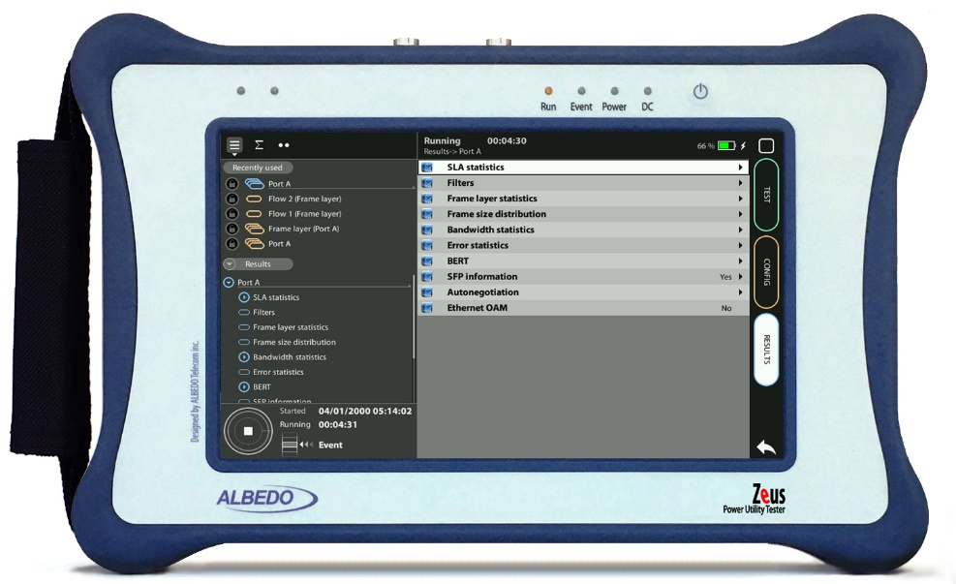

C.3794 Testing
Impairment Generation over C.3794 with Zeus
Guide & Slides corresponding to software ver. 2.10.5

Slide 2
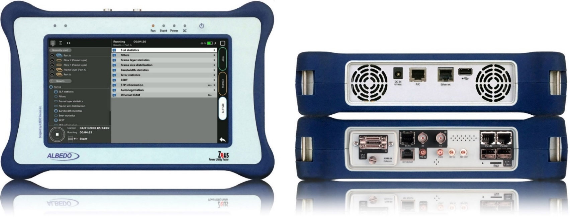

Zeus & xGenius
Zeus & xGenius provide deep insights to design, install, maintain, troubleshoot and engineer communications resources of Mobile Operators, Power Utilities, Finace, Labs and R+D centers. The unit is able to verify Ethernet/IP, SyncE, PTP, GbE, IRIG-B, 1PPS, T1/E1, G703, Serial Datacom, C37.94, GOOSE, SV, MMS, Round-trip & One-way Delay tests at all interfaces.
It also has a set of programmable filters to capture live data traffic at wire-speed

Slide 3
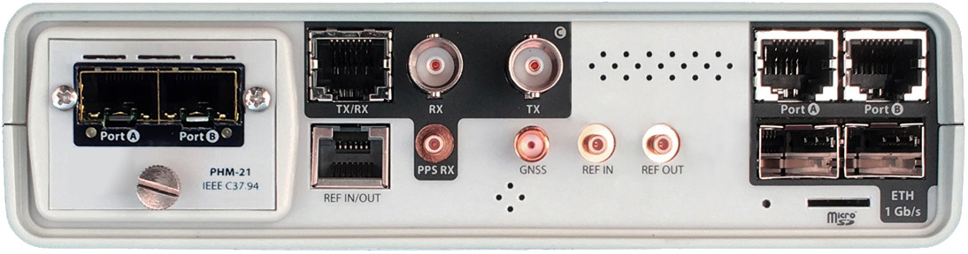
Interfaces & Clock References
C37.94 A
C37.94 B
RJ45-C
BNC-C
RJ45-A
RJ45-B
The unit is equipped with GNSS receiver with SMA female connector for connecting an antenna typically supplied with a 5 m of coaxial cable plus a 10 m extension cable.
PHM 21
RJ45
SMB-C
SMA
SMB-1
SMB-2
SFP-A
Micro SD
SFP-B
 | GNSS | PTP | NTP | ToD | IRIG-B | PPS | PP2S | SyncE | T1/E1 | MHz | C.3794
RJ45-A |  | in/out | in/out |  |  |  |  | in/out
RJ45-B |  |  |  |  |  |  |  | in/out
SFP-A |  | in/out | in/out |  |  |  |  | in/out
SFP-B |  |  |  |  |  |  |  | in/out
BNC-C |  |  |  |  |  |  |  |  | in/out | in/out
RJ45-C |  |  |  | in |  | in | in |  | in/out | in/out
SMB-C
SMA | in
SMB-1 |  |  |  |  | in | in | in
SMB-2 |  |  |  |  | out | out | out
RJ-45 |  |  |  | in/out | in/out | in/out | in/out |  | in/out | in/out
PHM |  |  |  |  |  |  |  |  |  |  | in/out

Slide 4
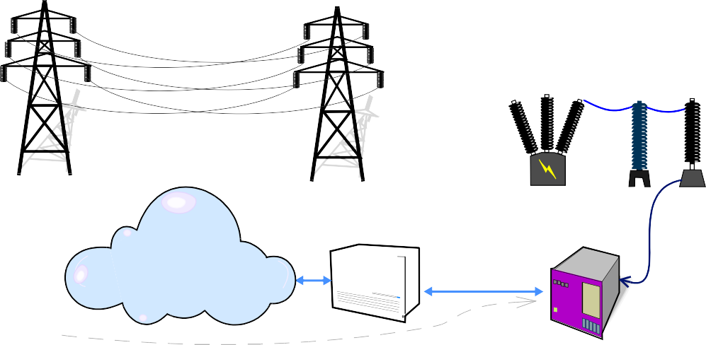

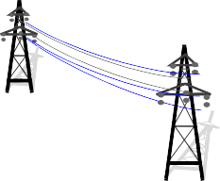
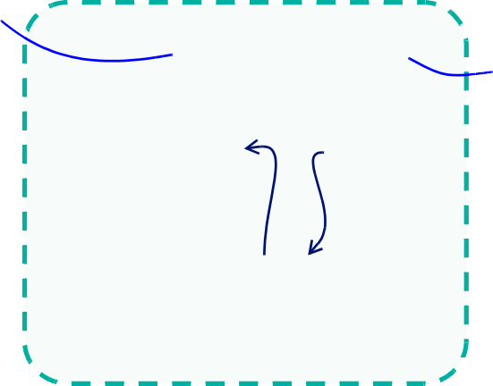

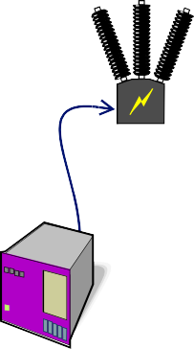








Teleprotection Testing
High Voltage
Low Voltage
S U B S T A T I O N - 1
S U B S T A T I O N - 2
VT
CT
CB
CB
CT
VT
GNSS
IEEE C37.94
SDH/SONET
IEEE C37.94
GNSS
IED
A
B
ALBEDO
xGenius
Testing Points
ALBEDO
xGenius
Protection schemes, such as C37.94, have the objective of keeping the Power System stable and isolated. For correct function the control of latency, latency variations and asymmetry is fundamental.
Zeus and xGenius equipped with C37.94 interfaces and synchronized by GPS, measure all key parameters including One‐Way Delay (OWD) by means of two units (in the picture A and B) at the ends of the path to be qualified.

Slide 5


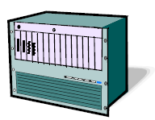

C37.94 Testing Modes
Endpoint emulation
Frequency, optical power
Jitter / wander generation and análisis
Defects / anomalies
Relay
Tester
Tester
MUX / Router
End-to-end
Delay tests
Performance and BERT
Tester
Network
Tester
Pass-through
Defects / anomalies
Delay / bit error generation
Jitter / wander analysis
Relay
Tester
MUX / Router
Relay
Tester
Relay

Slide 6
Clock forwarding in pass-through mode
Testing scenario #1
One of the endpoints provides the clock. The tester forwards this clock.
Clock recover
Clock recover
Clock master
Relay
Clock recover
Tester
MUX / Router
Testing scenario #2
Endpoints are clock slaves. The tester supplies the clock for both. It wouldn’t be possible to interconnect the endpoints without the tester!
Clock recover
Clock master
Relay
Tester
Clock master
Clock recover
Relay

Slide 7
Event insertion in pass-through mode
Symmetric and asymmetric delay generation
It helps determining which network conditions may lead to incorrect operation of protective relays
Operation failure
Operation failure
B-to-A delay
Tester
Relay A
A-to-B delay
Relay B
A-to-B = B-to-A
Symmetric delay
A-to-B ≠ B-to-A
Asymmetric delay

Slide 8
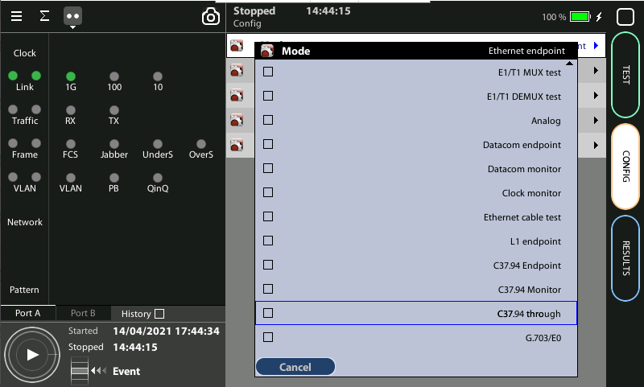
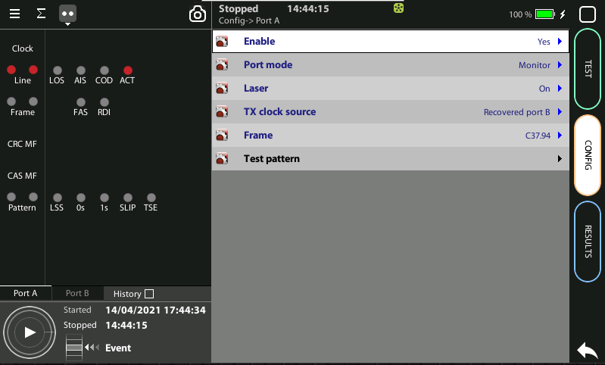

Enable the C37.94 pass-through analysis
2
1
Go to Home > Config > Mode > C37.94 through
Enable C37.94 Port A: Home > Config > Port A > Enable := yes
Repeat the configuration in Port B

Slide 9
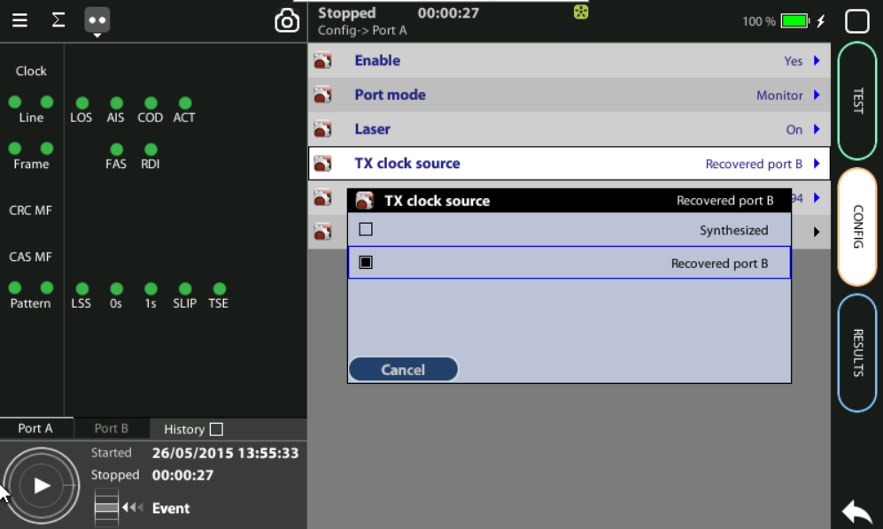
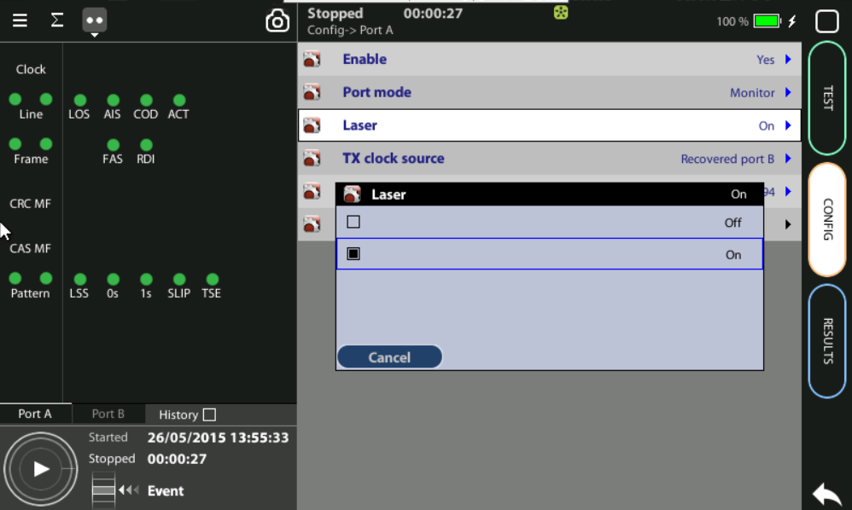
Configure the clocks
1
2
In Port A: Configure Home > Config > Port A > Tx clock source := Recovered port B (scenario #1) or Synthesized (scenario #2)
In port A: Set laser Config > Port A > Laser := On
Repeat the configuration in Port B

Slide 10
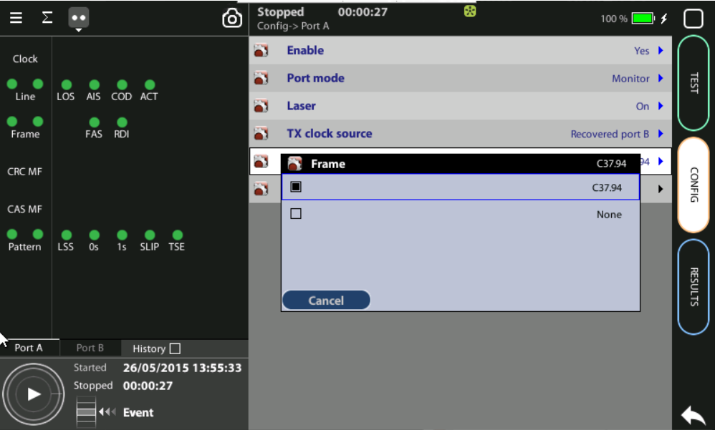
Configure the frame
1
In Port A: Configure Home > Config > Port A > Frame := C37.94
Repeat the configuration in Port B

Slide 11
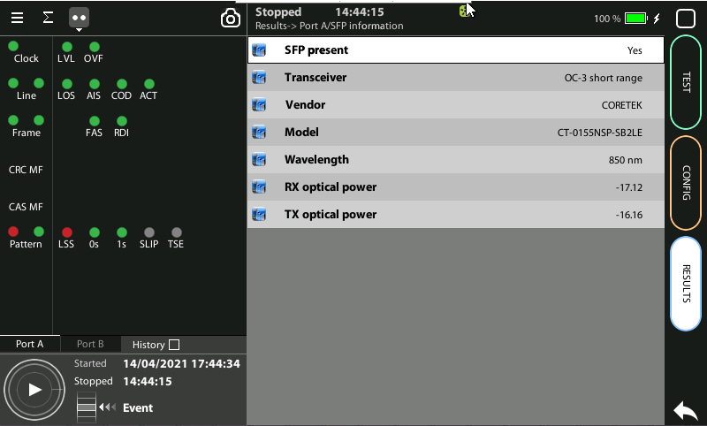
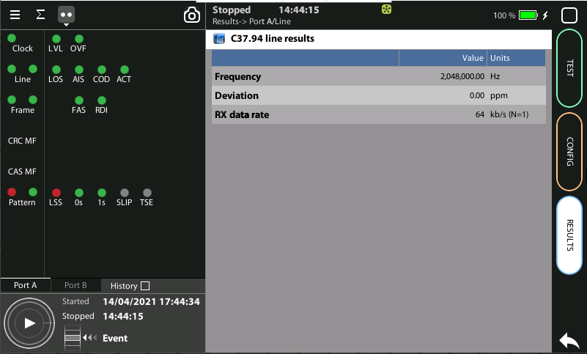

Check SFP Information and Line results
2
1
2
Check: Home > Results > Port A > SFP information. Make sure that RX and TX optical power are within the limits of IEEE C37.94
Check: Home > Results > Port A > Line. Make sure that Deviation is smaller than 100 ppm (scenario #1) or 0 (scenario #2)
Check the same results in Port B

Slide 12
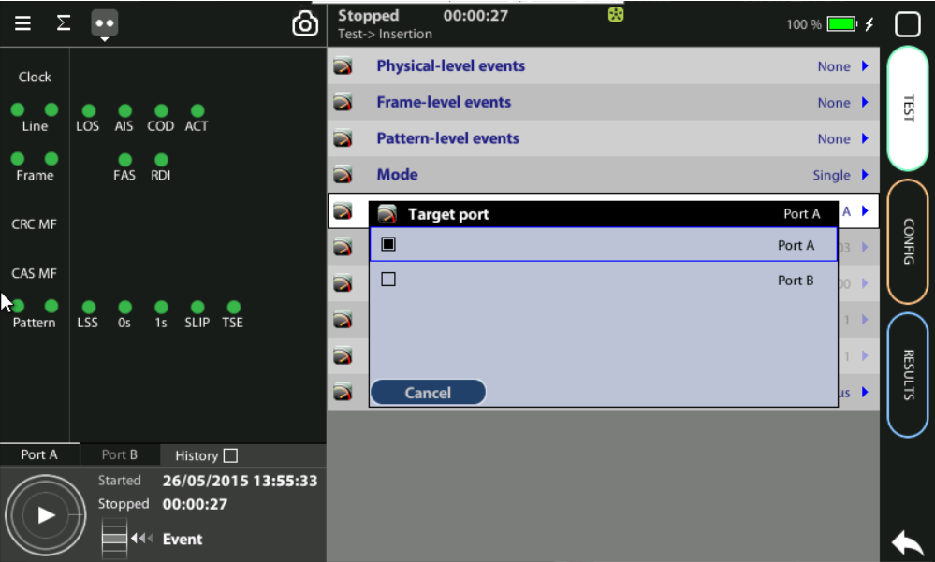
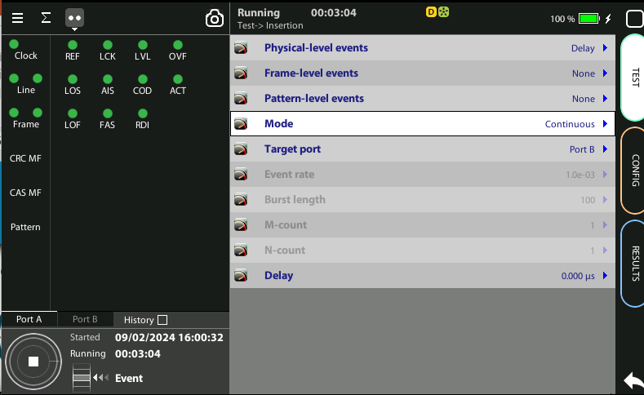
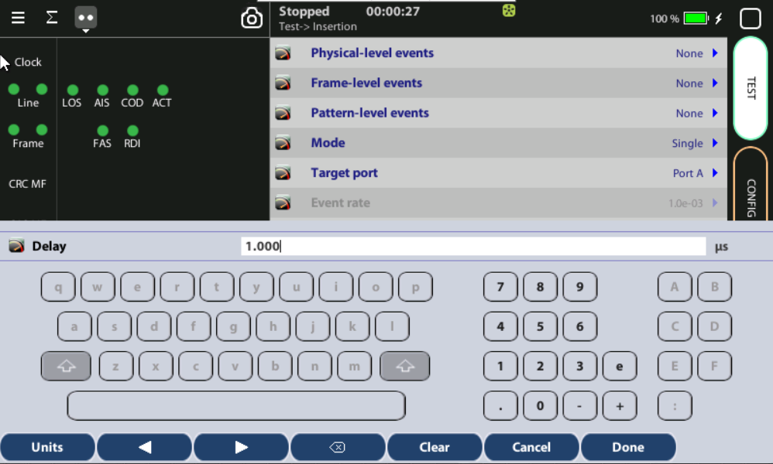
Insert Delay
2
1
3
Set the port where the delay is to be inserted: Test > Insertion > Target port := Port A or Port B
Select Delay
Configure the magnitude of the delay to be inserted (one hundred microseconds in this example): Test > Insertion > Delay:= 100 μs

Slide 13
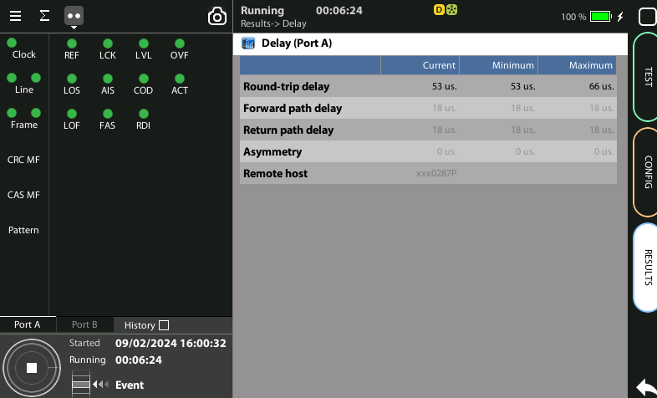
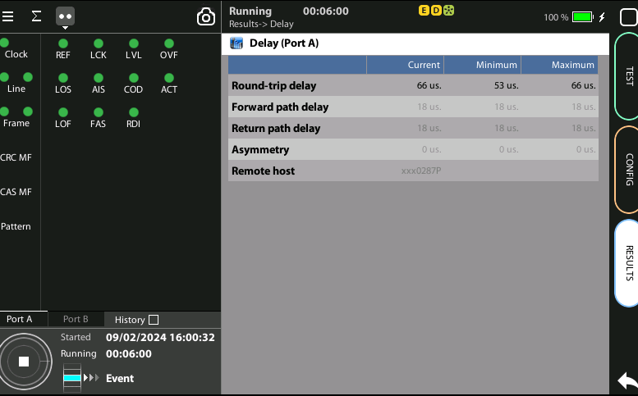
Observe the Results
2
2
3
1
Insert the Delay event
Spot how the Delay has been increased

Slide 14
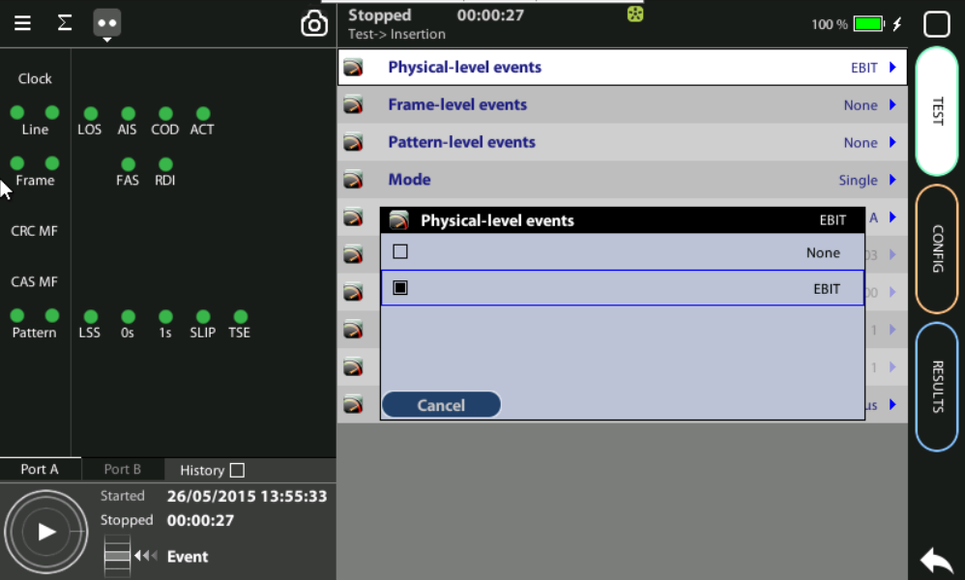
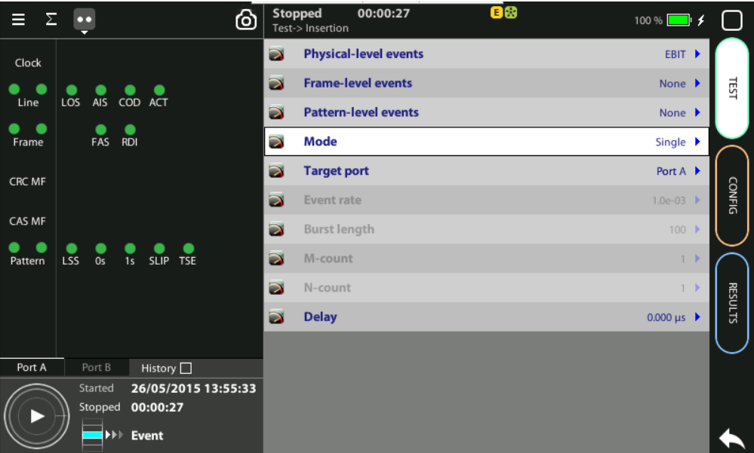
Insert Bit Errors
2
1
4
Set the port where the bit error is to be inserted: Test > Insertion > Target port := Port A or Port B
Configure the event: Test > Insertion > Physical-level events:= EBIT
Configure the insertion mode (“single” in this example): Test > Insertion > Mode := Single
Insert the bit error by pressing the Event button

Slide 15
Glossary
AAA: Authentication, Authorization, and Accounting
ACL: Access Control List
AP: Access Point
Busbar: Metallic strip or bar, typically housed inside switchgear, panel boards, and busway enclosures for local high current power distribution C37.94: TDM interface devoted for teleprotection
CB: Circuit Breaker designed to close or open electrical circuit under normal or abnormal conditions. It operates on relays command.
CBWFQ: Class-Based Weighted Fair Queuing
CG: Connected Grid
CID: Individual configuration of each IED CIP: Critical Infrastructure Protection CLI: Command-Line Interface
CorpSS: Corporate Substation
CT: Current Transformer, used for measurement of current, if too high to apply directly to measuring instruments, a CT produces a proportional current which can be measured and recorded, CT are used in metering and protective relays
DAN: Doubly Attached Nodes implementing HSR or PRP
DAU: Data Acquisition Unit
Disconnector: isolates physically and visually the lines
DMZ: Demilitarized Zone
DCB: Directional Comparison Blocking
DCS: distributed control systems
DSC: Differentiated Services Code Point
ESP: Electronic Security Perimeter
Feeder: Transmits power to the distribution points
GM: Grandmaster
GNSS: Global Navigation Satellite System
GOOSE: Generic Object-Oriented Substation Events is a control model defined as per IEC 61850 which provides a fast and reliable mechanism of transferring event data over entire electrical substation networks. When implemented, this model ensures the same event message is received by multiple physical devices using multicast or broadcast services
HMI: Human Machine Interface
PTP: Precision Time Protocol
RedBox: Redundancy Box
Relay: is automatic device which senses an abnormal condition of electrical circuit and closes its contacts and complete the circuit breaker trip.
REP: Resilient Ethernet Protocol
RCT: Redundancy Control Trailer
RTU: Remote Terminal Unit
SA: Substation Automation
SAN: Singly-Attached Node
Secondary Lines: lower voltage side at the substation
SCADA: Supervisory Control And Data Acquisition, transmits and receives data from events of controls, measuring, safety and monitoring. Power system elements can be controlled remotely over. Remote switching, telemetering of grids showing voltage, current, power, direction, consumption in kWh, synchronization.
SCD: Substation Configuration Description SCL: Substation Configuration Language SNTP: Simple Network Time Protocol
Station Bus: Connects the entire substation and helps provide connectivity between central management and individual bays
STP: Spanning Tree Protocol
SV: Sampled Values, is a method to read instantaneous values such as currents, voltages, impedances, etc. from CTs, VTs or digital I/O and then transmitted to make them are available for those IED subscribed.
Switchgear: combination of switches, fuses or CB to control, protect and isolate electrical equipment
SyncE: Synchronous Ethernet
TLV: Type, Length, Value
VT: Voltage Transformer (see CT)Potential Transformer, gives the reference voltage to the Relay for Over-voltage or Under-voltage Protection
UCA IuG: Utility Communications Architecture International Users Group
VDAN: Virtual D
HQoS: Hierarchical Quality of Service
HSR: High-Availability Seamless Redundancy
IA: Industrial Automation
ICS: Industrial control systems
ICU: Intelligent Control Unit
IEC: International Electrotechnical Commission
IEC 61850: Standard defining communication protocols for intelligent electronic devices at electrical substations
IED: Intelligent End Device, microprocessor-based controllers of power system equipment, such as circuit breakers, transformers and capacitor banks to enable advanced power automation.
IRIG: Inter-Range Instrumentation Group
ISE: Identity Services Engine
L3VPN: Layer 3 Virtual Private Network
LA: Lightning Arrester protects the power grid from electric storms
MQC: Modular QoS Command-Line Interface
MMS: Manufacturing Message Specification, messaging system for exchanging real-time data and supervisory control information. Allows client such as SCADA, an OPC server or a gateway to access all IED objects MPLS: Multi-protocol Label Switching
MU: Merging Unit connected to the process bus converts analog data(ie. volts, currect...) into digital information
NERC: North American Electric Reliability Corporation
NIST: National Institute of Standards and Technology
NMS: Network Management System
OAM: Operations and Maintenance
PCP: Priority Code Point
PIOC: Instantaneous overcorrent Protection
PLC: Programmable Logic Controller
PMU: Phasor Measurement Unit
POTT: Permissive Overreaching Transfer Trip
PP: Primary Power
Process Bus: Connects primary units and control equipment to the IEDs
PRP: Parallel Redundancy Protocol
PRTC: Primary Reference Clock
PT: see VT
T-GM: Grand Master PTP
T-BC: Boundary Clock
T-TSC: Slave Clock

Slide 16



That’s all
www.albedotelecom.com

