Slide 1
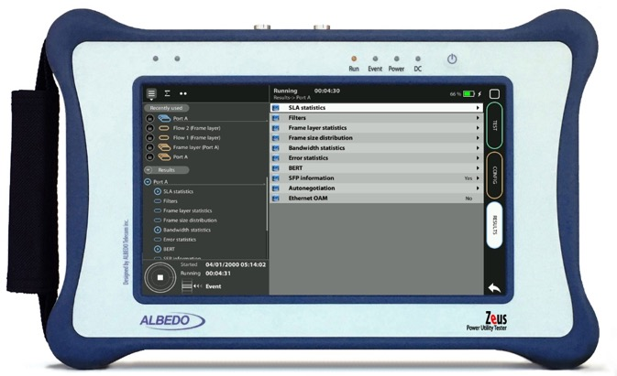

C37.94 Through Mode
Through Mode C37.94 with xGenius/Zeus
Guide & Slides corresponding to software ver. 2.6.1/1.4.1
Att.: To simulate this test 2 x Testers are required

Slide 2
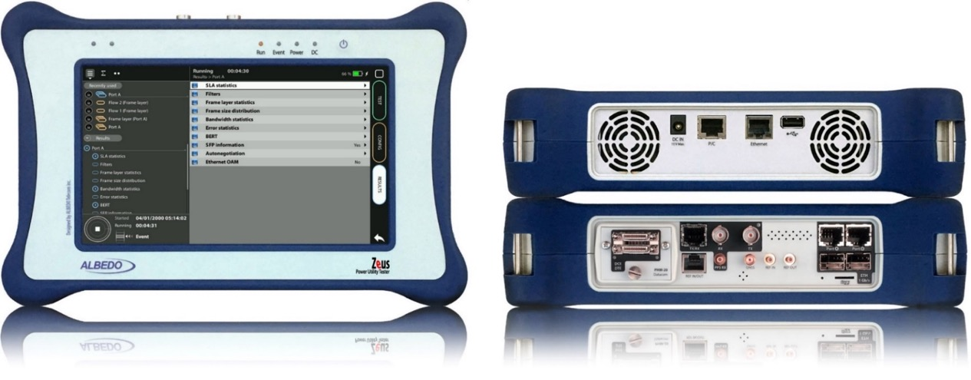
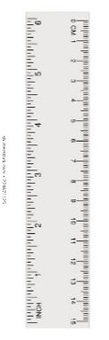
Zeus & xGenius
Zeus & xGenius provide deep insights to design, install, maintain, troubleshoot and engineer communications resources of Mobile Operators, Power Utilities, Finance, Labs and R+D centres. The unit is able to verify Ethernet/IP, SyncE, PTP, GbE, IRIG-B, 1PPS, T1/E1, G703, Serial Datacom, C37.94, GOOSE, SV, MMS, Round-trip & One-way Delay tests at all interfaces.
It also has a set of programmable filters to capture live data traffic at wire-speed

Slide 3
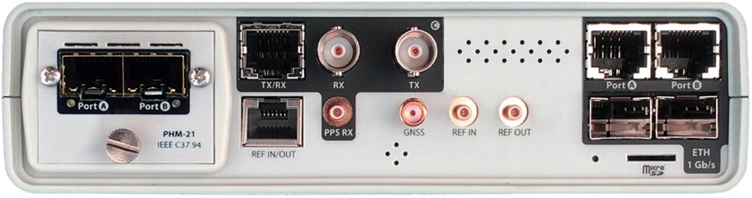
Interfaces & time References
PHM
RJ45-C
BNC-C
RJ45-A
RJ45-B
The unit is equipped with GNSS receiver with SMA female connector for connecting an antenna typically supplied with a 5 m of coaxial cable plus a 10 m extension cable.
RJ45
SMB-C
SMA
SMB-1
SMB-2
SFP-A
Micro SD
SFP-B
 | GNSS | PTP | NTP | ToD | IRIG-B | PPS | PP2S | SyncE | T1/E1 | MHz | C.3794
RJ45-A |  | in/out | in/out |  |  |  |  | in/out
RJ45-B |  |  |  |  |  |  |  | in/out
SFP-A |  | in/out | in/out |  |  |  |  | in/out
SFP-B |  |  |  |  |  |  |  | in/out
BNC-C |  |  |  |  |  |  |  |  | in/out | in/out
RJ45-C |  |  |  | in |  | in | in |  | in/out | in/out
SMB-C
SMA | in
SMB-1 |  |  |  |  | in | in | in
SMB-2 |  |  |  |  | out | out | out
RJ-45 |  |  |  | in/out | in/out | in/out | in/out |  | in/out | in/out
PHM |  |  |  |  |  |  |  |  |  |  | in/out

Slide 4
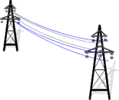

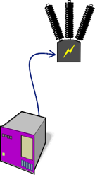


Through Mode using C37.94 Interface
High Voltage
Low Voltage
S U B S T A T I O N - 1
VT
CT
CB
IEEE C37.94
IED
v
ALBEDO
xGenius
Testing Points
Protection schemes, such as C37.94, have the objective of keeping the Power System stable and isolated. For correct function the control of latency, latency variations and asymmetry is fundamental.
Zeus and xGenius can be equipped with two C37.94 interfaces allowing them to be placed on a C37.94 circuit between two devices.

Slide 5

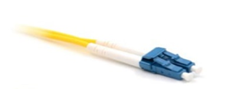
Connecting to the C37.94 interfaces
1
1
2
Zeus / xGenius are equipped with C37.94 optical interfaces using the PHM-21 module. Proceed to connect all the elements:
Insert compatible SFP to the C37.94 port A and port B on the unit.
Connect the optical cables to the SFPs into Port A and Port B

Slide 6


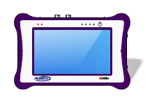
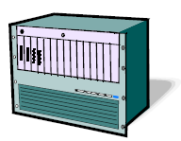
Hands-on C37.94 test
Teleprotection
IEEE C37.94
IEEE C37.94
A
Through Mode
Multiplexer
Multiplexer
Relay/IED
We are going to explain the Through Mode using a single tester, nevertheless Zeus / xGenius can also execute a number of other tests including:
  Measuring Frequency, Bit Rate and Optical Power
  Running BER and Performance Tests
  Event Generation and Analysis
  Latency measurement
  Jitter and Wander Generation and Analysis

Slide 7
Enable the C37.94 through mode
2
1
Go to Home > Config > Mode > C37.94 Through
Enable optical transmission Port A > Enable := yes
Enable optical transmission Port B > Enable := yes

Slide 8
Through Mode Clocking
IEEE C37.94
IEEE C37.94
A
Fig 1.
Through Mode
Multiplexer
Relay/IED
IEEE C37.94
IEEE C37.94
Fig 2.
A
Through Mode
Relay/IED
Relay/IED
Depending on the use case will dictate the clocking mode to use:
  Connecting in-line to a Mux/Network would require recovered clock mode (Fig 1.)
  Connecting two devices (ie. Relays) would require Synthesised clock (Fig 2.)

Slide 9

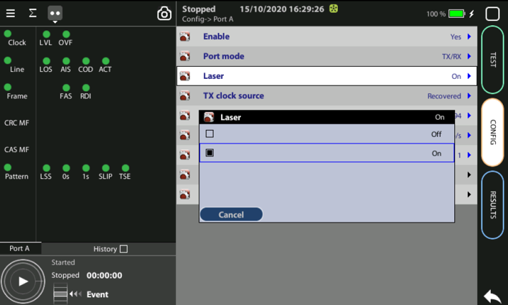
Configure clocks
4
1
1
3
On Port A: Configure TX clock source, TX clock offset (ppm), Frame to match your network settings
On Port B: Configure TX clock source, TX clock offset (ppm), Frame, TX data rate / TX timeslots and Test pattern to match your network settings
Set laser Config > Port A > Laser := On
Set laser Config > Port B > Laser := On

Slide 10
Through Mode
4
1
2
3
Select the LED tab
Next select Port A and check that the Line and Frame LEDs are all green, if not check clock setup for that port.
Repeat above process for Port B

Slide 11
Through Mode Tests
IEEE C37.94
IEEE C37.94
A
Through Mode
Multiplexer
Relay/IED
In through mode as well as checking the C37.94 signal for errors/anomalies you can insert the following :
  Physical bit errors (EBIT) into the transmitted data
  Fixed delay into Ports A & B (each port can have a different delay)
  Inject delay into Port A or B (delay can be switched on/off)

Slide 12
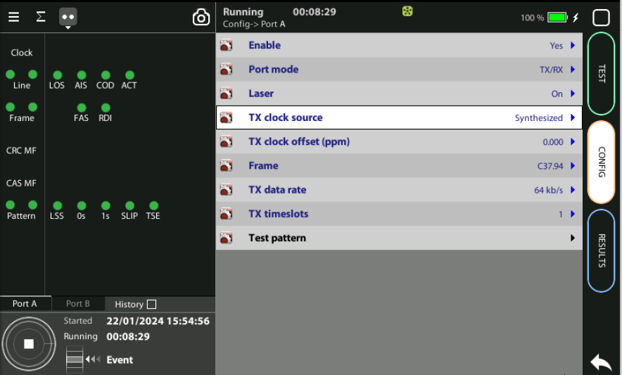
Fixed Delay
1
2
On Port A: Configure Forwarding Delay
Set Forwarding Delay to appropriate figure such as 40ms in the example above. This will introduce a 40ms fixed delay on traffic received from Port B and forwarded out of Port A.
Repeat on Port B if required, delays can by asymmetrical, not need to be the same.

Slide 13
Fixed Delay
1
3
2
Setting the fixed delay on Port A in the previous slide has introduced a 40ms delay in the return path.
The Asymmetry is approximately 40ms as there is minimal delay on the forward path
If we introduce a fixed delay on Port B in through mode we can now see there is a forward path delay of 20ms introduced and the asymmetry is now 20ms

Slide 14
Insert Event Delay
3
2
4
In addition to the fixed delay, we can create a delay event on one port which we can turn on and off
Go to Home > Test > Insertion
Select Physical level events
Select Delay

Slide 15

Insert Event Delay
1
2/4
Select Delay and enter required delay value, in this example 10ms
Select Target Port on which to introduce Event Delay.
Press the Event button to insert (turn on) delay, this will introduce the delay on the selected port. Event Delay will be added to any delay already configured in the fixed delay.
Pressing the Event button again will turn off the Event Delay

Slide 16
Insert Event EBIT
1
2/4
Insert Event EBIT will introduce bit errors into the transmitted C37.94 stream on the selected port
Go to Home > Test > Insertion > Physical level events and select EBIT
Select Target Port on which to introduce Event EBIT
Select Mode to select if a Single, Burst or other errors are introduced
Press the Event button to insert EBIT errors. Pressing the event button each time will inject single, burst or other errors.

Slide 17
Simulation with 2 testers
(this is how has to be executed)

Slide 18
Through Mode Clocking
IEEE C37.94
IEEE C37.94
Fig 1.
I
Through Mode
IED - A
IED - B
IEEE C37.94
I
II
Fig 2.
IEEE C37.94
Through Mode
Simulation of
IED – A
IED – B
We are going to simulate Fig 1 substitution both IED by one tester

Slide 19
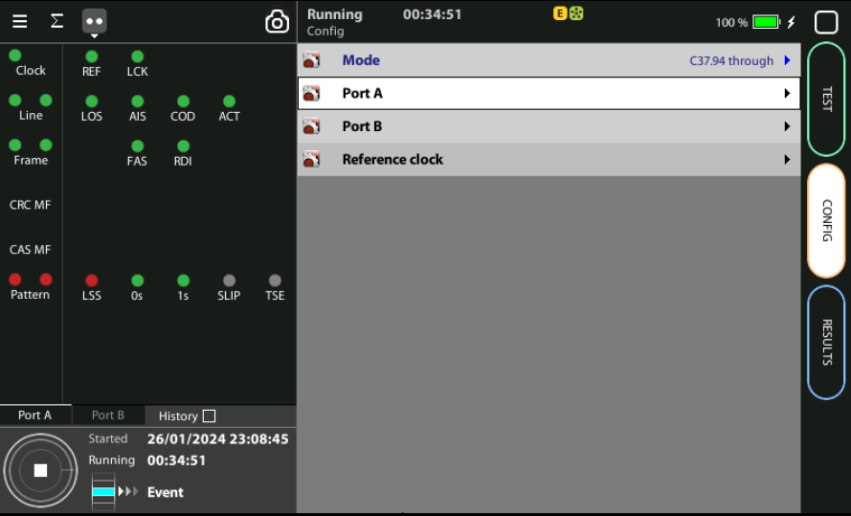
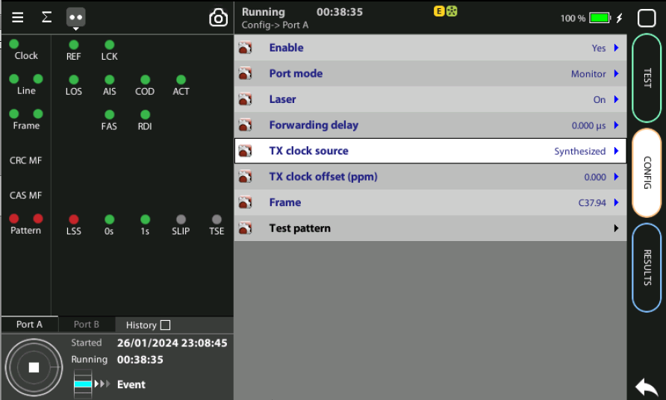
Configure Through mode Tester ONE
Tester ONE
Go to Home > Config > Mode := C37.94 through
Configure Port A
Enable := Yes
Port Mode : Monitor
Laser := ON
etc.

Slide 20
Configure IED Simulation Tester TWO
Tester ONE
Go to Home > Config > Mode := C37.94 through
Configure Port A
Enable := Yes
Port Mode : Monitor
Laser := ON
etc.

Slide 21
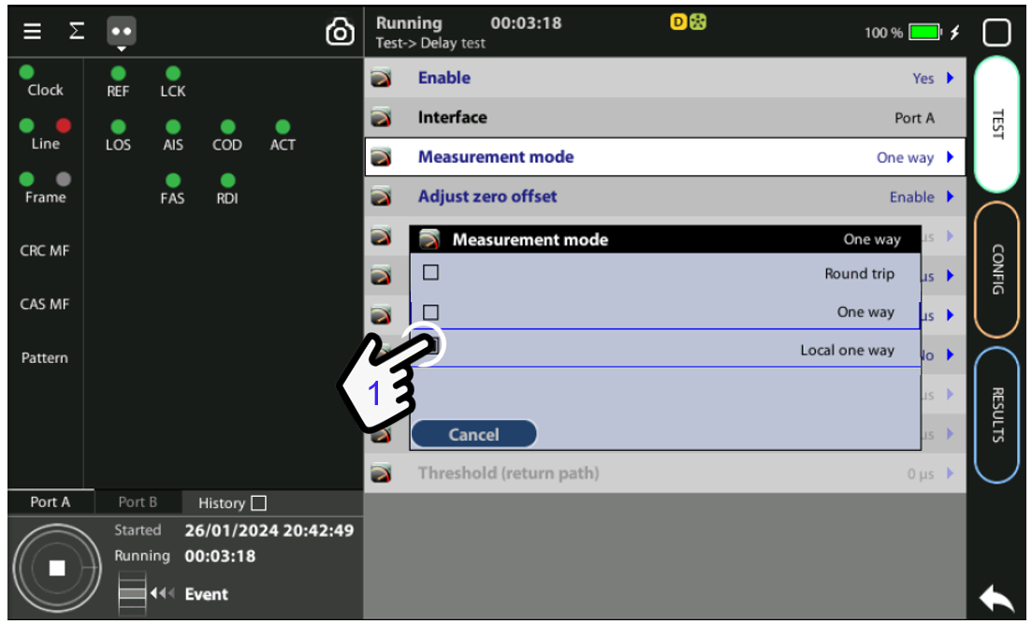
Configure Tester TWO mode
Test > Delay test > Measurement mode := Local one way

Slide 22

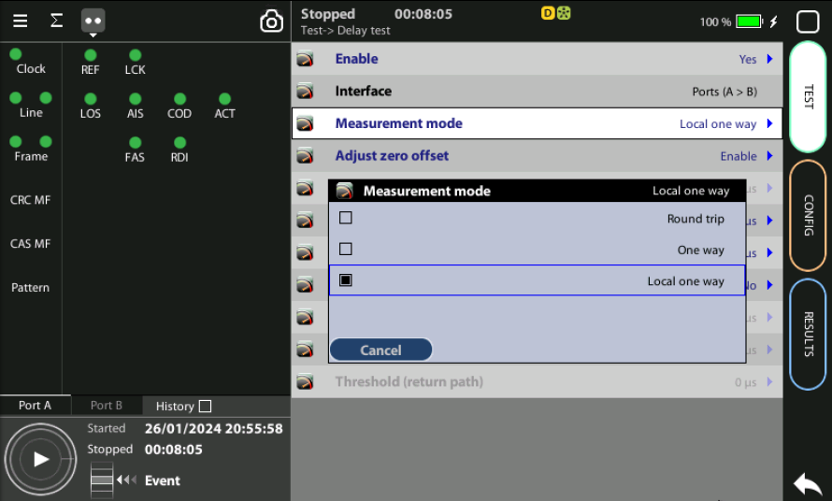

Configure Port B
4
1
3
Configure the local OWD test
OWD measurement is executed in Port A using Tester I and Tester II

Slide 23
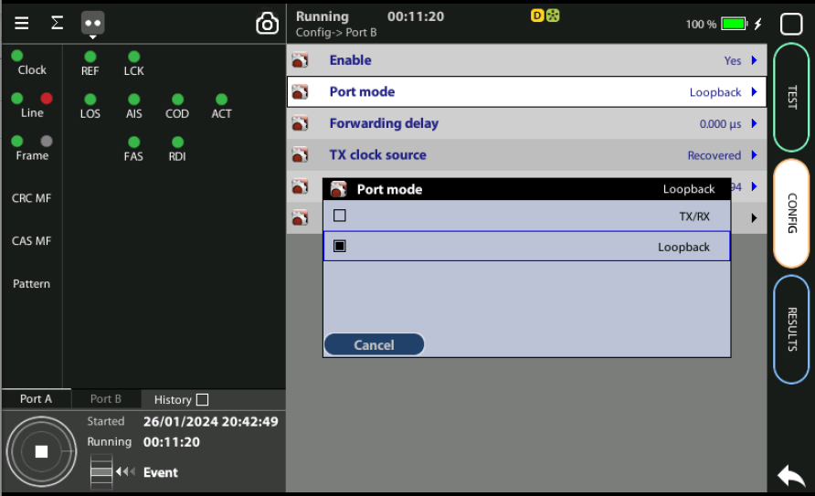
Configure Port A tester TWO
4
1/2
1/2
3
Tester TWO Configure:
Config > Port A > TX clock source := Synthetized
Config > Port A > TX clock offset (ppm) := 0
Config > Port A > Frame := C37.94
Config > Port A > TX data rate := 64kb/s
Config > Port A > Time Slots := 1
Set laser Config > Port A > Laser := On

Slide 24
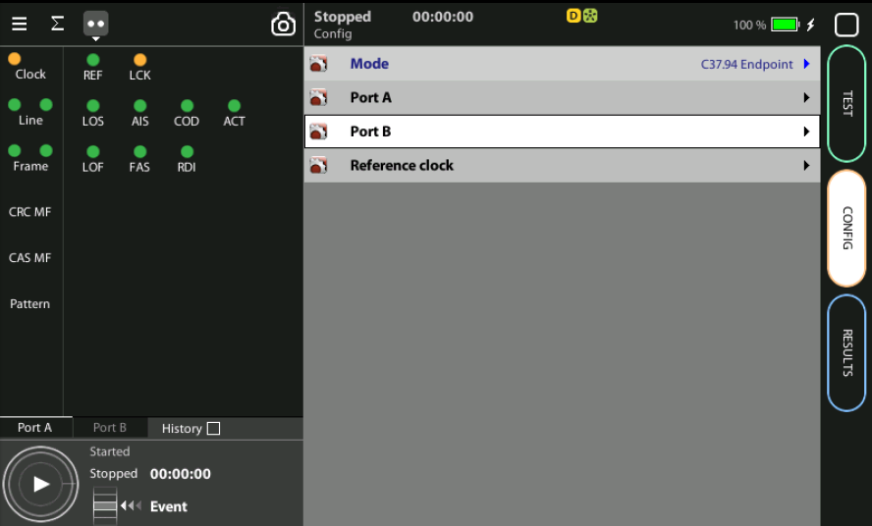
Configure Port B
It is not necessary to configure Port B
OWD measurement is executed in Port A using Tester I and Tester II

Slide 25
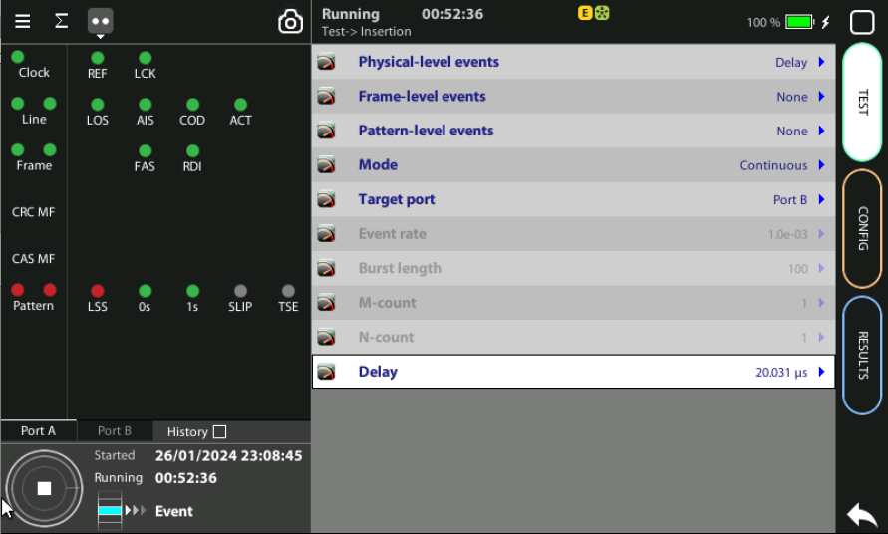
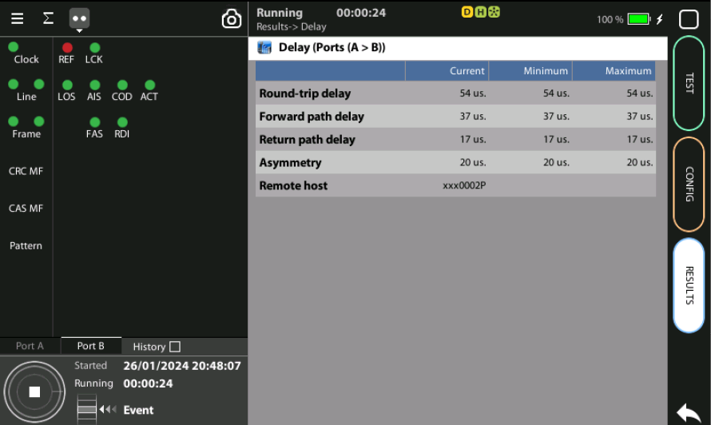


Insert Fixed Delay in Tester ONE
3
1
2
Tester ONE: Test > Insertion > Delay := (value)
Insert Delay event
Tester TWO: see what occurs

Slide 26
Glossary
AAA: Authentication, Authorization, and Accounting
ACL: Access Control List
ACT: Activity alarm when no data is detected in transmission
AP: Access Point
Busbar: Metallic strip or bar, typically housed inside switchgear, panel boards, and busway enclosures for local high current power distribution C37.94: TDM interface devoted for teleprotection
CB: Circuit Breaker designed to close or open electrical circuit under normal or abnormal conditions. It operates on relays command.
CBWFQ: Class-Based Weighted Fair Queuing
CG: Connected Grid
CID: Individual configuration of each IED CIP: Critical Infrastructure Protection CLI: Command-Line Interface
CorpSS: Corporate Substation
CT: Current Transformer, used for measurement of current, if too high to apply directly to measuring instruments, a CT produces a proportional current which can be measured and recorded, CT are used in metering and protective relays
DAN: Doubly Attached Nodes implementing HSR or PRP
DAU: Data Acquisition Unit
Disconnector: isolates physically and visually the lines
DMZ: Demilitarized Zone
DCB: Directional Comparison Blocking
DCS: distributed control systems
DSC: Differentiated Services Code Point
ESP: Electronic Security Perimeter
Feeder: Transmits power to the distribution points
GM: Grandmaster
GNSS: Global Navigation Satellite System
GOOSE: Generic Object-Oriented Substation Events is a control model defined as per IEC 61850 which provides a fast and reliable mechanism of transferring event data over entire electrical substation networks. When implemented, this model ensures the same event message is received by multiple physical devices using multicast or broadcast services
HMI: Human Machine Interface
PTP: Precision Time Protocol
RedBox: Redundancy Box
Relay: is automatic device which senses an abnormal condition of electrical circuit and closes its contacts and complete the circuit breaker trip.
REP: Resilient Ethernet Protocol
RCT: Redundancy Control Trailer
RTU: Remote Terminal Unit
SA: Substation Automation
SAN: Singly-Attached Node
Secondary Lines: lower voltage side at the substation
SCADA: Supervisory Control And Data Acquisition, transmits and receives data from events of controls, measuring, safety and monitoring. Power system elements can be controlled remotely over. Remote switching, telemetering of grids showing voltage, current, power, direction, consumption in kWh, synchronization.
SCD: Substation Configuration Description SCL: Substation Configuration Language SNTP: Simple Network Time Protocol
Station Bus: Connects the entire substation and helps provide connectivity between central management and individual bays
STP: Spanning Tree Protocol
SV: Sampled Values, is a method to read instantaneous values such as currents, voltages, impedances, etc. from CTs, VTs or digital I/O and then transmitted to make them are available for those IED subscribed.
Switchgear: combination of switches, fuses or CB to control, protect and isolate electrical equipment
SyncE: Synchronous Ethernet
TLV: Type, Length, Value
VT: Voltage Transformer (see CT)Potential Transformer, gives the reference voltage to the Relay for Over-voltage or Under-voltage Protection
UCA IuG: Utility Communications Architecture International Users Group
VDAN: Virtual D
HQoS: Hierarchical Quality of Service
HSR: High-Availability Seamless Redundancy
IA: Industrial Automation
ICS: Industrial control systems
ICU: Intelligent Control Unit
IEC: International Electrotechnical Commission
IEC 61850: Standard defining communication protocols for intelligent electronic devices at electrical substations
IED: Intelligent End Device, microprocessor-based controllers of power system equipment, such as circuit breakers, transformers and capacitor banks to enable advanced power automation.
IRIG: Inter-Range Instrumentation Group
ISE: Identity Services Engine
L3VPN: Layer 3 Virtual Private Network
LA: Lightning Arrester protects the power grid from electric storms
MQC: Modular QoS Command-Line Interface
MMS: Manufacturing Message Specification, messaging system for exchanging real-time data and supervisory control information. Allows client such as SCADA, an OPC server or a gateway to access all IED objects MPLS: Multi-protocol Label Switching
MU: Merging Unit connected to the process bus converts analog data(ie. volts, currect...) into digital information
NERC: North American Electric Reliability Corporation
NIST: National Institute of Standards and Technology
NMS: Network Management System
OAM: Operations and Maintenance
PCP: Priority Code Point
PIOC: Instantaneous overcorrent Protection
PLC: Programmable Logic Controller
PMU: Phasor Measurement Unit
POTT: Permissive Overreaching Transfer Trip
PP: Primary Power
Process Bus: Connects primary units and control equipment to the IEDs
PRP: Parallel Redundancy Protocol
PRTC: Primary Reference Clock
PT: see VT
T-GM: Grand Master PTP
T-BC: Boundary Clock
T-TSC: Slave Clock

Slide 27



That’s all
www.albedotelecom.com

