Slide 1
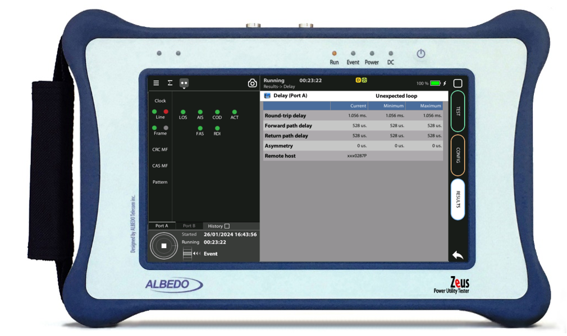
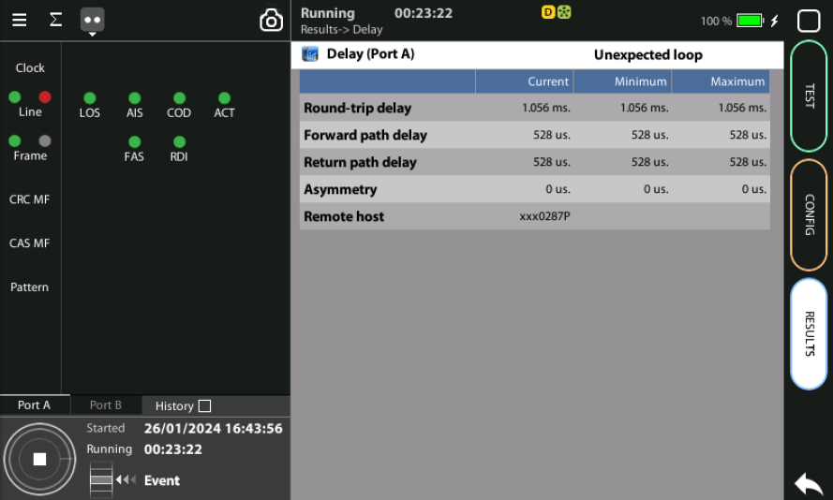

C37.94 Testing
One-Way Delay over C37.94 with xGenius
Guide & Slides corresponding to software ver. 2.10.5

Slide 2
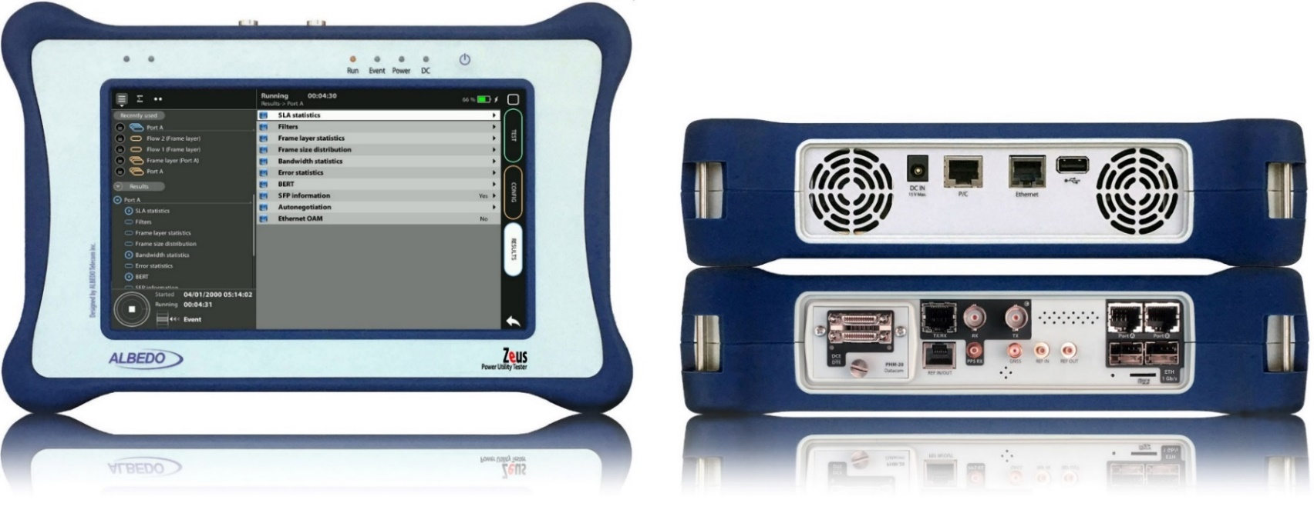

Zeus & xGenius
Zeus & xGenius provide deep insights to design, install, maintain, troubleshoot and engineer communications resources of Mobile Operators, Power Utilities, Finace, Labs and R+D centers. The unit is able to verify Ethernet/IP, SyncE, PTP, GbE, IRIG-B, 1PPS, T1/E1, G703, Serial Datacom, C37.94, GOOSE, SV, MMS, Round-trip & One-way Delay tests at all interfaces.
It also has a set of programmable filters to capture live data traffic at wire-speed

Slide 3
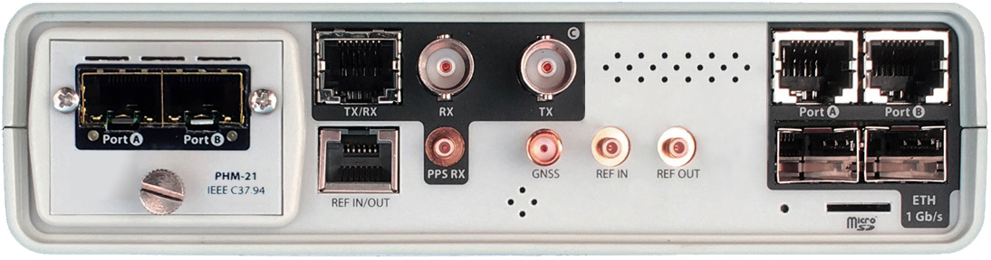
Interfaces & time References
PHM
RJ45-C
BNC-C
RJ45-A
RJ45-B
Always use Port A for OWD
(One Way Delay)
RJ45
SMB-C
SMA
SMB-1
SMB-2
SFP-A
Micro SD
SFP-B
 | GNSS | PTP | NTP | ToD | IRIG-B | PPS | PP2S | SyncE | T1/E1 | MHz | C37.94
RJ45-A |  | in/out | in/out |  |  |  |  | in/out
RJ45-B |  |  |  |  |  |  |  | in/out
SFP-A |  | in/out | in/out |  |  |  |  | in/out
SFP-B |  |  |  |  |  |  |  | in/out
BNC-C |  |  |  |  |  |  |  |  | in/out | in/out
RJ45-C |  |  |  | in |  | in | in |  | in/out | in/out
SMB-C
SMA | in
SMB-1 |  |  |  |  | in | in | in
SMB-2 |  |  |  |  | out | out | out
RJ-45 |  |  |  | in/out | in/out | in/out | in/out |  | in/out | in/out
PHM |  |  |  |  |  |  |  |  |  |  | in/out

Slide 4
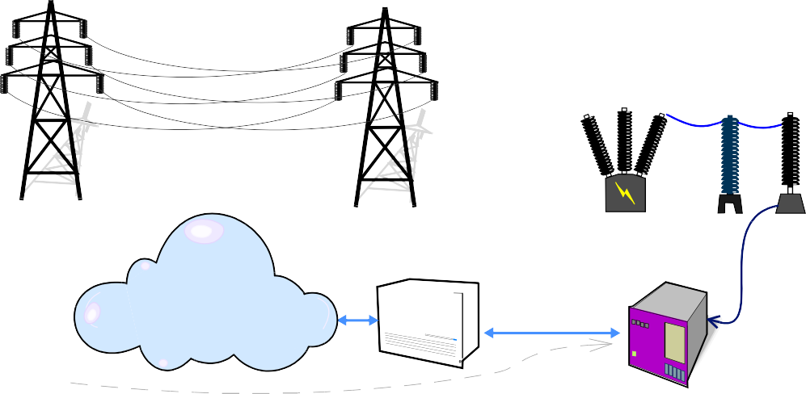

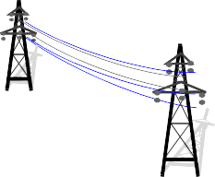
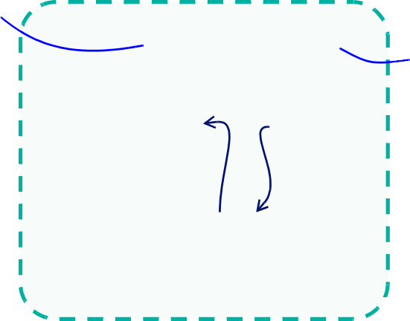

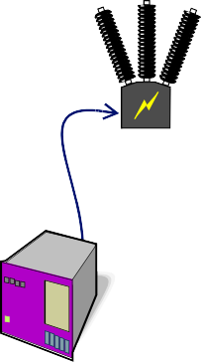








One-Way Delay over C37.94 Interface
High Voltage
Low Voltage
S U B S T A T I O N - 1
S U B S T A T I O N - 2
VT
CT
CB
CB
CT
VT
GNSS
IEEE C37.94
SDH/SONET
IEEE C37.94
GNSS
IED
A
B
ALBEDO
xGenius
Testing Points
ALBEDO
xGenius
Protection schemes, such as C37.94, have the objective of keeping the Power System stable and isolated. For correct function the control of latency, latency variations and asymmetry is fundamental.
Zeus and xGenius equipped with C37.94 interfaces and synchronized by GPS, measure all key parameters including One‐Way Delay (OWD) by means of two units (in the picture A and B) at the ends of the path to be qualified.

Slide 5

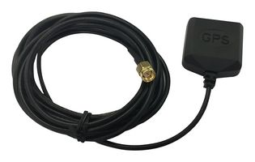
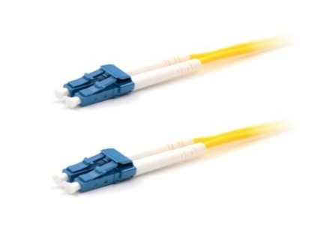
Connecting the GPS & C37.94
1
3
2
Zeus / xGenius are equipped with C47.94 optical interfaces and a built-in GNSS receiver. Proceed to connect all the elements:
Introduce a couple of compatible SFP to the C37.94 ports
Connect the optical cables to the SFPs
Connect the cable to the SMA and orient the antenna oriented to open sky.

Slide 6

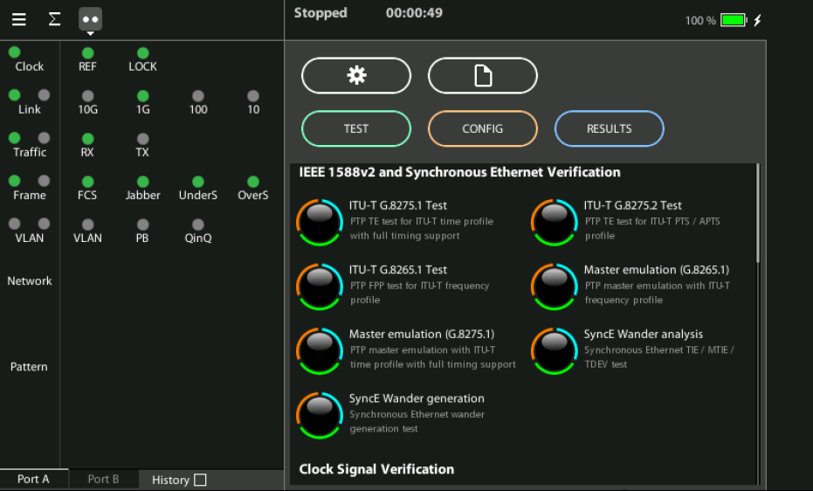
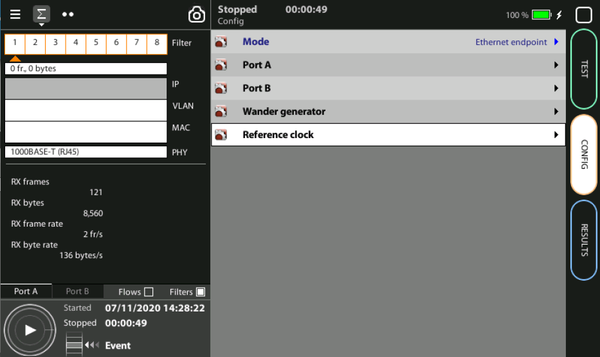
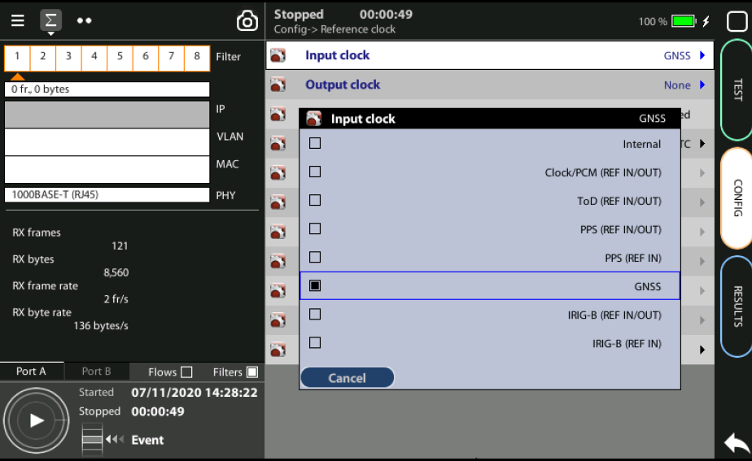
Steps to connect the built-in GNSS
3
2
1
1
Home > Config > Reference clock > Input clock := GNSS (*)
Press LEDS to check the status
Wait for the REF and LOCK LEDs to become green
(*) Go to Home panel, go to Config, the port setup will be displayed then Go to Reference clock and configure Input clock to GNSS
Note: The locking process for the OCXO version of xGenius may take around 10 minutes. The coarse locking process in Rubidium units

Slide 7
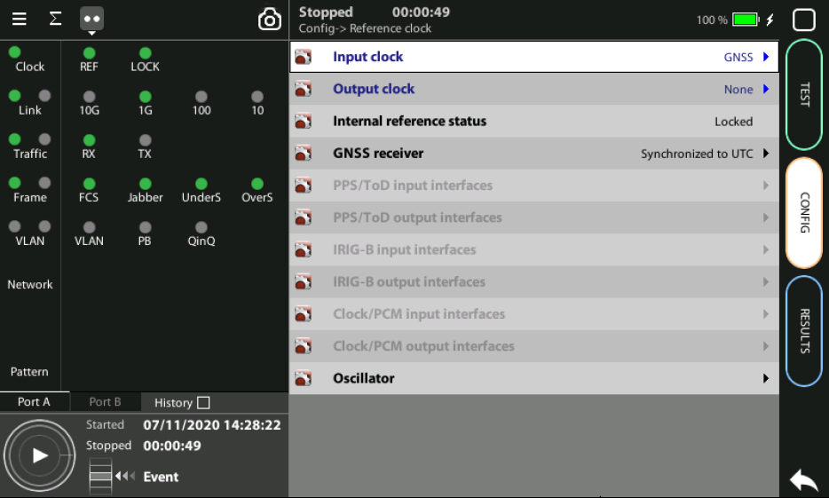
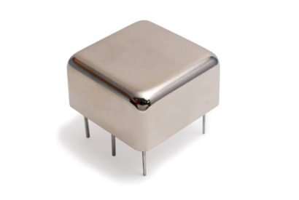
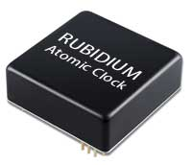
OCXO or Rubidium
1
  The unit will be ready for testing LOCK LED is green
  Mind that time is different depending which oscillator xGenius is equipped
Current locking status (Locking, Fine locking, Locked, Holdover, etc.) can be checked in the Reference clock menu.
Metric | OCXO | Rubidium
Locking time | < 5 minutes | < 4 hours

Slide 8
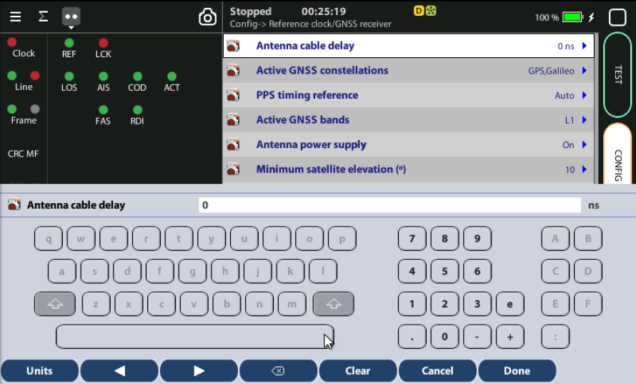
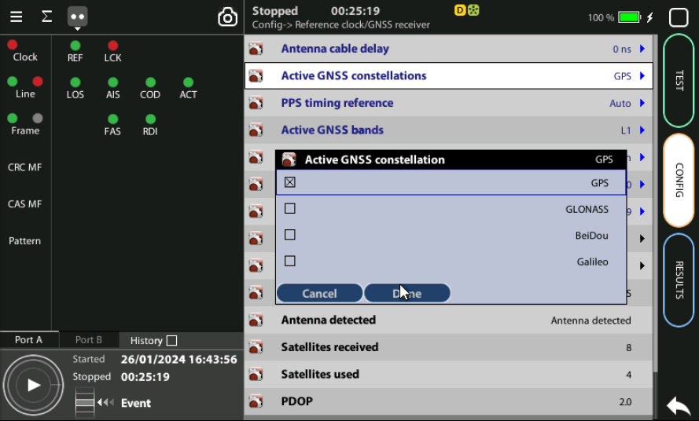
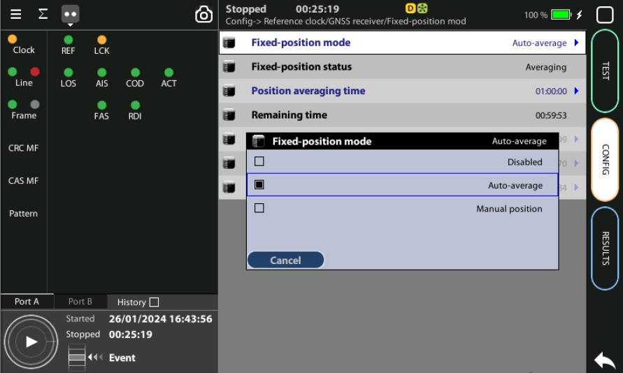
Configuring the GNSS Properties
1
2
3
Configure the GNSS to increase the accuracy:
Config > Reference clock > GNSS receiver > Antenna cable delay to configure a compensation at the correction field
In the same screen Enable/Disable any constellation (GPS, GLONASS, GALILEO, BEIDO) through the Active GNSS setting := GPS…
Go to Fixed‐position mode := Auto-average

Slide 9
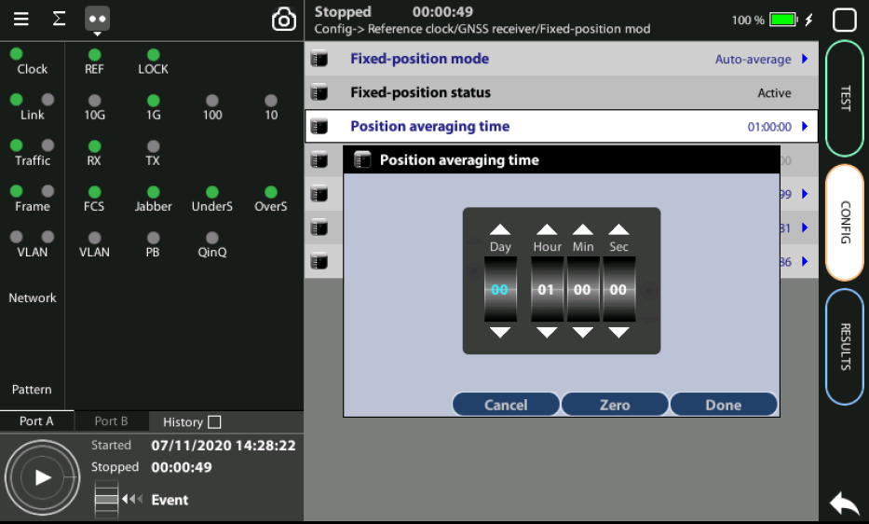
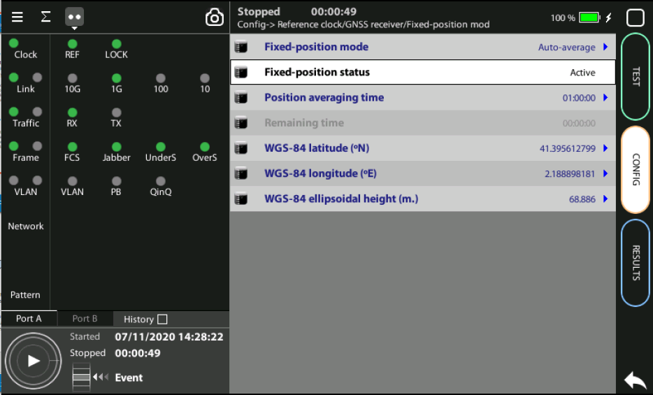
Position Averaging time
GPS has a statistical distribution and averaging for a time filters errors to improve accuracy.
Adjust the Position averaging time and by configuring Auto‐average in the that now displays Averaging
Wait to the Fixed position status to become Active. The unit is now ready for testing.
Note: Theoretically, testing could start before the end of the position averaging process. The improved time estimation due to this function would be automatically applied starting from the end of the auto‐averaging process.
1
Notes: (a) At least 1h of averaging is required for reasonable accuracy. (b) The procedure should be run only once as long as the location does not change. If any change is detected (longitude, latitude, altitude) an error will be displayed.
2

Slide 10
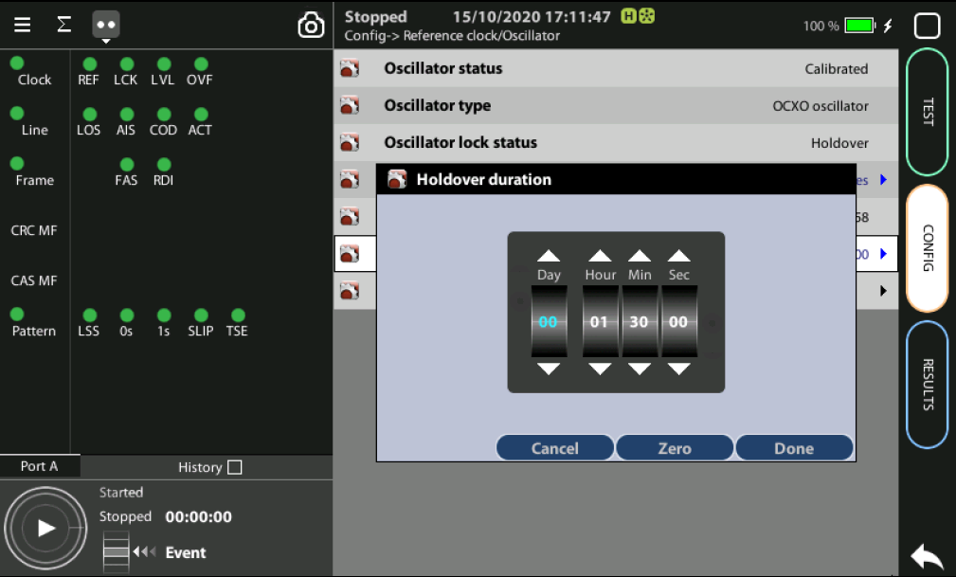
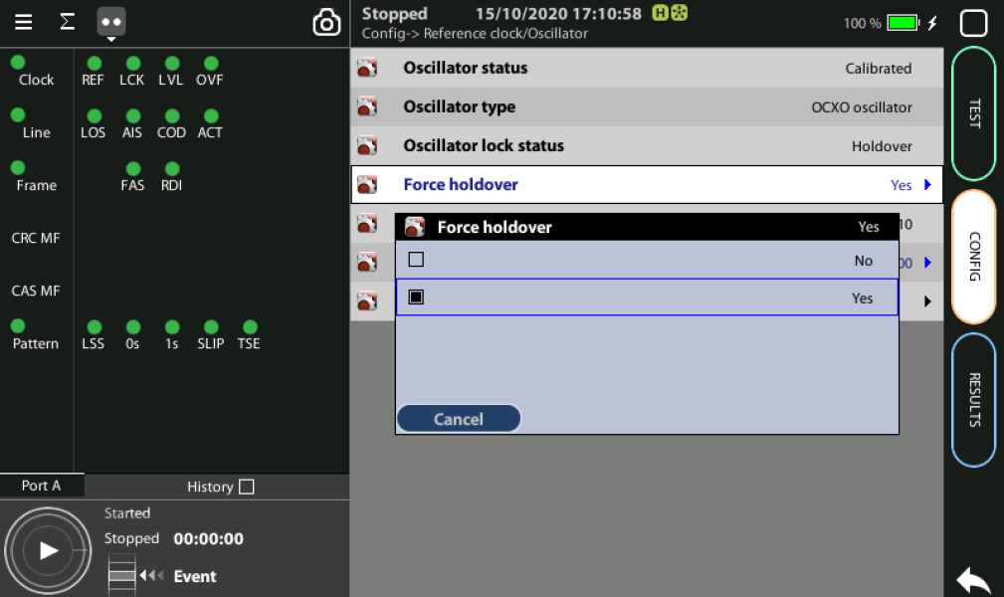
Holdover mode
1
3
2
When GPS is not available (i.e. a room without windows) you can first synchronize the unit in a place with GPS and then go to execute the test in holdover mode.
Accuracy will depend on: (a) the quality of the internal oscillator (Quartz, OCXO, Rubidium); and (b) the holdover period.
Synchronize to GPS and and verify that LED Clock, REF and LOCK are green
Config > Reference clock > Holdover duration := set the time you need for testing
Config > Reference clock > Force holdover := Yes

Slide 11
OWD with 2 synchronized testers
(this is how has to be executed)

Slide 12



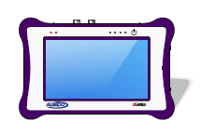
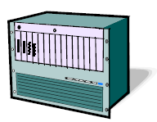
Hands-on to C37.94 test
Tester I
Tester II
GNSS
GNSS
Teleprotection
A
B
Generation
Analysis
Multiplexer
Loopback
We are going to explain the One-way delay using two testers synchronized
Zeus / xGenius can execute also a number of tests including:
  Measuring Frequency, Bit Rate and Optical Power
  Running BER and Performance Tests
  Event Generation and Analysis
  Latency measurement
  Jitter and Wander Generation and Analysis

Slide 13
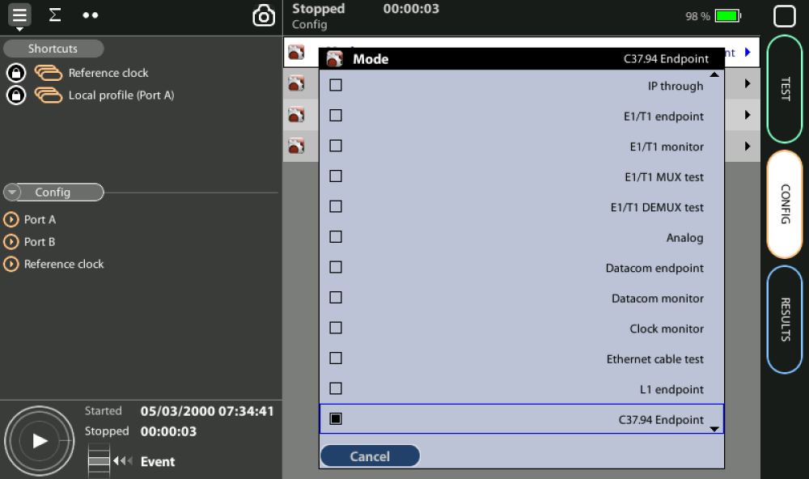
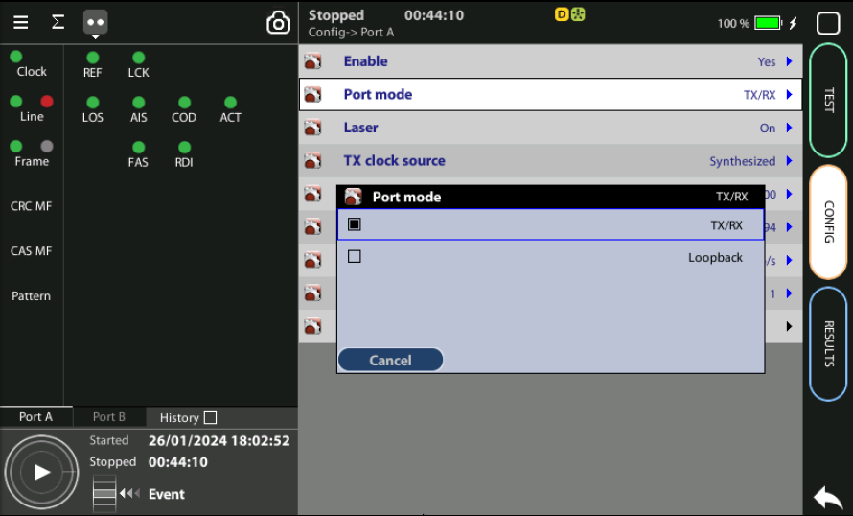
Enable the C37.94 analysis
5
2
3
Port A
B Port
4
1
Tester ONE: Go to Home > Config > Mode > C37.94 Endpoint
Enable optical transmission Port A > Enable := yes
Configure Tester I to Generate & Analyze traffic:
Config > Port Mode := TX/RX
Tester TWO: Interestingly this test is totally symmetric then repeat the configuration in Tester TWO
Attention: Remember to use Port A for delay tests, no Port B

Slide 14
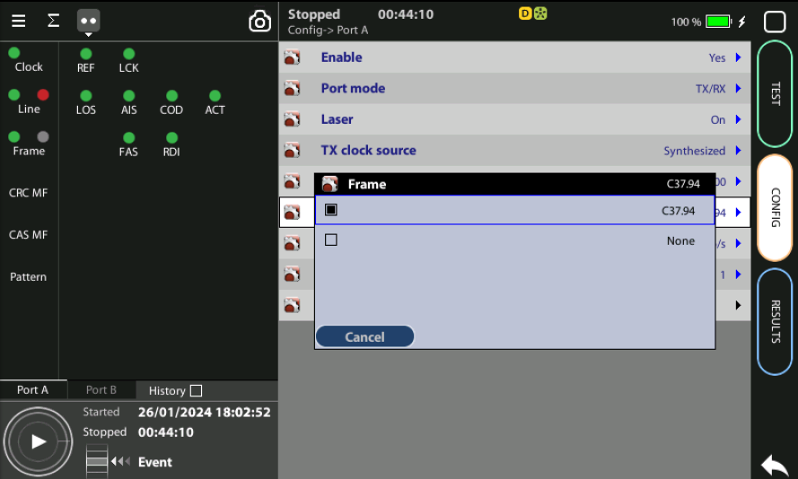
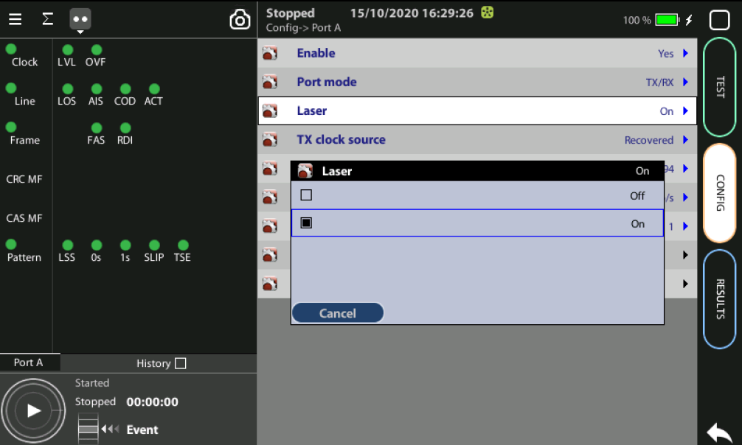
Configure Port A
4
1/2
1/2
3
Tester ONE & TWO Configure:
Config > Port A > TX clock source := Synthetized
Config > Port A > TX clock offset (ppm) := 0
Config > Port A > Frame := C37.94
Config > Port A > TX data rate := 64kb/s
Config > Port A > Time Slots := 1
Set laser Config > Port A > Laser := On
See Pattern

Slide 15
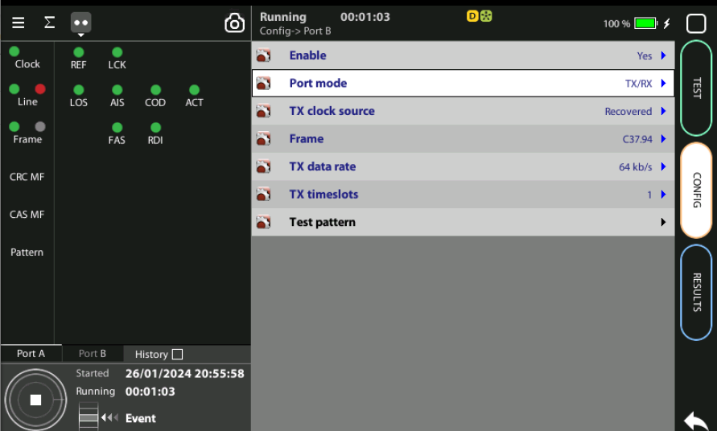
Configure Port B
4
3
3
It is not necessary to configure Port B
OWD measurement is executed in Port A using Tester I and Tester II

Slide 16
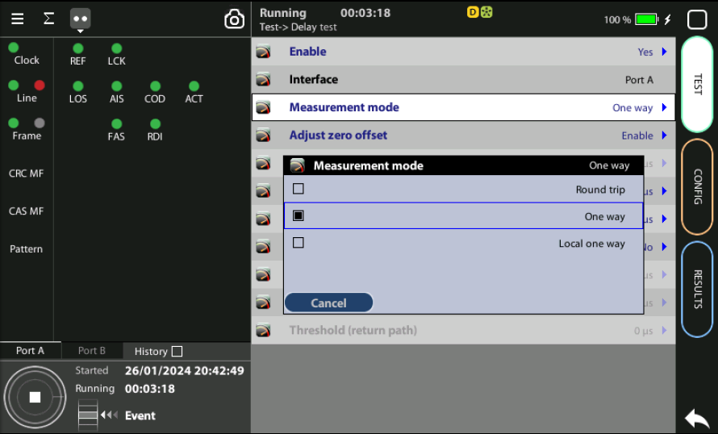
Enable the OWD test
1
Tester ONE & TWO Configure:
Test > Delay test > Enable := Yes
Configure to One‐way: Test > Measurement mode := One way

Slide 17
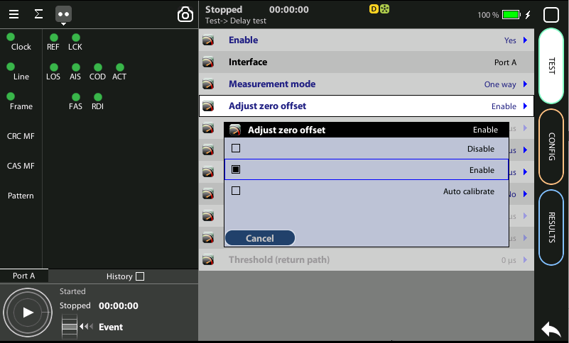
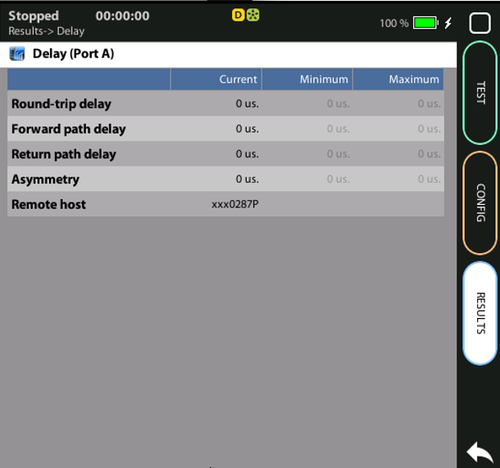
Adjust to Zero
1
3
2
It is necessary to cancel the delay due
to cables and intrinsic to the tester that
could modify the results.
Disconnect the unit from the network
and loop Tx - Rx with a patch cord
Test > Delay test > Adjust zero offset := Auto-calibrate
Go to Results > Delay (delay parameters are zero)
Once you have calibrated the OWD test, reconnect the unit to the network.
Repeat the configuration in tester II

Slide 18
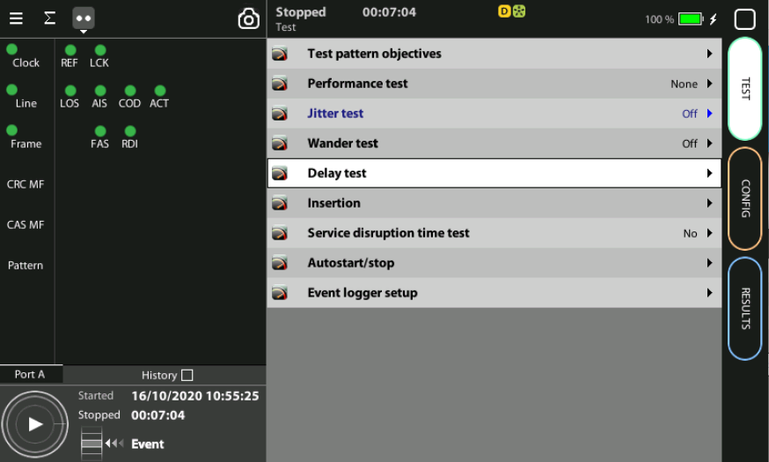
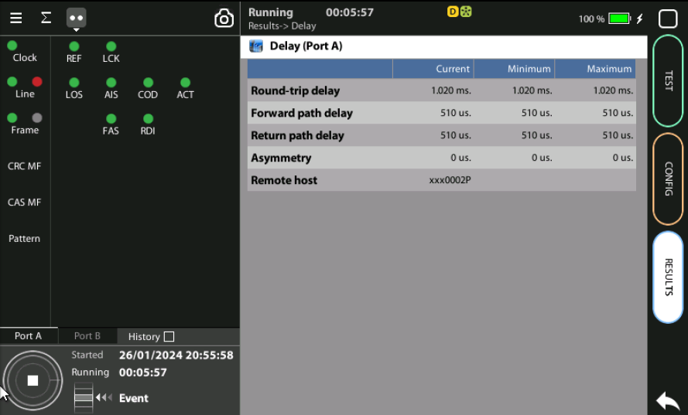
Running the OWD test
3
2
2
The test is now ready to start then Press RUN
Check Delay results at any time during the testing process:
Home > Results > Delay test

Slide 19
OWD with 1 synchronized testers
(this is for demo or learning)

Slide 20
Configure
OWD with 2 synchronized testers
(this is how has to be executed)
1
You need 2 testers but you may simulate to demo or learning with 1 tester
Test > Delay test > Measurement mode := Local one way

Slide 21
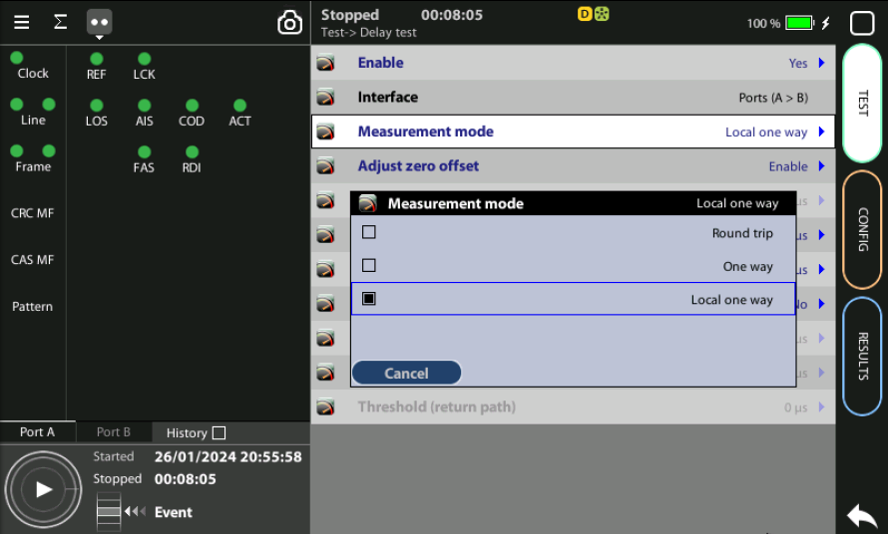
Configure Port B
4
1
3
Configure the local OWD test
OWD measurement is executed in Port A using Tester I and Tester II

Slide 22
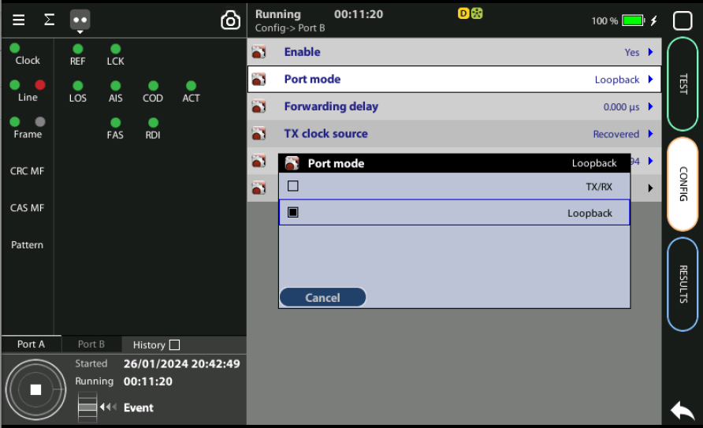
Configure Port A
4
1/2
1/2
3
Tester ONE & TWO Configure:
Config > Port A > TX clock source := Synthetized
Config > Port A > TX clock offset (ppm) := 0
Config > Port A > Frame := C37.94
Config > Port A > TX data rate := 64kb/s
Config > Port A > Time Slots := 1
Set laser Config > Port A > Laser := On

Slide 23
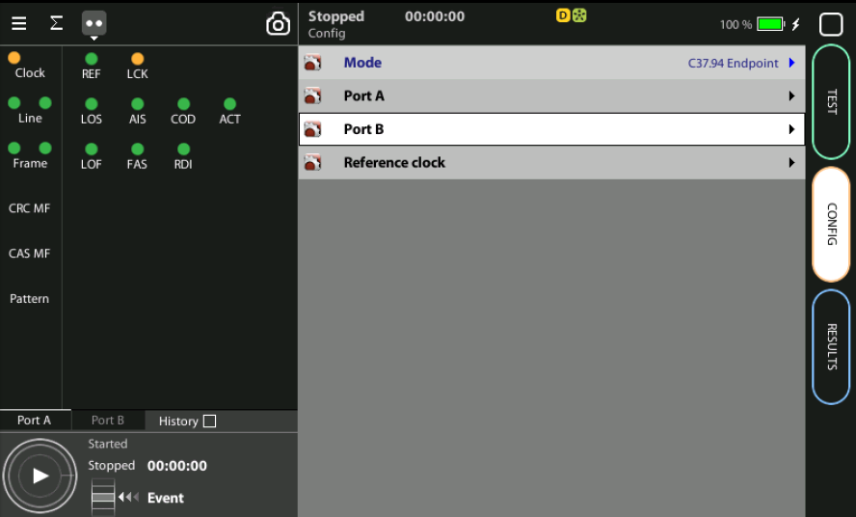
Configure Port B
It is not necessary to configure Port B
OWD measurement is executed in Port A using Tester I and Tester II

Slide 24
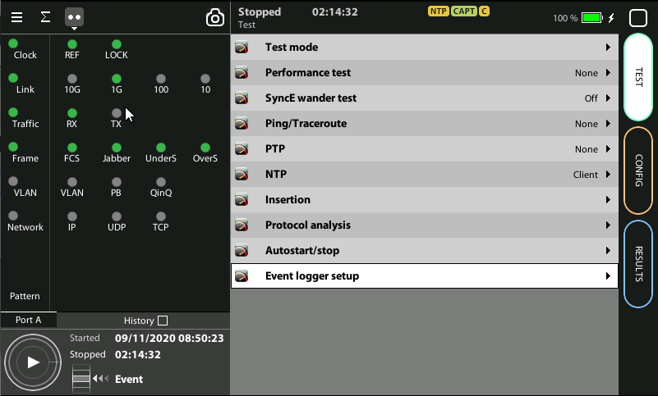
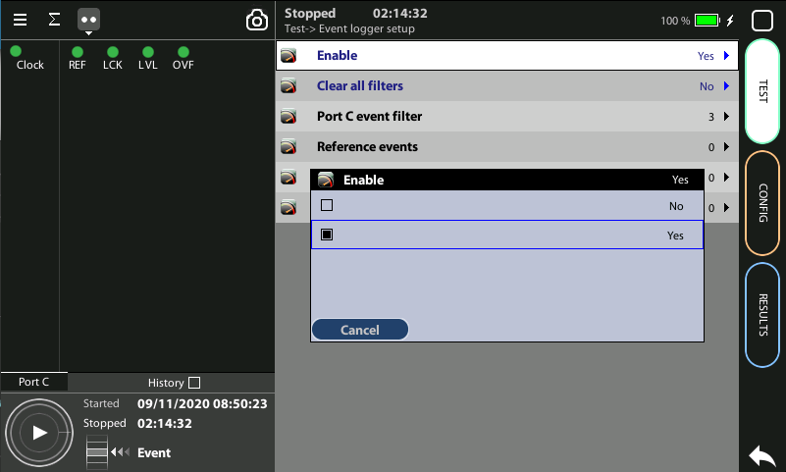
Event logger enable
1
1
Global counts, statistics and LEDs provide information about which events and how many of them have been registered but they do not say too much about how they are distributed in time. These information is supplied at the Event Logger a graphical representation tool that permits to trace the evolution of key parameters.
The first thing to to is to enable it:
Go to Home > Test > Event logger setup
Set Enable := Yes

Slide 25
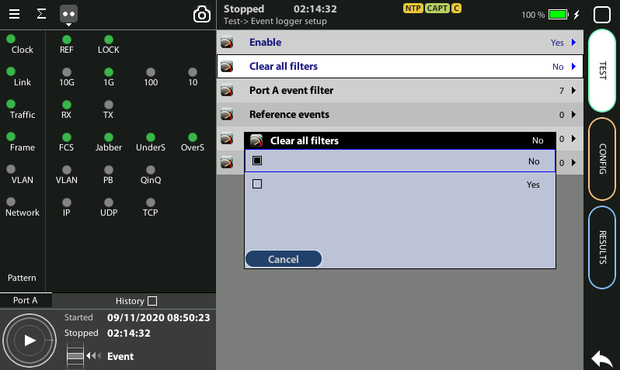
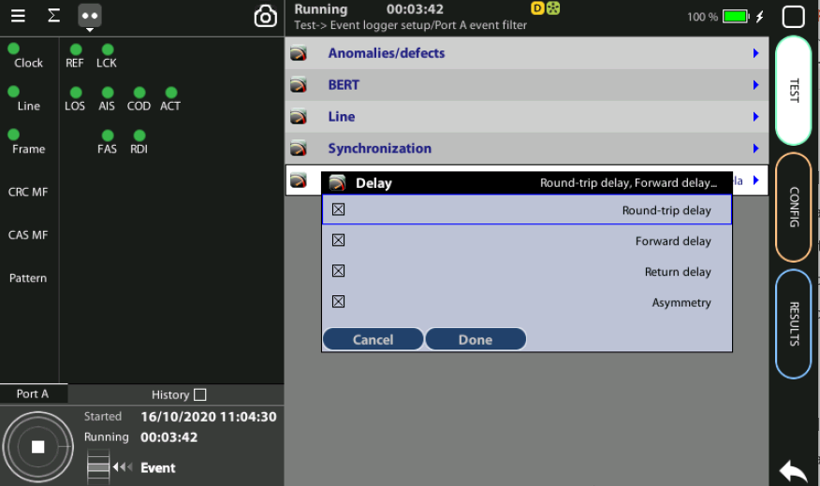
Configuring the Event Logger
2
1
3
4
Traceable Events are categorized in different classes. Moreover, each test port has its own traceable events. These events may be different for each test port.
Clear the currently selected filters: Clear all filters := Yes
Select the events: Port A > Delay := Round trip | Forward | Return | Asymmetry
Choose the events to trace: Anomalies/defects | Bandwidth statistics | Frame layer statistics | SLA statistics | BERT | PTP | NTP | Synchronization
Press Run to begin the generation of a trace file

Slide 26
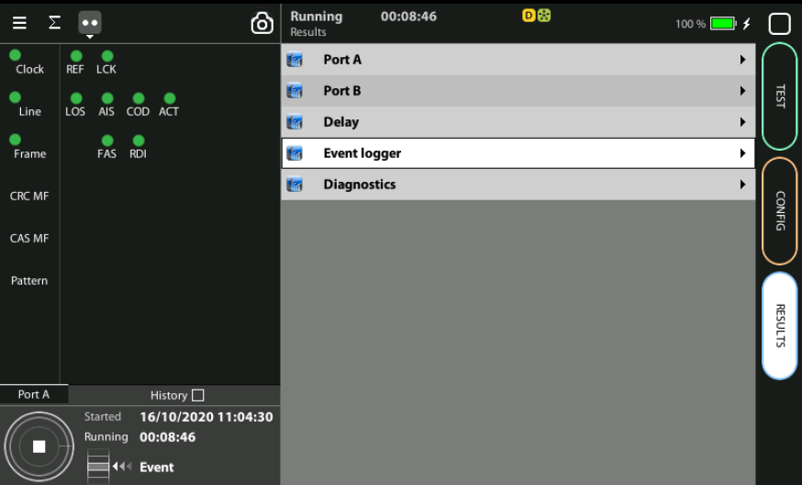
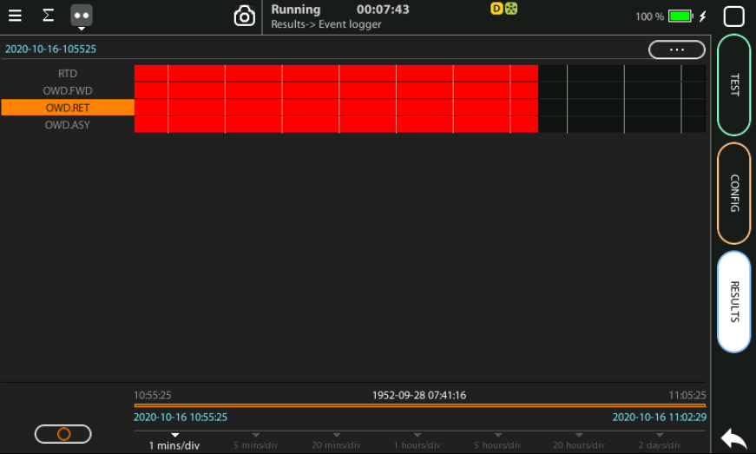
Display the logs
2
1
With the Event Logger you can select one or various events and trace them so that all changes along with the time and date these changes are registered are recorded with a 1 second resolution. The event logger provides representations and zoom levels to enable event analysis at different time scales:
Go to Results > Event logger
Analyze all the delay parameters displayed

Slide 27
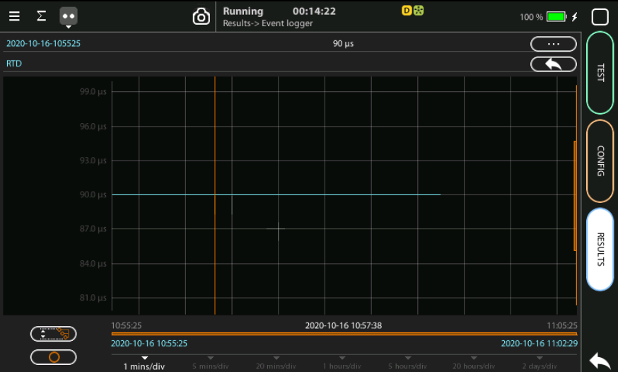
Event logger results
1
4
3
6
4
2
2
2
You can display the trace of the evolution of the previously selected parameters:
View and analyze the details of the histogram
Set the scale at your preferred zoom level
Selected OWD.RET (one way delay) event to display a more detailed diagram
Click on the screen to know the exact value at one specific time

Slide 28
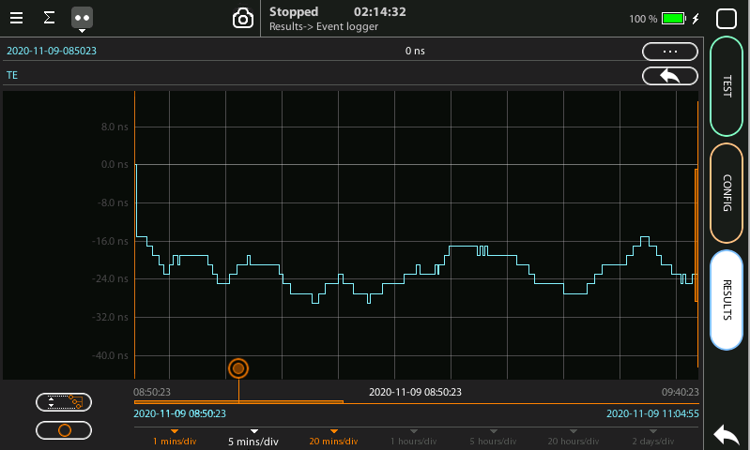
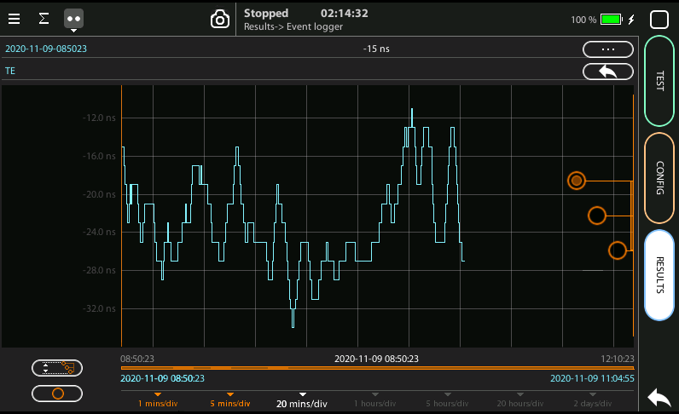
Scaling the trace
1
2
5
1
1
To change the scale horizontally click one time, for vertical two times
Click in the red buttom and draw to the left or to the right
To change the scale vertically click two times
To move the trace across the time click one of the three the red buttoms and draw the finger up and down
Click in the auto-scale symbol to return to the initial conditions

Slide 29
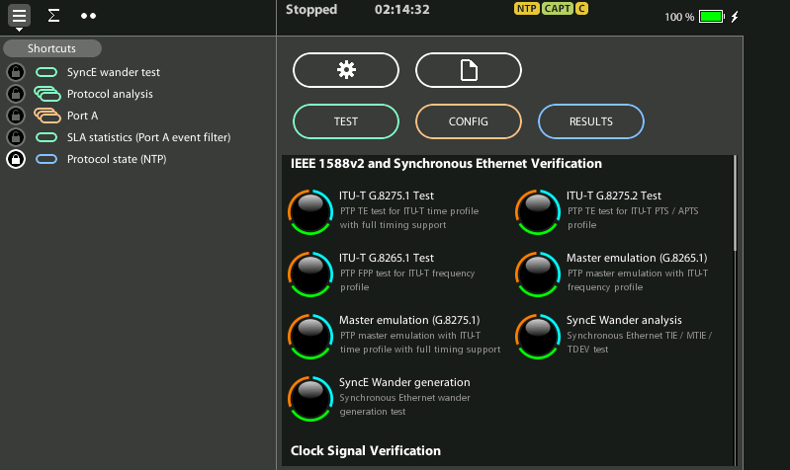
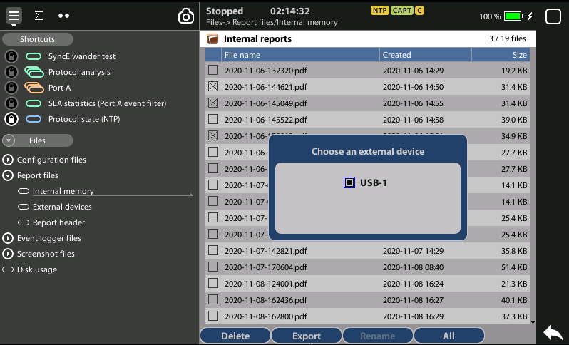
Exporting Logs
1
1
3
2
To export log files in CSV format:
Go Home > [File icon] > Configuration files | Report files > Internal memory
to list the files currently stored in the unit
Select the files you want to export: File name > Export
Choose an external device: micro SD | USB
If no external device a popup will appear: ‘No devices present’

Slide 30
Glossary
AAA: Authentication, Authorization, and Accounting
ACL: Access Control List
AP: Access Point
Busbar: Metallic strip or bar, typically housed inside switchgear, panel boards, and busway enclosures for local high current power distribution C37.94: TDM interface devoted for teleprotection
CB: Circuit Breaker designed to close or open electrical circuit under normal or abnormal conditions. It operates on relays command.
CBWFQ: Class-Based Weighted Fair Queuing
CG: Connected Grid
CID: Individual configuration of each IED CIP: Critical Infrastructure Protection CLI: Command-Line Interface
CorpSS: Corporate Substation
CT: Current Transformer, used for measurement of current, if too high to apply directly to measuring instruments, a CT produces a proportional current which can be measured and recorded, CT are used in metering and protective relays
DAN: Doubly Attached Nodes implementing HSR or PRP
DAU: Data Acquisition Unit
Disconnector: isolates physically and visually the lines
DMZ: Demilitarized Zone
DCB: Directional Comparison Blocking
DCS: distributed control systems
DSC: Differentiated Services Code Point
ESP: Electronic Security Perimeter
Feeder: Transmits power to the distribution points
GM: Grandmaster
GNSS: Global Navigation Satellite System
GOOSE: Generic Object-Oriented Substation Events is a control model defined as per IEC 61850 which provides a fast and reliable mechanism of transferring event data over entire electrical substation networks. When implemented, this model ensures the same event message is received by multiple physical devices using multicast or broadcast services
HMI: Human Machine Interface
PTP: Precision Time Protocol
RedBox: Redundancy Box
Relay: is automatic device which senses an abnormal condition of electrical circuit and closes its contacts and complete the circuit breaker trip.
REP: Resilient Ethernet Protocol
RCT: Redundancy Control Trailer
RTU: Remote Terminal Unit
SA: Substation Automation
SAN: Singly-Attached Node
Secondary Lines: lower voltage side at the substation
SCADA: Supervisory Control And Data Acquisition, transmits and receives data from events of controls, measuring, safety and monitoring. Power system elements can be controlled remotely over. Remote switching, telemetering of grids showing voltage, current, power, direction, consumption in kWh, synchronization.
SCD: Substation Configuration Description SCL: Substation Configuration Language SNTP: Simple Network Time Protocol
Station Bus: Connects the entire substation and helps provide connectivity between central management and individual bays
STP: Spanning Tree Protocol
SV: Sampled Values, is a method to read instantaneous values such as currents, voltages, impedances, etc. from CTs, VTs or digital I/O and then transmitted to make them are available for those IED subscribed.
Switchgear: combination of switches, fuses or CB to control, protect and isolate electrical equipment
SyncE: Synchronous Ethernet
TLV: Type, Length, Value
VT: Voltage Transformer (see CT)Potential Transformer, gives the reference voltage to the Relay for Over-voltage or Under-voltage Protection
UCA IuG: Utility Communications Architecture International Users Group
VDAN: Virtual D
HQoS: Hierarchical Quality of Service
HSR: High-Availability Seamless Redundancy
IA: Industrial Automation
ICS: Industrial control systems
ICU: Intelligent Control Unit
IEC: International Electrotechnical Commission
IEC 61850: Standard defining communication protocols for intelligent electronic devices at electrical substations
IED: Intelligent End Device, microprocessor-based controllers of power system equipment, such as circuit breakers, transformers and capacitor banks to enable advanced power automation.
IRIG: Inter-Range Instrumentation Group
ISE: Identity Services Engine
L3VPN: Layer 3 Virtual Private Network
LA: Lightning Arrester protects the power grid from electric storms
MQC: Modular QoS Command-Line Interface
MMS: Manufacturing Message Specification, messaging system for exchanging real-time data and supervisory control information. Allows client such as SCADA, an OPC server or a gateway to access all IED objects MPLS: Multi-protocol Label Switching
MU: Merging Unit connected to the process bus converts analog data(ie. volts, currect...) into digital information
NERC: North American Electric Reliability Corporation
NIST: National Institute of Standards and Technology
NMS: Network Management System
OAM: Operations and Maintenance
PCP: Priority Code Point
PIOC: Instantaneous overcorrent Protection
PLC: Programmable Logic Controller
PMU: Phasor Measurement Unit
POTT: Permissive Overreaching Transfer Trip
PP: Primary Power
Process Bus: Connects primary units and control equipment to the IEDs
PRP: Parallel Redundancy Protocol
PRTC: Primary Reference Clock
PT: see VT
T-GM: Grand Master PTP
T-BC: Boundary Clock
T-TSC: Slave Clock

Slide 31



That’s all
www.albedotelecom.com

