Slide 1
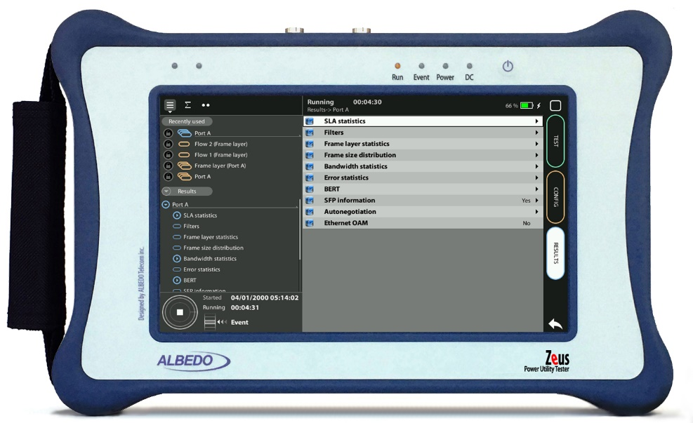
C37.94 Testing
Round Trip Delay over C37.94 with Zeus
Guide & Slides corresponding to software ver. 2.3.11

Slide 2
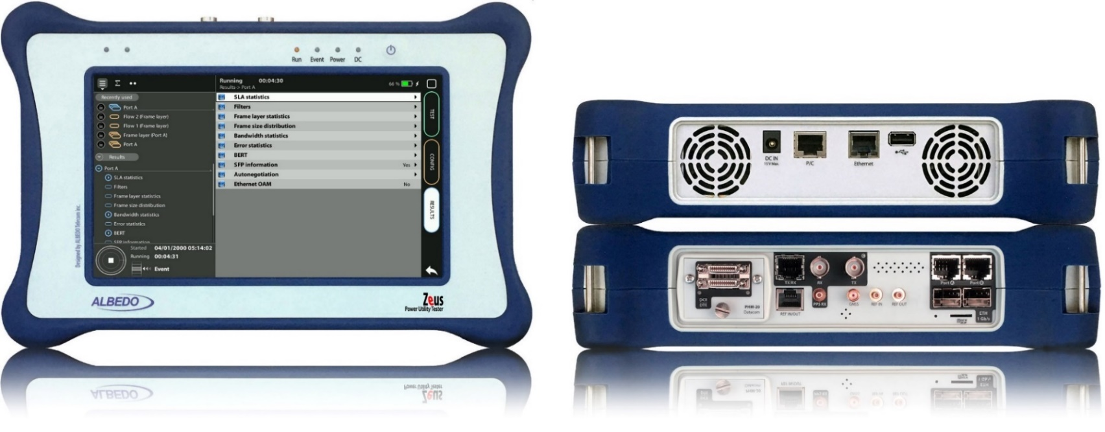
Zeus & xGenius
Zeus & xGenius provide deep insights to design, install, maintain, troubleshoot and engineer communications resources of Mobile Operators, Power Utilities, Finace, Labs and R+D centers. The unit is able to verify Ethernet/IP, SyncE, PTP, GbE, IRIG-B, 1PPS, T1/E1, G703, Serial Datacom, C37.94, GOOSE, SV, MMS, Round-trip & One-way Delay tests at all interfaces.
It also has a set of programmable filters to capture live data traffic at wire-speed

Slide 3
Interfaces & time References
PHM
RJ45-C
BNC-C
RJ45-A
RJ45-B
The unit is equipped with GNSS receiver with SMA female connector for connecting an antenna typically supplied with a 5 m of coaxial cable plus a 10 m extension cable.
RJ45
SMB-C
SMA
SMB-1
SMB-2
SFP-A
Micro SD
SFP-B
 | GNSS | PTP | NTP | ToD | IRIG-B | PPS | PP2S | SyncE | T1/E1 | MHz | C.3794
RJ45-A |  | in/out | in/out |  |  |  |  | in/out
RJ45-B |  |  |  |  |  |  |  | in/out
SFP-A |  | in/out | in/out |  |  |  |  | in/out
SFP-B |  |  |  |  |  |  |  | in/out
BNC-C |  |  |  |  |  |  |  |  | in/out | in/out
RJ45-C |  |  |  | in |  | in | in |  | in/out | in/out
SMB-C
SMA | in
SMB-1 |  |  |  |  | in | in | in
SMB-2 |  |  |  |  | out | out | out
RJ-45 |  |  |  | in/out | in/out | in/out | in/out |  | in/out | in/out
PHM |  |  |  |  |  |  |  |  |  |  | in/out

Slide 4
Round-Trip-Delay over C37.94 Interface
High Voltage
Low Voltage
S U B S T A T I O N - 1
S U B S T A T I O N - 2
VT
CT
CB
CB
CT
VT
IEEE C37.94
SDH/SONET
IEEE C37.94
IED
A
Testing Points
B
CONFIGURATION 1: Physical Loop
ALBEDO
xGenius
ALBEDO
xGenius
CONFIGURATION 2: Looback Tester
RTD Tester
Protection schemes, such as C37.94, have the objective of keeping the Power System stable and isolated. For correct function the control of latency, latency variations and asymmetry is fundamental.
Zeus and xGenius equipped with C37.94 interfaces and synchronized by GPS, measure all key parameters including Round-Trip-Delay (RTD) simply using a Physical Loop at one extreme (Configuration 1) or by means of two units (Configuration 2). The result will be exactly the same.

Slide 5
Connecting the fiber
1
1
2
2
Zeus / xGenius support C47.94 optical interfaces:
Introduce a compatible C37.94 SFP into Port A, the indicated for Delay tests
Connect the optical cables
If you are using two testers, repeat the same operation in Tester B
If you are using a physical loop connect the fiber at the remote end

Slide 6
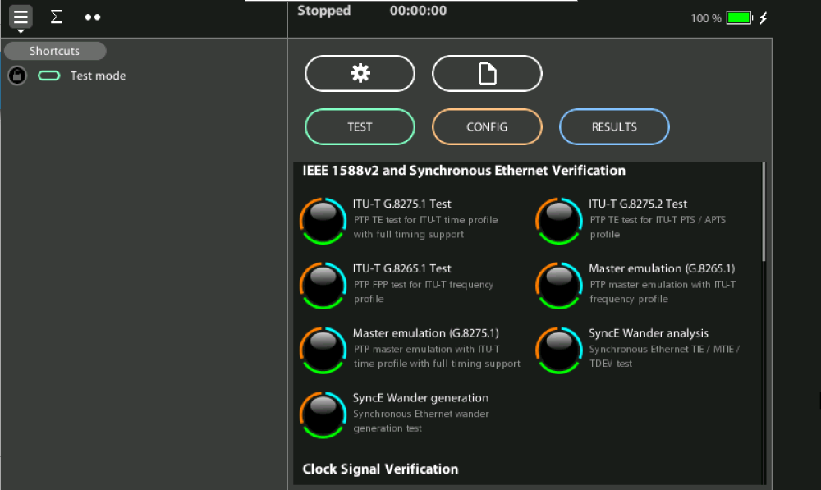
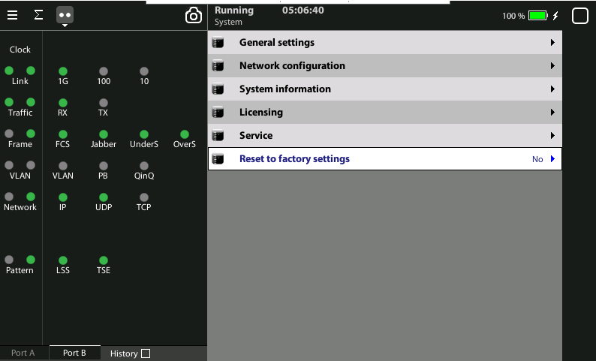
Select the global operation mode
1
Home > [System] > Reset to factory settings := Yes

Slide 7
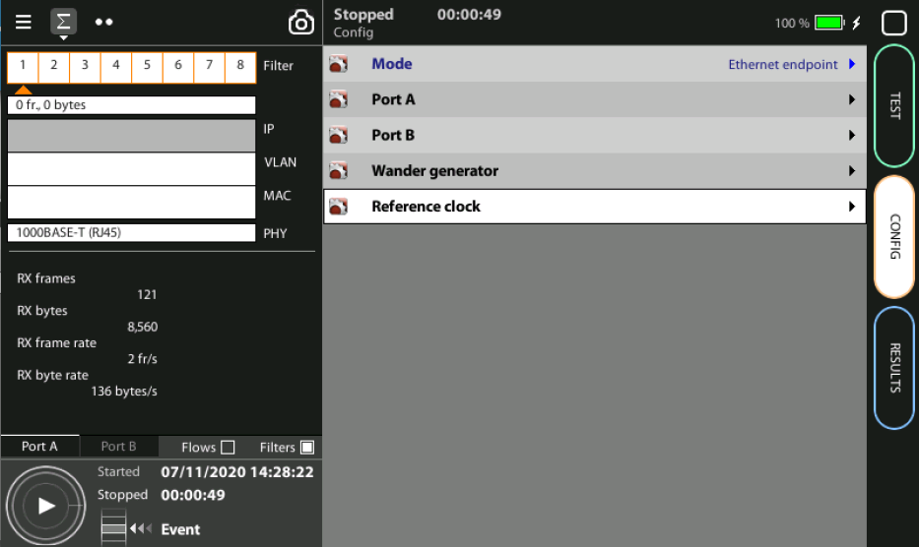
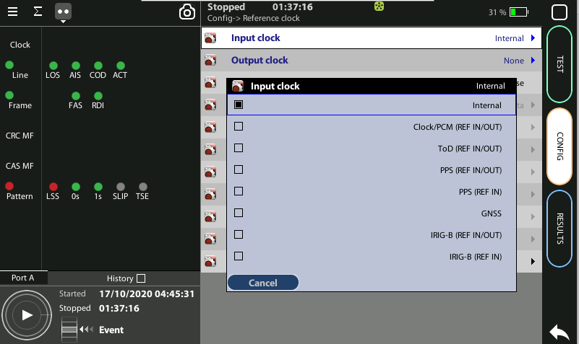
Use the internal clock
1
1
RTD test does not need external synchronization then use internal clock
Home > Config > Reference clock > Input clock := Internal
Repeat this configuration with tester B

Slide 8
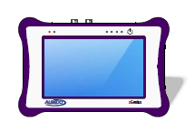
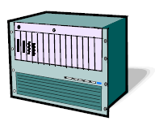
Hands-on to RTD over C37.94 test
Teleprotection
Option 1: Physical Loop
Option 2: Remote Tester
A
B
Generation Analysis
Multiplexer
Loopback
We are going to explain the Round Trip Delay using two testers, however Zeus / xGenius can execute also a number of tests including:
Measuring Frequency, Bit Rate and Optical Power
Running BER and Performance Tests
Event Generation and Analysis
Latency measurement
Jitter and Wander Generation and Analysis

Slide 9
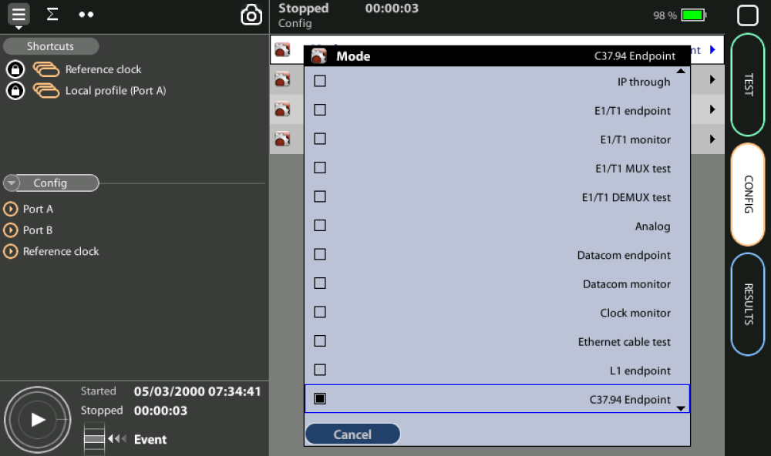
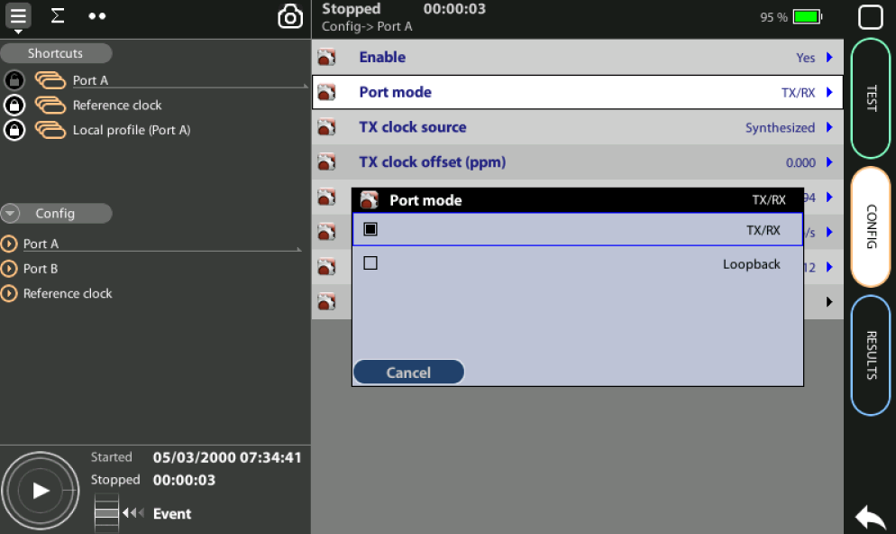
Enable the C37.94 analysis
2
3
4
1
Go to Home > Config > Mode > C37.94 Endpoint
Enable optical transmission Port A > Enable := yes
Configure Tester A to Generate & Analyze traffic: Config > Port A > Port Mode := TX/RX
Configure Tester B to Loopback: Config > Port B > Port Mode := Loopback
If you are using a physical loop, skip step 4
Attention: Remember use Port A for delay tests, forget Port B

Slide 10
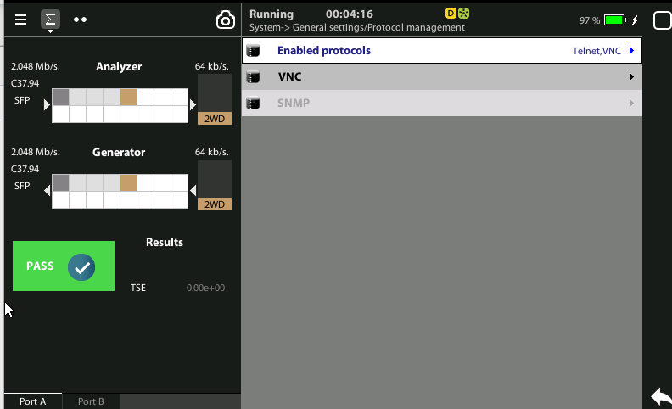
Display configuration
2
1
1
You can go to the graph
Click on the Σ symbol
Observe the C37.94 details

Slide 11
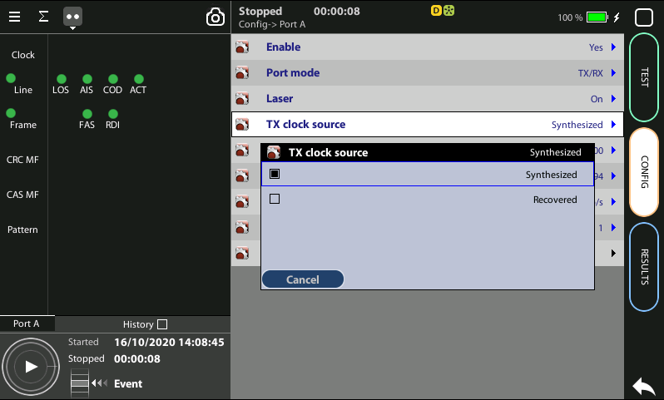
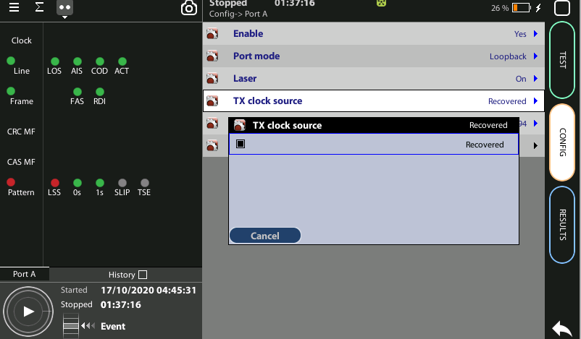
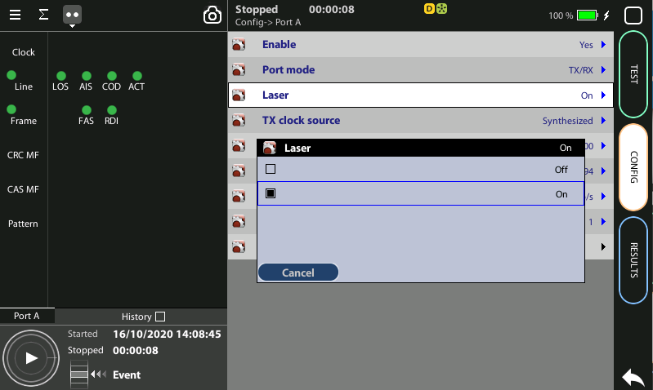
Configure TX clock source
1
Tester A will generate the traffic using their internal clock whilst Tester B shall recover the clock from the signal received from A:
Tester A:
Config > Port A > TX clock source := Synthesized
Config > Port A > Laser := On
Tester B:
Config > Port A > TX clock source := Recovered
Config > Port A > Laser := On
3
2
4

Slide 12
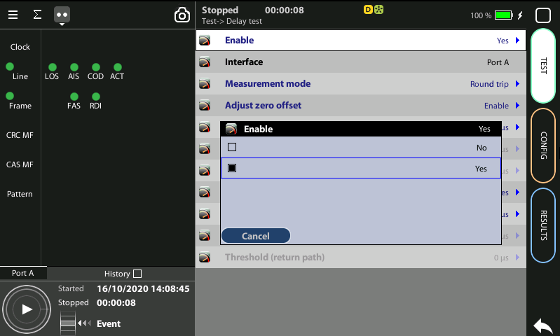
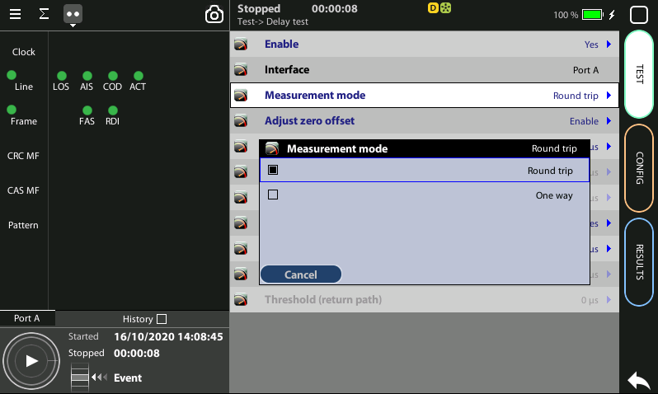
Enable the RTD test
In Tester A configure the type of test:
Test > Delay test > Enable := Yes
Test > Delay test > Measurement mode := Round trip
No special settings are required in Tester B

Slide 13
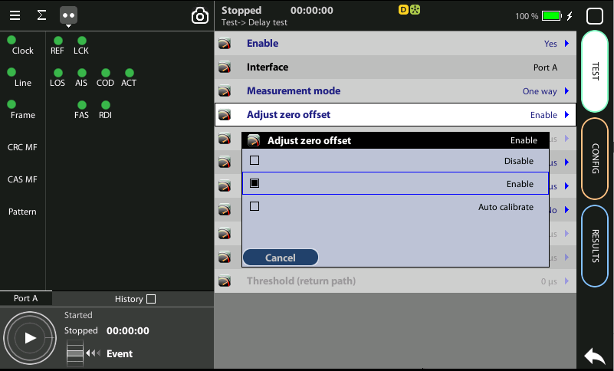
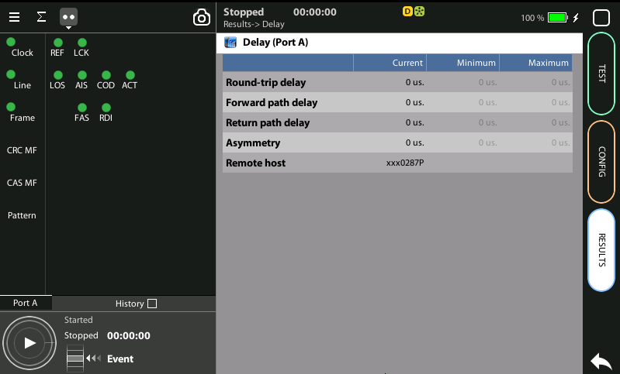
Adjust to Zero
1
3
2
It is necessary to cancel the intrinsic delay of the tester that may modify the results:
Disconnect the unit from the network and loop Tx - Rx with a patch cord
Test > Delay test > Adjust zero offset := Auto-calibrate
Go to Results > Delay (All delay parameters shall be zero)
Once you have set the zero offset in Tester A, reconnect to the network
No special settings are required in Tester B

Slide 14
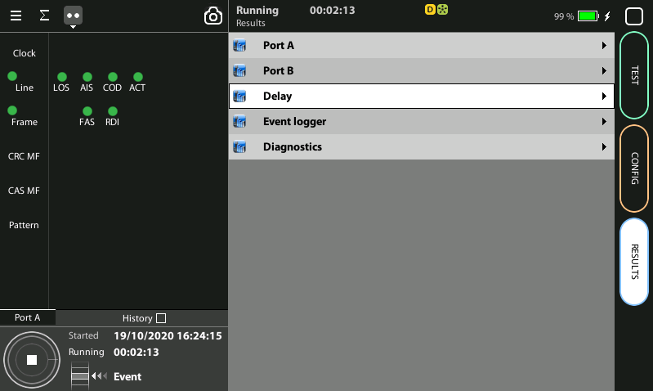
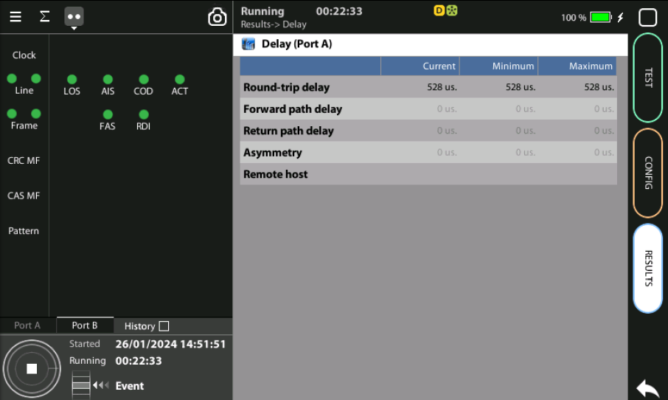
Running the RTD test
2
2
1
The test is now ready to start then Press RUN in Tester A
Check Delay results at any time during the testing process:
Home > Results > Delay test

Slide 15
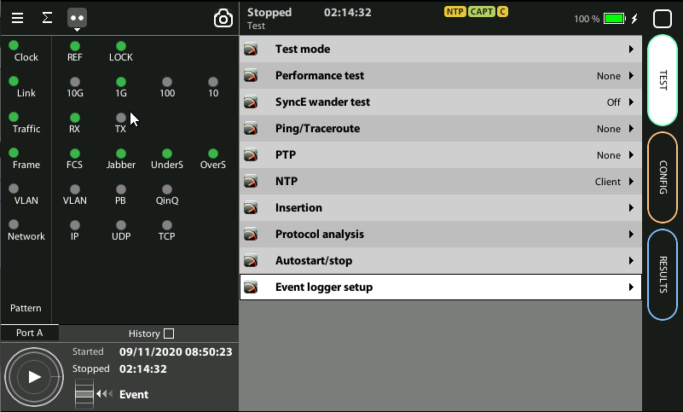
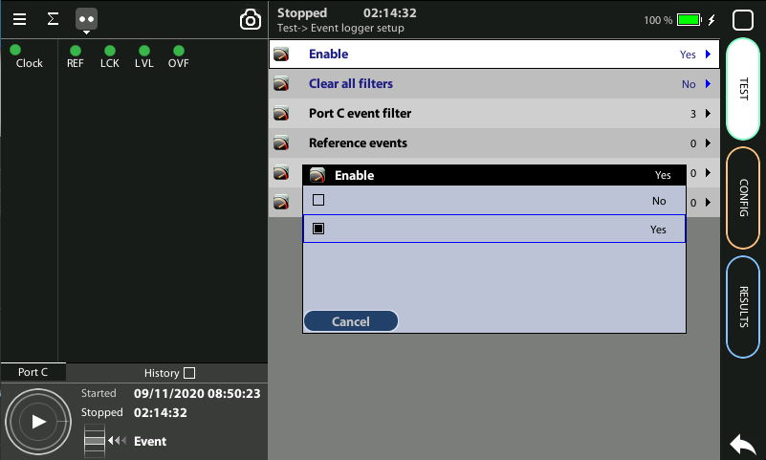
Event logger enable
1
1
Global counts, statistics and LEDs provide information about which events and how many of them have been registered but they do not say too much about how they are distributed in time. These information is supplied at the Event Logger a graphical representation tool that permits to trace the evolution of key parameters.
The first thing to to is to enable it:
Go to Home > Test > Event logger setup
Set Enable := Yes

Slide 16
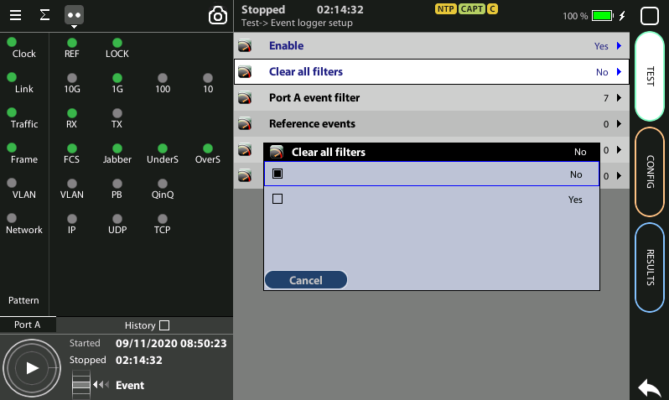
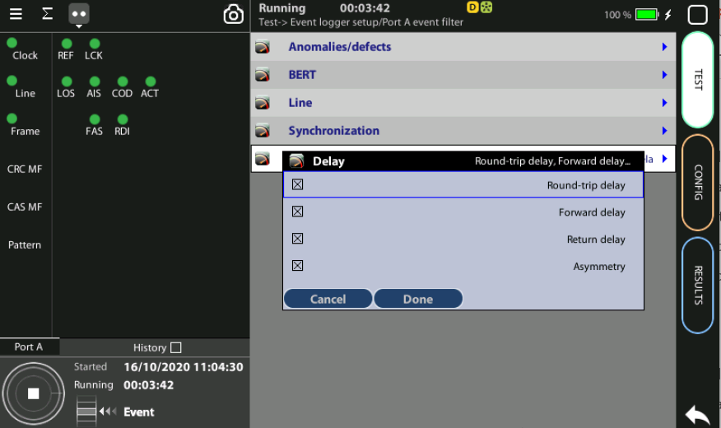
Configuring the Event Logger
2
1
3
4
Traceable Events are categorized in different classes. Moreover, each test port has its own traceable events. These events may be different for each test port.
Clear the currently selected filters: Clear all filters := Yes
Select the events: Port A > Delay := Round trip
Press Run to begin the generation of a trace file

Slide 17
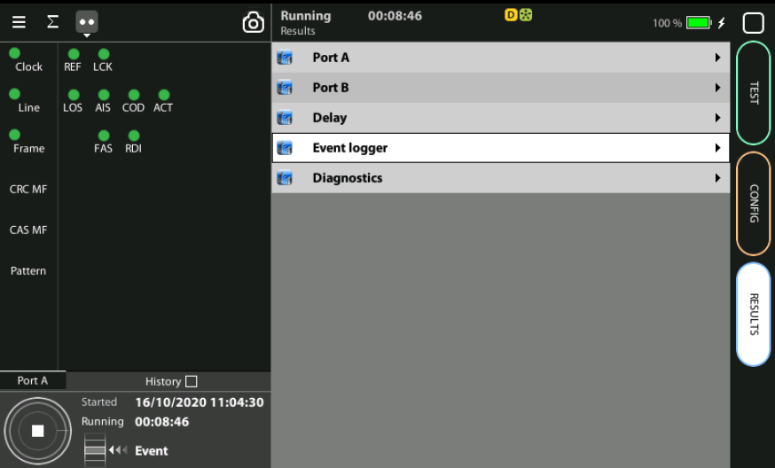
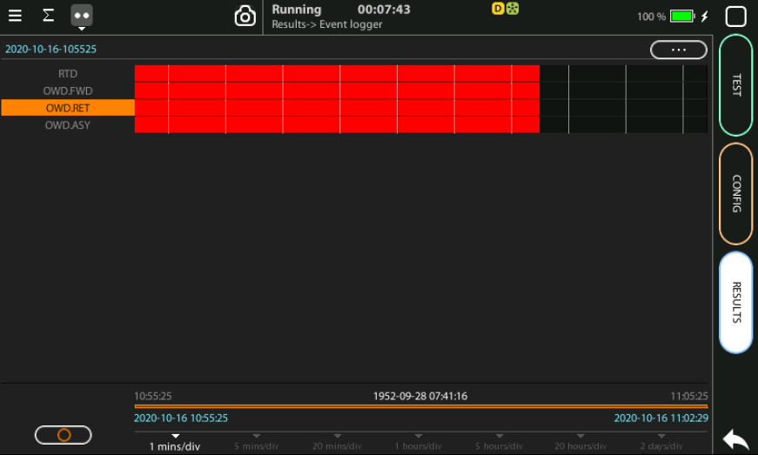
Display the logs
2
1
With the Event Logger you can select one or various events and trace them so that all changes along with the time and date these changes are registered are recorded with a 1 second resolution. The event logger provides representations and zoom levels to enable event analysis at different time scales:
Go to Results > Event logger
Analyze all the delay parameters displayed

Slide 18
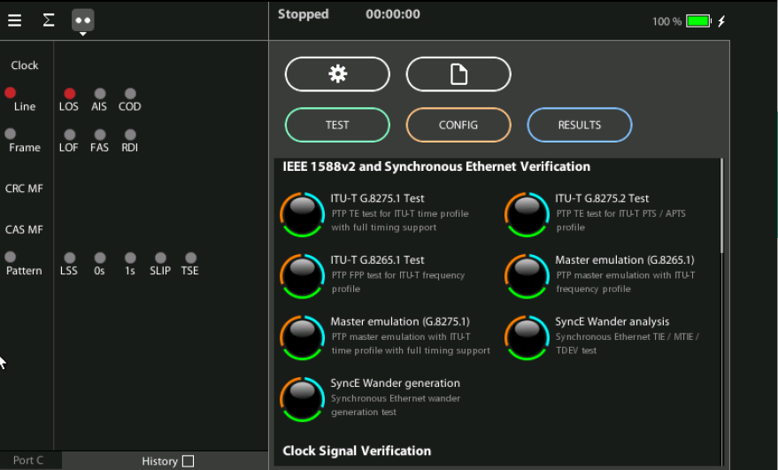
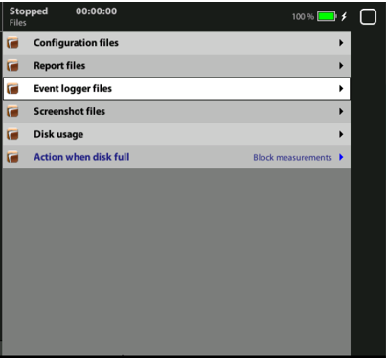
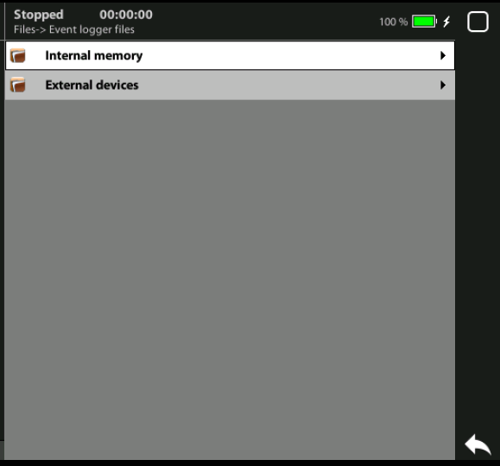
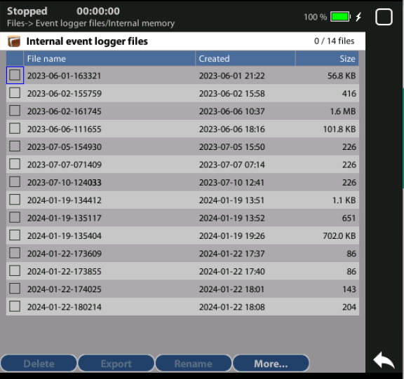
Event logger results
1
4
1
2
2
3
You can display the event logger
Select the files to display
Select: Event logger > Internal memory
Select the file to display

Slide 19
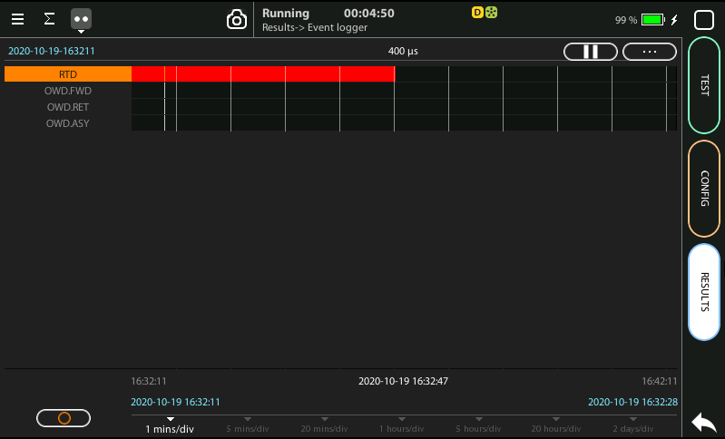
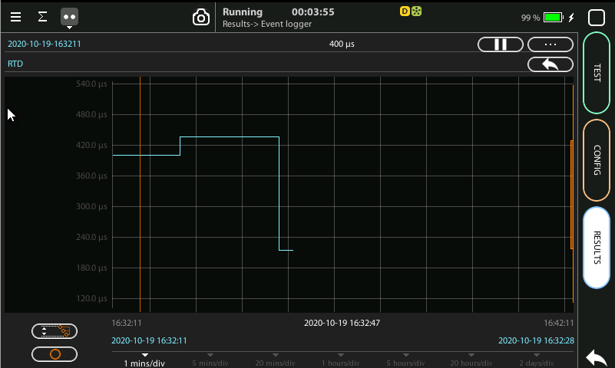
Event logger results
1
4
3
6
4
2
2
2
You can display the trace of the evolution of the previously selected parameters:
View and analyze the details of the histogram
Set the scale at your preferred zoom level
Selected RTD (round trip delay) event to display a more detailed diagram
Click on the screen to know the exact value at one specific time

Slide 20
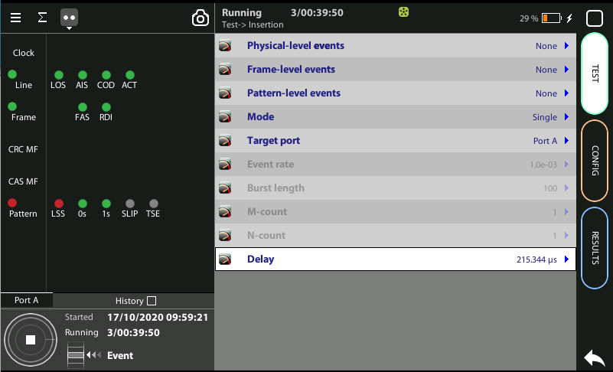
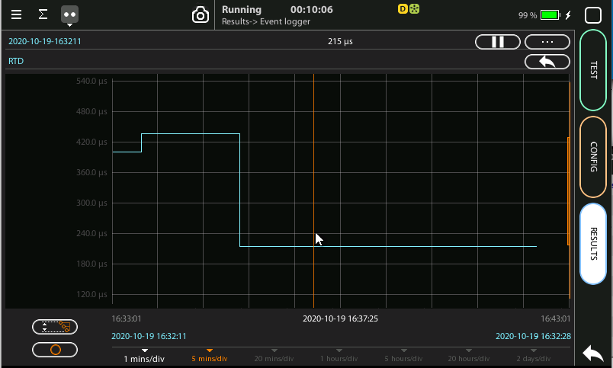
Delay insertion
2
1
If you are using two testers at the remote tester B you can add arbitrary delays.
Test > Insertion > Delay := Value
Display the impact at the trace after introducing three different delays

Slide 21
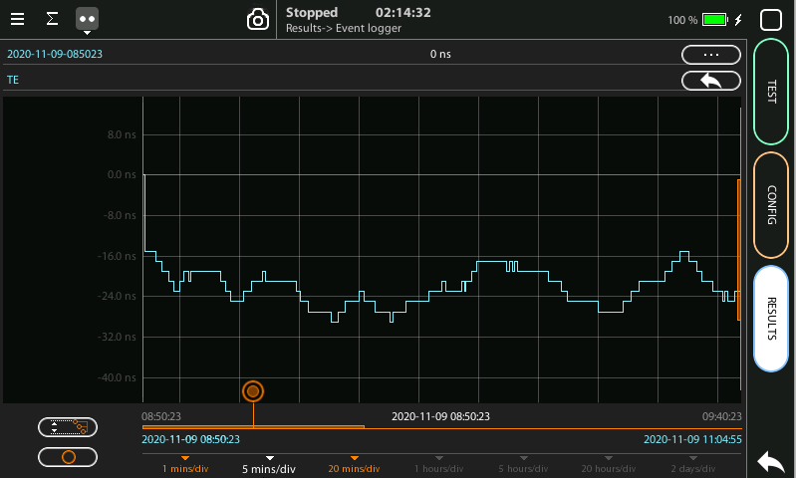
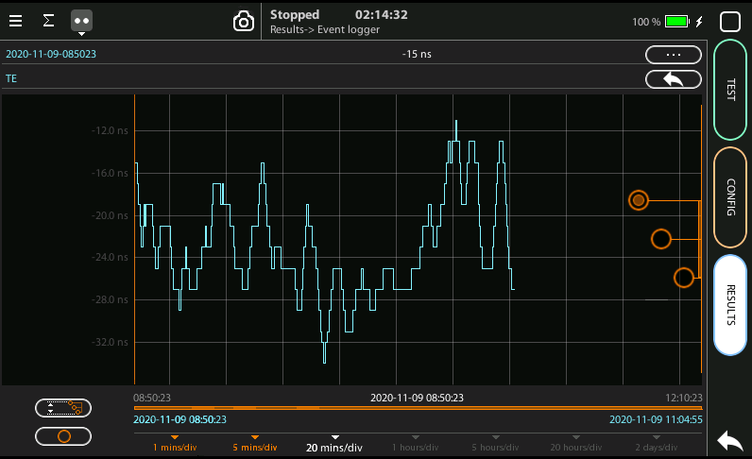
Scaling the trace
1
2
5
1
1
To change the scale horizontally click one time, for vertical two times
Click in the red button and draw to the left or to the right
To change the scale vertically click two times
To move the trace across the time click one of the three the red buttons and draw the finger up and down
Click in the auto-scale symbol to return to the initial conditions

Slide 22
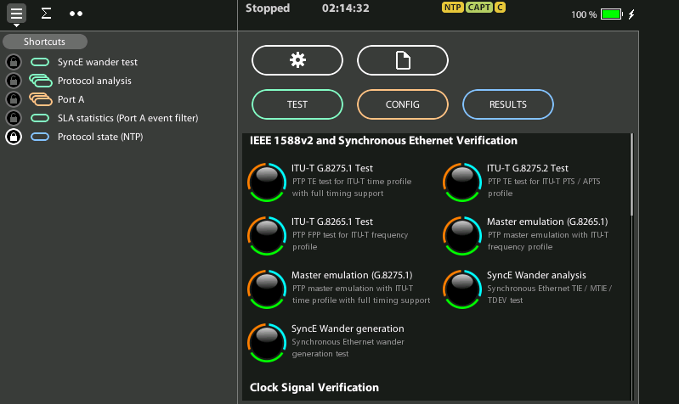
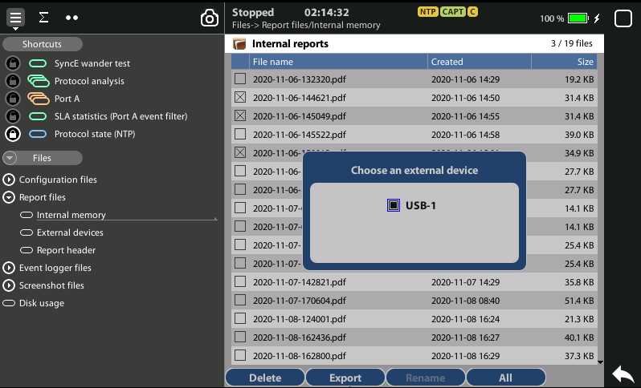
Exporting Logs
1
1
3
2
To export log files in CSV format:
Go Home > [File icon] > Configuration files | Report files > Internal memory to list the files currently stored in the unit
Select the files you want to export: File name > Export
Choose an external device: micro SD | USB
If no external device a popup will appear: ‘No devices present’

Slide 23
Glossary
AAA: Authentication, Authorization, and Accounting
ACL: Access Control List
AP: Access Point
Busbar: Metallic strip or bar, typically housed inside switchgear, panel boards, and busway enclosures for local high current power distribution C37.94: TDM interface devoted for teleprotection
CB: Circuit Breaker designed to close or open electrical circuit under normal or abnormal conditions. It operates on relays command.
CBWFQ: Class-Based Weighted Fair Queuing
CG: Connected Grid
CID: Individual configuration of each IED CIP: Critical Infrastructure Protection CLI: Command-Line Interface
CorpSS: Corporate Substation
CT: Current Transformer, used for measurement of current, if too high to apply directly to measuring instruments, a CT produces a proportional current which can be measured and recorded, CT are used in metering and protective relays
DAN: Doubly Attached Nodes implementing HSR or PRP
DAU: Data Acquisition Unit
Disconnector: isolates physically and visually the lines
DMZ: Demilitarized Zone
DCB: Directional Comparison Blocking
DCS: distributed control systems
DSC: Differentiated Services Code Point
ESP: Electronic Security Perimeter
Feeder: Transmits power to the distribution points
GM: Grandmaster
GNSS: Global Navigation Satellite System
GOOSE: Generic Object-Oriented Substation Events is a control model defined as per IEC 61850 which provides a fast and reliable mechanism of transferring event data over entire electrical substation networks. When implemented, this model ensures the same event message is received by multiple physical devices using multicast or broadcast services
HMI: Human Machine Interface
PTP: Precision Time Protocol
RedBox: Redundancy Box
Relay: is automatic device which senses an abnormal condition of electrical circuit and closes its contacts and complete the circuit breaker trip.
REP: Resilient Ethernet Protocol
RCT: Redundancy Control Trailer
RTU: Remote Terminal Unit
SA: Substation Automation
SAN: Singly-Attached Node
Secondary Lines: lower voltage side at the substation
SCADA: Supervisory Control And Data Acquisition, transmits and receives data from events of controls, measuring, safety and monitoring. Power system elements can be controlled remotely over. Remote switching, telemetering of grids showing voltage, current, power, direction, consumption in kWh, synchronization.
SCD: Substation Configuration Description SCL: Substation Configuration Language SNTP: Simple Network Time Protocol
Station Bus: Connects the entire substation and helps provide connectivity between central management and individual bays
STP: Spanning Tree Protocol
SV: Sampled Values, is a method to read instantaneous values such as currents, voltages, impedances, etc. from CTs, VTs or digital I/O and then transmitted to make them are available for those IED subscribed.
Switchgear: combination of switches, fuses or CB to control, protect and isolate electrical equipment
SyncE: Synchronous Ethernet
TLV: Type, Length, Value
VT: Voltage Transformer (see CT)Potential Transformer, gives the reference voltage to the Relay for Over-voltage or Under-voltage Protection
UCA IuG: Utility Communications Architecture International Users Group
VDAN: Virtual D
HQoS: Hierarchical Quality of Service
HSR: High-Availability Seamless Redundancy
IA: Industrial Automation
ICS: Industrial control systems
ICU: Intelligent Control Unit
IEC: International Electrotechnical Commission
IEC 61850: Standard defining communication protocols for intelligent electronic devices at electrical substations
IED: Intelligent End Device, microprocessor-based controllers of power system equipment, such as circuit breakers, transformers and capacitor banks to enable advanced power automation.
IRIG: Inter-Range Instrumentation Group
ISE: Identity Services Engine
L3VPN: Layer 3 Virtual Private Network
LA: Lightning Arrester protects the power grid from electric storms
MQC: Modular QoS Command-Line Interface
MMS: Manufacturing Message Specification, messaging system for exchanging real-time data and supervisory control information. Allows client such as SCADA, an OPC server or a gateway to access all IED objects MPLS: Multi-protocol Label Switching
MU: Merging Unit connected to the process bus converts analog data(ie. volts, currect...) into digital information
NERC: North American Electric Reliability Corporation
NIST: National Institute of Standards and Technology
NMS: Network Management System
OAM: Operations and Maintenance
PCP: Priority Code Point
PIOC: Instantaneous overcorrent Protection
PLC: Programmable Logic Controller
PMU: Phasor Measurement Unit
POTT: Permissive Overreaching Transfer Trip
PP: Primary Power
Process Bus: Connects primary units and control equipment to the IEDs
PRP: Parallel Redundancy Protocol
PRTC: Primary Reference Clock
PT: see VT
T-GM: Grand Master PTP
T-BC: Boundary Clock
T-TSC: Slave Clock

Slide 24
That’s all
www.albedotelecom.com

