Slide 1



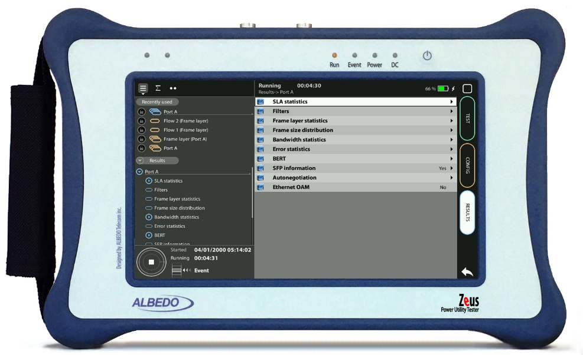

E1 / T1 Wander test
E1/T1 Wander testing with xGenius
Guide & Slides corresponding to software ver. 2.6.2

Slide 2
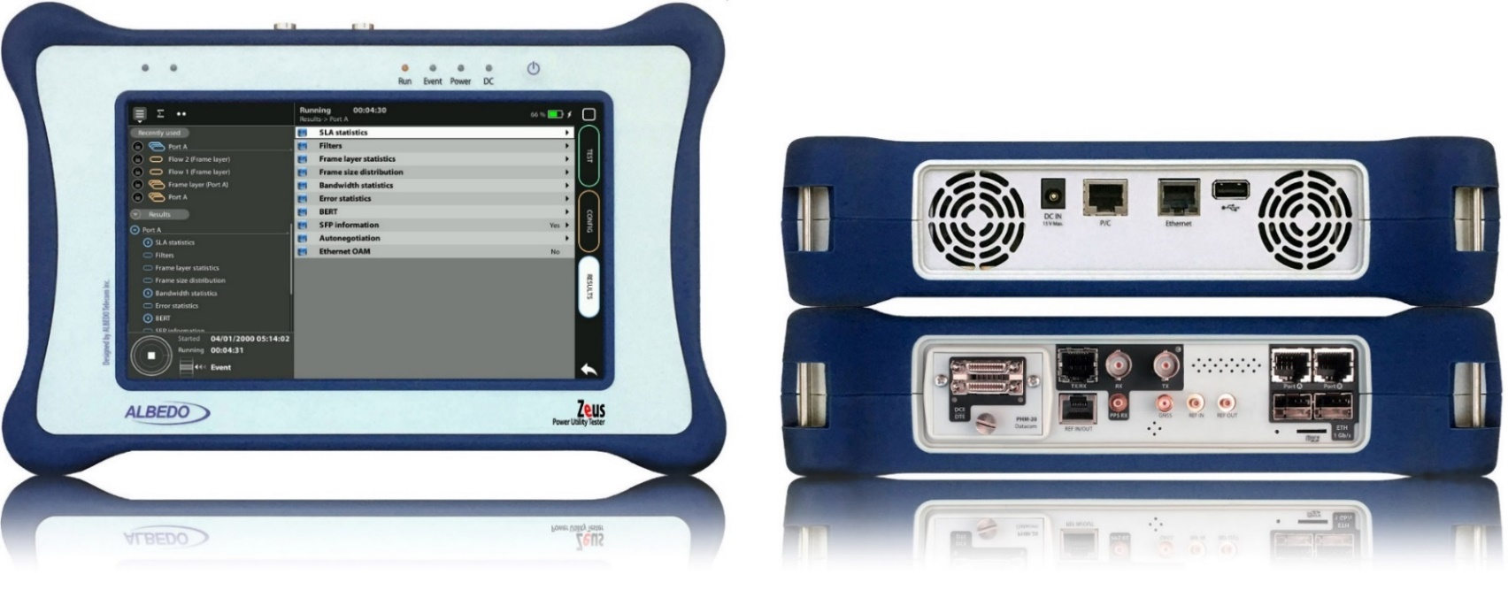

Zeus & xGenius
Zeus & xGenius provide deep insights to design, install, maintain, troubleshoot and engineer communications resources of Mobile Operators, Power Utilities, Finace, Labs and R+D centers. The unit is able to verify Ethernet/IP, SyncE, PTP, GbE, IRIG-B, 1PPS, T1/E1, G703, Serial Datacom, C37.94, GOOSE, SV, MMS, Round-trip & One-way Delay tests at all interfaces.
It also has a set of programmable filters to capture live data traffic at wire-speed

Slide 3
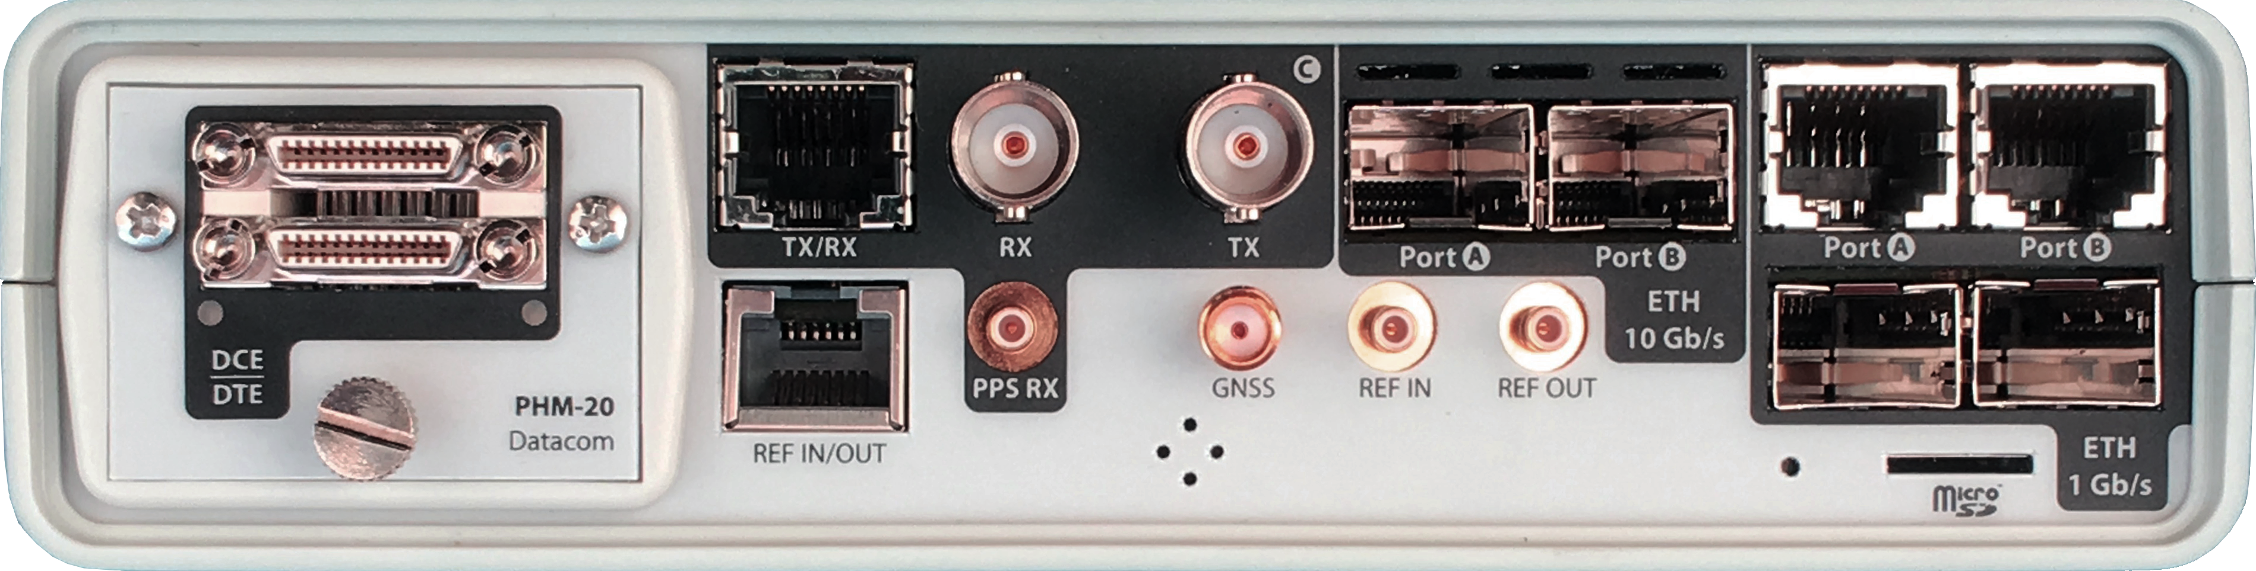

Interfaces & time References
PHM
RJ45-C
BNC-C
SFP+ A
SFP+ B
RJ45-A
RJ45-B
xGenius generates and analyses different kinds of 1544 kb/s and 2048 kb/s signals and also unframed 1544 / 2048 kb/s signals.
RJ45
SMB-C
SMA
SMB-1
SMB-2
SFP-A
Micro SD
SFP-B
 | GNSS | PTP | NTP | ToD | IRIG-B | PPS | PP2S | SyncE | T1/E1 | MHz | Data
RJ45-A |  | in/out | in/out |  |  |  |  | in/out
RJ45-B |  |  |  |  |  |  |  | in/out
SFP-A |  | in/out | in/out |  |  |  |  | in/out
SFP-B |  |  |  |  |  |  |  | in/out
SFP+A |  | in/out | in/out |  |  |  |  | in/out
SFP+B |  |  |  |  |  |  |  | in/out
BNC-C |  |  |  |  |  |  |  |  | in/out | in/out
RJ45-C |  |  |  | in |  | in | in |  | in/out | in/out
SMB-C
SMA | in
SMB-1 |  |  |  |  | in | in | in
SMB-2 |  |  |  |  | out | out | out
RJ-45 |  |  |  | in/out | in/out | in/out | in/out |  | in/out | in/out
PHM |  |  |  |  |  |  |  |  |  |  | in/out

Slide 4
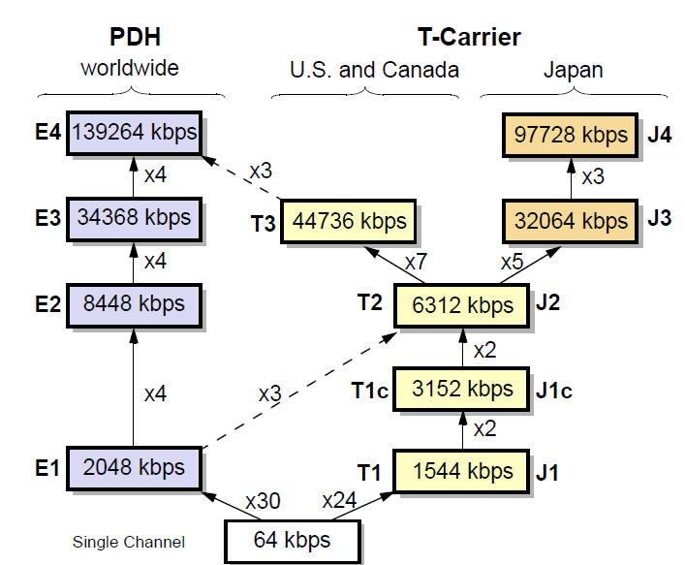
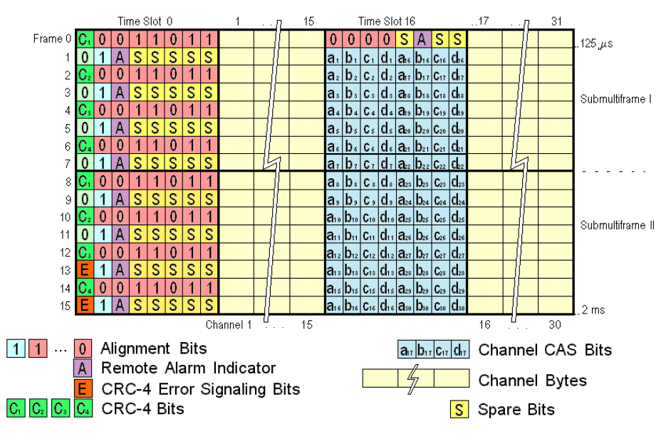
E1/T1: the first level in the Hierarchy
The E1 frame defines a cyclical set of 32 time slots of 8 bits. The time slot 0 is devoted to transmission management and time slot 16 for signaling; the rest were assigned originally for voice/data transport.

Slide 5




The Wander test
GNSS
Network
E1
Wander measurement
ALBEDO
xGenius
Wander is defined as a slow phase fluctuation in a network traffic or timing interface. Wander is propagated through the network and because it is never absorbed due to its low frequency, it is accumulated causing jitter, slips and bit errors due to pointer adjustments and mapping / demapping processes.
Wander measurements require long periods of time. It is also necessary to detect phase transients during these measurements, which calls for high temporal resolution, and, as a result, there is a considerable accumulation of data. With the aim of summarizing all this information, three parameters are defined: TIE, MTIE, and TDEV.

Slide 6

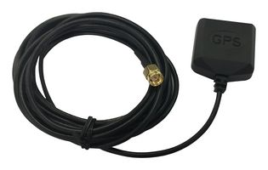
Connecting the antenna
xGenius is equipped with a built-in GNSS receiver. It has a SMA female connector suitable for connecting an antenna. A compact antenna with 5 m of coaxial cable plus a 10 m extension cable. Using a different antenna is possible whenever is compliant with xGenius specifications.
Connect the antenna to the unit oriented to open sky. Some tests may loss accuracy if the number of satellites in sight is limited.

Slide 7
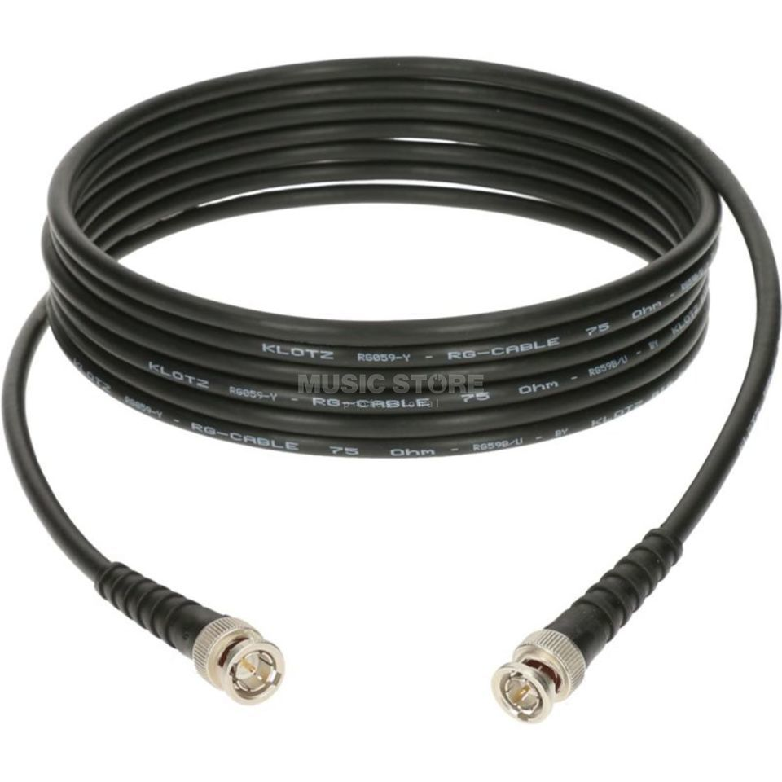

Connecting the BNC cables to Port C
2
1
1
xGenius Port C can be Balanced (RJ45) or Unbalanced (BNC)
In our test, we are going to use the BNC cables
Connect BNC transmission (Tx) in Port C
Connect BNC Reception (Rx) in Port C

Slide 8
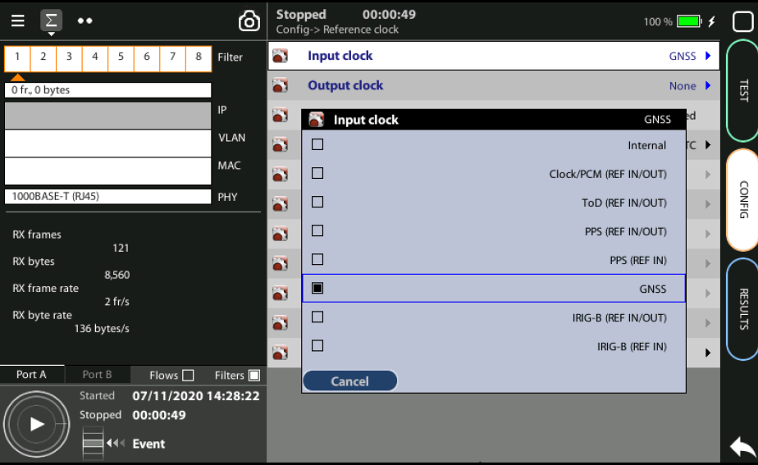
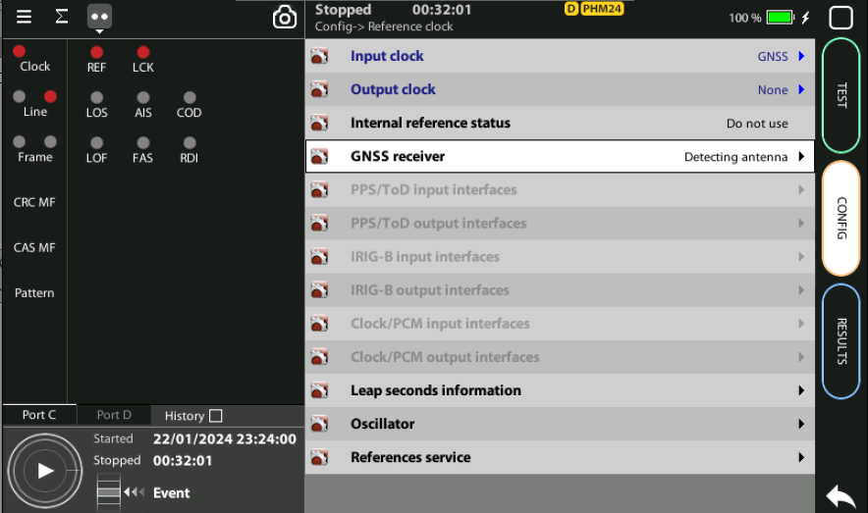
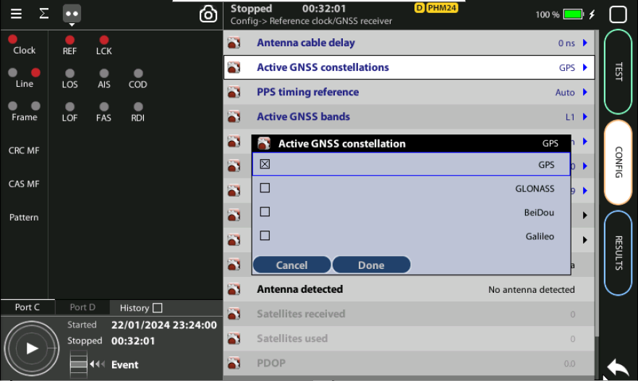
Steps to configure the built-in GNSS
2
3
1
3
Home > Config > Reference clock > Input clock := GNSS (*)
In the same screen Enable/Disable any constellation
… > GNSS receiver > Gactive GNNSS constellations := [GPS | Beidou | … ]
Select the desired constellation
(*) Go to Home panel, go to Config, the port setup will be displayed then Go to Reference clock and configure Input clock to GNSS.

Slide 9
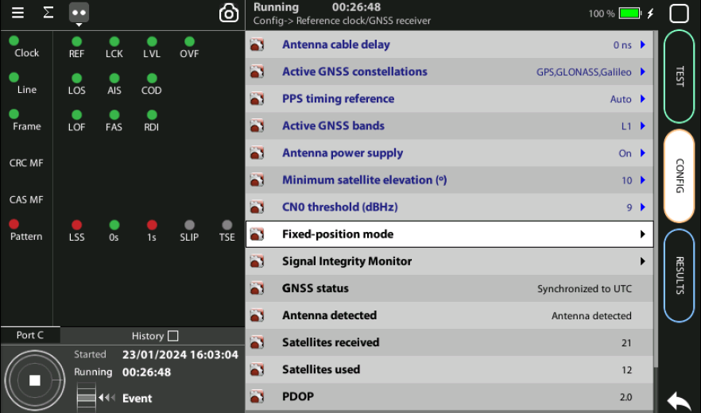
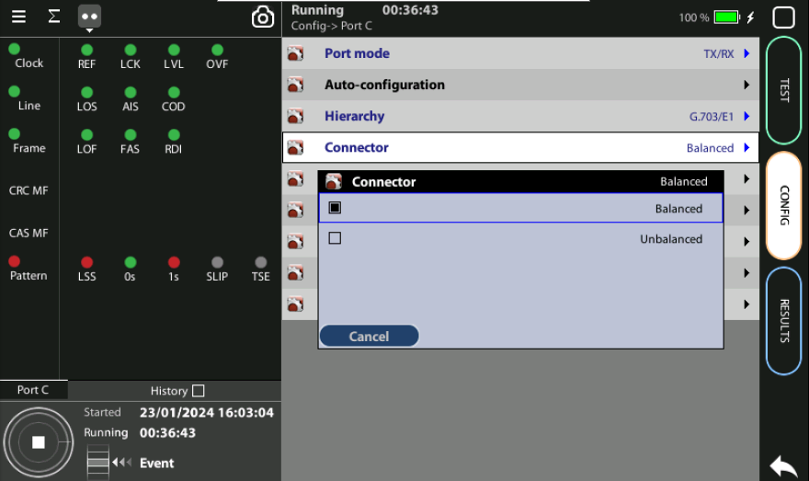
Verification Notes
4
3
2
1
Verify GNSS, Antenna is detected and a number of Satellites are available
Use the correct Port which is C and the correct connector
Press LEDS to check the status
Wait for the REF and LOCK LEDs to become green

Slide 10
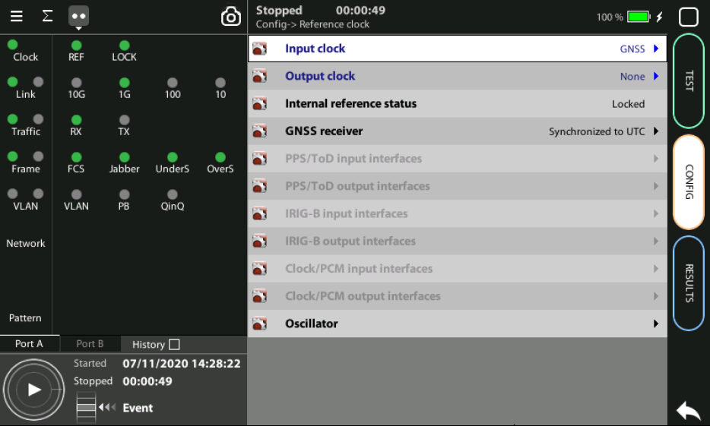
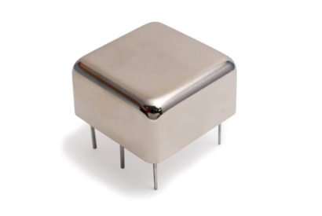

OCXO or Rubidium
1
  The unit will be ready for testing LOCK LED is green
  Mind that time is different depending which oscillator xGenius is equipped
Current locking status (Locking, Fine locking, Locked, Holdover, etc.) can be checked in the Reference clock menu.
Metric | OCXO | Rubidium
Locking time | < 5 minutes | < 4 hours

Slide 11
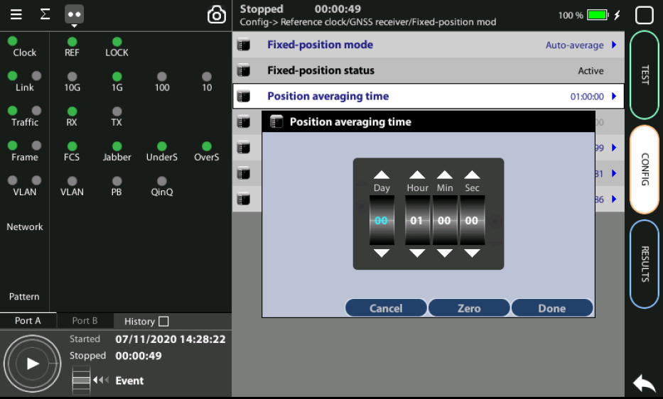
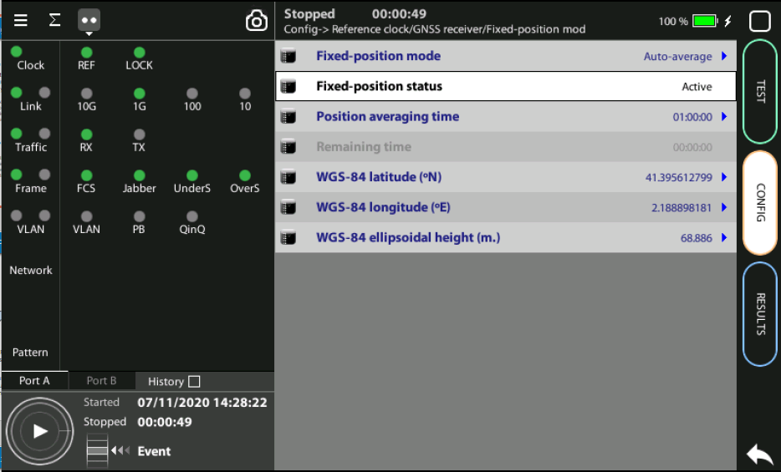
Position Averaging time
Configure the GNSS to increase the accuracy:
Go to Fixed‐position mode := Auto-average
Adjust the Position averaging time and by configuring Auto‐average in the that now displays Averaging
Wait to the Fixed position status to become Active. The unit is now ready for testing.
Note: Theoretically, testing could start before the end of the position averaging process. The improved time estimation due to this function would be automatically applied starting from the end of the auto‐averaging process.
1
Note: (a) At least 1h of averaging is required for reasonable accuracy. (b) The procedure should be run only once as long as the location does not change. If any change is detected (longitude, latitude, altitude) an error will be displayed.
2

Slide 12
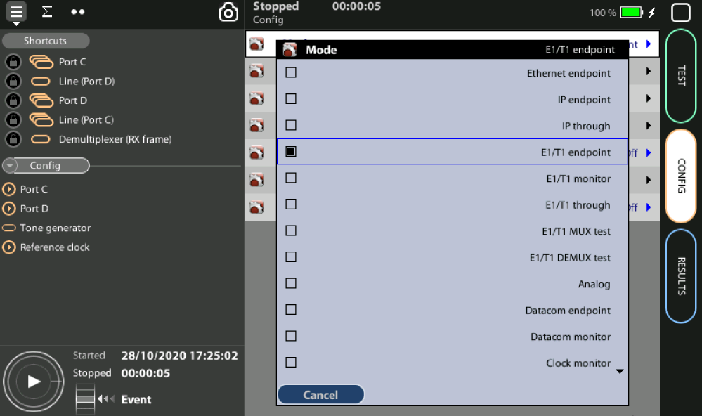
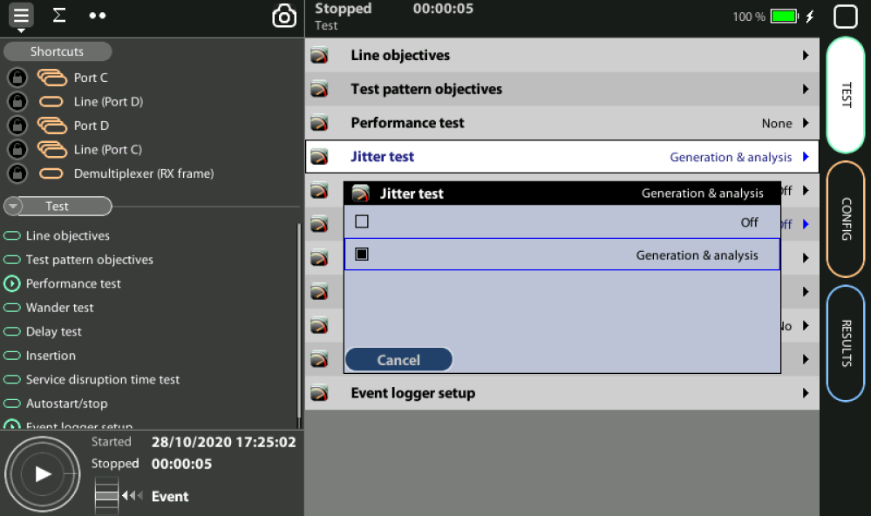
Enable the E1 wander test
1
2
Enable the E1/T1 endpoint mode and the wander test,
Home > Config > Mode := E1/T1 endpoint
Home > Test > Wander test := MTIE/TDEV

Slide 13
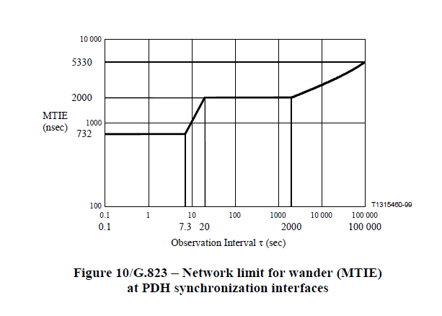
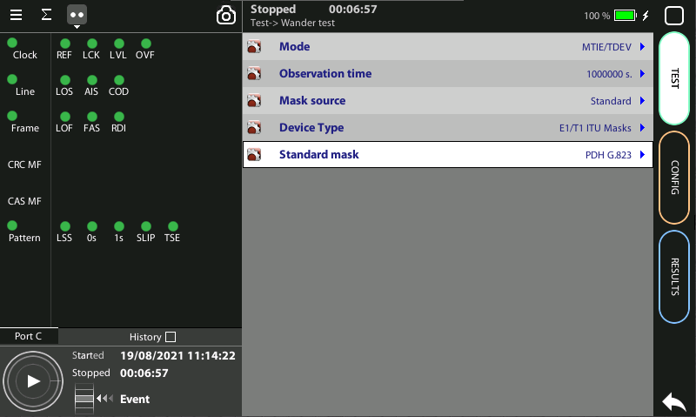
ITU-T G.823 − Output wander in a PDH interface
1
2
Configure a suitable mask for your testing scenario. In this example, the ITU-T G.823 mask for a PDH synchronization interface:
Home > Test > Wander test > Device Type := E1/T1 ITU Masks
Home > Test > Wander test > Standard mask := PDH G.823

Slide 14
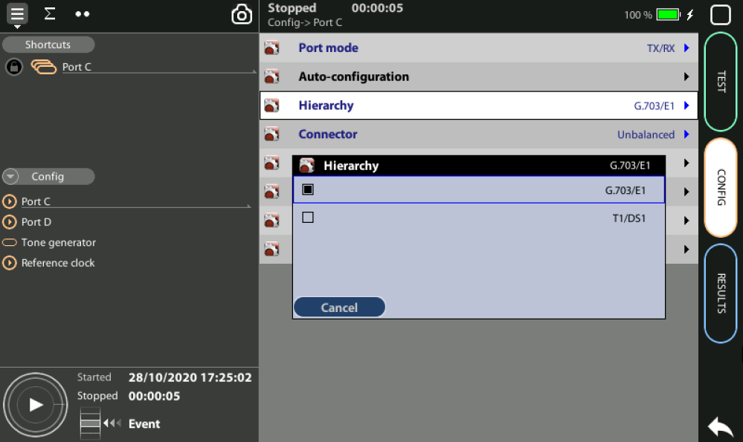
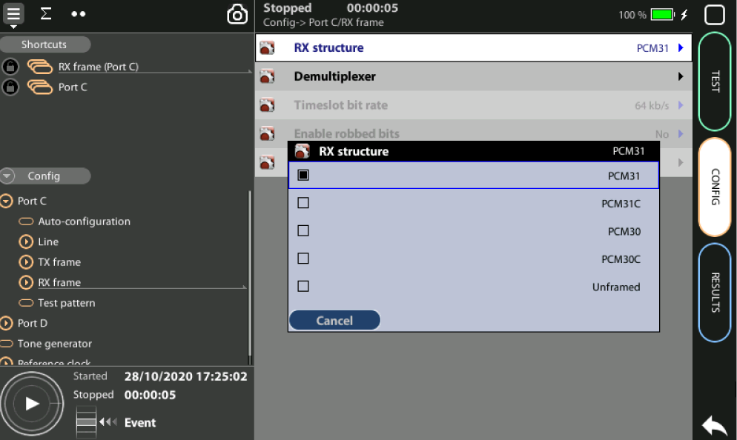
Select Hierarchy & Frame structure
1
2
Select E1 as hierarchy and PCM31 as Frame structure to test:
Home > Config > Port C > Hierarchy := G.703/E1
Home > Config > Port C > RX_Frame > RX Structure := PCM31

Slide 15
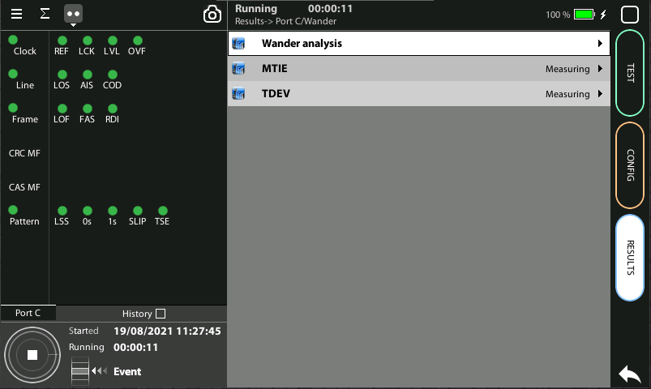
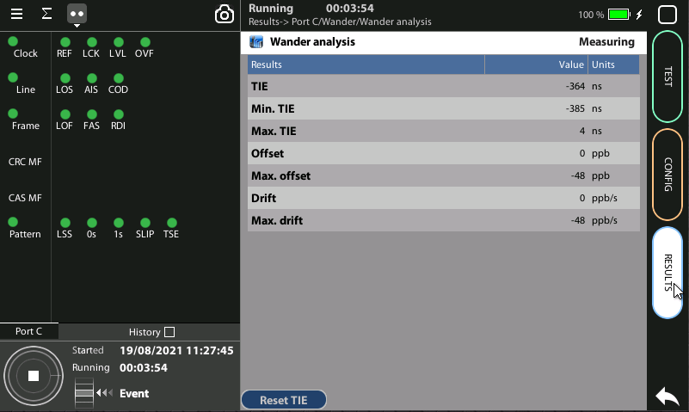
Run the test and sheck Results
2
3
1
Start a new test
Go to Home > Results > Port C > Wander > Wander analysis
Check the [TIE, Offset, Drift] results

Slide 16
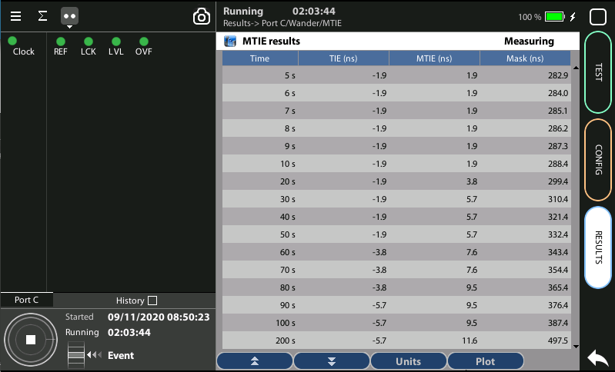
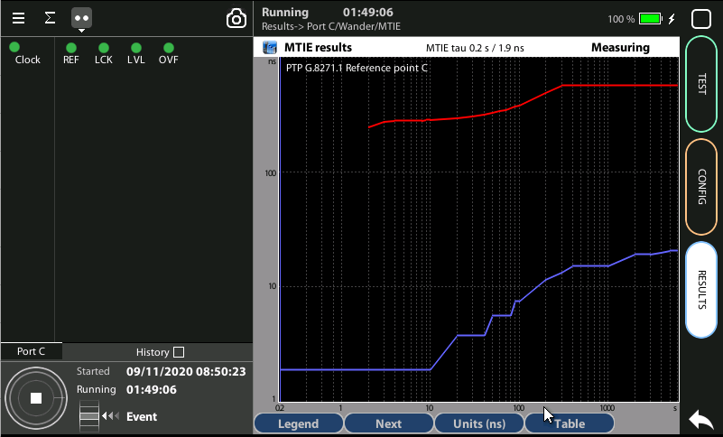
MTIE results
2
3
The MTIE / TDEV test is executed at the same time that the TIE test:
Go to Results > Port C > Wander > MTIE
Check [Time, TIE, MTIE, Mask] results in table format
Press Plot to display the same results in graphical mode
Notes:
(1) To stop the tests press RUN a second time at any moment.

Slide 17
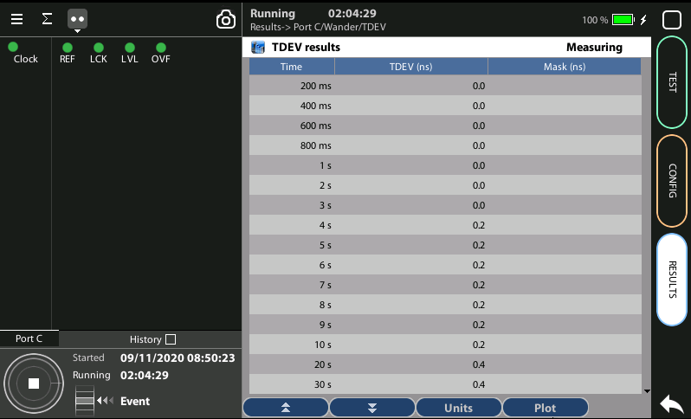
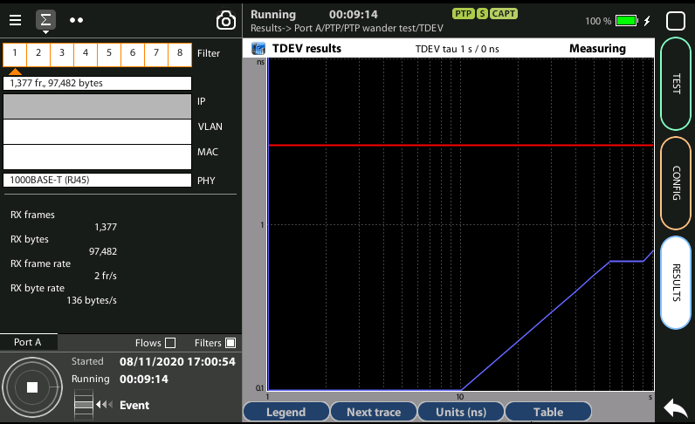
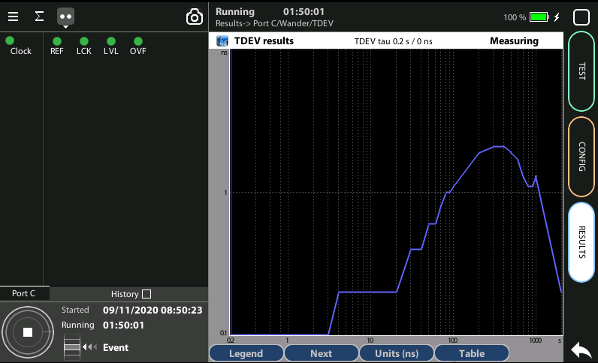
TDEV results
2
3
The MTIE / TDEV test is executed at the same time that the TIE test:
Go to Results > Port C > Wander > TDEV
Check [Time, TDEV, Mask] results in table format
Press Plot to display the same results in graphical mode
Notes:
(1) To stop the tests press RUN a second time at any moment.

Slide 18
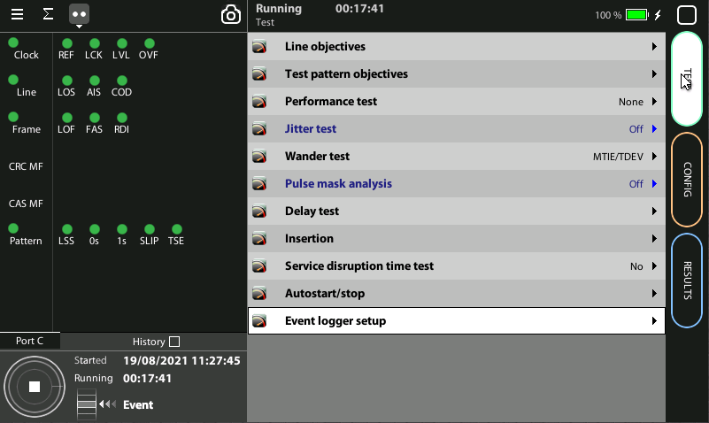
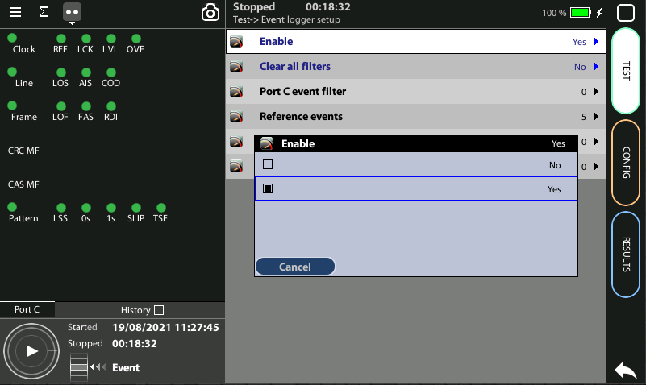
Event logger enable
2
1
Global counts, statistics and LEDs provide information about which events and how many of them have been registered but they do not say too much about how they are distributed in time. These information is supplied at the Event Logger a graphical representation tool that permits to trace the evolution of key parameters.
The first thing to to is to enable it:
Go to Home > Test > Event logger setup
Set Enable := Yes

Slide 19
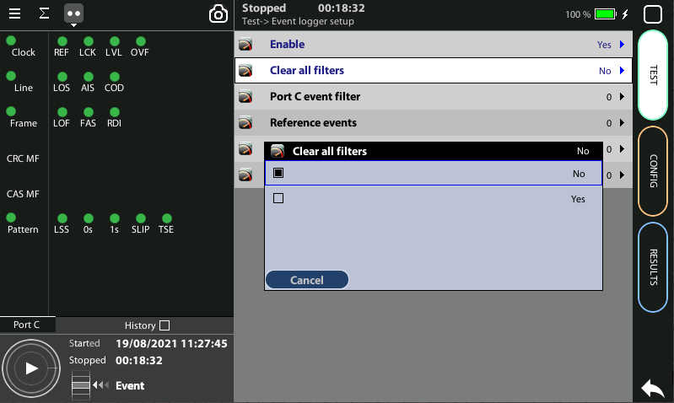
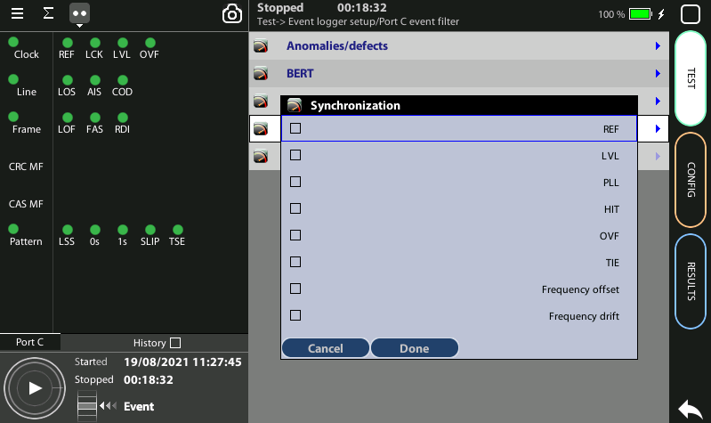
Configuring the Event Logger
2
1
3
4
Traceable Events are categorized in different classes. Moreover, each test port has its own traceable events. These events may be different for each test port.
Clear the currently selected filters: Clear all filters := Yes
Select the Port C
Choose the events to trace: Anomalies/defects | BERT| | Line | Synchronization | Delay
Start a new test to begin the generation of a trace file

Slide 20
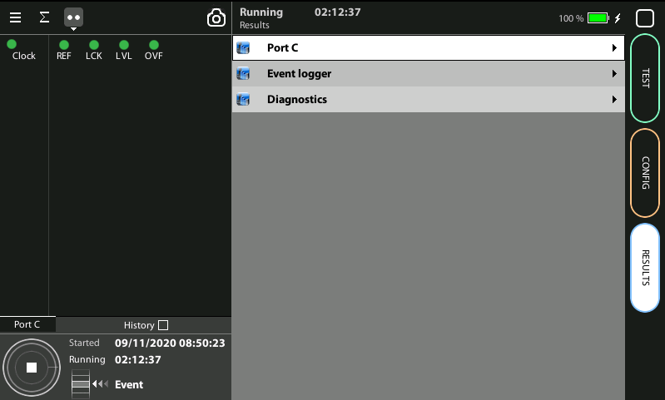
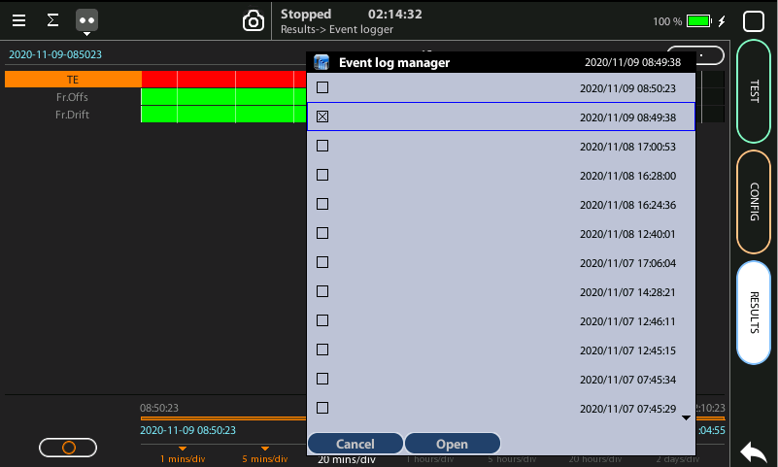
Display the logs
2
1
3
3
With the Event Logger you can select one or various events and trace them so that all changes along with the time and date these changes are registered are recorded with a 1 second resolution. The event logger provides representations and zoom levels to enable event analysis at different time scales:
Go to Results > Event logger
To select a saved trace double click at (…) to display the folder of traces
Select and Open one of the files

Slide 21
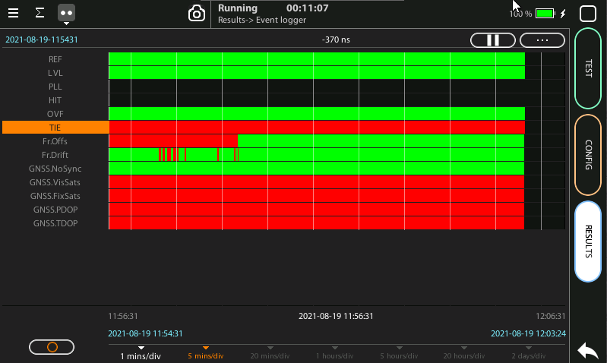
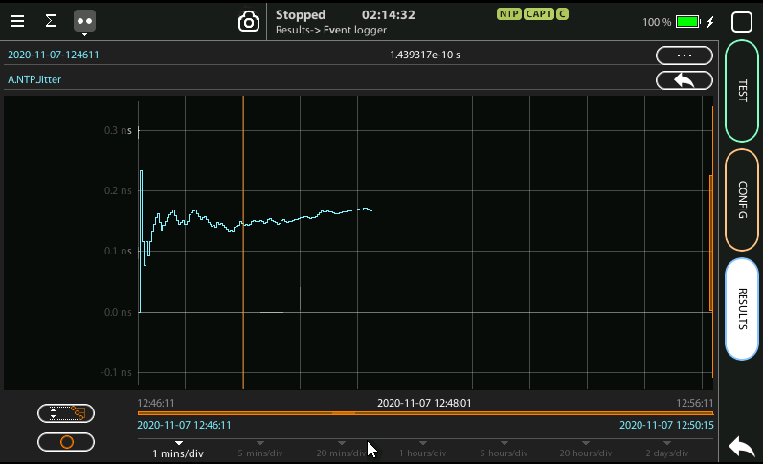
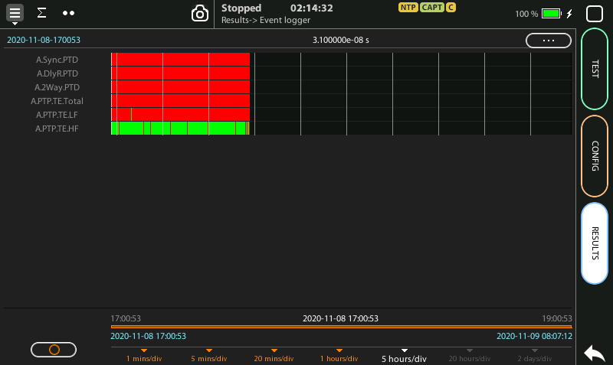
Event logger results
1
4
6
3
4
2
You can display the trace of the evolution of the previously selected parameters:
View and analyze the details of the histogram
Set the scale at your preferred zoom level
Selected one event to display a more detailed diagram
Click on the screen to know the exact value at one specific time

Slide 22
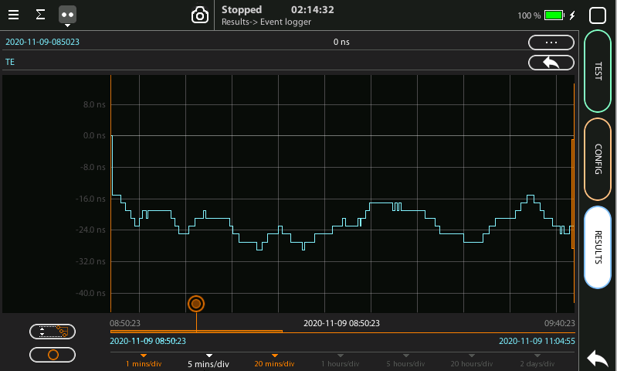
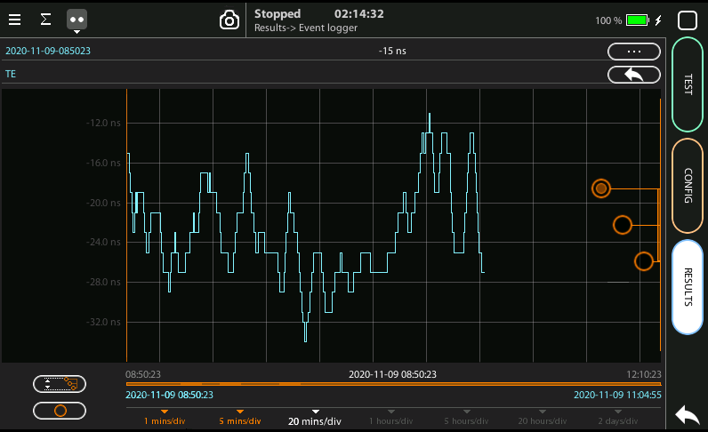
Scaling the trace
1
2
5
1
1
To change the scale horizontally click one time
Click in the red button and drag to the left or to the right
To change the scale vertically click two times
Click one of the three the red buttons and drag the finger up and down
Click in the auto-scale symbol to return to the initial conditions

Slide 23
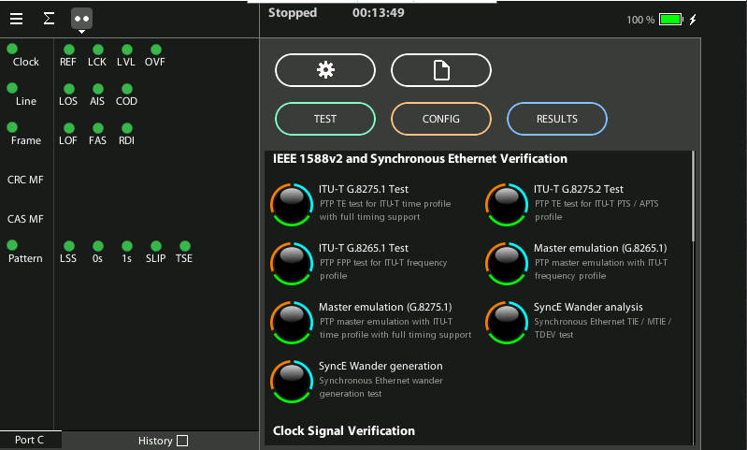
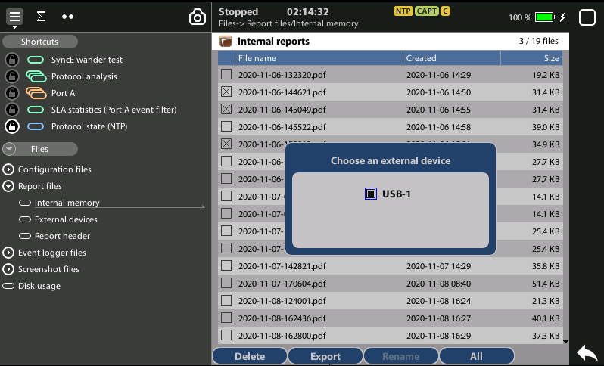
Exporting Logs
1
1
3
2
To export log files in CSV format:
Go Home > [File icon] > Configuration files | Log > Internal memory
to list the files currently stored in the unit
Select the files you want to export: File name > Export
Choose an external device: micro SD | USB
If no external device a popup will appear: ‘No devices present’

Slide 24



That’s all
www.albedotelecom.com

