Slide 1




E1 / T1 Jitter test
E1/T1 Jitter testing with xGenius
Guide & Slides corresponding to software ver. 2.3.13

Slide 2
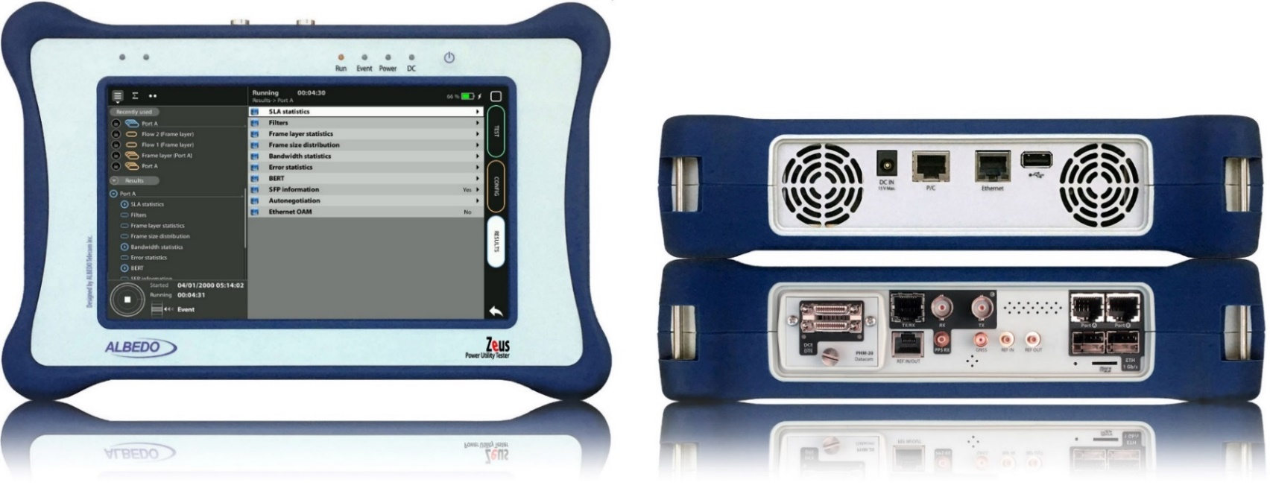
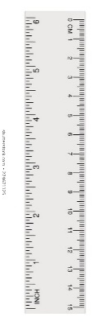
Zeus & xGenius
Zeus & xGenius provide deep insights to design, install, maintain, troubleshoot and engineer communications resources of Mobile Operators, Power Utilities, Finace, Labs and R+D centers. The unit is able to verify Ethernet/IP, SyncE, PTP, GbE, IRIG-B, 1PPS, T1/E1, G703, Serial Datacom, C37.94, GOOSE, SV, MMS, Round-trip & One-way Delay tests at all interfaces.
It also has a set of programmable filters to capture live data traffic at wire-speed

Slide 3
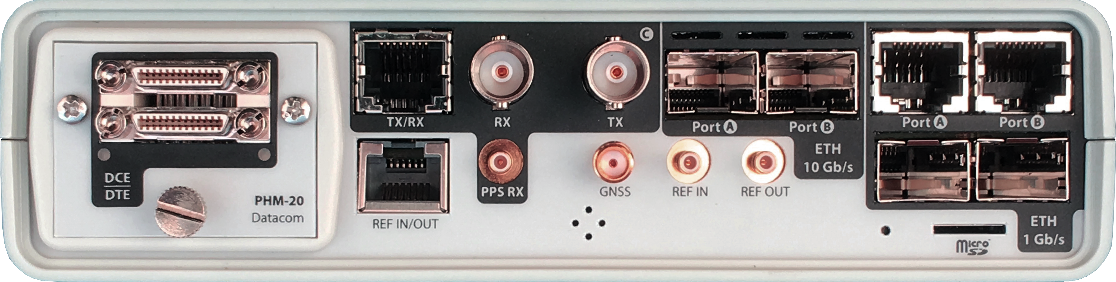

Interfaces & time References
PHM
RJ45-C
BNC-C
SFP+ A
SFP+ B
RJ45-A
RJ45-B
xGenius generates and analyses different kinds of 1544 kb/s and 2048 kb/s signals and also unframed 1544 / 2048 kb/s signals.
RJ45
SMB-C
SMA
SMB-1
SMB-2
SFP-A
Micro SD
SFP-B
 | GNSS | PTP | NTP | ToD | IRIG-B | PPS | PP2S | SyncE | T1/E1 | MHz | Data
RJ45-A |  | in/out | in/out |  |  |  |  | in/out
RJ45-B |  |  |  |  |  |  |  | in/out
SFP-A |  | in/out | in/out |  |  |  |  | in/out
SFP-B |  |  |  |  |  |  |  | in/out
SFP+A |  | in/out | in/out |  |  |  |  | in/out
SFP+B |  |  |  |  |  |  |  | in/out
BNC-C |  |  |  |  |  |  |  |  | in/out | in/out
RJ45-C |  |  |  | in |  | in | in |  | in/out | in/out
SMB-C
SMA | in
SMB-1 |  |  |  |  | in | in | in
SMB-2 |  |  |  |  | out | out | out
RJ-45 |  |  |  | in/out | in/out | in/out | in/out |  | in/out | in/out
PHM |  |  |  |  |  |  |  |  |  |  | in/out

Slide 4
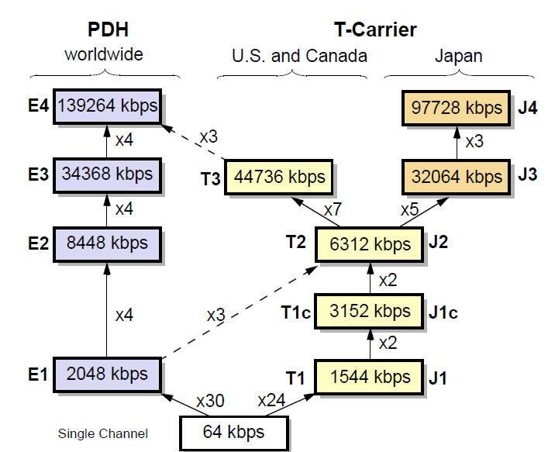
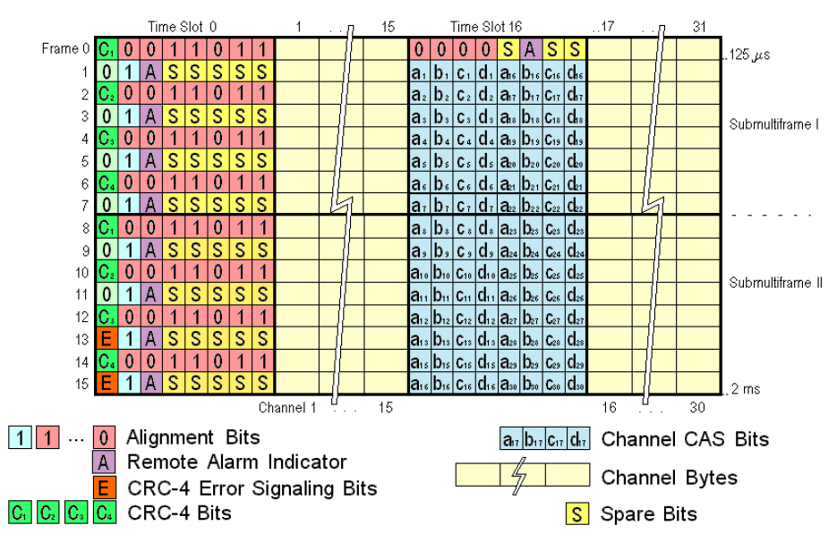
E1/T1: the first level in the Hieranchy
The E1 frame defines a cyclical set of 32 time slots of 8 bits. The time slot 0 is devoted to transmission management and time slot 16 for signalling; the rest were assigned originally for voice/data transport.

Slide 5

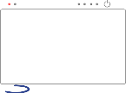


The Jitter test
Network
E1
Jitter measurement
ALBEDO
xGenius
Jitter is defined as short-term variations of the significant instants of a digital signal from their reference positions in time. In other words, it is a phase oscillation with a frequency higher than 10 Hz. Jitter causes sampling errors and provokes slips in the phase-locked loops (PLL) buffers.
This measurement attempts to obtain the jitter amplitude present in the output port at a network equipment. The ITU-T specifies the maximum jitter allowed in a network in the ITU-T G.823 The jitter may be generated by the equipment itself, or may result from the transfer of jitter from one of the inputs of the element, either the data input or the synchronization input. The result of the measurement is the jitter amplitude in a specific bandwidth. Should we wish to measure the jitter generated by the NE, we need to connect an input signal free of jitter. .

Slide 6
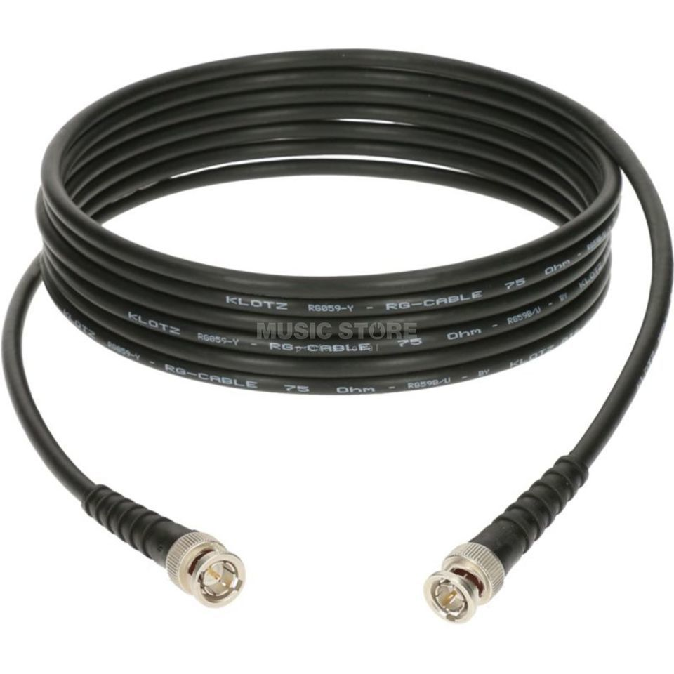

Connecting the BNC cables to Port C
2
1
1
xGenius Port C can be Balanced (RJ45) or Unbalance (BNC)
In our test, we are going to use the BNC cables
Connect BCN transmission (Tx) in Port C
Connect BCN Reception (Rx) in Port C

Slide 7
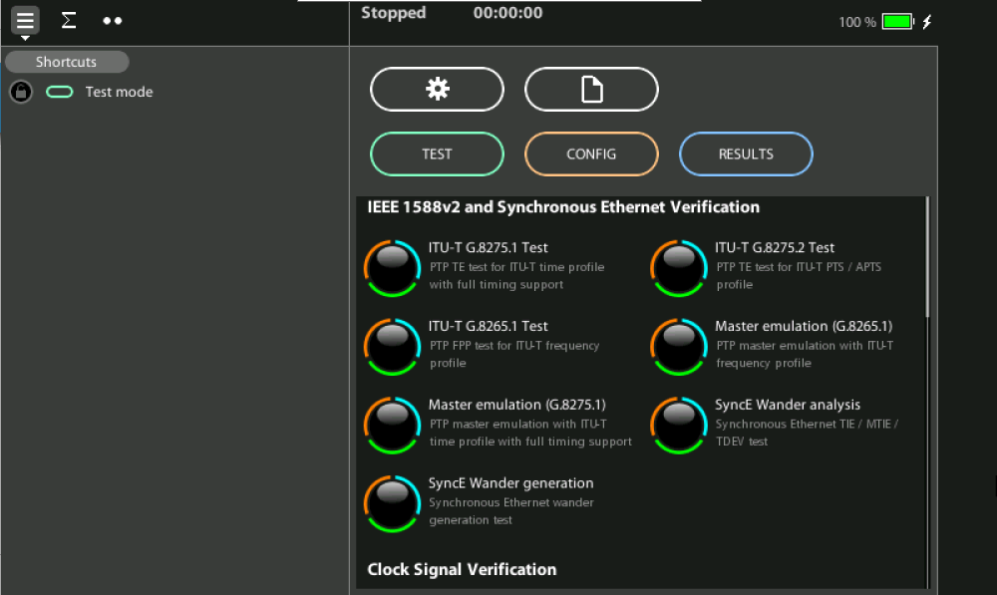
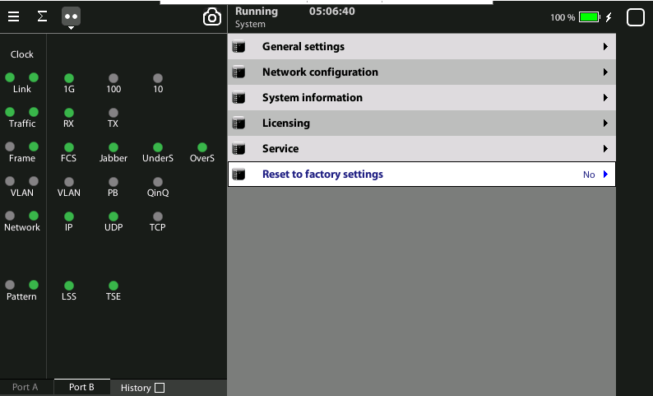
Select the global operation mode
1
Home > [System] > Reset to factory settings := Yes

Slide 8
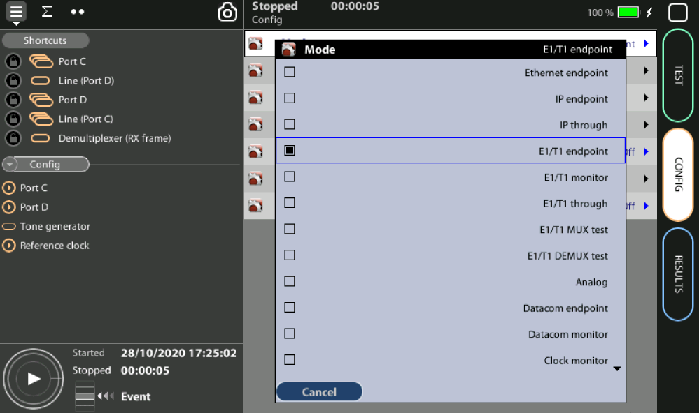
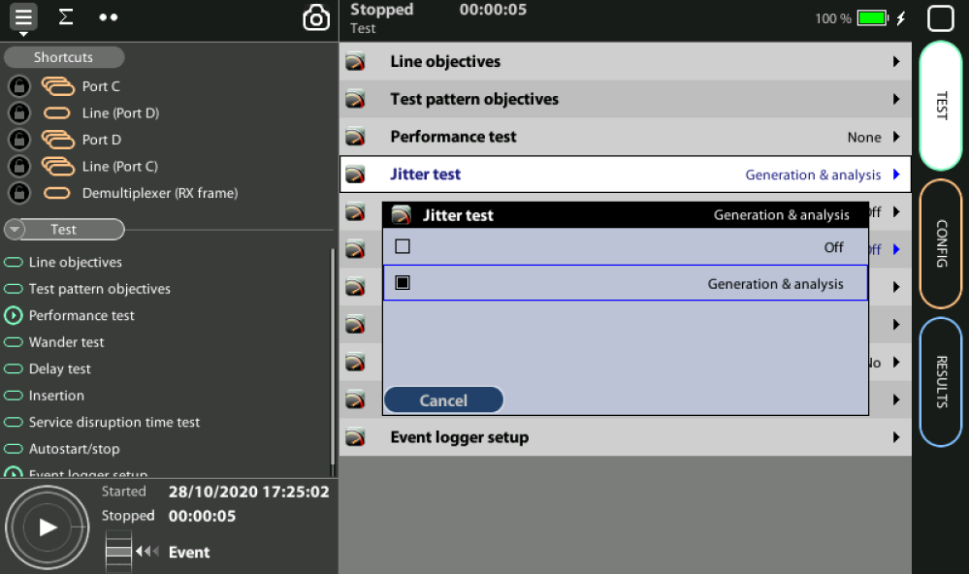
Configure the test mode
1
2
From the Home panel, go to CONFIG,
Home > Config > Mode := E1/T1 endpoint
Home > Test > Jitter test := Generation & Analysis
We are going to generate jitter and then analyze it.

Slide 9
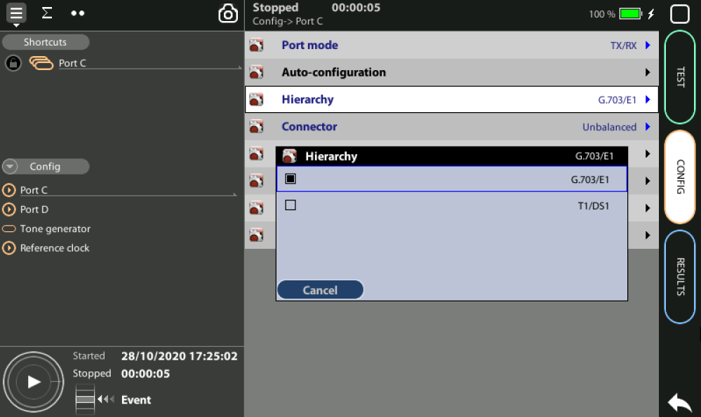
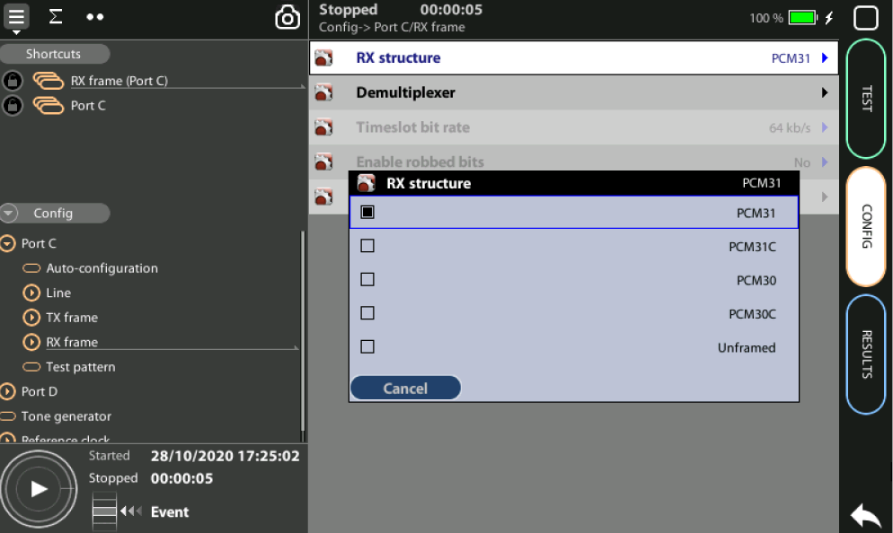
Select Hierarchy & Frame structure
1
2
Select E1 as hierarchy and PCM31 as Frame structure to test:
Home > Config > Port C > Hierarchy := G.703/E1
Home > Config > Port C > RX_Frame > RX Structure := PCM31

Slide 10

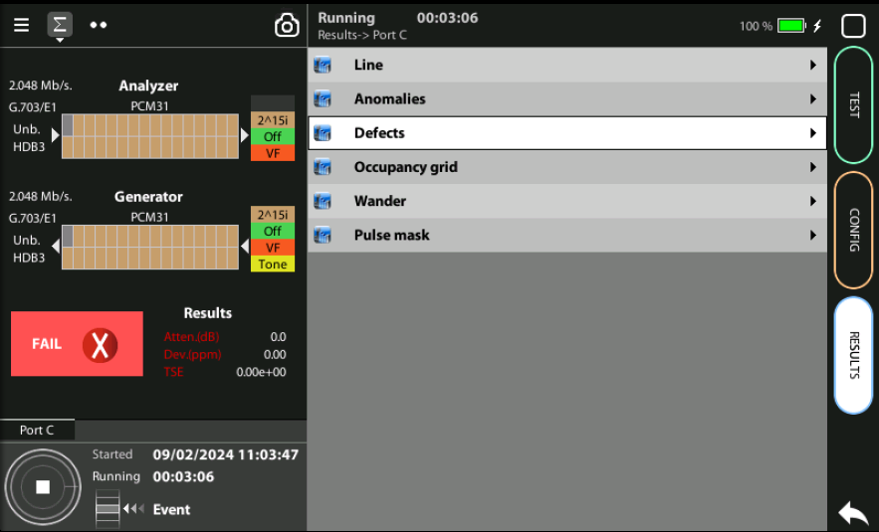
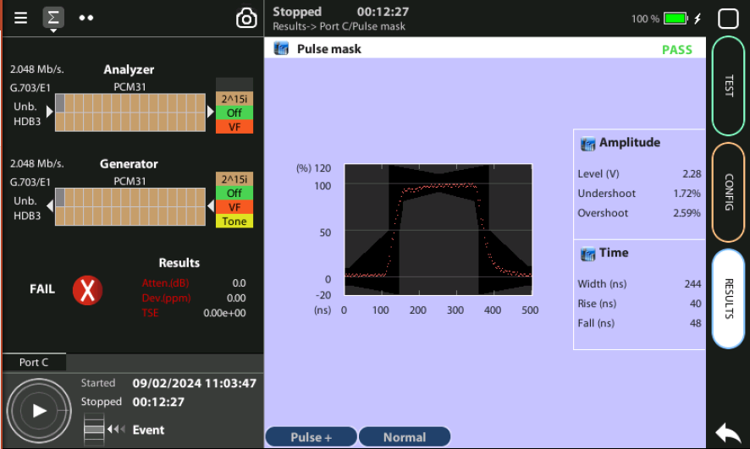
Display Configuration & Pulse Mask
2
1
3
2
Configure the integration period and extended jitter measurement band:
Click to display the diagram
Look at the Configuration
Home > Results > Port C > Pulse Mask

Slide 11
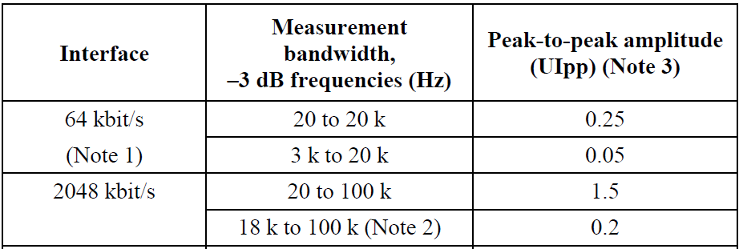
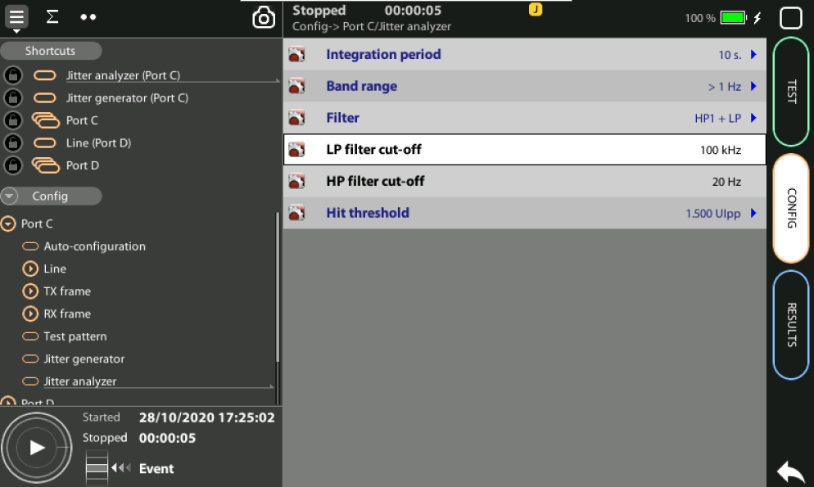
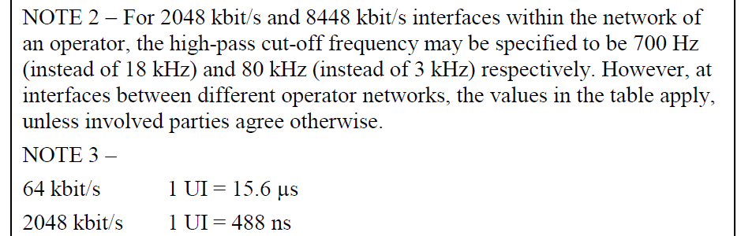
ITU-T G.823 − Maximum permissible jitter at E1
1
2
Configure a filter according ITU-T that specifies and limits the maximum amount of jitter allowed for E1 in G.823 that we can configure in the test set:
Home > Config > Port C > Jitter analyzer > Filter := [ HP1 + LP | HP2 + LP ]
  If you choose [ HP1 + LP ] then: LP filter = 20kHz whilst HP filter = 100kHz
  If you choose [ HP2 + LP ] then: LP filter = 18kHz whilst HP filter = 100kHz
Home > Config > Port C > Jitter analyzer > Hit threshold := [1.5 | 0.2] set phase hit events in UIpp

Slide 12
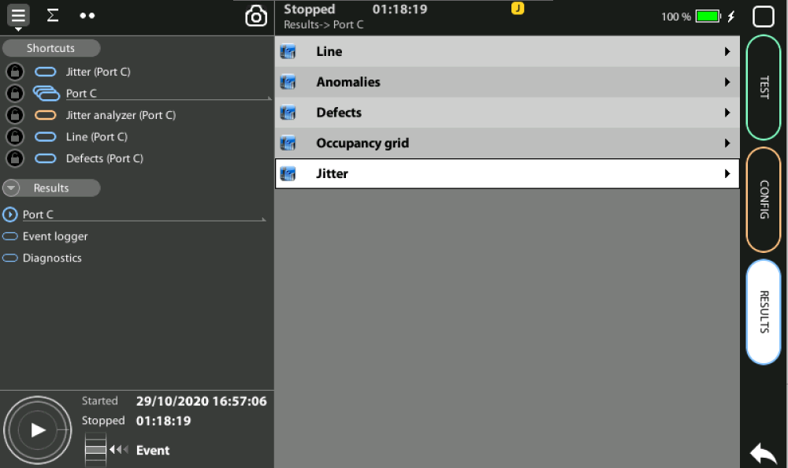
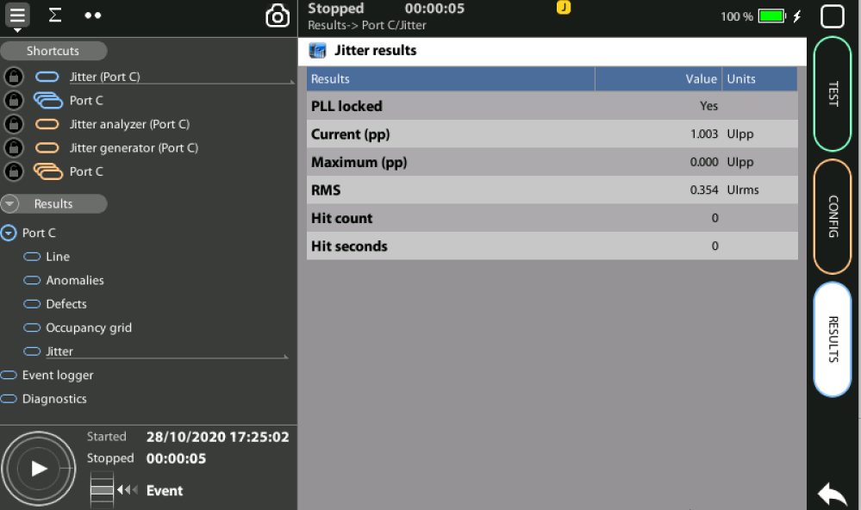
Check Results
3
1
Go to Home > Results > Port C > Jitter
Make sure that the PLL is tracking the phase: PLL locked
Check the Current (pp) and RMS jitter values
If you want to analyze the maximum jitter amplitude, the hit count and the hit seconds start a measurement with run or program a test. While the test is running, the maximum jitter and hit counts are upgraded in real time.

Slide 13
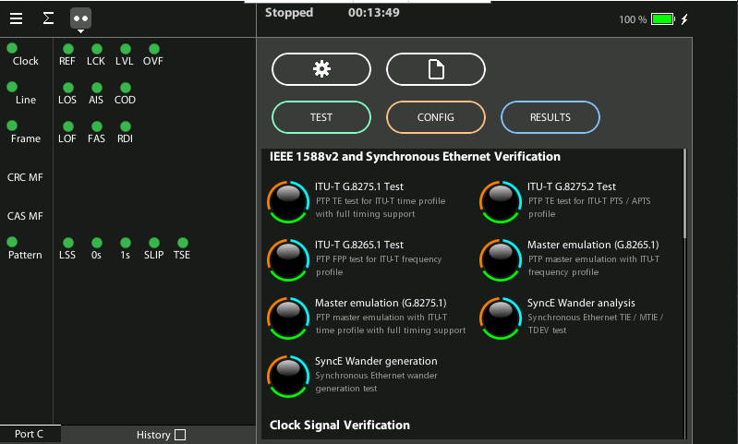
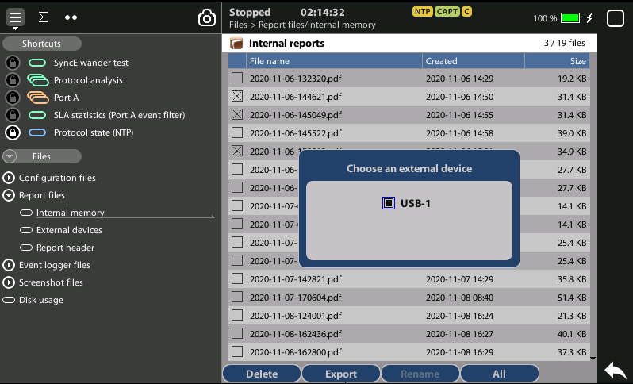
Exporting Reports
1
1
3
2
To export report files:
Go Home > [File icon] > Configuration files | Report files > Internal memory
to list the files currently stored in the unit
Select the files you want to export: File name > Export
Choose an external device: micro SD | USB
If no external device a popup will appear: ‘No devices present’

Slide 14



That’s all
www.albedotelecom.com

