Slide 1
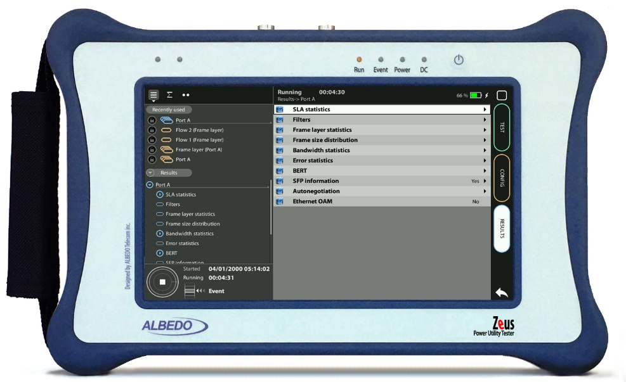
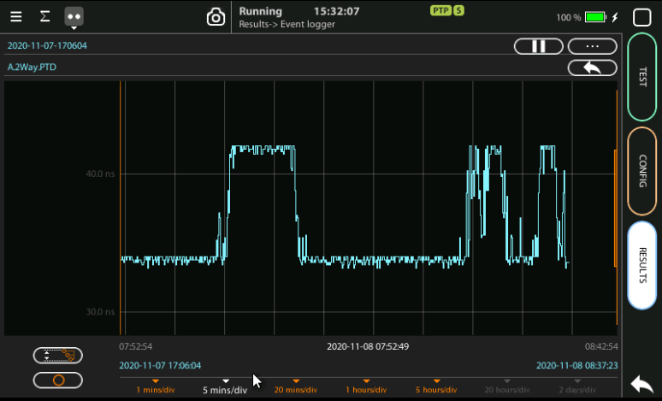

GNSS Antenna Setup
How to with xGenius/Zeus
Guide & Slides corresponding to software ver. 2.3.11

Slide 2
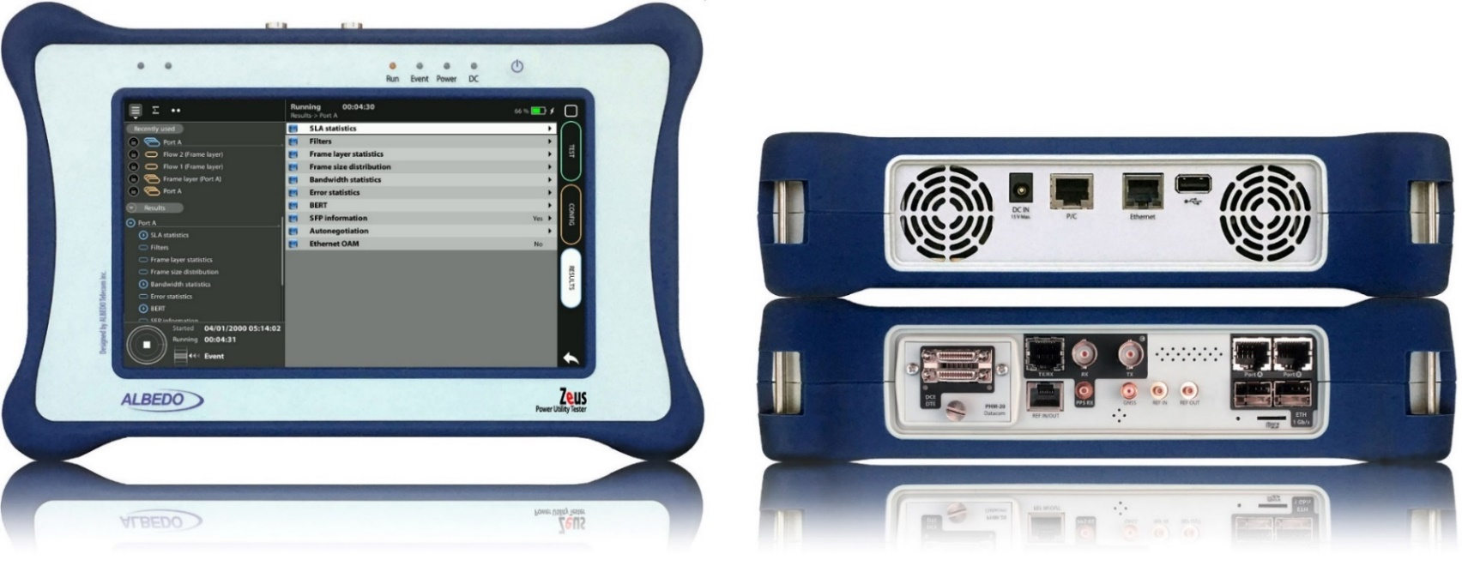
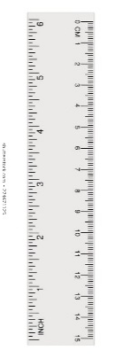
xGenius & Zeus
xGenius / Zeus provide deep insights to design, install, maintain, troubleshoot and engineer communications infrastructures of the Smart Grid and more particularly of the Power Substations. The unit is able to test Ethernet/IP, PTP, GbE, IRIG-B, T1/E1, G703, C37.94, GOOSE, SV and MMS protocols. One-way-delay tests, assisted by GPS, is possible at all interfaces.
It also has a set of programmable filters to capture live data traffic at wire-speed

Slide 3




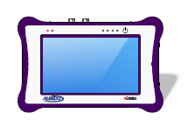
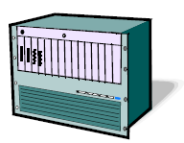
A built-in GNSS receiver
GNSS
Operation
Synchronization
DUT
Some tests require a time reference such as GNSS to synchronize the unit with a satellite constellation. The built-in GNSS receiver is a hardware option you have to purchase for your testers and it is supplied with a compact antenna with 5 m of coaxial cable plus a 10 m extension cable.

Slide 4
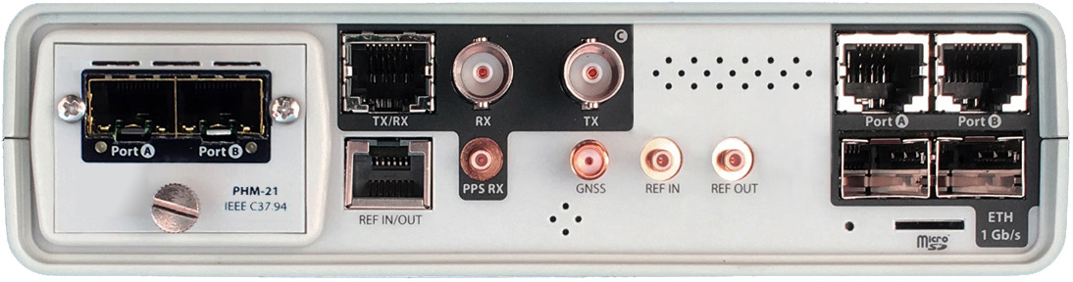
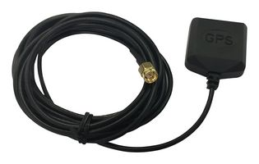

Connecting the GPS antenna
1
2
Zeus / xGenius are equipped with C47.94 optical interfaces and a built-in GNSS receiver. Proceed to connect all the elements:
Attach the GNSS antenna to the unit.
Make sure that the antenna sees as much of the sky as possible.
The unit may fail to achieve synchronization if there are not enough satellites in sight. Some tests may loss accuracy if the number of satellites in sight is reduced.

Slide 5

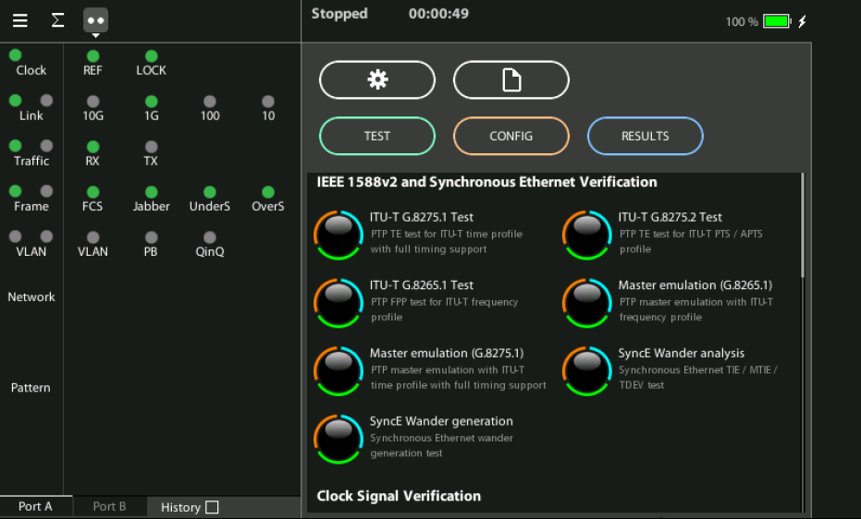
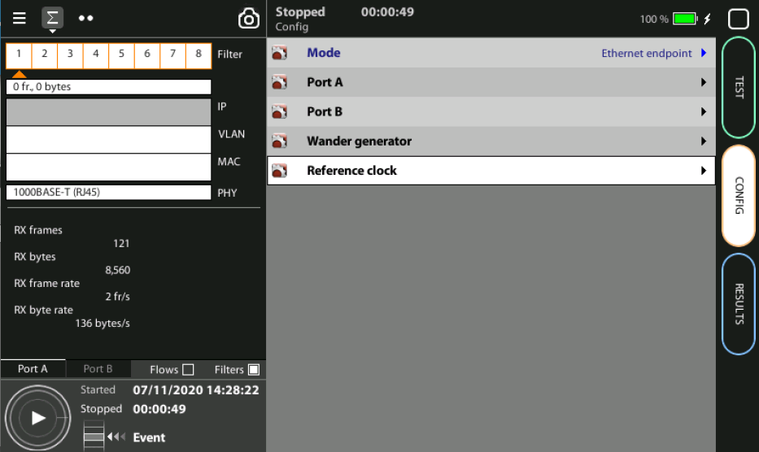
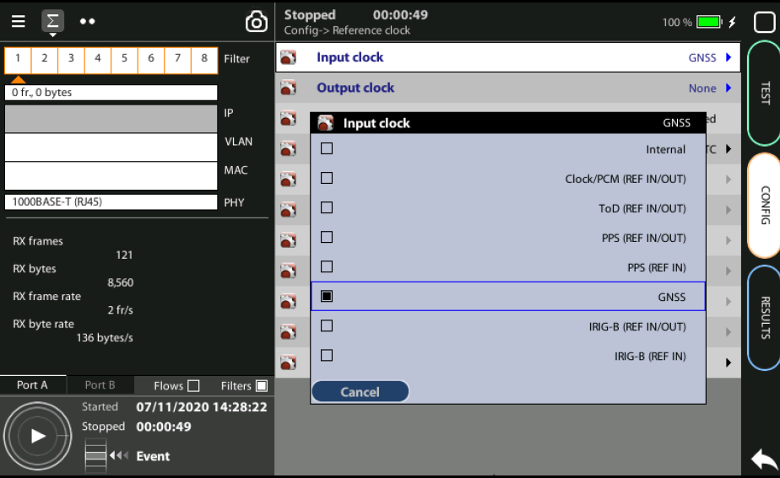
Steps to connect the built-in GNSS
3
2
1
1
Home > Config > Reference clock > Input clock := GNSS (*)
Press LEDS to check the status
Wait for the REF and LOCK LEDs to become green
(*) Go to Home panel, go to Config, the port setup will be displayed then Go to Reference clock and configure Input clock to GNSS.

Slide 6
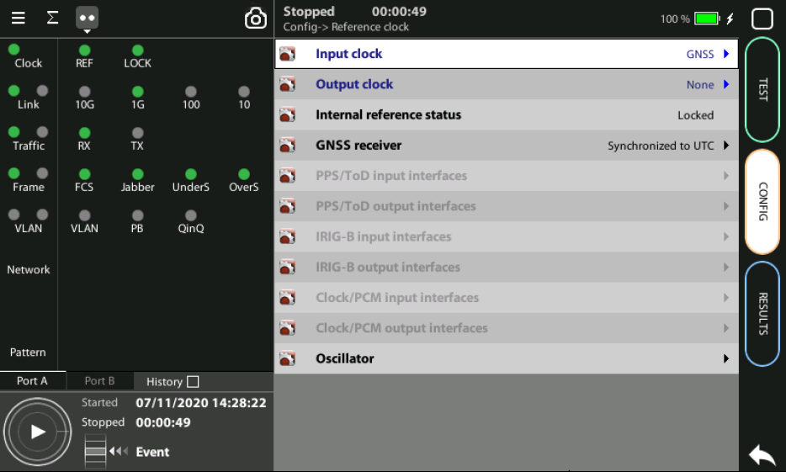
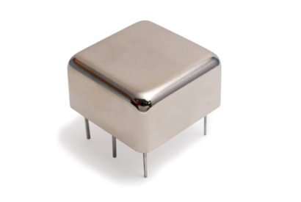
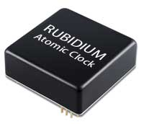
OCXO or Rubidium
1
  The unit will be ready for testing LOCK LED is green
  Mind that time is different depending which oscillator xGenius is equipped
Current locking status (Locking, Fine locking, Locked, Holdover, etc.) can be checked in the Reference clock menu.
Metric | OCXO | Rubidium
Locking time | < 5 minutes | < 4 hours

Slide 7
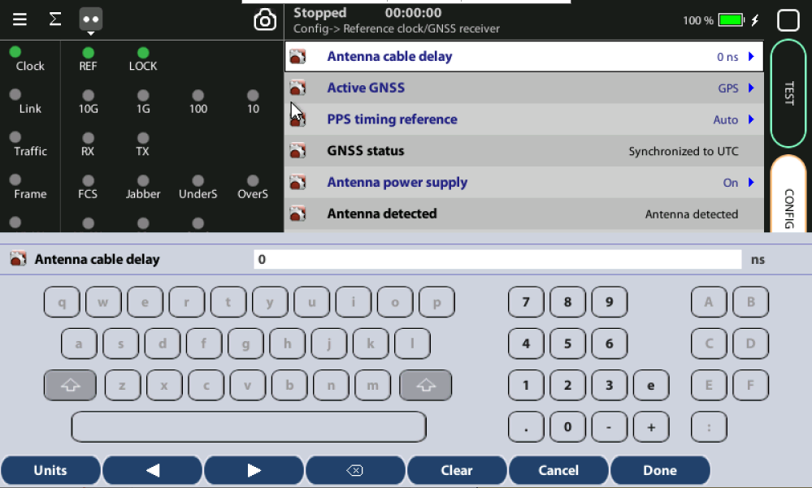
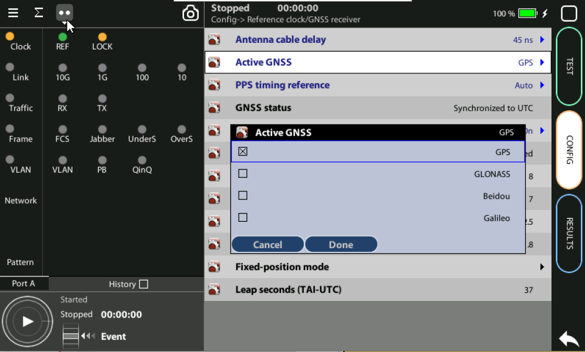
Configuring the GNSS Properties
2
1
3
Configure the GNSS to increase the accuracy:
Config > Reference clock > GNSS receiver > Antenna cable delay to configure a compensation at the correction field
In the same screen Enable/Disable any constellation (GPS, GLONASS, GALILEO, BEIDOU) through the Active GNSS setting := GPS…
Go to Fixed‐position mode := Auto-average

Slide 8
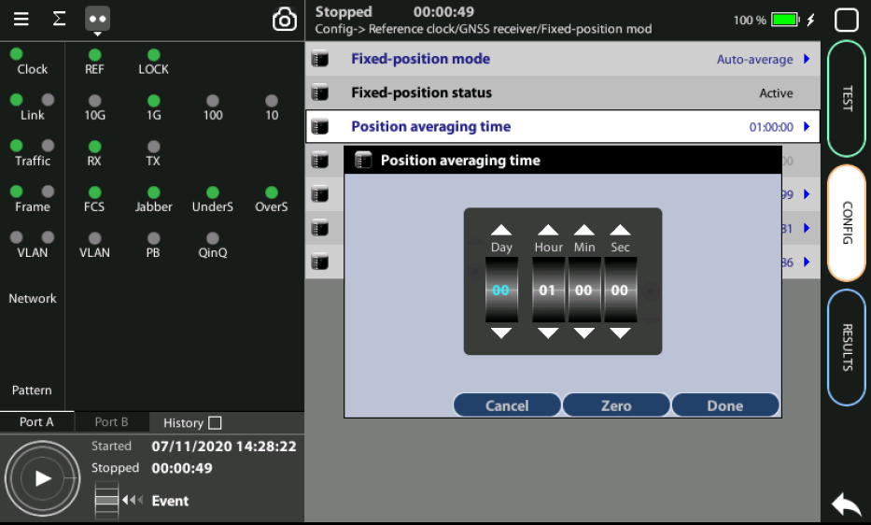
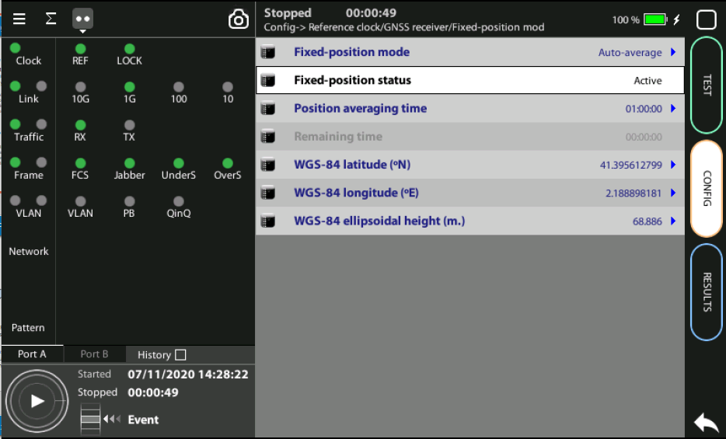
Position Averaging time
GPS has a statistical distribution and averaging for a time filters errors to improve accuracy.
Adjust the Position averaging time and by configuring Auto‐average in the that now displays Averaging
Wait to the Fixed position status to become Active. The unit is now ready for testing.
Note: Theoretically, testing could start before the end of the position averaging process. The improved time estimation due to this function would be automatically applied starting from the end of the auto‐averaging process.
1
Notes: (a) At least 1h of averaging is required for reasonable accuracy. (b) The procedure should be run only once as long as the location does not change. If any change is detected (longitude, latitude, altitude) an error will be displayed.
2

Slide 9
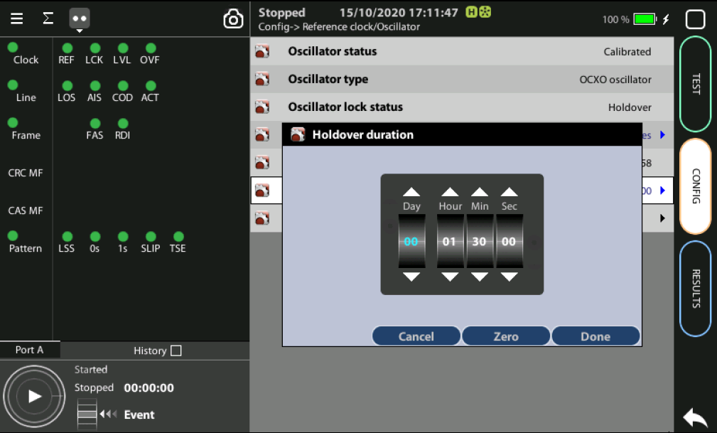
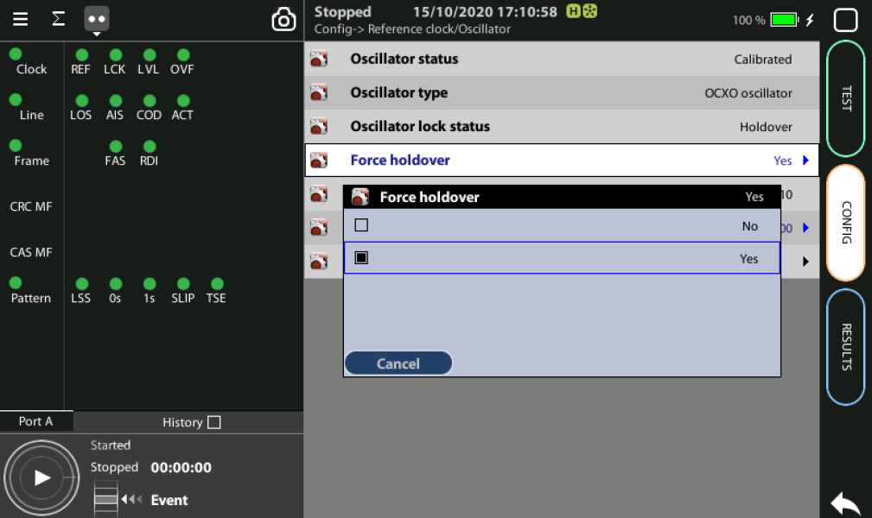
Holdover mode
1
3
2
When GPS is not available (i.e. a room without windows) you can first synchronize the unit in a place with GPS and then go to execute the test in holdover mode.
Accuracy will depend on: (a) the quality of the internal oscillator (Quartz, OCXO, Rubidium); and (b) the holdover period.
Synchronize to GPS and and verify that LED Clock, REF and LOCK are green
Config > Reference clock > Holdover duration := set the time you need for testing
Config > Reference clock > Force holdover := Yes

Slide 10
Glossary
AAA: Authentication, Authorization, and Accounting
ACL: Access Control List
AP: Access Point
Busbar: Metallic strip or bar, typically housed inside switchgear, panel boards, and busway enclosures for local high current power distribution C37.94: TDM interface devoted for teleprotection
CB: Circuit Breaker designed to close or open electrical circuit under normal or abnormal conditions. It operates on relays command.
CBWFQ: Class-Based Weighted Fair Queuing
CG: Connected Grid
CID: Individual configuration of each IED CIP: Critical Infrastructure Protection CLI: Command-Line Interface
CorpSS: Corporate Substation
CT: Current Transformer, used for measurement of current, if too high to apply directly to measuring instruments, a CT produces a proportional current which can be measured and recorded, CT are used in metering and protective relays
DAN: Doubly Attached Nodes implementing HSR or PRP
DAU: Data Acquisition Unit
Disconnector: isolates physically and visually the lines
DMZ: Demilitarized Zone
DCB: Directional Comparison Blocking
DCS: distributed control systems
DSC: Differentiated Services Code Point
DUT: Device Under Test
ESP: Electronic Security Perimeter
Feeder: Transmits power to the distribution points
GM: Grandmaster
GNSS: Global Navigation Satellite System
GOOSE: Generic Object-Oriented Substation Events is a control model defined as per IEC 61850 which provides a fast and reliable mechanism of transferring event data over entire electrical substation networks. When implemented, this model ensures the same event message is received by multiple physical devices using multicast or broadcast services
GPS: Global Positioning System
HMI: Human Machine Interface
PTP: Precision Time Protocol
RedBox: Redundancy Box
Relay: is automatic device which senses an abnormal condition of electrical circuit and closes its contacts and complete the circuit breaker trip.
REP: Resilient Ethernet Protocol
RCT: Redundancy Control Trailer
RTU: Remote Terminal Unit
SA: Substation Automation
SAN: Singly-Attached Node
Secondary Lines: lower voltage side at the substation
SCADA: Supervisory Control And Data Acquisition, transmits and receives data from events of controls, measuring, safety and monitoring. Power system elements can be controlled remotely over. Remote switching, telemetering of grids showing voltage, current, power, direction, consumption in kWh, synchronization.
SCD: Substation Configuration Description SCL: Substation Configuration Language SNTP: Simple Network Time Protocol
Station Bus: Connects the entire substation and helps provide connectivity between central management and individual bays
STP: Spanning Tree Protocol
SV: Sampled Values, is a method to read instantaneous values such as currents, voltages, impedances, etc. from CTs, VTs or digital I/O and then transmitted to make them are available for those IED subscribed.
Switchgear: combination of switches, fuses or CB to control, protect and isolate electrical equipment
SyncE: Synchronous Ethernet
TLV: Type, Length, Value
UCA IuG: Utility Communications Architecture International Users Group
VT: Voltage Transformer (see CT)Potential Transformer, gives the reference voltage to the Relay for Over-voltage or Under-voltage Protection
VDAN: Virtual D
HQoS: Hierarchical Quality of Service
HSR: High-Availability Seamless Redundancy
IA: Industrial Automation
ICS: Industrial control systems
ICU: Intelligent Control Unit
IEC: International Electrotechnical Commission
IEC 61850: Standard defining communication protocols for intelligent electronic devices at electrical substations
IED: Intelligent End Device, microprocessor-based controllers of power system equipment, such as circuit breakers, transformers and capacitor banks to enable advanced power automation.
IRIG: Inter-Range Instrumentation Group
ISE: Identity Services Engine
L3VPN: Layer 3 Virtual Private Network
LA: Lightning Arrester protects the power grid from electric storms
MQC: Modular QoS Command-Line Interface
MMS: Manufacturing Message Specification, messaging system for exchanging real-time data and supervisory control information. Allows client such as SCADA, an OPC server or a gateway to access all IED objects MPLS: Multi-protocol Label Switching
MU: Merging Unit connected to the process bus converts analog data(ie. volts, correct...) into digital information
NERC: North American Electric Reliability Corporation
NIST: National Institute of Standards and Technology
NMS: Network Management System
OAM: Operations and Maintenance
OCXO: Oven-Controlled crystal Oscillator
PCP: Priority Code Point
PIOC: Instantaneous overcurrent Protection
PLC: Programmable Logic Controller
PMU: Phasor Measurement Unit
POTT: Permissive Overreaching Transfer Trip
PDOP: Position Dilution of Precision
PP: Primary Power
Process Bus: Connects primary units and control equipment to the IEDs
PRP: Parallel Redundancy Protocol
PRTC: Primary Reference Clock
PT: see VT
T-GM: Grand Master PTP
T-BC: Boundary Clock
T-TSC: Slave Clock

Slide 11



That’s all
www.albedotelecom.com

