Slide 1
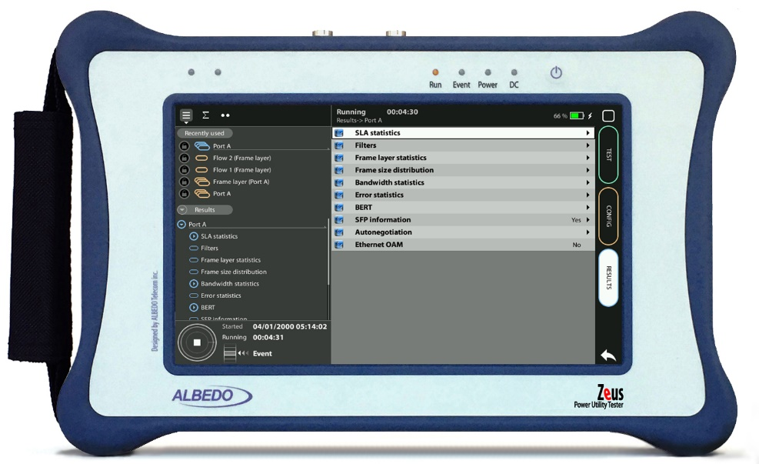
Connect Testers & Networks
Connecting the Tester to the Network Guide & Slides corresponding to software ver. 2.3.13

Slide 2
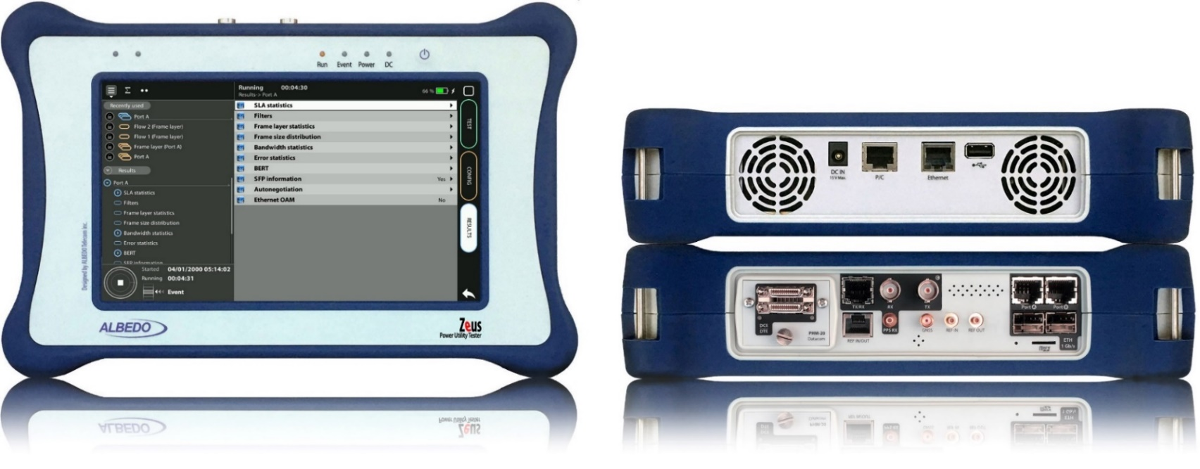
Zeus & xGenius
Zeus & xGenius provide deep insights to design, install, maintain, troubleshoot and engineer communications resources of Mobile Operators, Power Utilities, Finace, Labs and R+D centers. The unit is able to verify Ethernet/IP, SyncE, PTP, GbE, IRIG-B, 1PPS, T1/E1, G703, Serial Datacom, C37.94, GOOSE, SV, MMS, Round-trip & One-way Delay tests at all interfaces.
It also has a set of programmable filters to capture live data traffic at wire-speed

Slide 3
Interfaces
BNC-C
SFP+ A
RJ45-A
PHM
RJ45-C
SFP+ B
RJ45-B
This course describes how to connect the tester to the network and how to configure it to receive and send signals.
RJ45
SMB-C
SMA
SMB-1
SMB-2
SFP-A
SFP-B
Micro SD
 | GNSS | Eth/IP | PTP | NTP | ToD | IRIG-B | PPS | PP2S | SyncE | T1/E1 | MHz | Data
RJ45-A |  | in/out | in/out | in/out |  |  |  |  | in/out
RJ45-B |  | in/out |  |  |  |  |  |  | in/out
SFP-A |  | in/out | in/out | in/out |  |  |  |  | in/out
SFP-B |  | in/out |  |  |  |  |  |  | in/out
SFP+A |  | in/out | in/out | in/out |  |  |  |  | in/out
SFP+B |  | in/out |  |  |  |  |  |  | in/out
BNC-C |  |  |  |  |  |  |  |  |  | in/out | in/out
RJ45-C |  |  |  |  | in |  | in | in |  | in/out | in/out
SMB-C |  |  |  |  |  |  | out | ou
SMA | in
SMB-1 |  |  |  |  |  | in | in | in
SMB-2 |  |  |  |  |  | out | out | out
RJ-45 |  |  |  |  | in/out | in/out | in/out | in/out |  | in/out | in/out
PHM |  |  |  |  |  |  |  |  |  |  |  | in/out

Slide 4
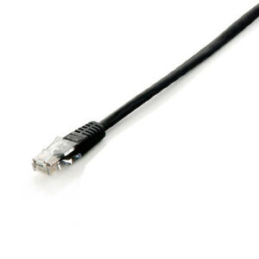
Connecting the Electrical or Optical cables
2
1
1
3
xGenius Ports A and B have the connector for the RJ45 cables and SFP for optical media. Connect the selected interface:
For electrical the Cable directly
For Optical introduce a compatible SFP into Port A*
Connect the optical cables to the SFP in Port A

Slide 5
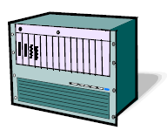
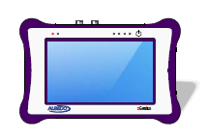
Basic connection setup
Routed Network
Port A
Port B
1000BASE-T
ALBEDO
xGenius
ALBEDO
xGenius
The way to connect the tester depends on the operation mode.
IP through mode: connect the equipment in “transparent” mode, with the traffic going through the unit from Port A to Port B and Port B to Port A.
Ethernet Endpoint mode: if They also prefer to avoid generation of any IP stack protocol (ICMP, ARP, DHCP, PPP) within their administrative domains

Slide 6
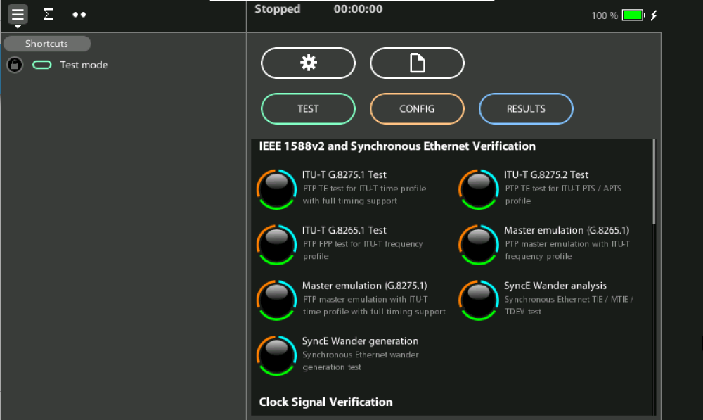
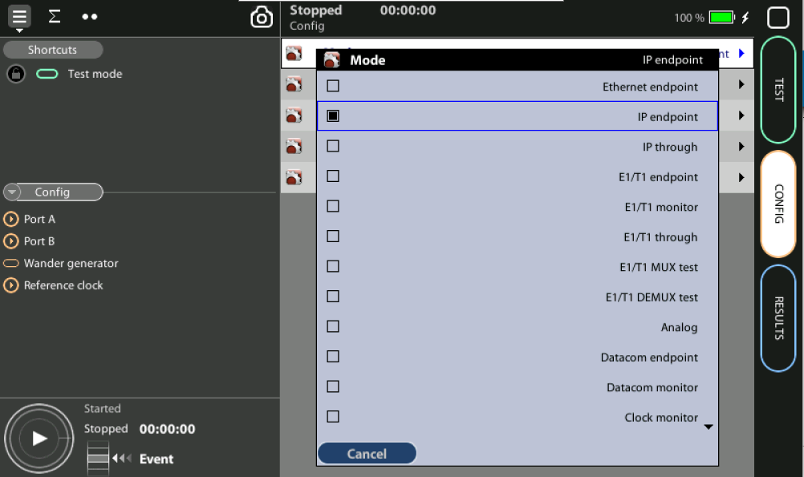
Connecting the Tester to the Network
1
1
Set operation mode: Home > Config > Mode := [Ethernet endpoint | IP endpoint | IP Through | Ethernet cable test | L1 endpoint]*
(*) Some other operation modes may be available depending on the hardware /
software options available in your test unit.

Slide 7
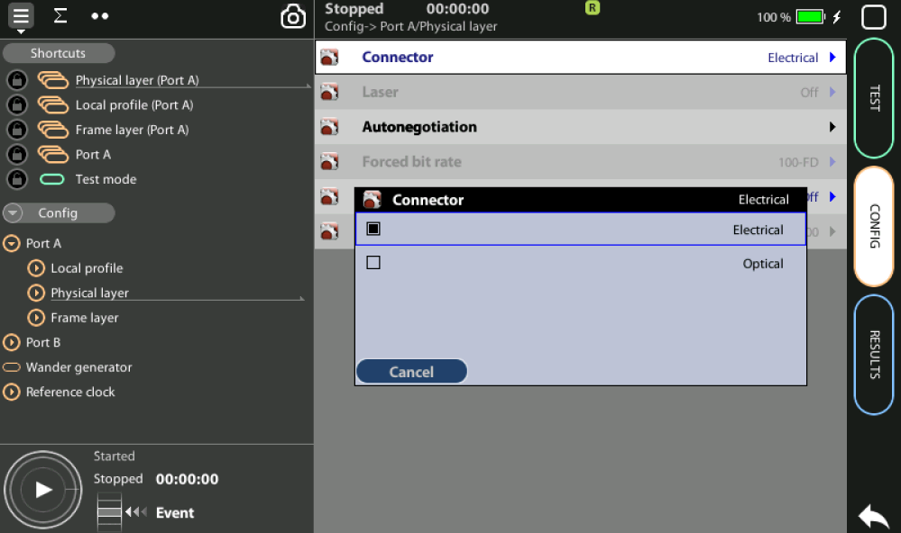
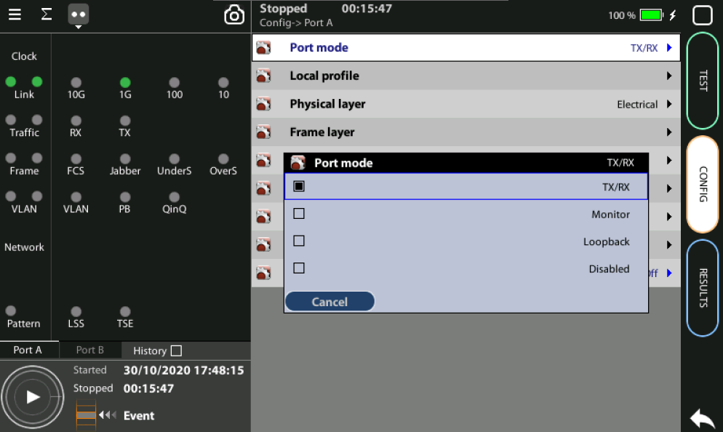
Configuring the Connector
1
2
Select Connector: Config > Port B > Physical Layer > Connector := [Electrical |Optical]
Mode: Home > Config > [Port A | B] > Port mode := [Tx/Rx |Monitor | Loopback| Disabled]

Slide 8
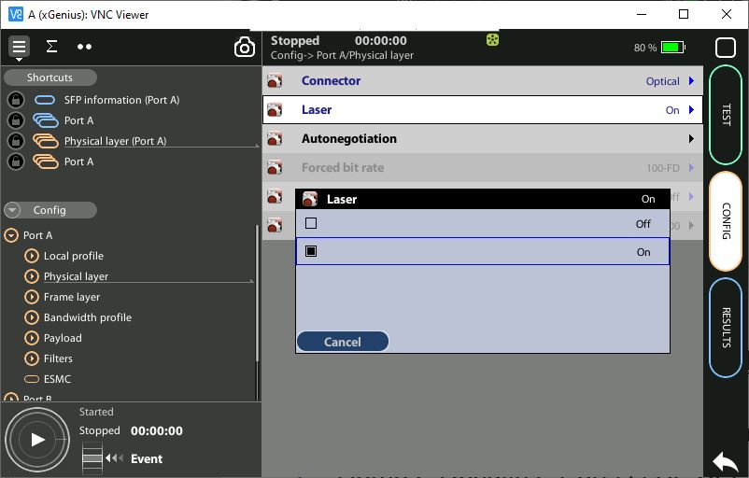
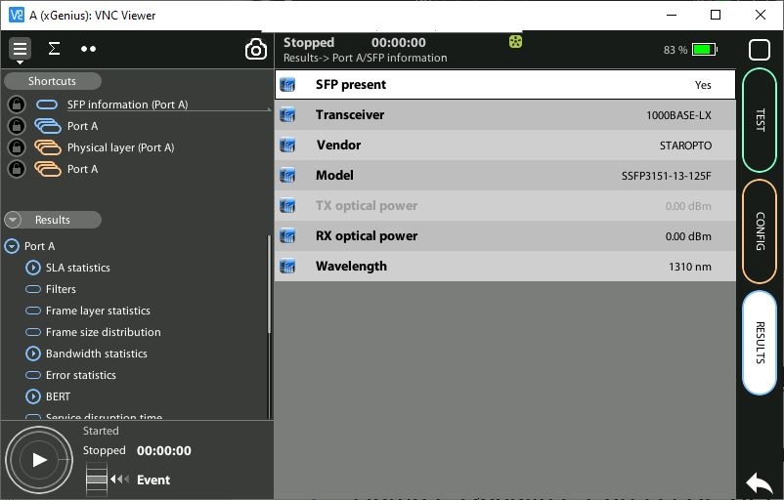
Using the SFP / SFP+ Ports
2
1
Switch the optical transmitter on: Home > Config > [Port A | B] > Physical layer > Laser := [On]
To display the SFP / SFP+ interface information:
Home > Results > Port A | B> SFP information := [SFP present |Transceiver |Vendor | Model |TX optical power | RX optical power | Wavelength]

Slide 9
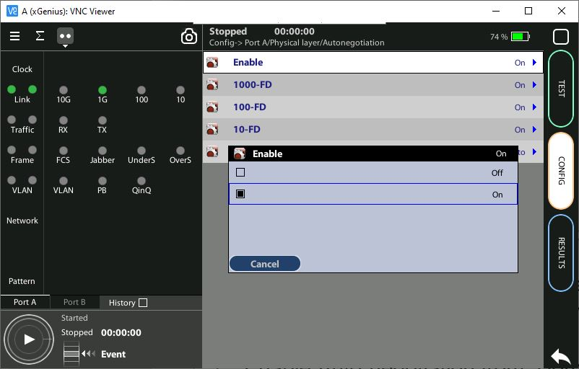
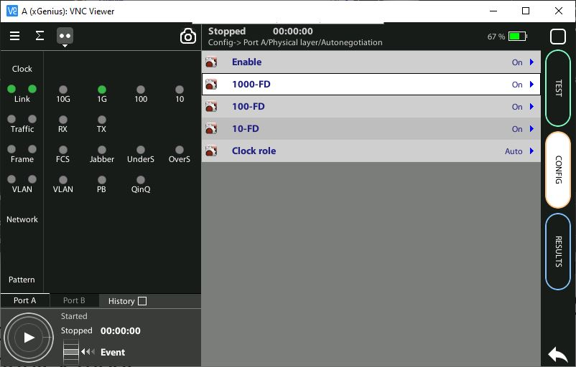
Configuring Port auto-negotiation 1
2
1
In the electrical interfaces, auto-negotiation is always enabled where in optical 10 Gb/s interfaces (SFP+) should be forced to 10 Gb/s bit rate in full duplex mode:
To enable auto-negotiation from: Home > Config > Port A | B > Physical layer > Autonegotiation := On
Configure the allowed bit rates > [1000-FD | 100-FD | 10-FD] := [On | Off]

Slide 10
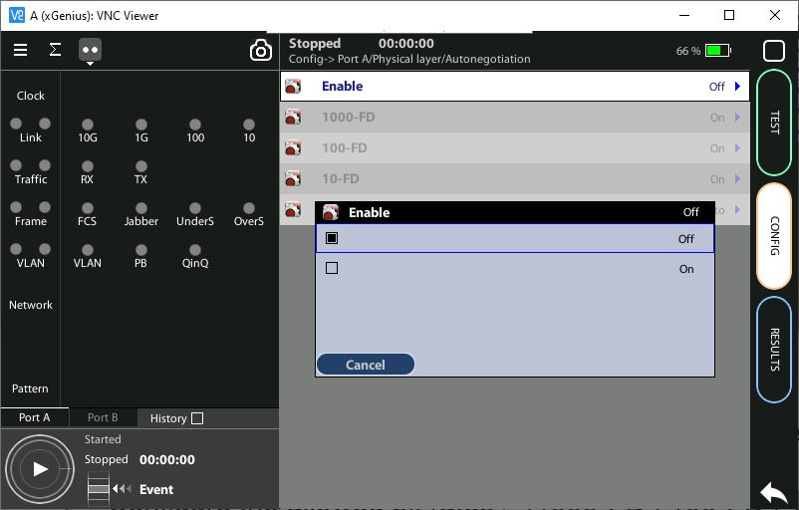
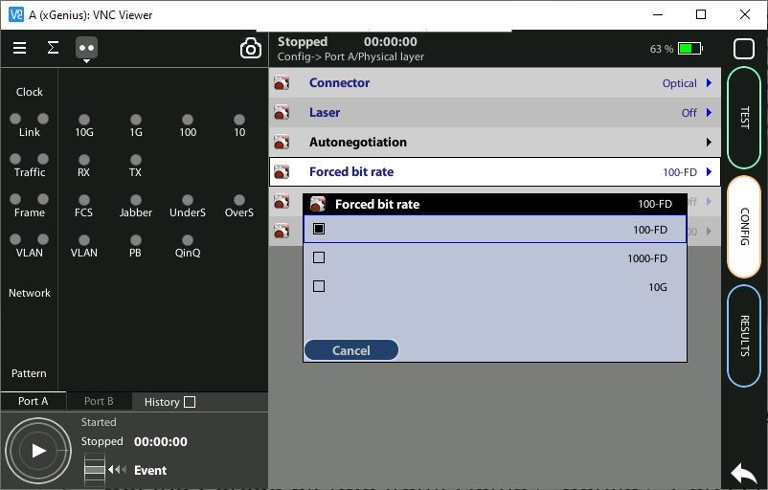
Configuring Port auto-negotiation 2
1
2
To force the link speed to a fixed value (optical):
Disable auto-negotiation from: Home > Config > Port A | B > Physical layer > Autonegotiation := Off
Set the Forced bit-rate from: Home > Config > Port A | B > Physical layer > Forced bit rate:= [100-FD | 1000-FD | 10G]*
Enable the optical transmitter (refer to “Using the SFP / SFP+ Ports”)
(*) The 1000 Mb/s rate in electrical interfaces cannot be forced and it is only
available through auto-negotiation due to IEEE 802.3 restrictions. The 10 Gb/s bit rate is always forced

Slide 11
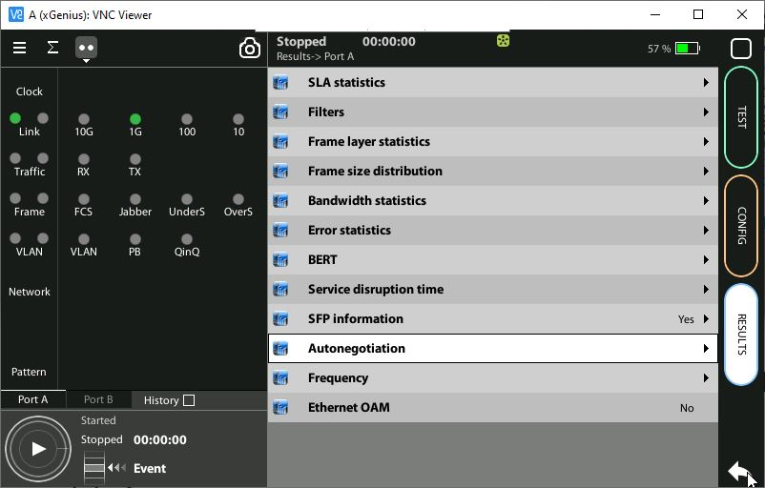
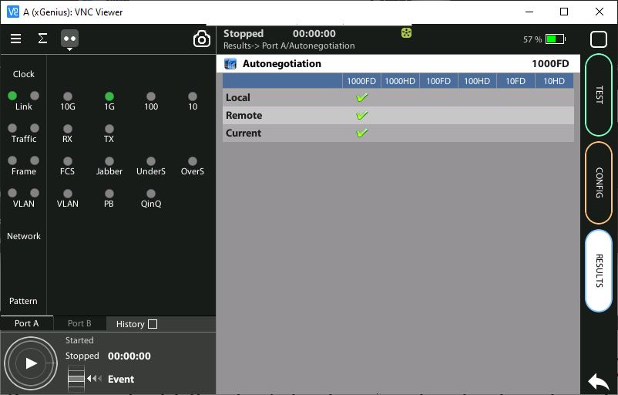
Checking auto-negotiation results
2
1
Once the tester and connector have been configured correctly:
Go to : Home > Results > Port A | B > Autonegotiation
Verify supported bit rate / duplex modes by local and remote and currently used interfaces
Att. LED indicate the link has been established but not traffic

Slide 12
That’s all
www.albedotelecom.com

