Slide 1
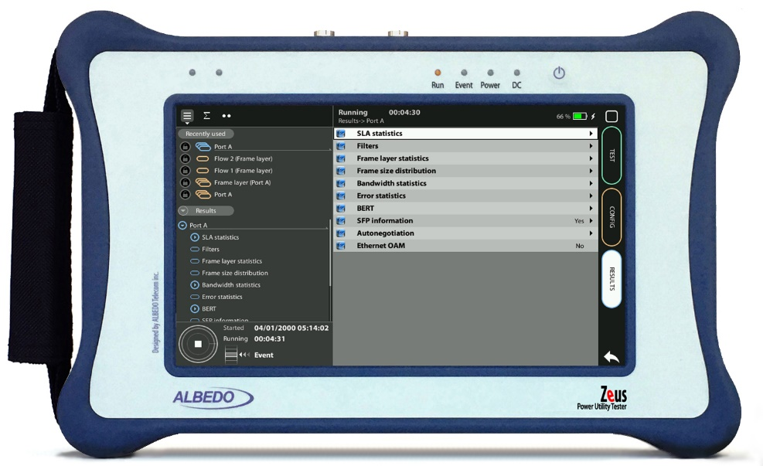
Basic VNC Setup
Connecting xGenius by VNC
Guide & Slides corresponding to software ver. 2.3.13

Slide 2
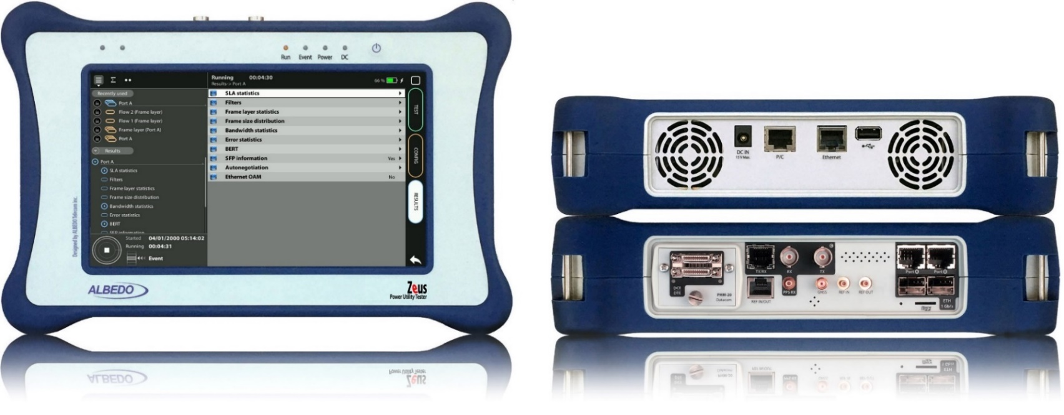
Zeus & xGenius
Zeus & xGenius provide deep insights to design, install, maintain, troubleshoot and engineer communications resources of Mobile Operators, Power Utilities, Finace, Labs and R+D centers. The unit is able to verify Ethernet/IP, SyncE, PTP, GbE, IRIG-B, 1PPS, T1/E1, G703, Serial Datacom, C37.94, GOOSE, SV, MMS, Round-trip & One-way Delay tests at all interfaces.
It also has a set of programmable filters to capture live data traffic at wire-speed

Slide 3
Interfaces & time References
RJ45
The remote control application constitutes a remote graphical user interface that reproduces pixel by pixel the tester screen in virtually any remote device supporting the VNC protocol. This includes computers, smartphones and tablets.

Slide 4
The Traffic test
Ethernet
We are going to connect the xGenius directly to the laptop to operate it from Windows or any other host using VNC

Slide 5
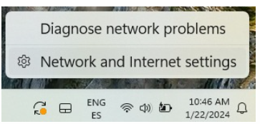
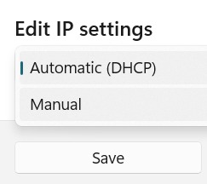
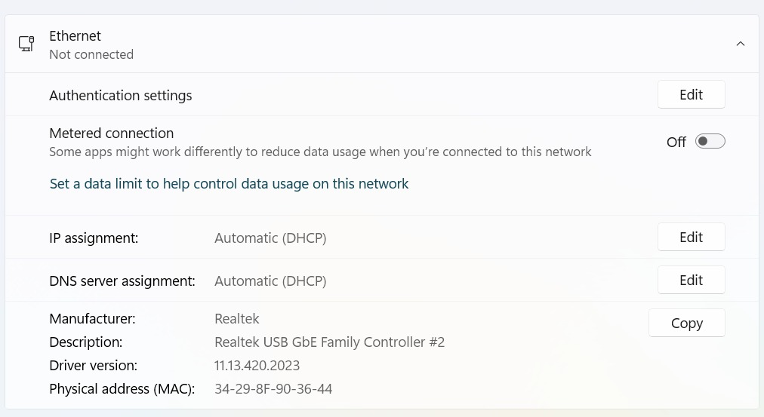
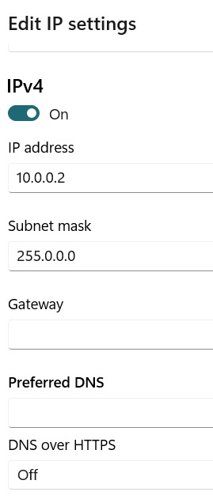
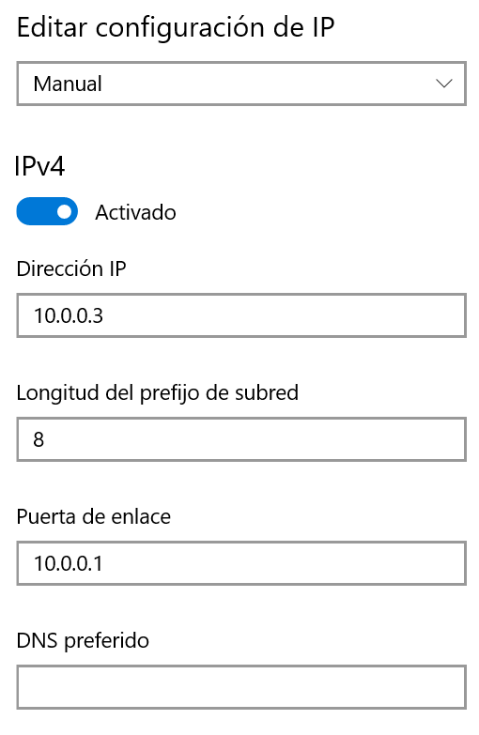
Configure the Labtop
2
1
2
4
4
3
Select the Network in your labtop (Click right )
Network settings > Ethernet
IP settings := Manual
Configure the IP address and the mask

Slide 6
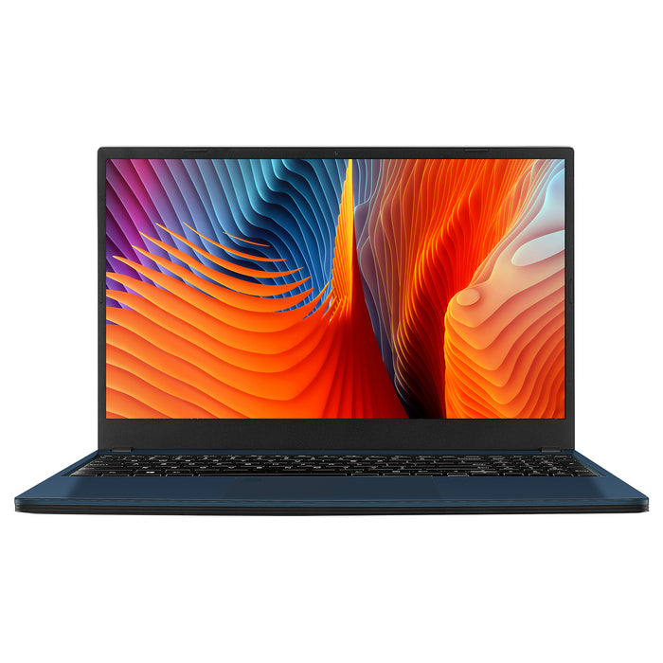
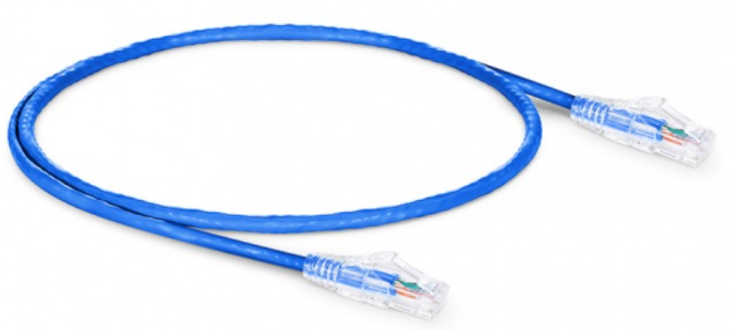
Connecting the BNC cables to Port C
1
2
xGenius has a connector for the RJ45 cables
Connect the Cable to xGenius management Port
Connect the Cable to Laptop

Slide 7
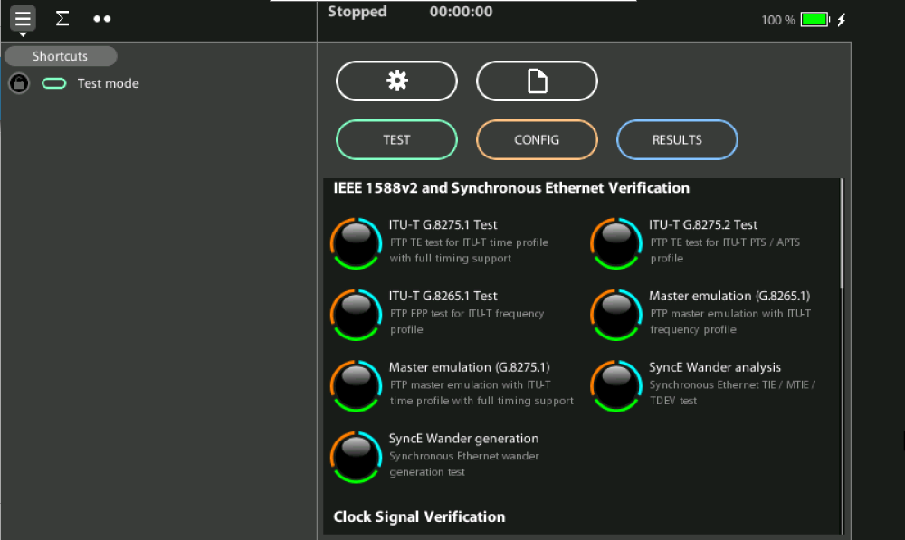
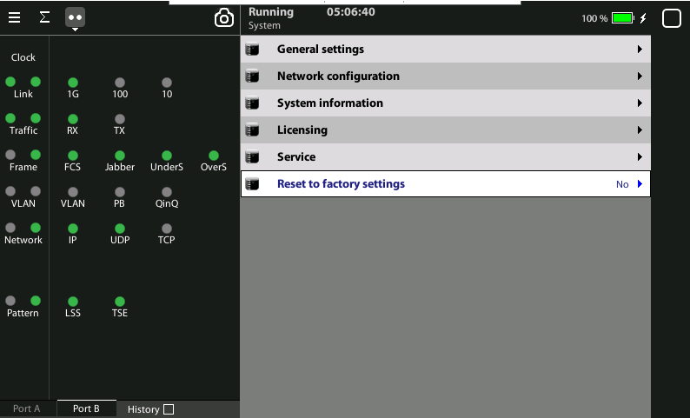
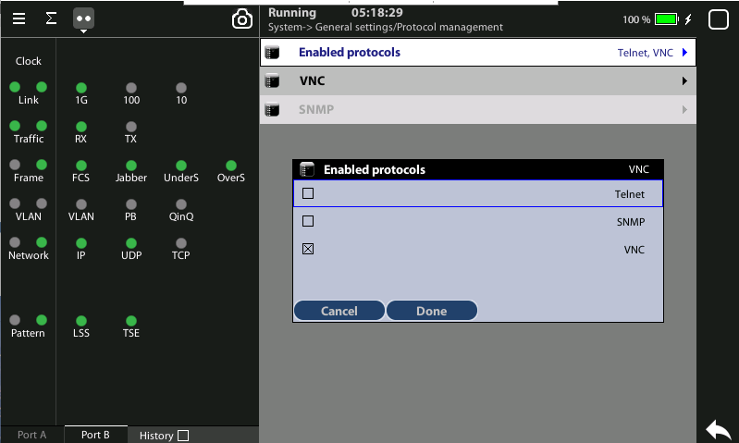
Select the global operation mode
1
2
2
3
Home > [System] > Reset to factory settings := Yes
[System] > General settings > Protocol mng. > Enable protocols:= VNC
Enable VNC
Optionally, supply a password with Remote control password.
Assure that the labtop and the tester have configured two different IP address

Slide 8
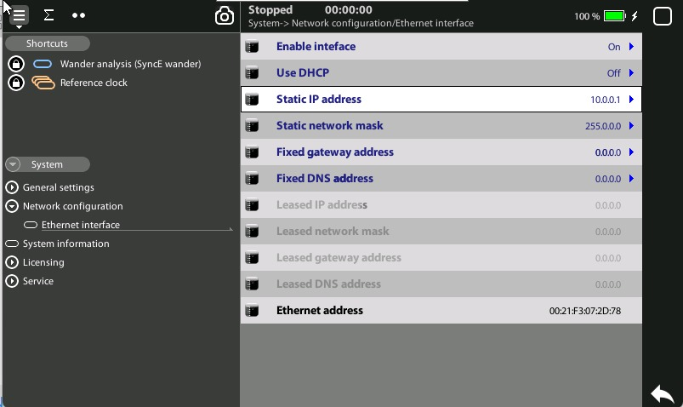
Configure xGenius IP address
1
1
2
[System] > Network Configration > Ethernet i/f > Static IP address := 10.0.0.1
Write the IP address associated with the xGenius to be used by the VNC host

Slide 9
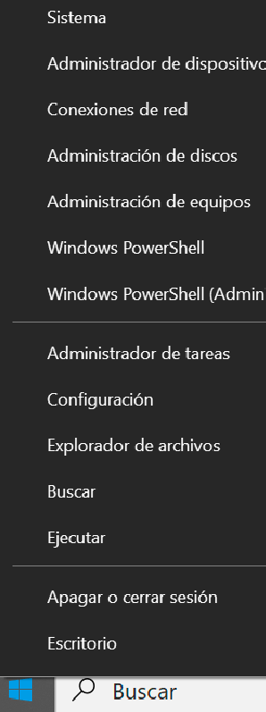
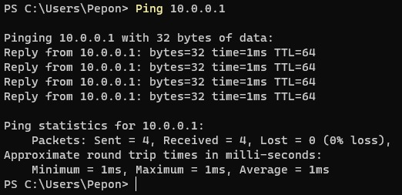
Verify the connection with PING
4
3
2
2
Windows > Right clock
Select Terminal
Ping 10.10.10.1 addres of xGenius
Verify the connection and the statistics
1
1

Slide 10
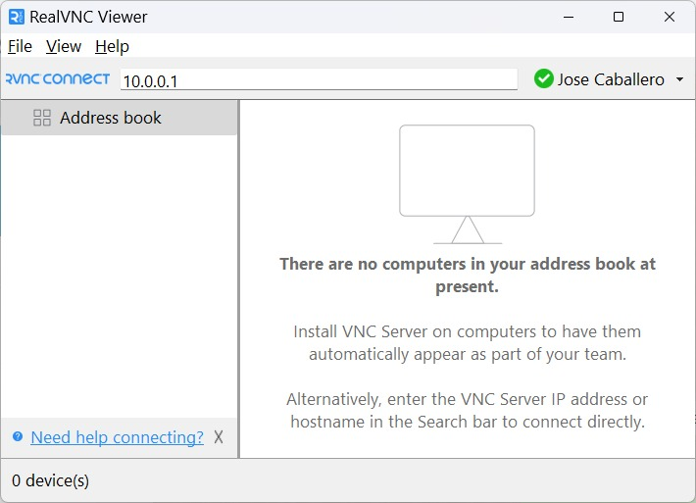
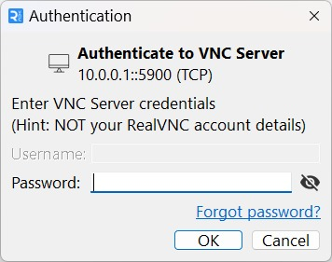
At the laptop run VNC
2
2
In the labtop, run VNC and the enter the IP address of xGenius
Enther password* if you are using it, otherwise press OK (*) it can configured in Remote control password

Slide 11
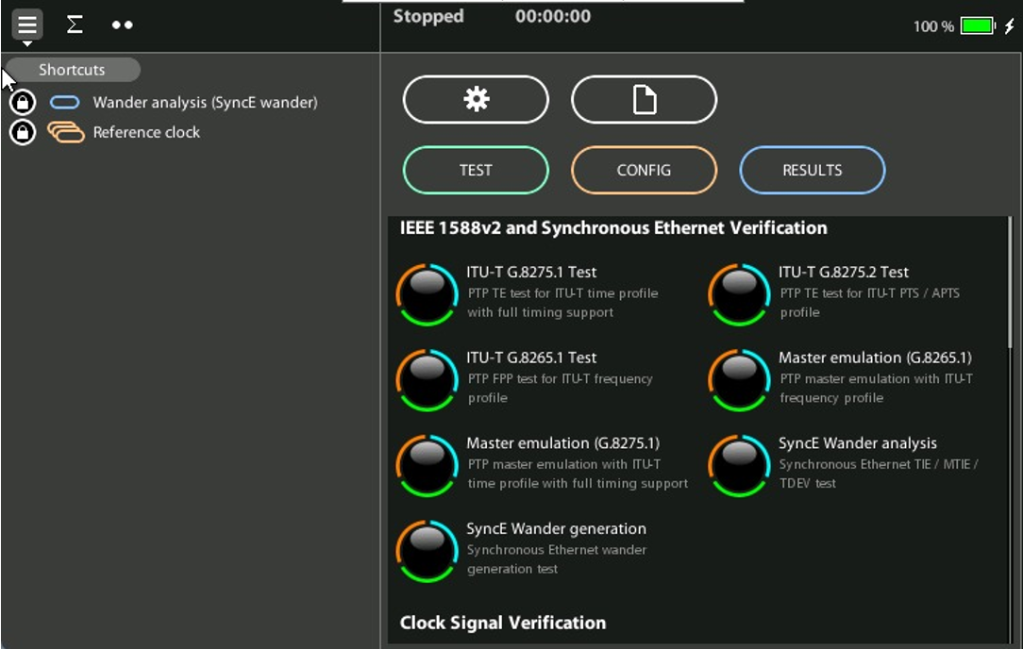
Navigate a use the xGenius from the Labtop
The configuration can be extended to the internet to control the tester remotely

Slide 12
That’s all
www.albedotelecom.com

