Slide 1
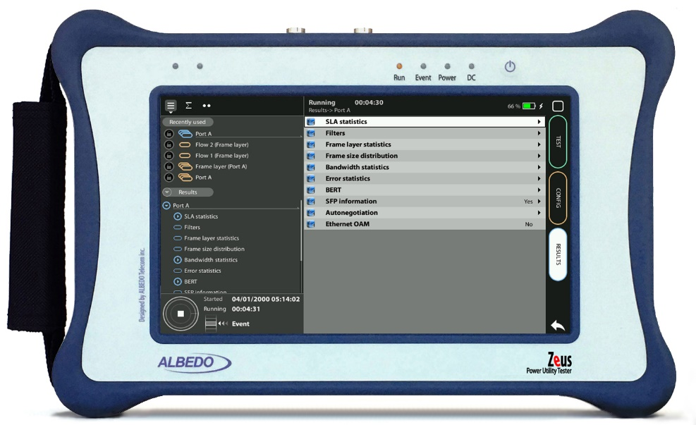
eSAM test
eSAM testing with xGenius
Guide & Slides corresponding to software ver. 2.10.5

Slide 2
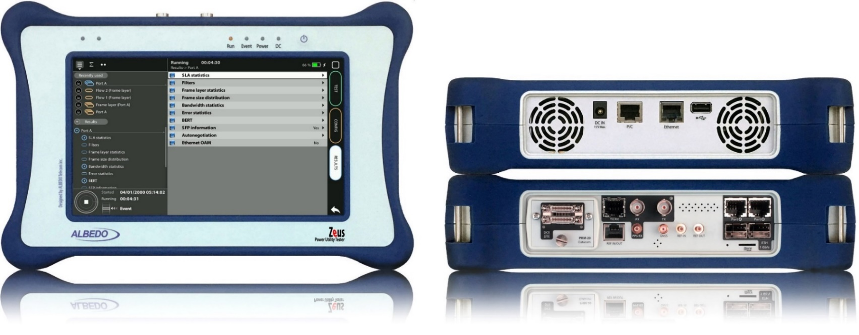
Zeus & xGenius
Zeus & xGenius provide deep insights to design, install, maintain, troubleshoot and engineer communications resources of Mobile Operators, Power Utilities, Finace, Labs and R+D centers. The unit is able to verify Ethernet/IP, SyncE, PTP, GbE, IRIG-B, 1PPS, T1/E1, G703, Serial Datacom, C37.94, GOOSE, SV, MMS, Round-trip & One-way Delay tests at all interfaces.
It also has a set of programmable filters to capture live data traffic at wire-speed

Slide 3
Interfaces & time References
PHM
RJ45-C
BNC-C
SFP+ A
SFP+ B
RJ45-A
RJ45-B
xGenius generates and analyses different kinds of 1544 kb/s and 2048 kb/s signals and also unframed 1544 / 2048 kb/s signals.
RJ45
SMB-C
SMA
SMB-1
SMB-2
SFP-A
Micro SD
SFP-B
 | GNSS | Eth/IP | PTP | NTP | ToD | IRIG-B | PPS | PP2S | SyncE | T1/E1 | MHz | Data
RJ45-A |  | in/out | in/out | in/out |  |  |  |  | in/out
RJ45-B |  | in/out |  |  |  |  |  |  | in/out
SFP-A |  | in/out | in/out | in/out |  |  |  |  | in/out
SFP-B |  | in/out |  |  |  |  |  |  | in/out
SFP+A |  | in/out | in/out | in/out |  |  |  |  | in/out
SFP+B |  | in/out |  |  |  |  |  |  | in/out
BNC-C |  |  |  |  |  |  |  |  |  | in/out | in/out
RJ45-C |  |  |  |  | in |  | in | in |  | in/out | in/out
SMB-C
SMA | in
SMB-1 |  |  |  |  |  | in | in | in
SMB-2 |  |  |  |  |  | out | out | out
RJ-45 |  |  |  |  | in/out | in/out | in/out | in/out |  | in/out | in/out
PHM |  |  |  |  |  |  |  |  |  |  |  | in/out

Slide 4
The eSAM (ITU-T Y.1564) vs. RFC 2544
eSAM (Y.1564) is focused on the activation and troubleshooting of Ethernet services, ensuring that they meet service-level agreements (SLAs) and performance criteria.
Purpose: Y.1564 is designed for Ethernet services by combining multiple test parameters (throughput, frame loss, frame delay, etc.) into a single test.
Approach: Y.1564 aims to verify the end-to-end performance providing a more holistic view of how the Ethernet service performs under real-world conditions.
While RFC 2544 is more device-centric, focusing on the capabilities of network devices, Y.1564 is more service-centric, addressing the activation and performance of Ethernet services as a whole. Y.1564 is often preferred for its efficiency in testing multiple parameters and its alignment with the requirements of Ethernet service.

Slide 5
eSAM test
Using 2 testers
Test 1
Routed Network
Test 2
1
Port A
Port B
2
1000BASE-T
ALBEDO
xGenius
ALBEDO
xGenius
PHY Loop
Using 1 tester
Routed Network
1
Port A
ALBEDO
xGenius
The test described aims to teach how to set up the tester to generate and receive real traffic with specific frames, bit rates, and events. With a few changes it will be possible to evaluate other traffic parameters.

Slide 6
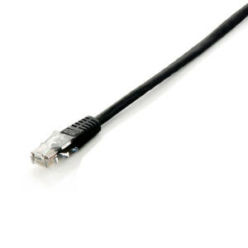
Connecting the BNC cables to Port C
1
1
xGenius Ports A and B have the connector for the RJ45 cables
xGenius also support optical media and higher bit rates but we are going to execute this test in 1000BASE-T
Connect the Cable to Port A in tester A
Connect the Cable to Port B in tester B

Slide 7
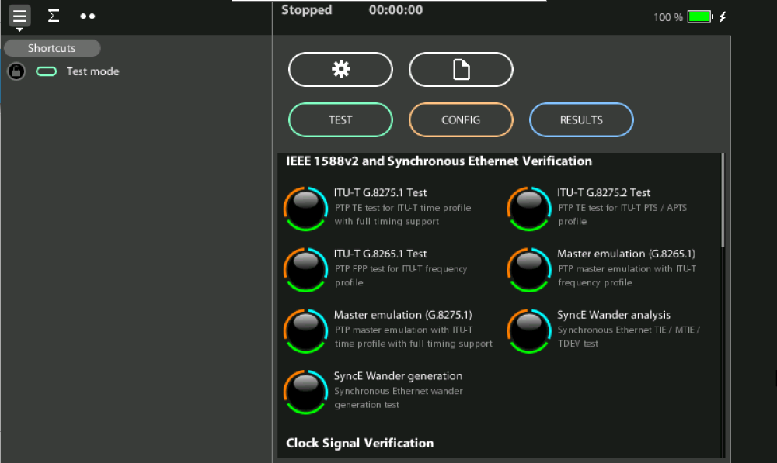
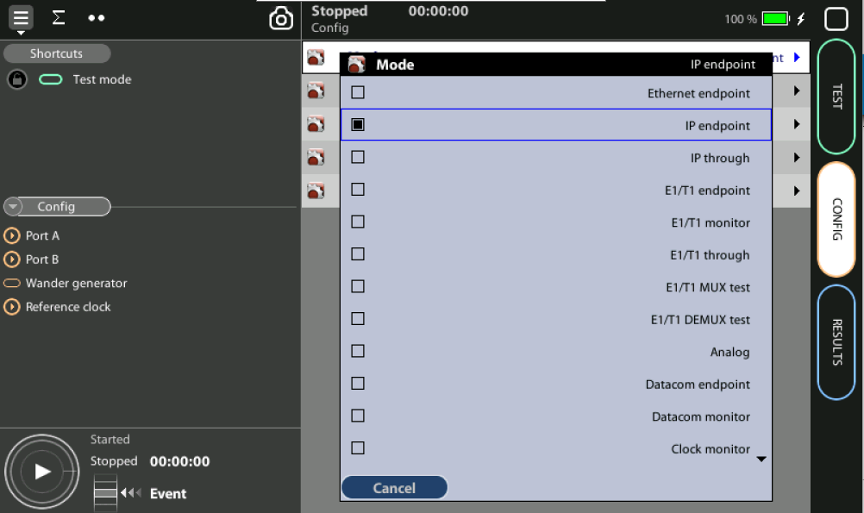
Configure the tester
1
2
Restore defaults: Home > [System] > Reset to factory settings := Yes
Set operation mode: Home > Test > Mode := Ethernet endpoint

Slide 8
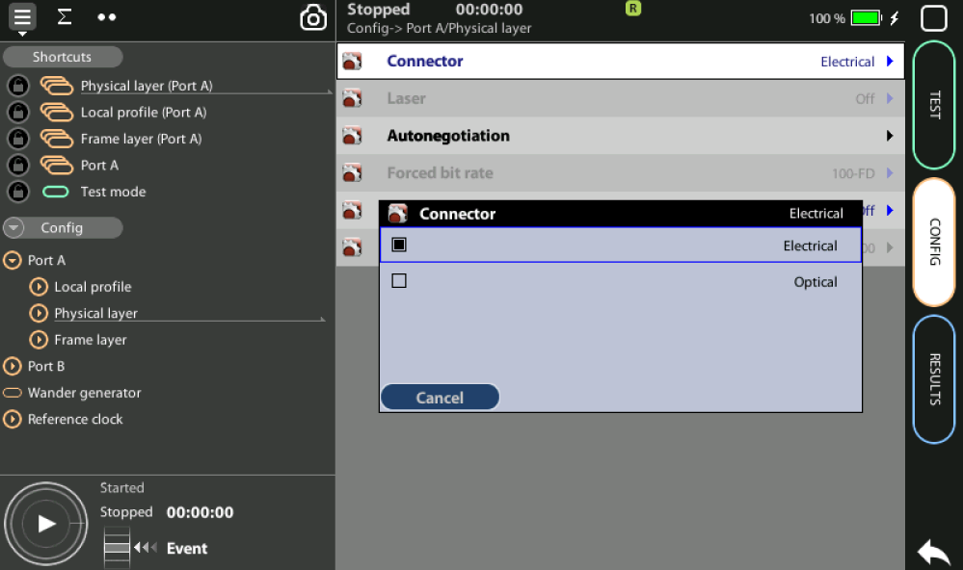
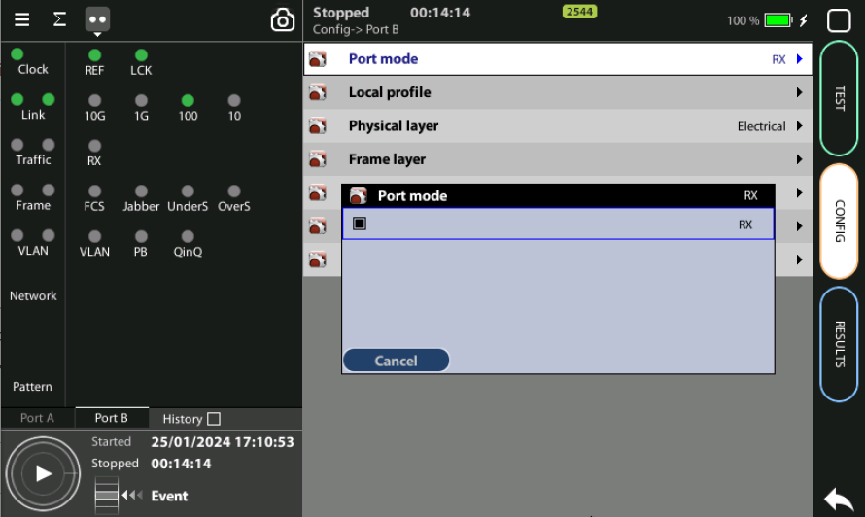
Configure the PHY layer Tester 1
1
3
Configure the Physical layer in Port A to generate traffic:
Config > Port A > Physical Layer > Connector := Electrical
Config > Port A > Port Mode := Tx/Rx
Results are in Port B in the case we use only one tester:
Config > Port B > Port Mode := Loopback
(*) The RFC can also be executed with two testers

Slide 9
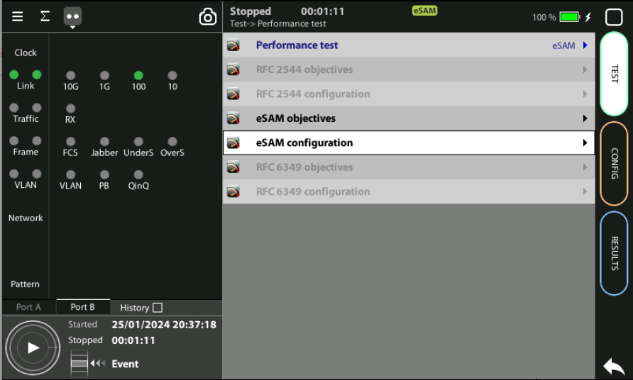
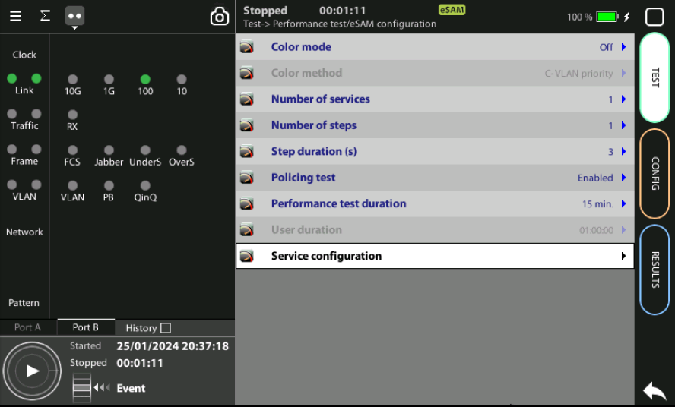
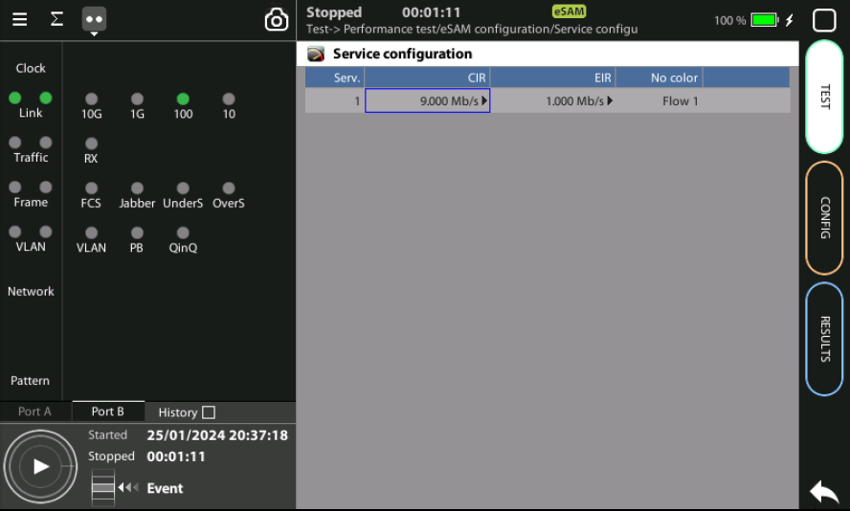
Configure type o Test
1
2
4
3
Select eSAM, define Objectives and Configuration:
Test > Performance test := eSAM
Test > eSAM configuration > Service Configuration := (Set the values) (*) If you want just to learn how to program you can use Port A and B of the same tester

Slide 10
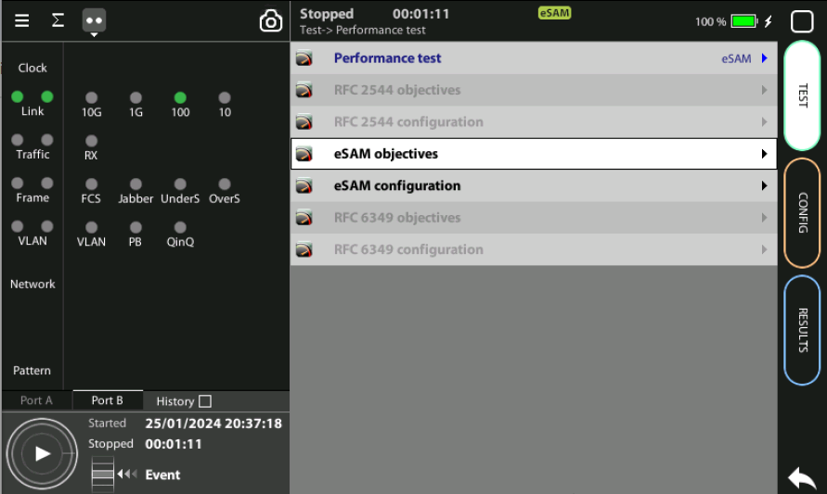
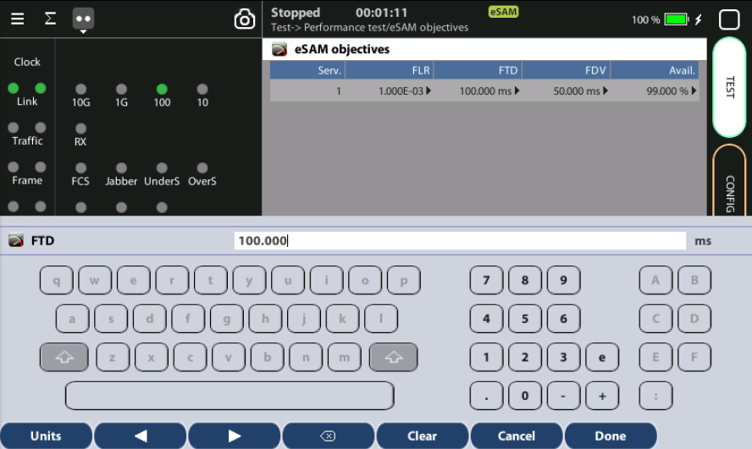
Defines performance objectives
1
6
2
2
2
2
1
For each separate service defines objectives per parameter:
Test > eSAM objectives > FLR := (setup values)
Test > eSAM objectives > FTD := (setup values)
Test > eSAM objectives > FFDV := (setup values)
Test > eSAM objectives > Avail := (setup values)

Slide 11
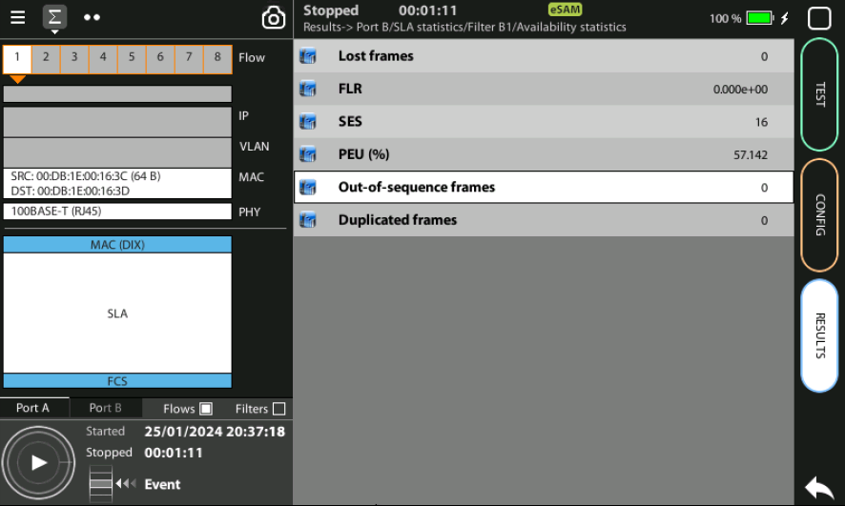
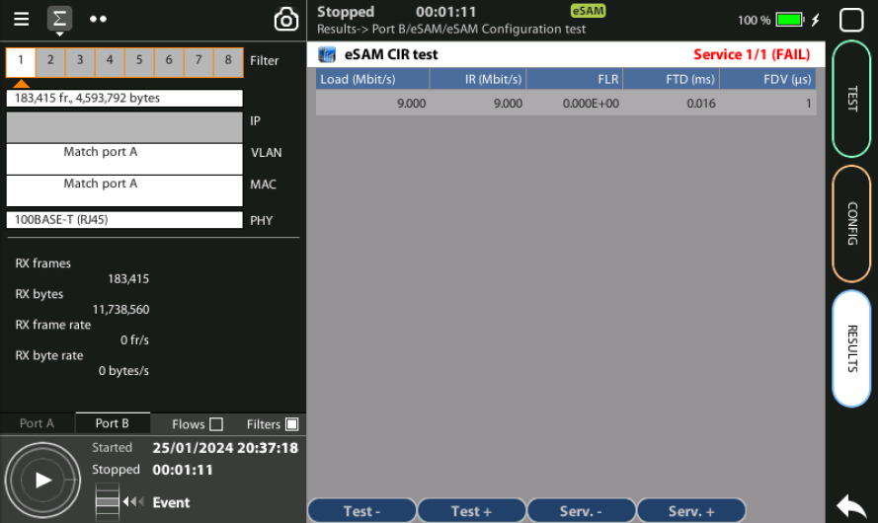
Press RUN
1
3
2
You can spot the frame and the test profile configured at Port B and the type of traffic to be generated at Port A including the flow, the Physical layer, the Ethernet frame, MAC addresses, the PRBS generated, etc.
Press RUN to activate the traffic generation
You can see the activity how the test is progressing Results > Port B > eSAM > eSAM configuration test

Slide 12
That’s all
www.albedotelecom.com

